Slide 1
M19800 & M9800
Folding Door
Notes:
Bi folding door system

Slide 2
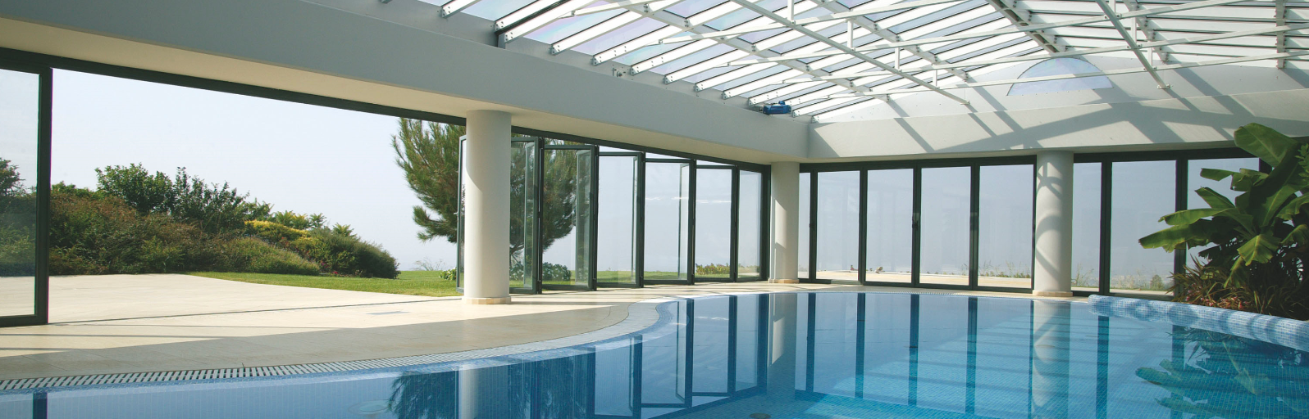
M19800 & M9800 Bi-Folding
What
M19800 and M9800 are SMARTIA systems for folding doors, insulated and non-insulated, top-hung, for normal and heavier constructions and address to middle-end projects.
Both are inexpensive and effective solutions for the folding doors market.

Slide 3

M19800 & M9800 Bi-Folding
Why
to divide and isolate spaces both internally and externally
to provide our proposal for folding doors of high performance and standards equal to the other SMARTIA systems
to offer an extensive range of sturdy and versatile solutions (offices, hotels, café, “winter-garden”, always at a reasonable price

Slide 4
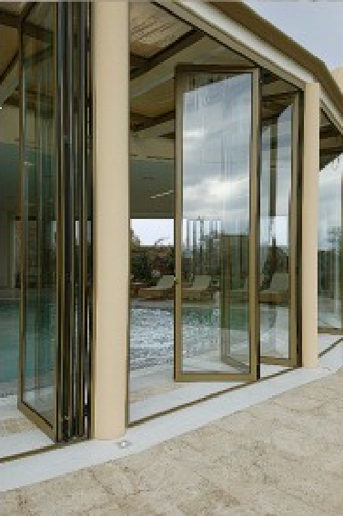
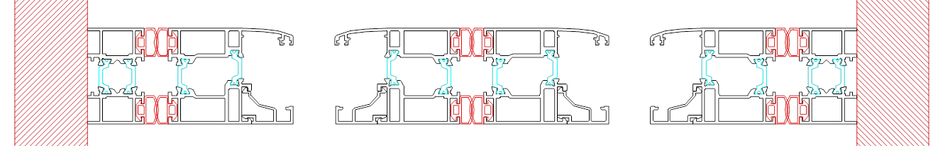
M19800 & M9800 Bi-Folding
Vent or Frame width: 50 mm
Vent height: 65mm
Frame height: 30mm
Vent weight: up to 100 Kg
In-floor sill height: 4.5mm
Glazing: 24 to 32mm
Insulation Uw: 2,8Wm²/K
Max heights: 3.0 - 3,5m
Notes:
Frame sash condition

Slide 5
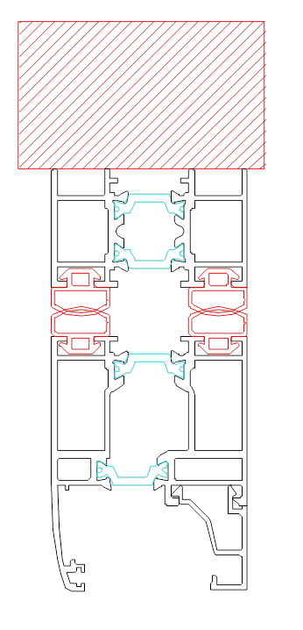
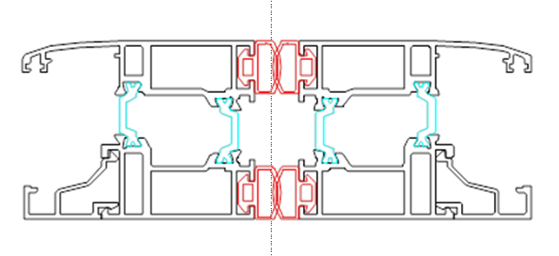
M19800 & M9800
Sight line
Frame/ Vent width: 100mm (M9800)
107mm (M19800)
Adjustable Frame/ Vent width: 117mm (M9800)
126mm (M19800)
Vent/ Vent height: 130mm (M9800)
142mm (M19800)
Notes:
Frame sash condition

Slide 6
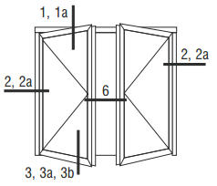
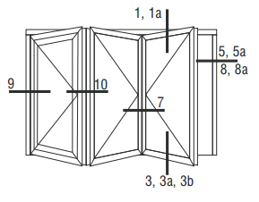
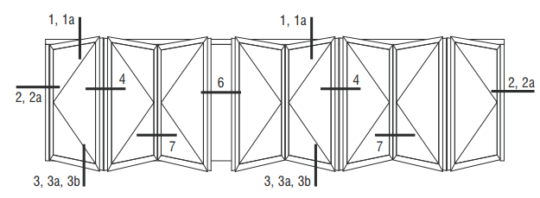
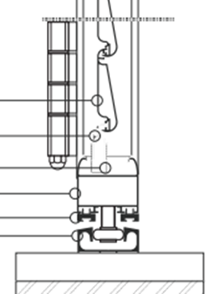
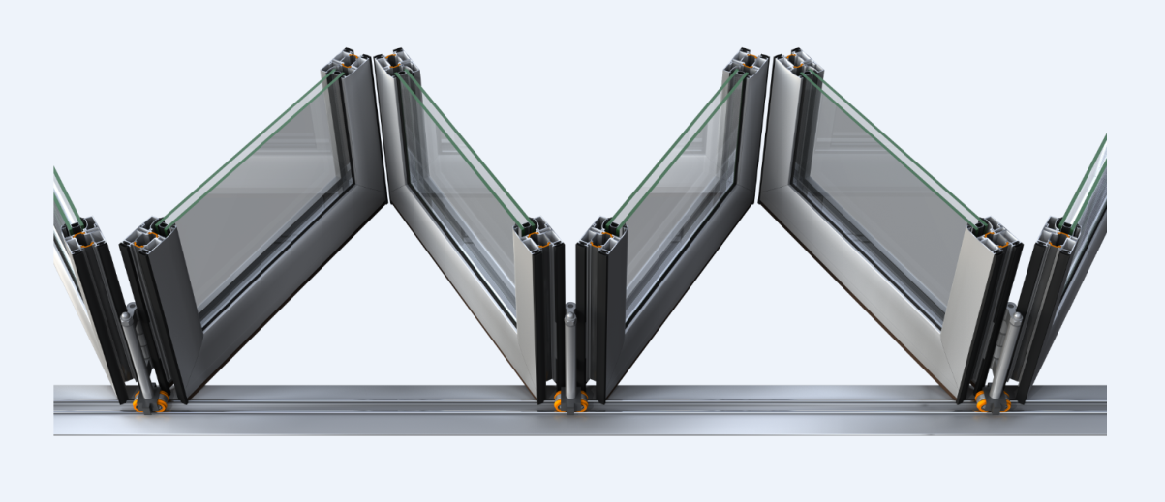
M19800 & M9800
Typologies
n+ 0
n + 1
n + m
(odd numbers)
Outwards and inwards opening of vents and door
With glass panel and blinds

Slide 7
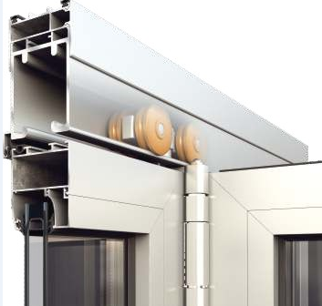
Μ19800 & Μ9800
Cuttings
Frame: top-guide, bottom guide and side profiles, and 90º cutting and no cleat corners
Vent: 1 single profile and 45º cutting

Slide 8
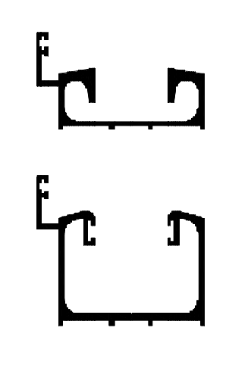

M9800 Thresholds
4 different threshold profiles
Normal top-mounted with insulating wing
Low top-mounted with insulating wing (different bottom roller)
In-floor (concealed)
Low on-floor placement (flexible)
New flat with new roller (concept)

Slide 9
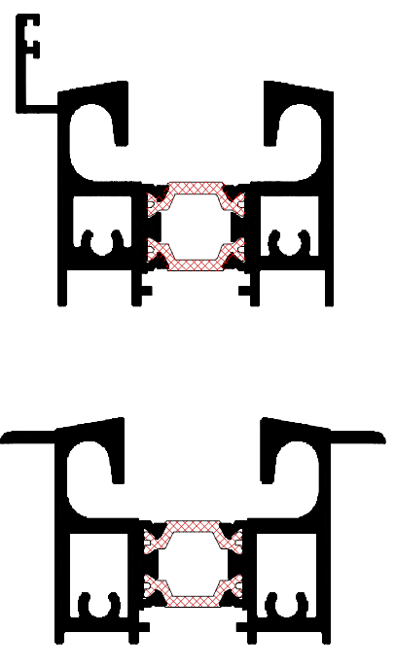
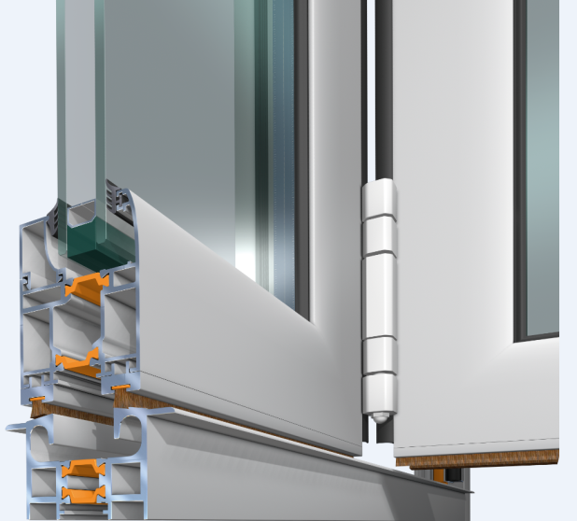
M19800 Thresholds
2 different threshold profiles
Top-mounted with insulating wing
In-floor

Slide 10
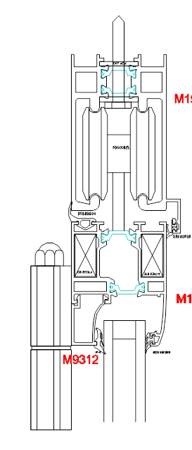
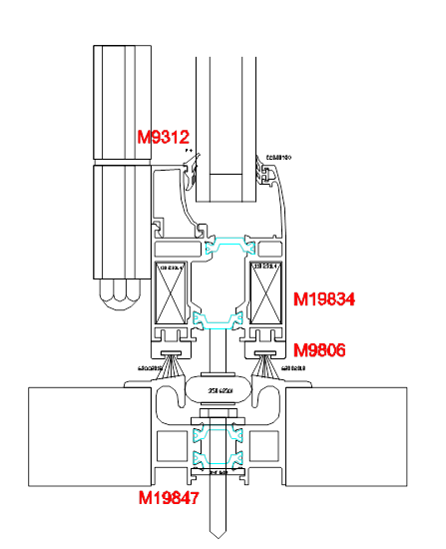
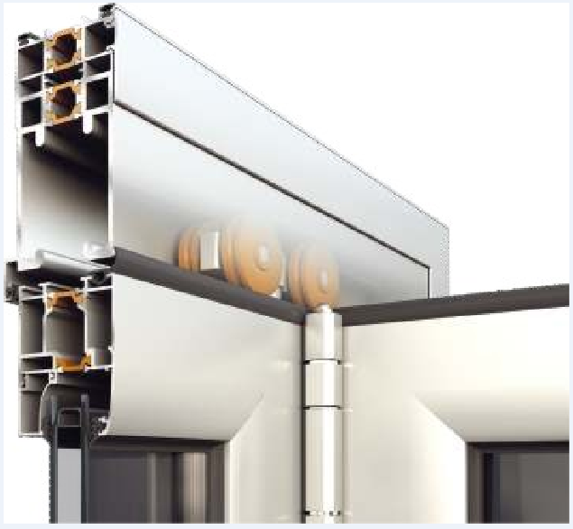
M19800 & M9800 Roller Hinges
Top-hung bi-folding door
Special heavy-duty roller hinge for top-hung (125Kg per vent, 250 Kg per roller)
2 special roller hinges at bottom threshold for vents alignment
one of the normal guide and
one for the low guide
Notes:
Roller of 35mm
Alligner of 33 mm, to prevent the relocation of the sash

Slide 11
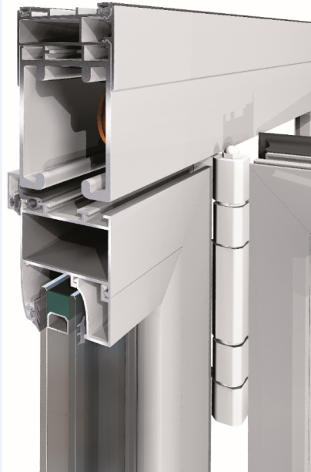
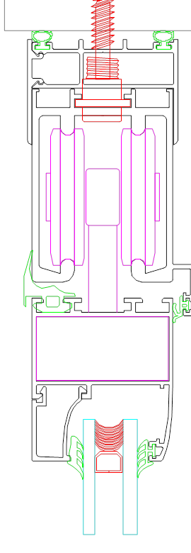
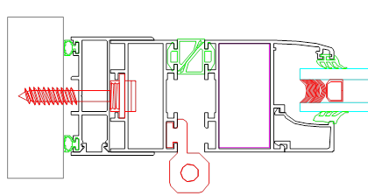
M19800 & M9800 Adjustment
Structure adjustment for easier installation
Vertical adjustment of 20+20mm with double-frame profile
Horizontal adjustment of 20mm with double-frame profile
Notes:
regulators

Slide 12
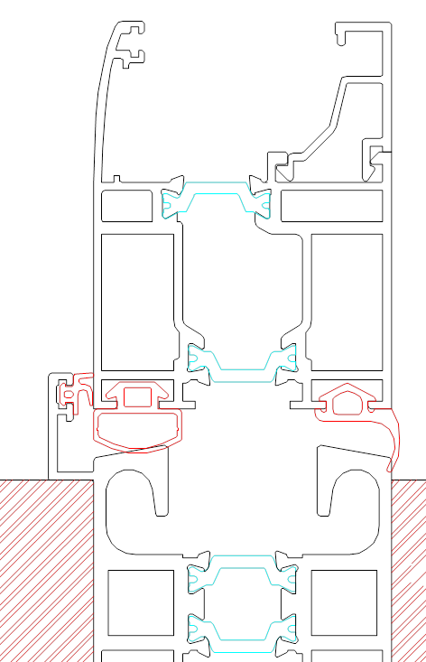
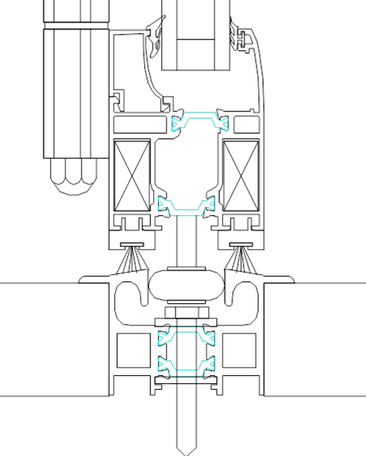
M19800 & M9800
Gaskets
Double EPDM gasket
Possibility of perimetrical gasket placement for top insulation
Alternatively, with weathering brushes on the vertical

Slide 13
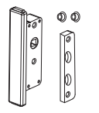
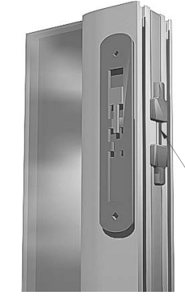
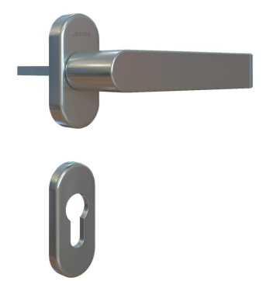
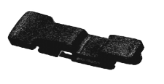
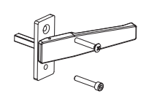
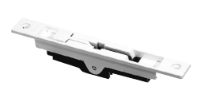
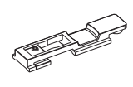
CF85 Bi-Folding
Locking
Intermediate vents locking
with normal handle and getriebe
with flush handle (albatros)
With latch (1st vent)
Entrance door with various locking possibilities and Alumil brand handle

Slide 14
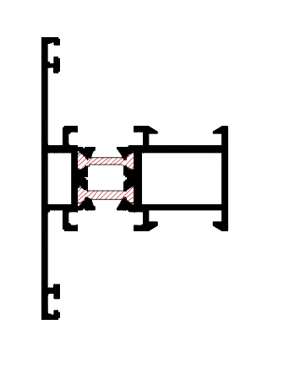
M19800 & M9800 T support
Extra vent support for the vent frame with horizontal placed T profiles

Slide 15
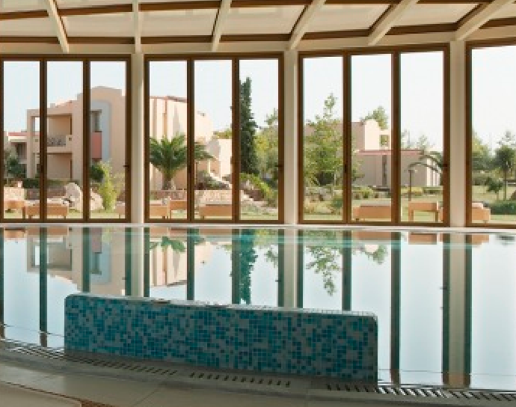
M19800 & M9800 BENEFITS
Wide variety of solution with various thresholds, typologies, thermal and non-thermal version
Minimal design with less aluminium (sufficient sight line)
Easy fabrication / installation
Achieve high dimensions (3.0 to 3.5m) and may cover wide openings (many vents)

Slide 16
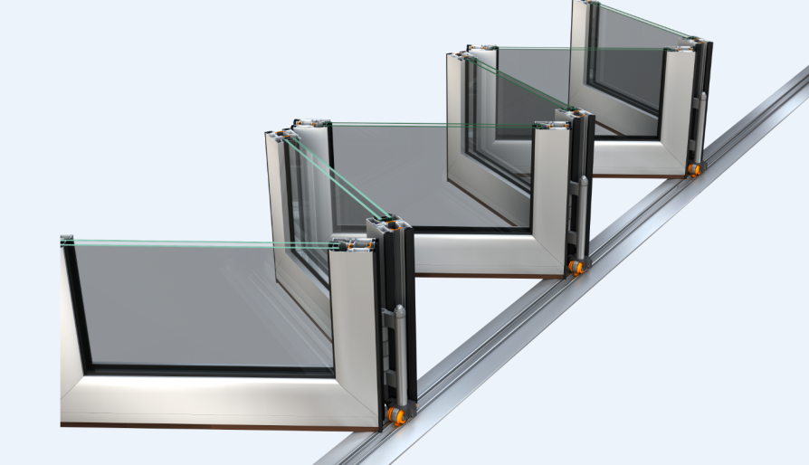
M19800 & M9800 BENEFITS
High performance in terms of thermal insulation, air and water sealing (4-sided EPDM, thresholds, etc)
Inexpensive solution with relatively light profiles
Flawless functionality
Anti-burglar Security

Slide 17
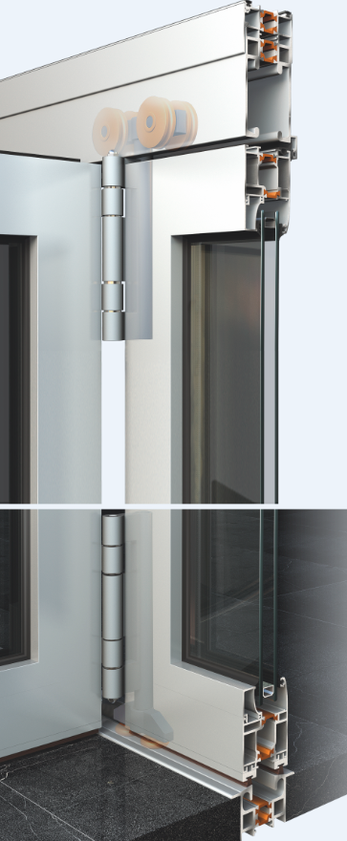
THANK YOU
FOR YOUR ATTENTION

