Slide 1
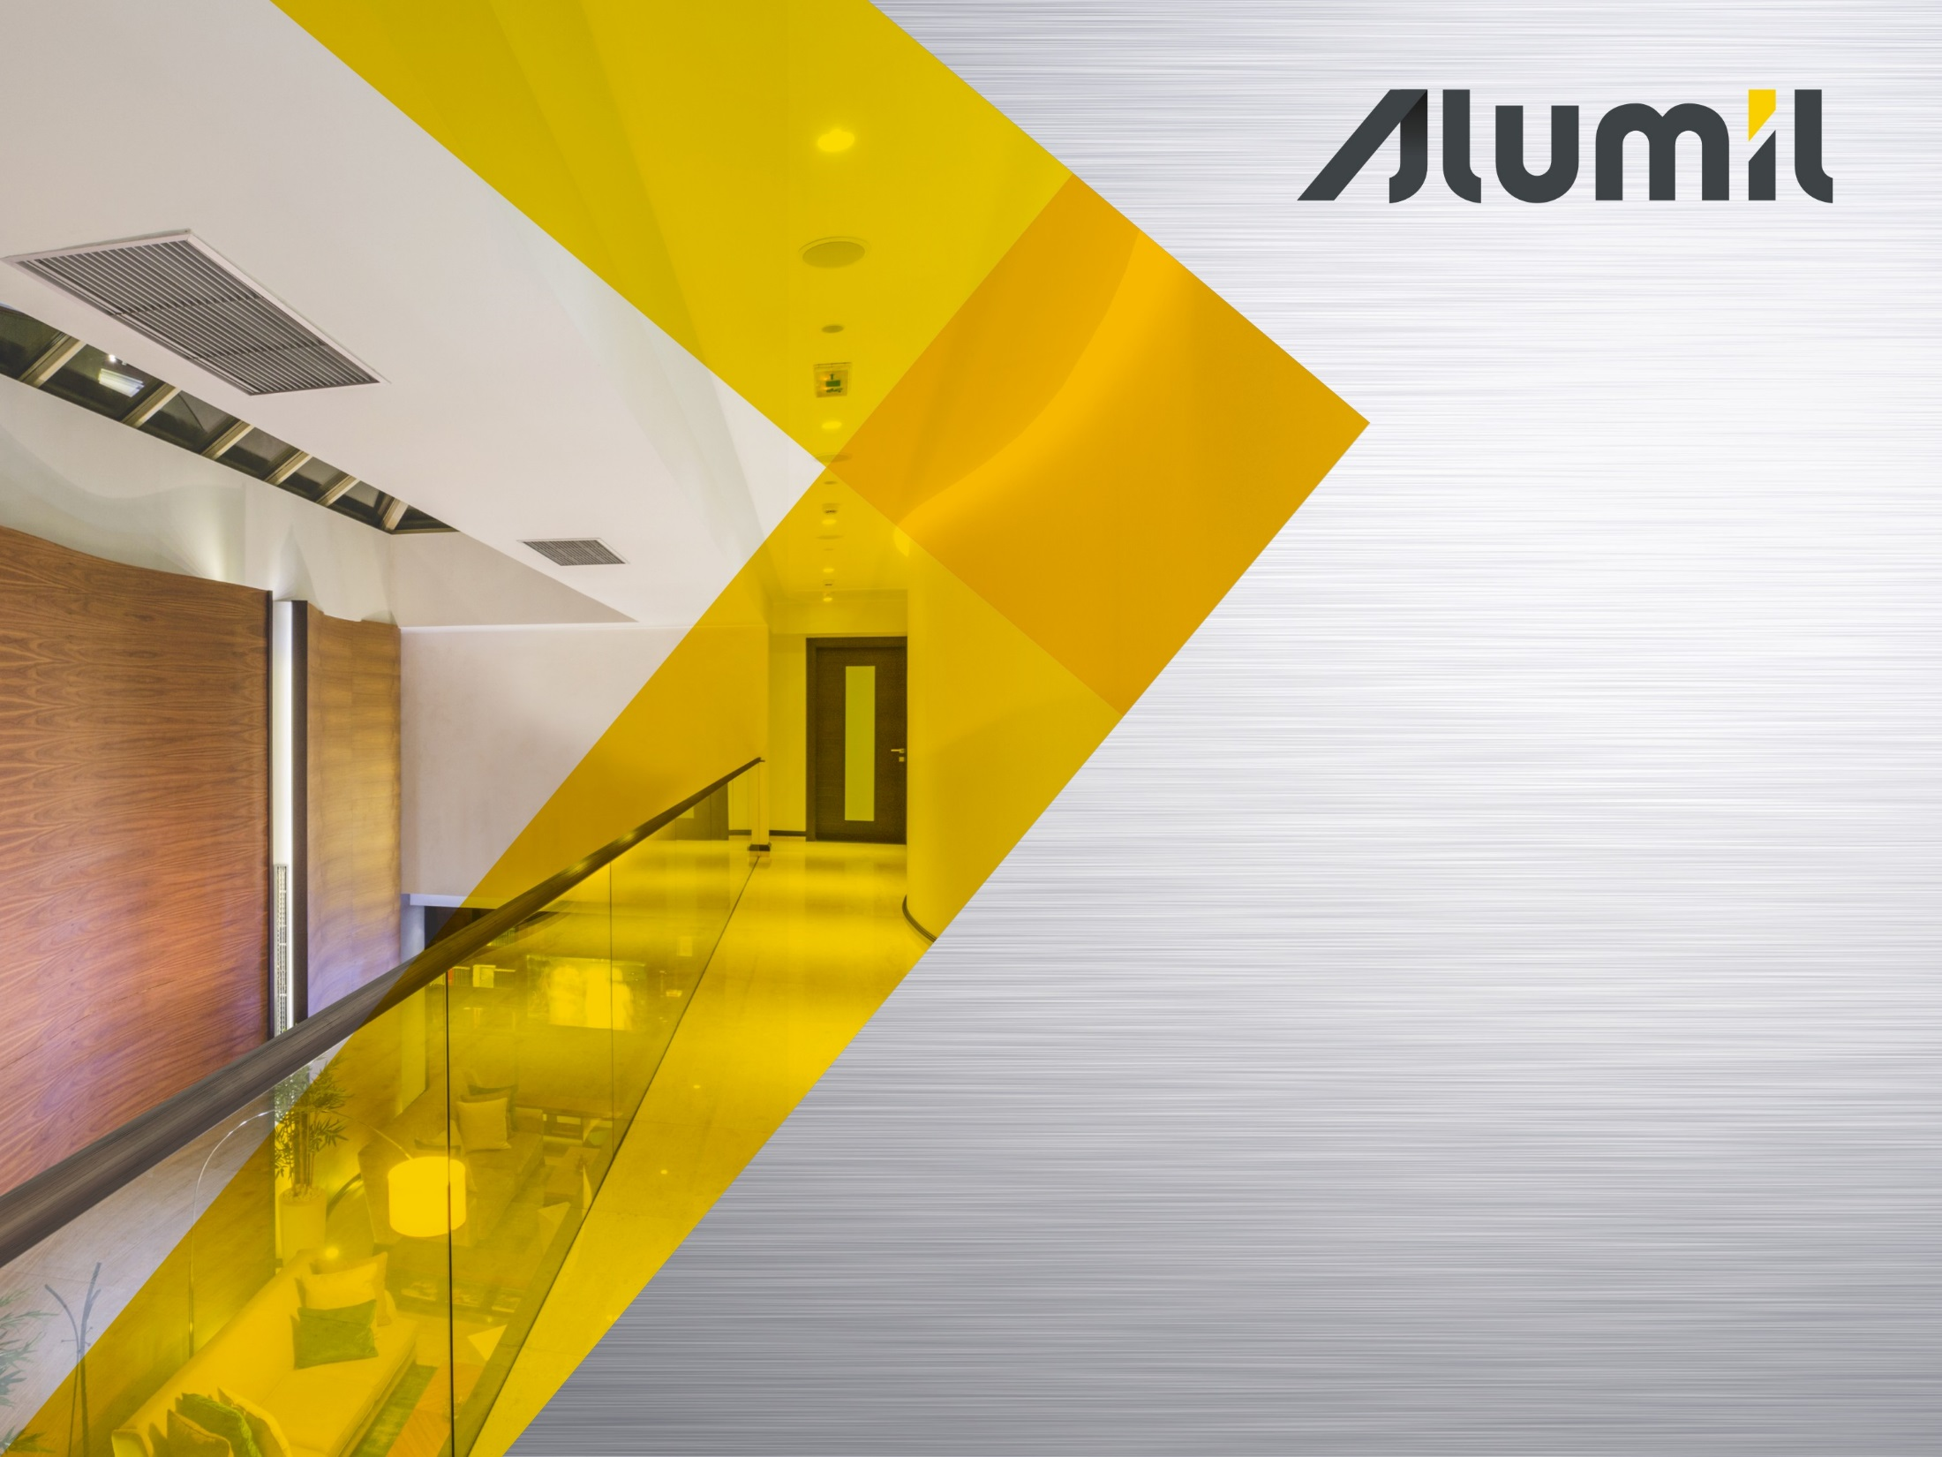


Slide 2

What
Aluminium vertical glass support system for glass railings of modern aesthetics without mullions, which leave the visual field free and offer a sense of luxurious freedom.
Ideal for modern residences, hotels and shopping centers, public & office buildings, surrounding areas and partitions, for exterior & interior use.
Robust continuous profiles with simple wedge fixation

Slide 3
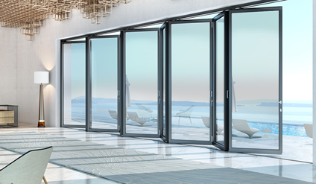
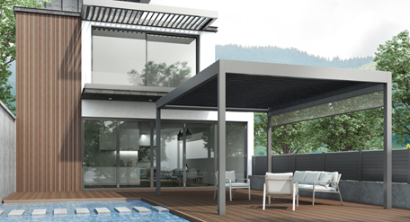
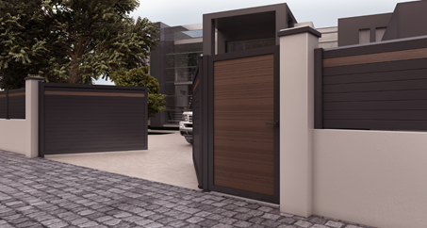
Why
to offer a qualitative system complementary to our aluminium architectural series (windows, doors, facades) to
offer complete solutions to a project, e.g. hotels, office buildings
offer complete solutions to our clients and have them deal with one reliable system-supplier
provide compatibility and uniformity between the various systems (e.g. same color and finishes)
to enrich our railing product variety, no to mention the Outdoor product mix

Slide 4
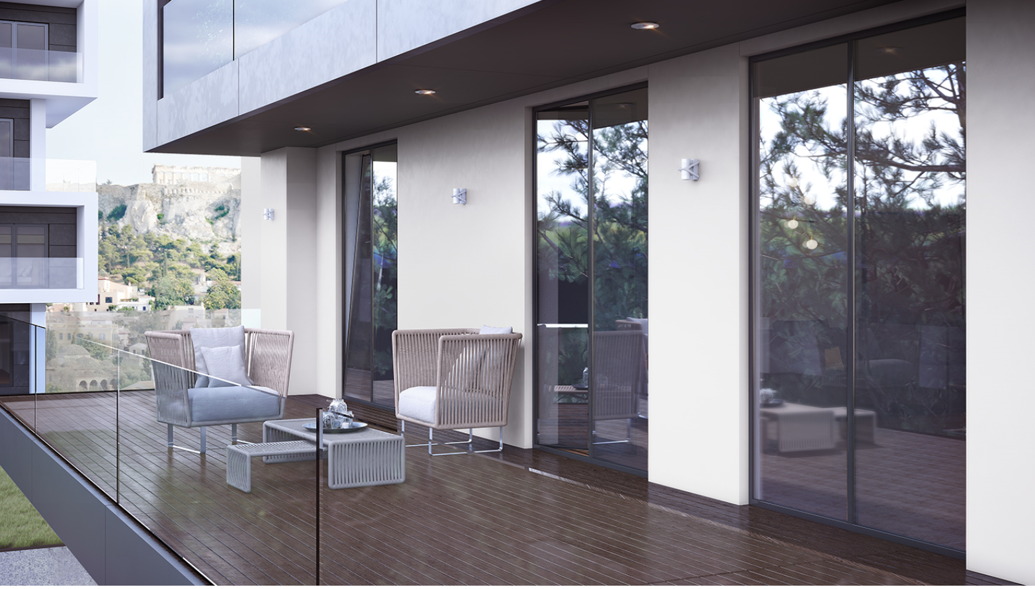
TECHNICAL SECTION

Slide 5
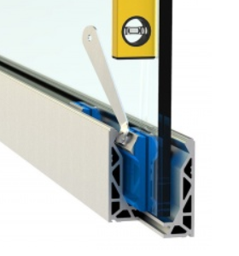
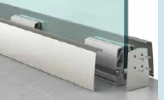
Technical Characteristics
Glass railing philosophies
There are 3 basic structure types of glass railing systems
Continuous profiles with simple wedge for glass fixation, like M8200
Continuous profiles with adjustable (“smart”) wedges, placed on one or both sides (heavy profiles & expensive fittings)
Piecemeal logic with 10-15cm adjustable parts, which are covered with flat profiles for the continuous effect
Placed on-floor, side-mounted, concealed and embedded.
b.
c.

Slide 6
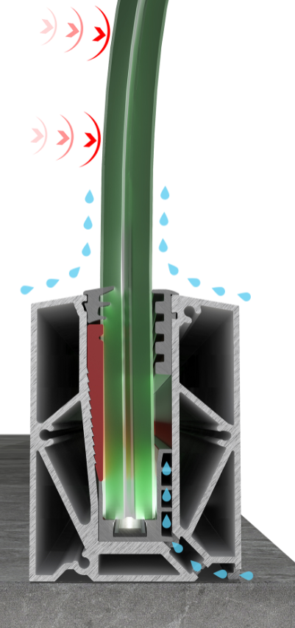
Technical Characteristics
System Categorisation
There is a triple categorization, i.e. 1., 2. and 3.) which refers to the linear horizontal load in KN/m (1KN/m, 2KN/m, etc)
Though there are no EN standards, the market uses this categorisation for residential (1), public (2) and special cases (3) correspondingly.
The latter refers to stadiums and crowded places, however it is requested quite often lately in the hotel sector.

Slide 7
Technical Characteristics Main features
Continuous profile with simple wedge
On-floor, side-mounted, in-floor placement
Laminate tempered glass of various thicknesses (10+10, 8+8, 6+6 and 5+5mm)
4-layer membrane for tempered glass and single membrane for non-tempered (not recommended)
Sophisticated sealing and drainage system
Linear horizontal load, up to 4.0KN/m
LED possibility (when the thinner glass is used, e.g. 8+8mm)

Slide 8
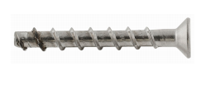


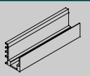
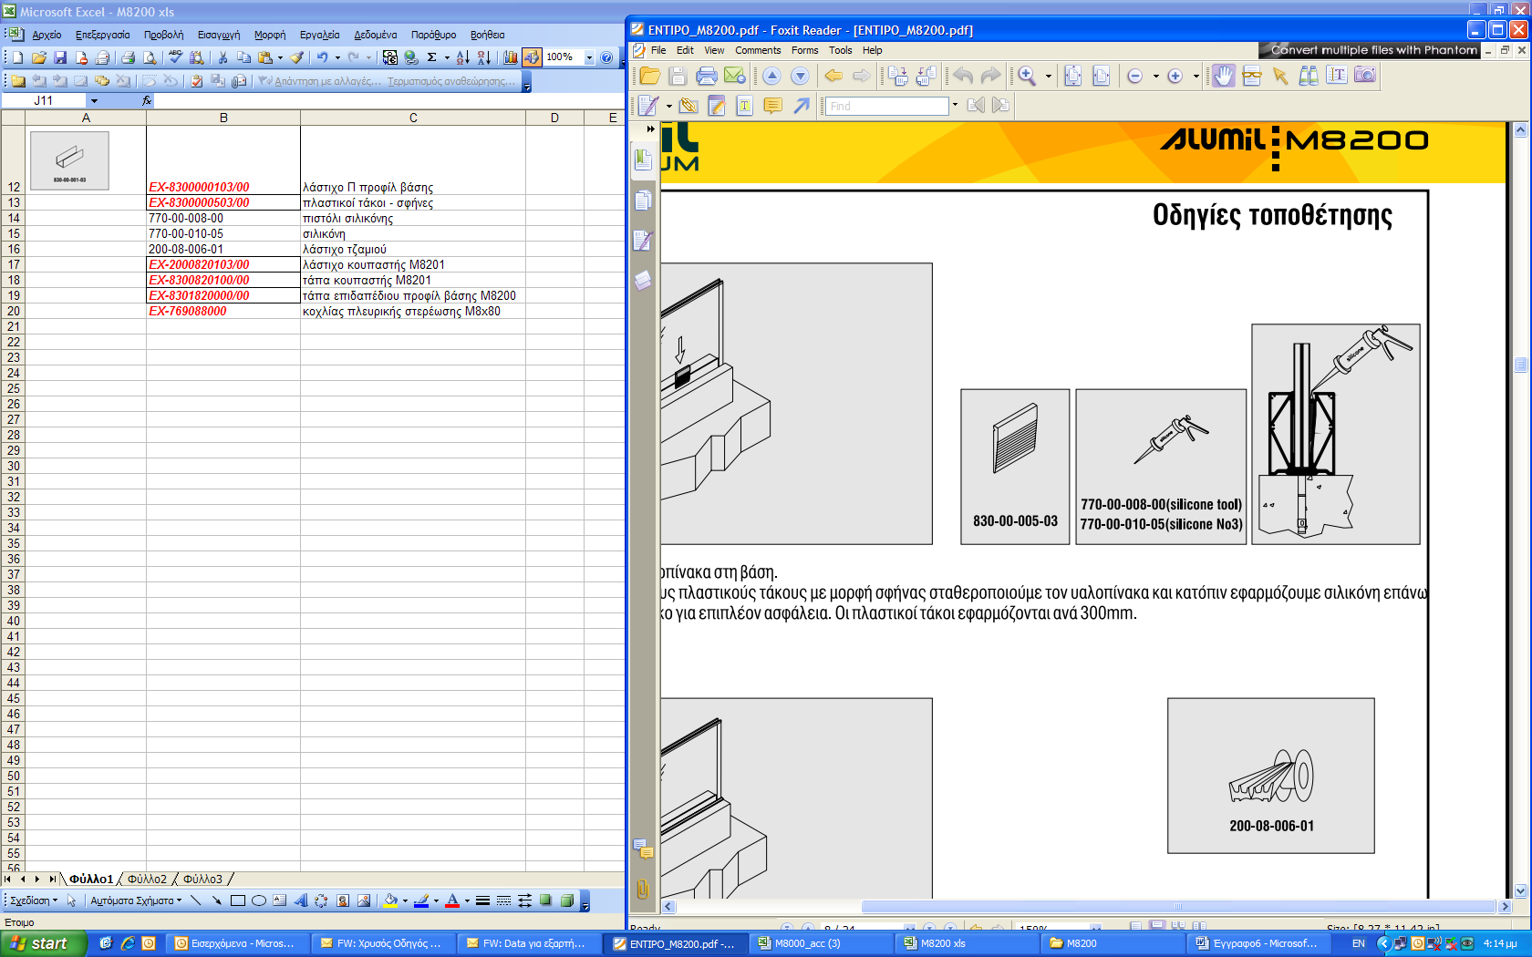
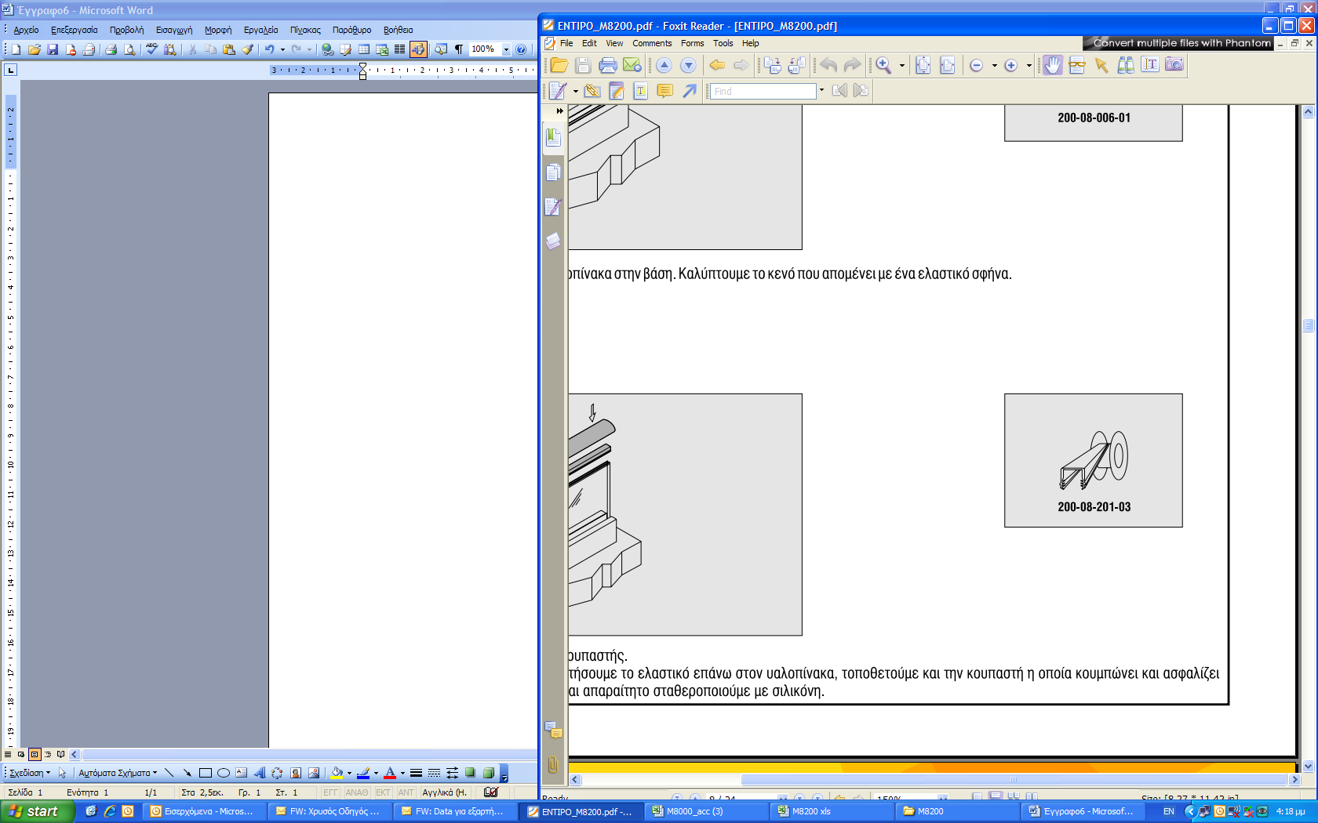
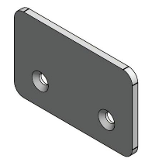
Technical Characteristics Main features
Same set of accessories for all the base profiles (except M8209)
“U” type accessory to prevent alum. and glass contact
Simple wedge 5.0 x 4.0 cm
Anchorage screws with metal plates or not
Special plastic pad when single membrane (1.2mm)
Handrail gaskets
Inox or aluminium end covers, the latter in powder coating and matt anodising shades
Gasket for sealing the gap (~1cm) between the glass panels
Every 300mm wedge and “U” fitting
Various handrails (round, oval, square, 2 flat or none)
Surface treatment of Alumil quality and variety, including polished anodizing (inox type)

Slide 9
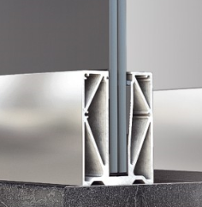
Railing base profiles
M8200
7.26 Kg/m
the sturdiest base and resistant to 4.0 KN/m linear horizontal load
same set of accessories and inox or aluminium caps
on floor 8+8 and 10+10mm (certified)

Slide 10
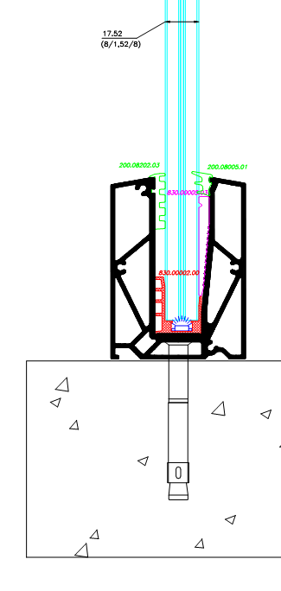
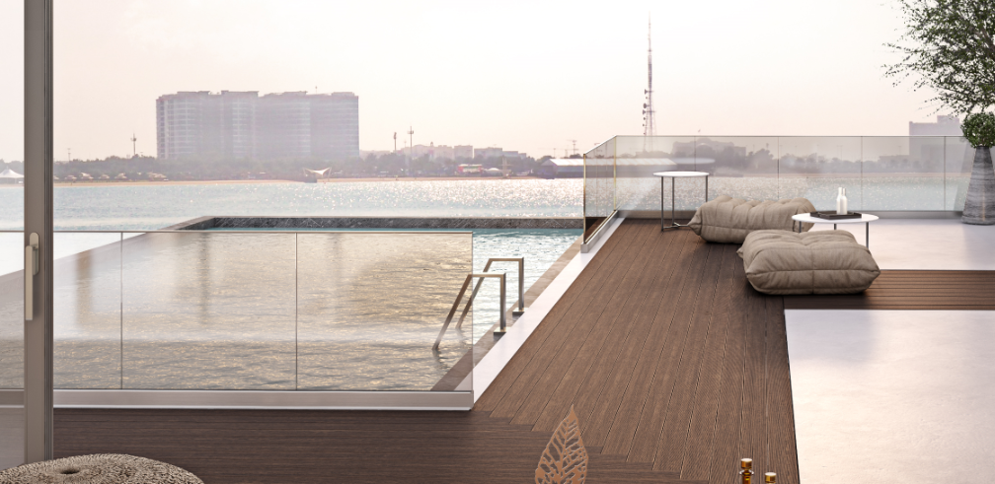
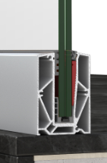
Railing base profiles
M8207
4.05 Kg/m
most competitive, light and robust i.e. 2.5 KN/m linear load
in-house formally tested with great success
special water outflow system
on floor 8+8 and 10+10mm

Slide 11
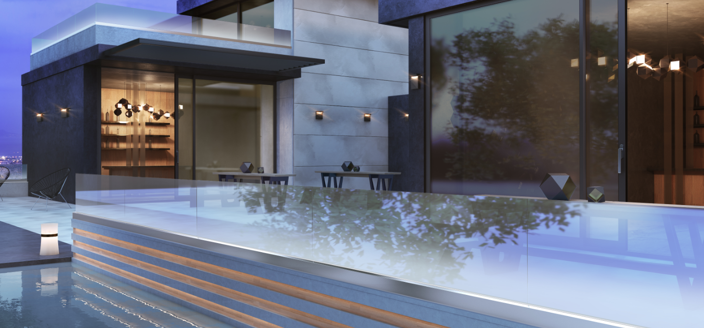
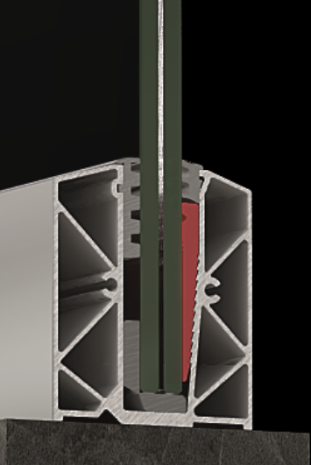
Railing base profiles
M8209
2.5Kg/m
on floor with 5+5, 6+6 and 8+8mm glass
1.5 KN/m appr. horizontal load
70cm glass height on existing concrete parapet
1.05m balustrade height with handrail fixed on wall

Slide 12
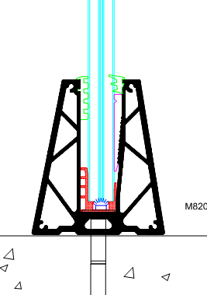
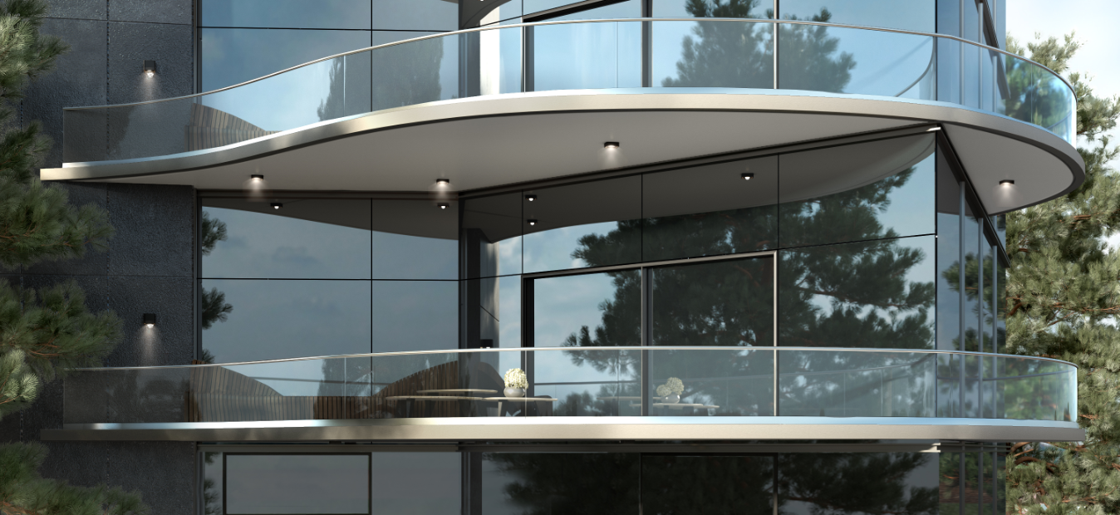
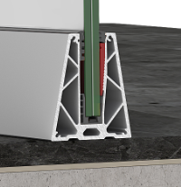
Railing base profiles
M8208
5.58Kg/m
on floor 8+8 and 10+10mm
designed for curved railings, sold also straight
Price for straight, quote for curved in a project

Slide 13
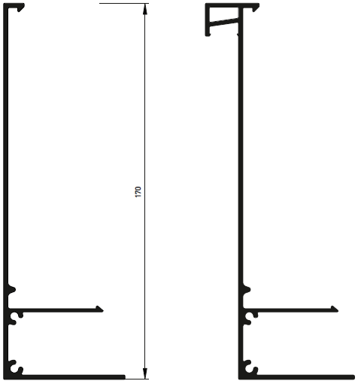
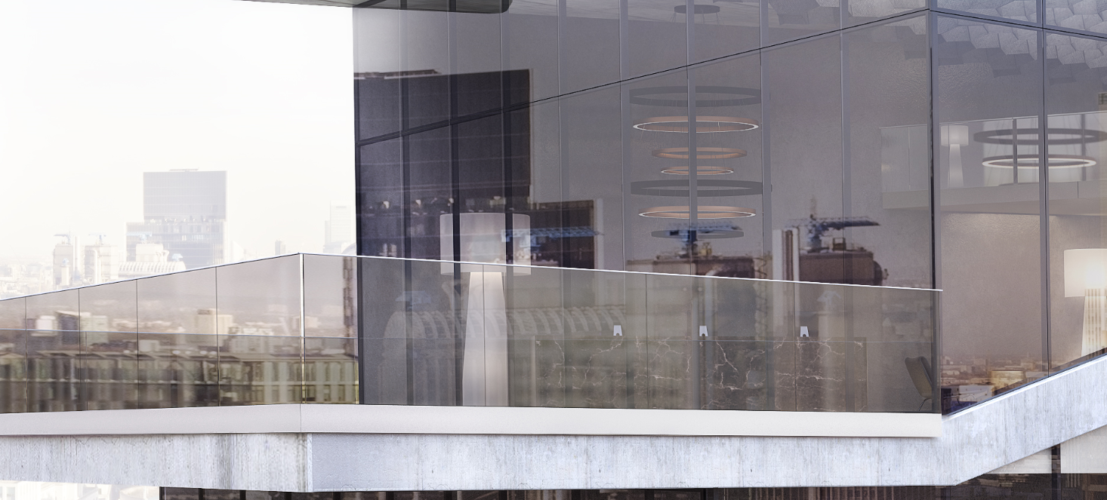
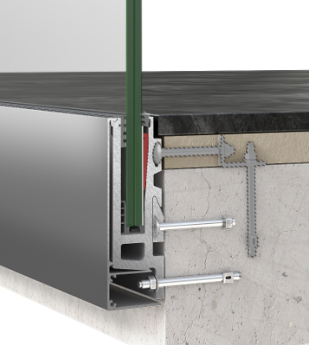
Railing base profiles
M8202
9.6Kg/m
Installed at finished and semi-finished floor
two different cover profiles
side mounted 8+8 and 10+10mm (certified)

Slide 14
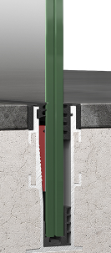
Railing base profiles
M8210
2.85 Kg/m
in-floor embedded for 8+8 and 10+10mm
molded, fixed without anchors, and then have the concrete applied
4-sided with unzipping stripe
special aluminium bars for profile alignment

Slide 15
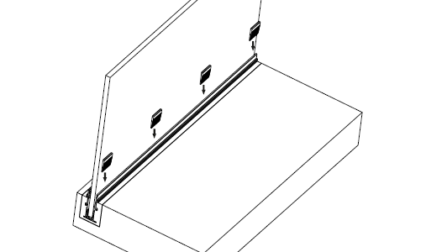

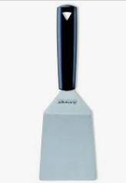
Installation
Installation guidelines are presented in the technical catalogue and an extra document for the embedded typology
Wedges and “U” shape accessories, every 300mm same line
Gradually hit the wedges, one by one, with a flat edge tool for the glass fastening
If hit a wedge at once, this might break the glass (if not tempered) the next day

Slide 16
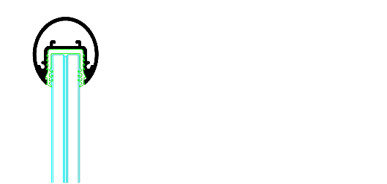

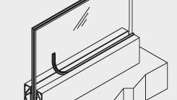
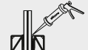

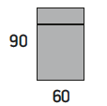
Installation
To make glass alignment easier use special adjustable fittings or a part of a handrail with the relevant gasket
Apply silicone along the inner side to enhance sealing performance.
If single membrane glass is applied, put a thicker gasket to get the difference and seal
Use the special gasket cut at small pieces and place them between the glass panels and at the gap that the panels leave in-between.
Though not proposed, when using non-tempered thinned glass, put a 1.2mm plastic pad between the glass and the wedge.

Slide 17
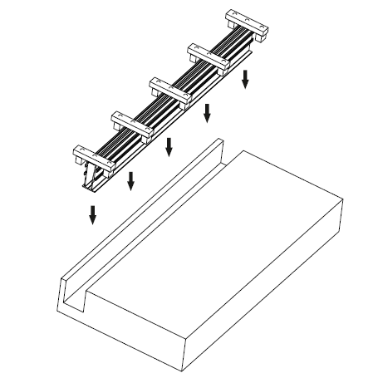
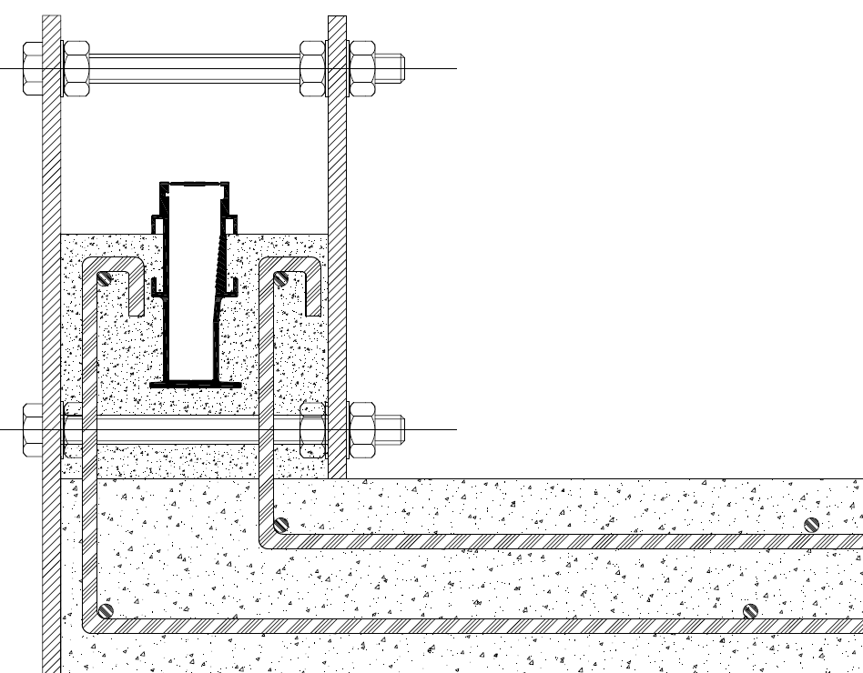
Installation
Especially, for the embedded typology, there is an extra technical document with installation guidelines and two different scenarios for the fixation of the aluminium base profile.
The first is with the profile molded at the same time with the rest of the concrete parts and uses simple cement. While the second has the base profile mounted in a channel (socket) and fixed with a cement-resin mixture.

Slide 18
COMMERCIAL SECTION

Slide 19
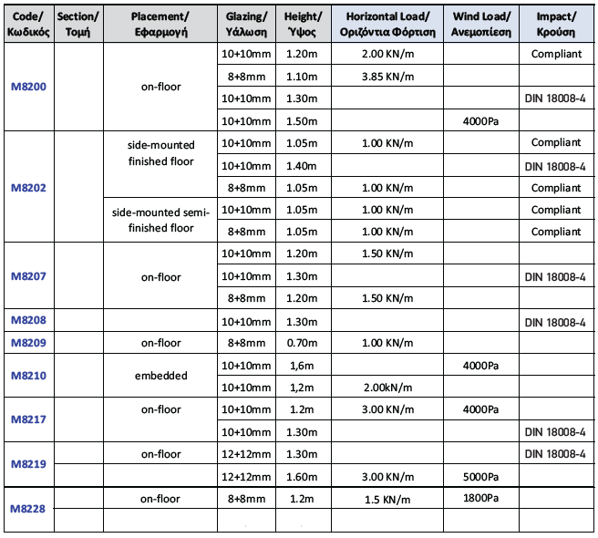
1. Extreme Sturdiness
Certifications & official tests

Slide 20
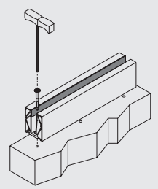
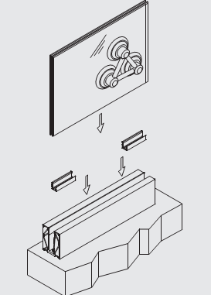
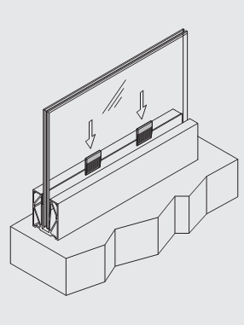
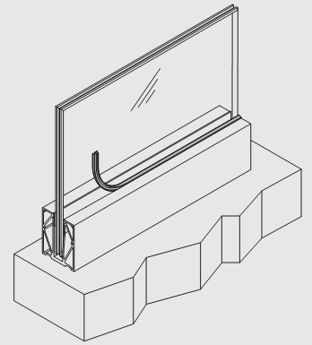
2. Easy and fast to install
The installation is fast and easy, because
the base profiles are continuous and can be easily mounted on relatively uneven grounds
come predrilled (for counter-shank screws)
(piecemeal logic railings cannot be mounted on non-flat surfaces easily)

Slide 21
3. No problems with glass alignment
Due to the continuous profile and the sophisticated design, M8200 railings have no problem with glass alignment, either with or without handrail placement.
Great lengths can be easily achieved (>20m)
(our first project with M8207 was a 60m height building with 21m single railing structures)

Slide 22
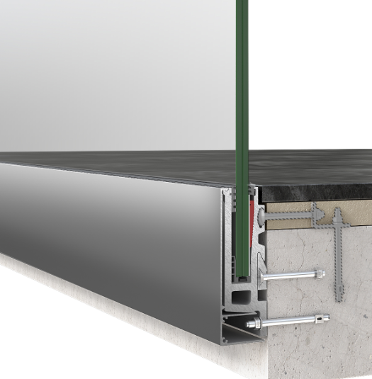
4. Extensive variety in solutions
Mounting
The installation of this railing system can be on-floor, side-mounted or in-floor
On-floor bases can be also used in-floor
In interior and exterior placement, esp. seaside

Slide 23
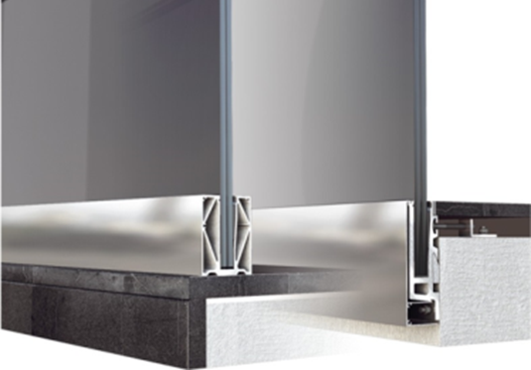
4. Extensive variety in solutions
Glass thickness
Applicable for various glass thicknesses, i.e. 5+5, 6+6, 8+8, 10+10 and 12+12mm
According to specs with quadruple membrane (1,52mm)
Special pad 1.2mm for single membrane 0,38mm

Slide 24
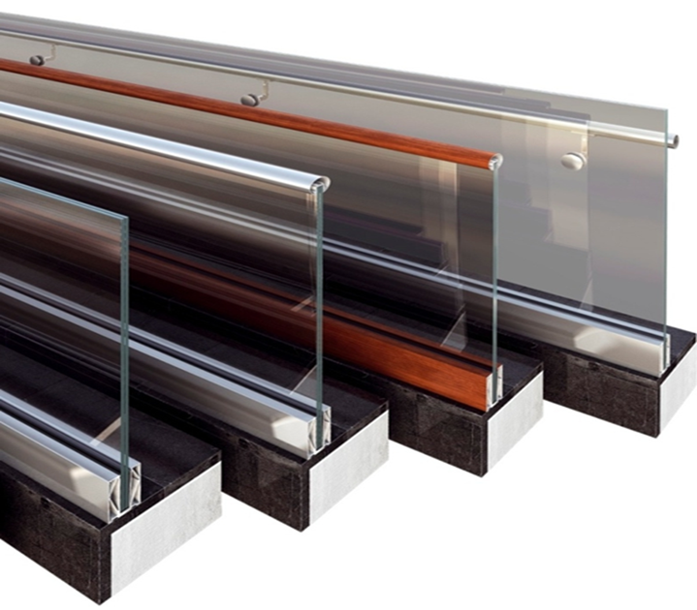
4. Extensive variety in solutions
Surface treatment
Available in all anodizing and powder coating colors, incl. mechanically polished anodizing (inox type -60) and the deep-brushed (-70)
….. of Alumil admittedly top quality and variety …

Slide 25
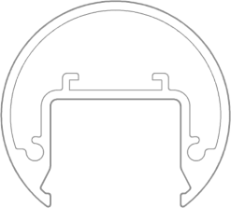
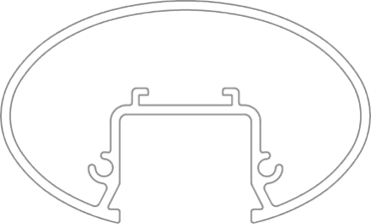
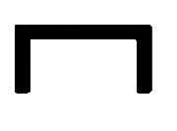

4. Extensive variety in solutions
Handrails
In various shapes, i.e. round, oval, flat and the new rectangular one

Slide 26
5. Quality
Quality in design
Sealing and drainage system design
Use of the same set of accessories
LED prediction
Counter-shank anchorages
Inox and aluminium end covers
Special pad in case of single membrane used
Curving structures possibility

Slide 27
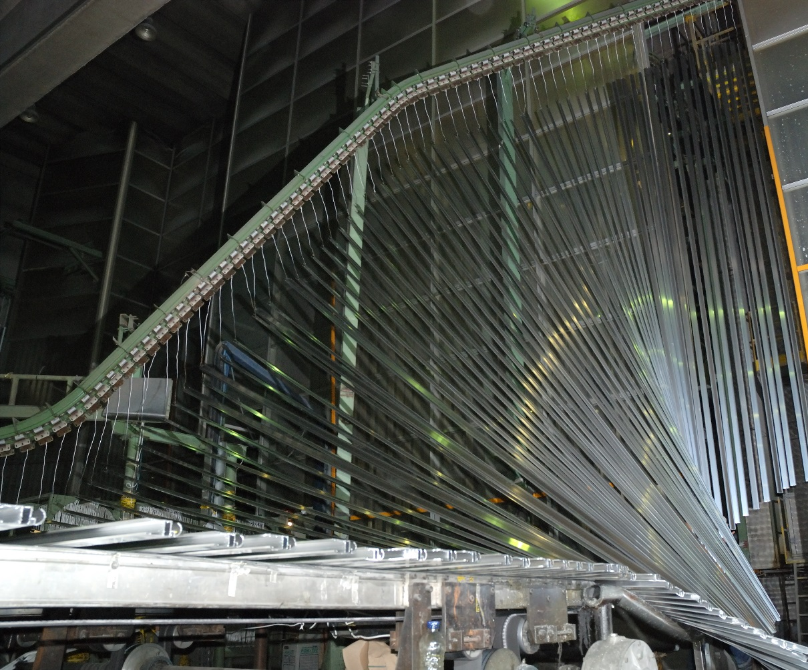
5. Quality
Quality in production
European product
From the alloys used without impurities and the extrusion process to the surface treatment (coating, anodizing), from packaging to shipment, all phases are characterized by ALUMIL top and certified quality standards

Slide 28
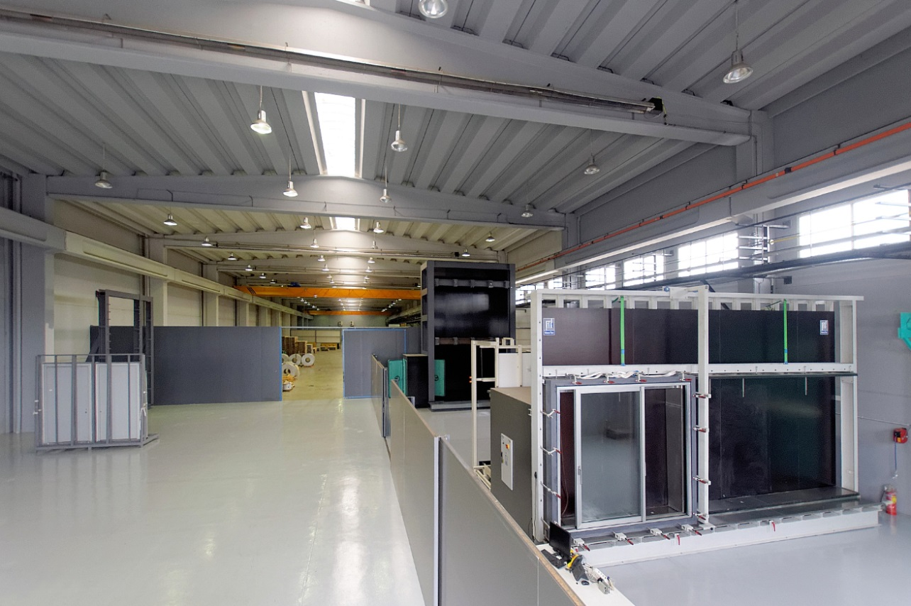
6. Added value product Competitive pricing
with premade holes (counter-shank), foil, other
Higher than specs performance
In-house tested during development
production and treatment quality
Qualitative and inexpensive surface treatment

Slide 29
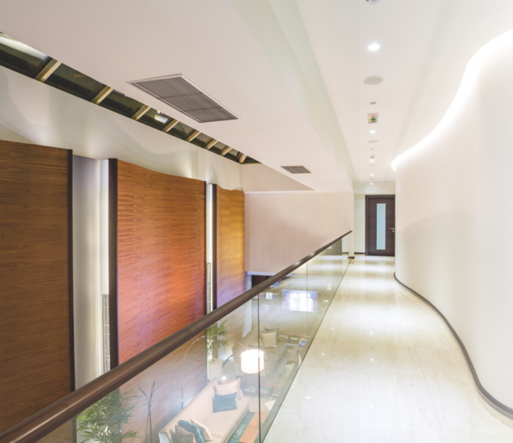
Aggregated Benefits
Extreme Sturdiness
Easy and Fast to install
Great lengths – no glass alignment issues
Extensive variety in solutions
Qualitative - European product (made in Alumil)

Slide 30
Problems & Solutions
Some glasses have broken
This may happen with non-tempered glass. It has to do with incorrect installation. One needs to place wedges and U fitting at the same line, and gradually hit
The construction wobbles, seems not so stable
This may happen when mounting the base profile on some steel anchored corner instead of concrete.
100mm layers before concrete
There are special longer screws, e.g. 180-200mm
There is no base profile that covers our specific need
We as ALUMIL are flexible enough to come with new solutions, e.g. in-floor 12+12mm
Simple wedge means difficult alignment in contrast to the adjustable ones
It is less easy. This is a worry of those who have not work with M8200 yet. Big clients of ours insist that they do not have such issue.

Slide 31
Competition Comparison
piecemeal logic
Such systems may have a wide variety of solutions as well, but they are less competitive because
They may have similar cost with most of M8200 typologies, but they cannot compete in price M8207 on-floor solution
They are much less sturdy and glass panels may loose their alignment or even go off
They offer easy glass installation but the parts themselves are difficult to be aligned, esp. when ground is not flat
They are of much lower quality (and variety) of surface treatment since usually they are not European products.

Slide 32
Competition Comparison
Adjustable wedges
Such systems may be a little bit better in installation ease terms but
They are extremely expensive for what they offer. Profiles are much heavier and the adjustable wedges are very expensive. Only in central Europe there is such a market.
These systems are generally offered by companies that are characterised by lack of flexibility in terms of delivery times, special pricing, design customisation, production planning, anodising/powder coating possibilities, etc.
Esp. in large scale projects, our philosophy railings are the most competitive

Slide 33

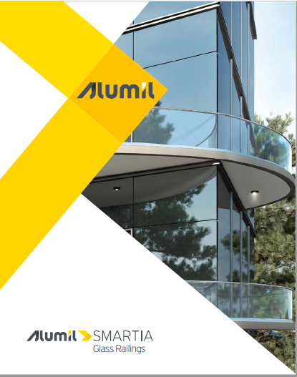
Promotional material
Glass railings pre-Q catalogue
OUTDOOR Solutions Catalogues
Technical catalogue
Tiering catalogues (SMARTIA, golden pages)
Samples with glass and handrail 200x250mm appr., for M8200, M8202, M8207, M8209
XLS file for pricelist and material/cost calculation

Slide 34
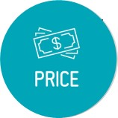

Price & commercial policy
SMARTIA tiering and sold in in €/m
Anodising and powder coating are charged much lower than in other architectural series
Special prices in case of very large projects
Price includes pre-drilling, film, etc
Stocked in mill finish and natural anodisation
Special XLS file with prices and cost/material calc. tool

Slide 35


Placement
Projects with hotels and other buildings as well as modern residences
Via usual commercial channels i.e. fabricators, architects, etc
Special sales channel: Glass suppliers
Cross selling approach and Outdoor concept

Slide 36
THANK YOU
FOR YOUR ATTENTION

