Slide 1
SMARTIA S67 URBAN

Slide 2

What is industrial look
Industrial style or industrial chic refers to an aesthetic trend in architectural design that takes elements from old factories, warehouses and industrial spaces which have been recently converted into living spaces(loft and others).
Components of industrial style include weathered wood, building systems, exposed brick, industrial lighting fixtures and concrete.

Slide 3
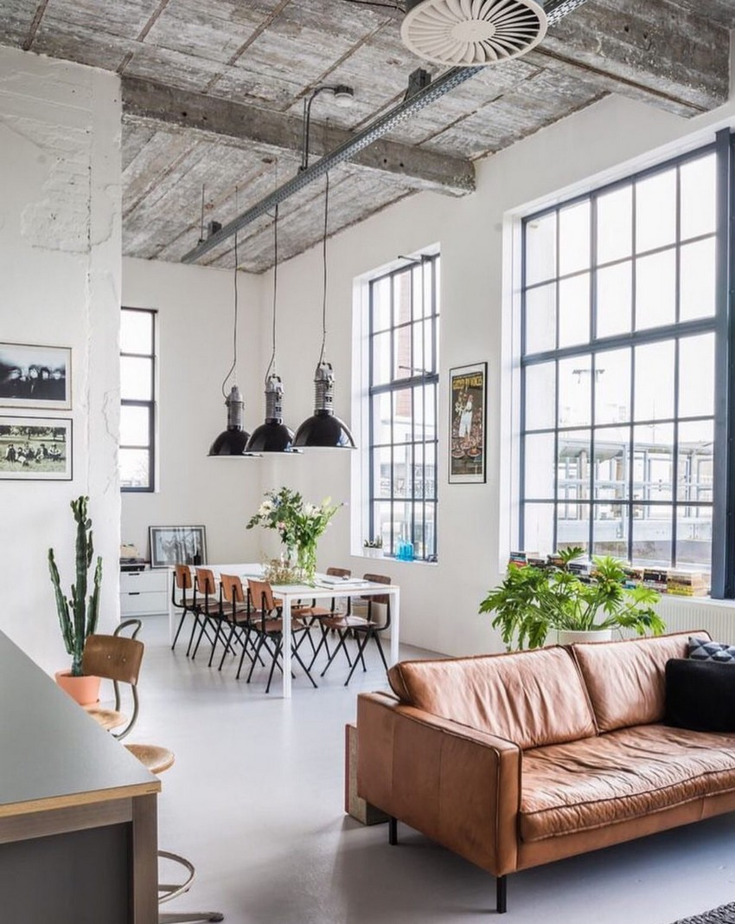
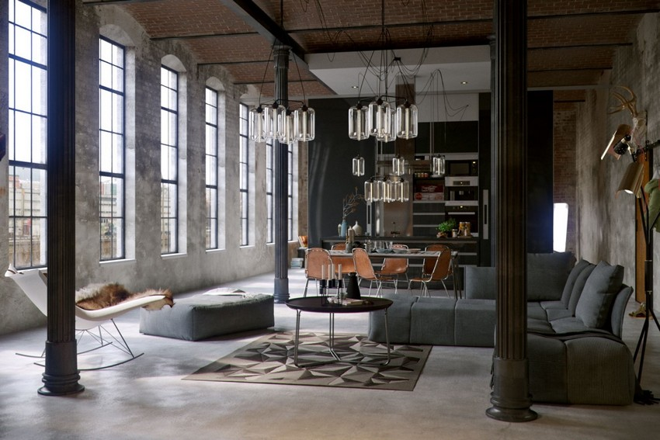
What it looks like…

Slide 4
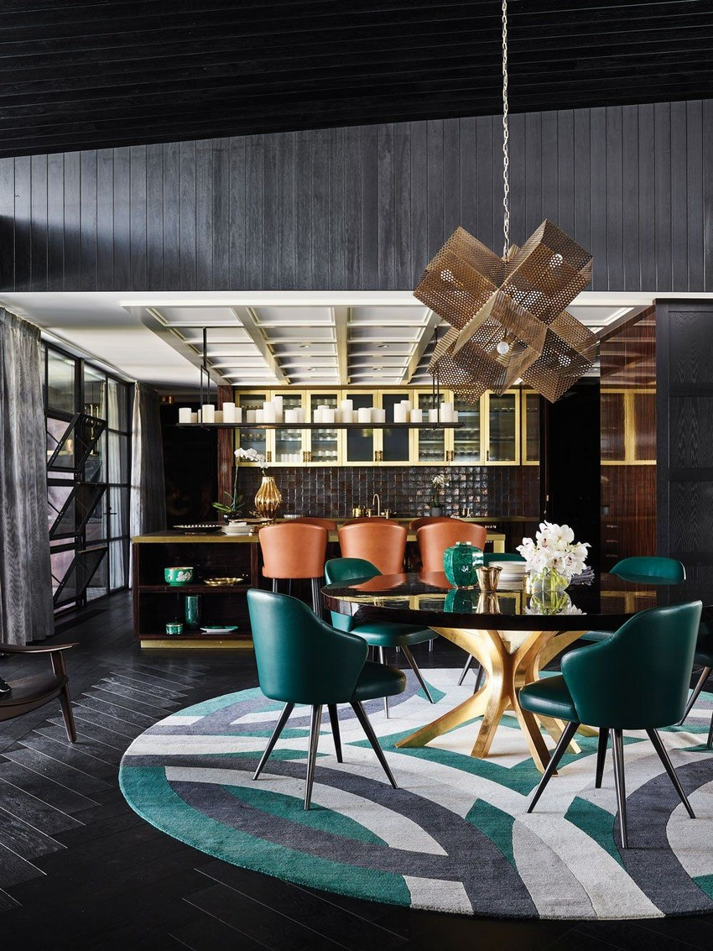
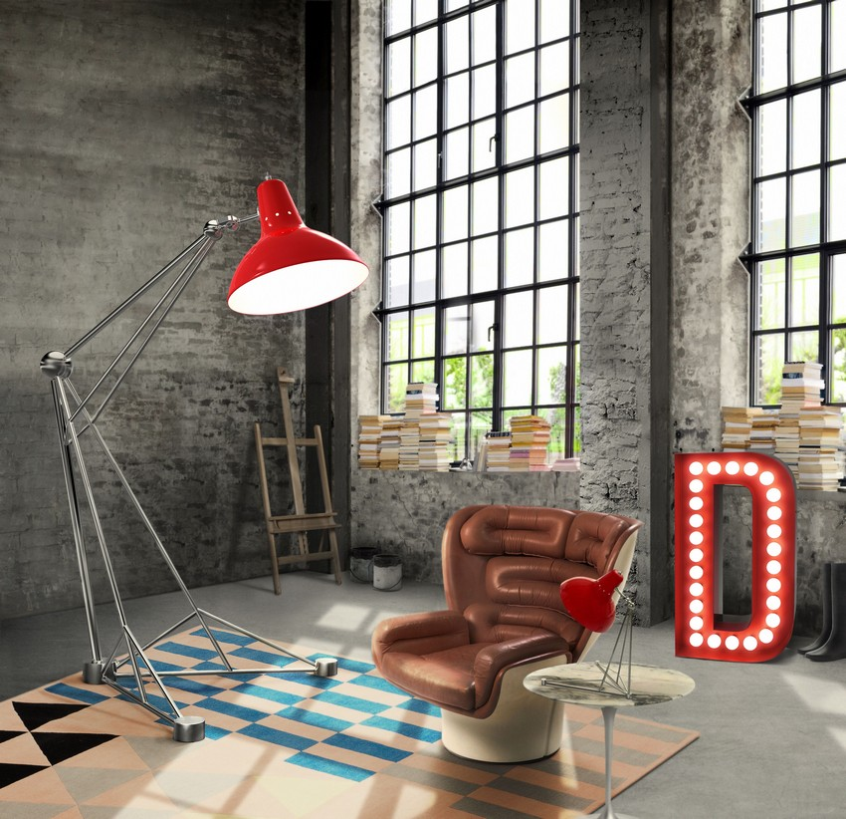
What it looks like…

Slide 5
What is S67 URBAN and why we develop it…

Slide 6
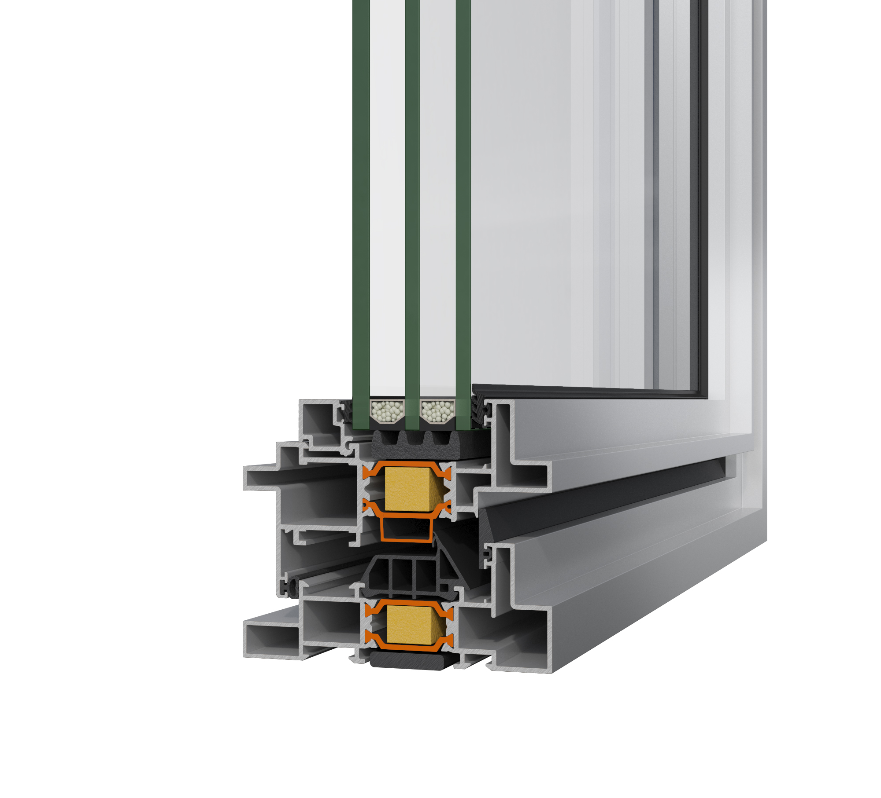
what
A new hinged insulated system by ALUMIL, which successfully combines the present with the past and the classic with the modern.
The unique aesthetics of S67 Urban, meet the contemporary architectural trends for industrial design, which render the system an ideal choice for industrial look on new buildings, or upgrading old steel framed windows.

Slide 7
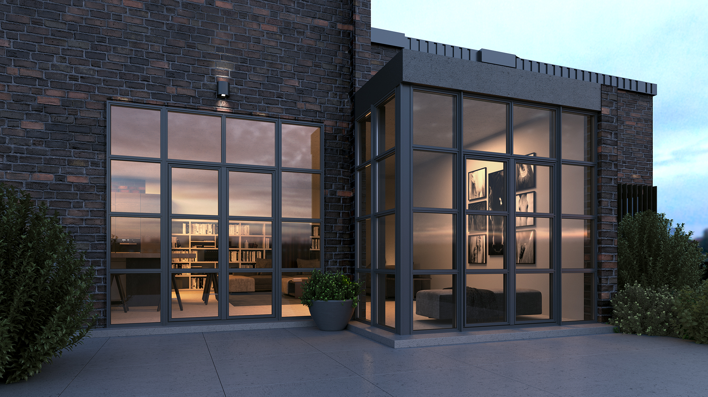
why
S67 URBAN was designed to enrich ALUMIL’s range with a system that meet the global trend of industrial steel look combined with all the advantages of an insulated hinged system.

Slide 8
TECHNICAL TRAINING

Slide 9
S67 URBAN at a glance:
Basic system width frame/sash 105mm
Visible width frame-sash 85mm
Frame height 40mm
Sash height 65mm
Glazing up to 44mm

Slide 10
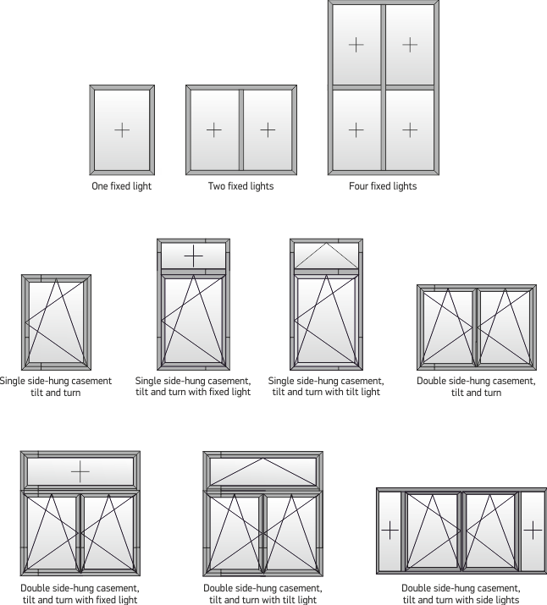
Typologies
Applicable to all tilt and turn typologies.

Slide 11
Technical details
Available in two versions: Standard and Hi.
Heavy constructions can be easily implemented: maximum weight per sash up to 180 kg
Designed for European groove mechanism (…only)
Improve aesthetics with the use of concealed hinges.
Grid system of small glass panes can be implemented with the use of muntin bars.

Slide 12
Technical details
Muntin bars

Slide 13
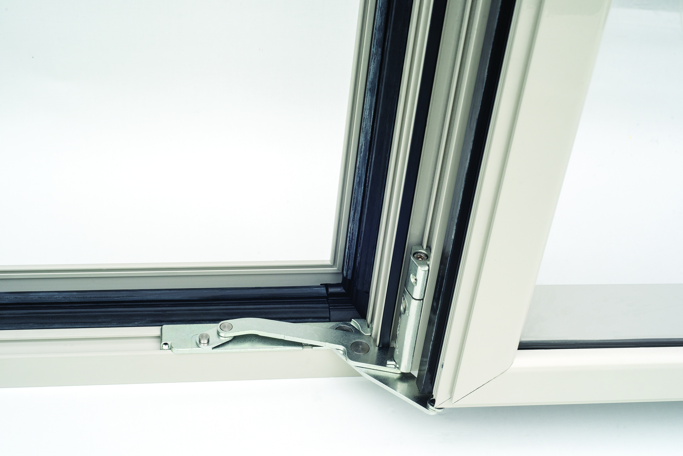
Technical details
Improve system aesthetics and add to its elegant design with the use of concealed hinges.

Slide 14
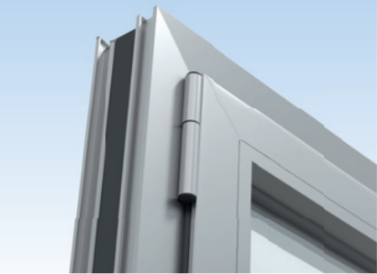
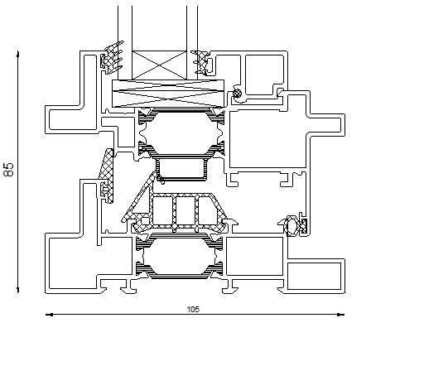
Technical details
Furthermore, for more economical solution, visible hinges can be implemented by using special designed frame.

Slide 15
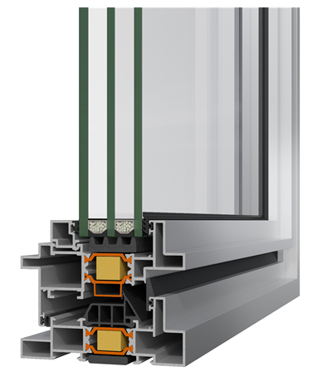
Technical details
Tubular glazing bead increase system`s security and resistance to wind load.
Variety of beads that can cover both double and triple glazing up to 44mm

Slide 16
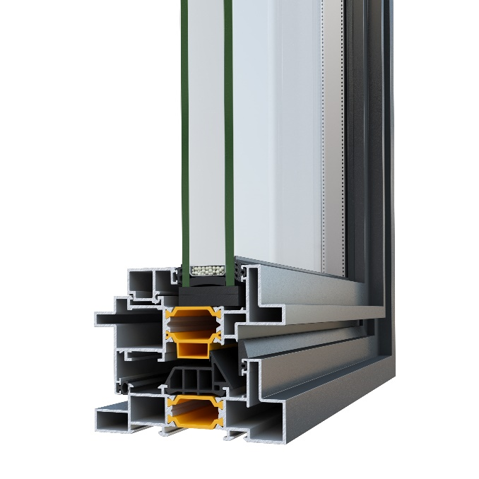
Variety of energy solutions
S67 URBAN, by choosing among available accessories, offers flexibility in terms of energy saving , providing two available versions:
S67 URBAN versions
STANDARD
HI

Slide 17
Variety of energy solutions
STANDARD
HI
Multi chamber EPDM central gasket
One chamber EPDM wedge gasket
Multi chamber EPDM central gasket
One chamber EPDM wedge gasket
PE Insulation Foam
Energy Bar

Slide 18
Variety of energy solutions
30mm width fiberglass reinforced polyamides
Multi chamber EPDM central gasket
Energy Bar, both in frame and sash
Insulation foam perimetrically of glazing panel
Insulation foam perimetrically of the frame
4
3
1
2
5

Slide 19
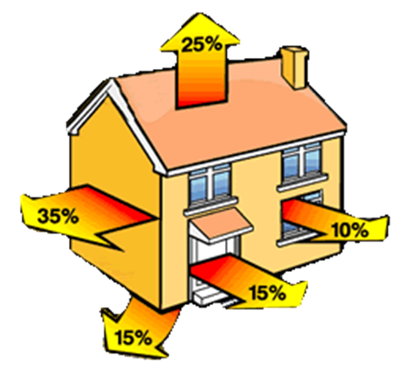
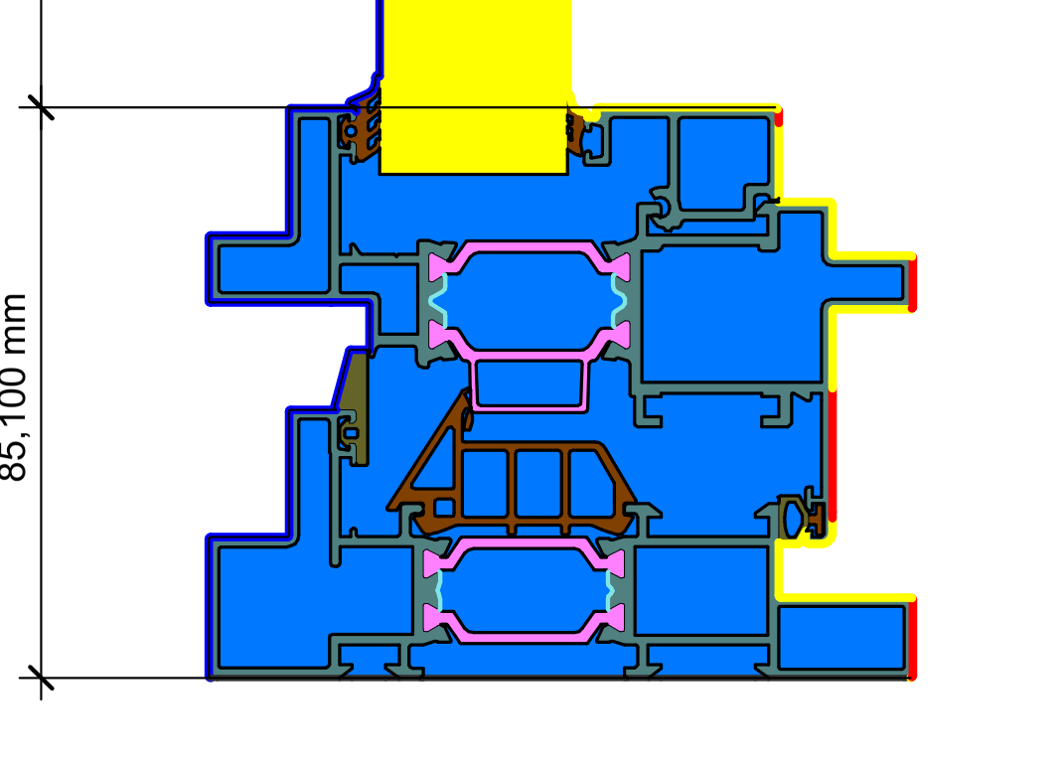
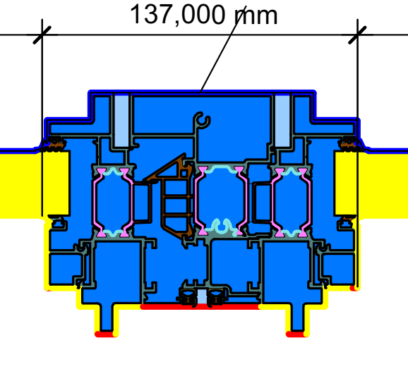
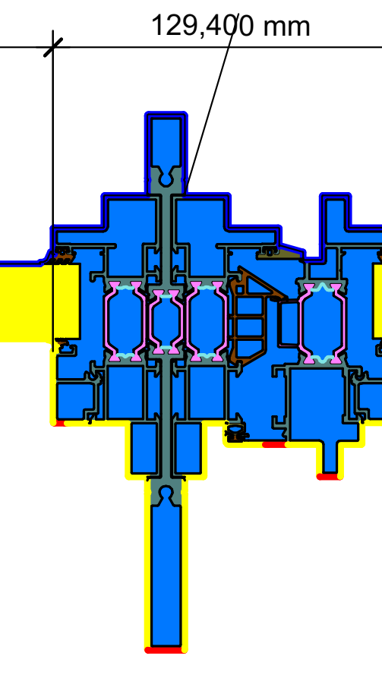
Energy Saving
Maximum
energy saving by reducing energy losses.
Uf=2,8W/m².K
Standard version
Uf=3,2W/m².K
Standard version
Uf=2,6W/m².K
Standard version

Slide 20
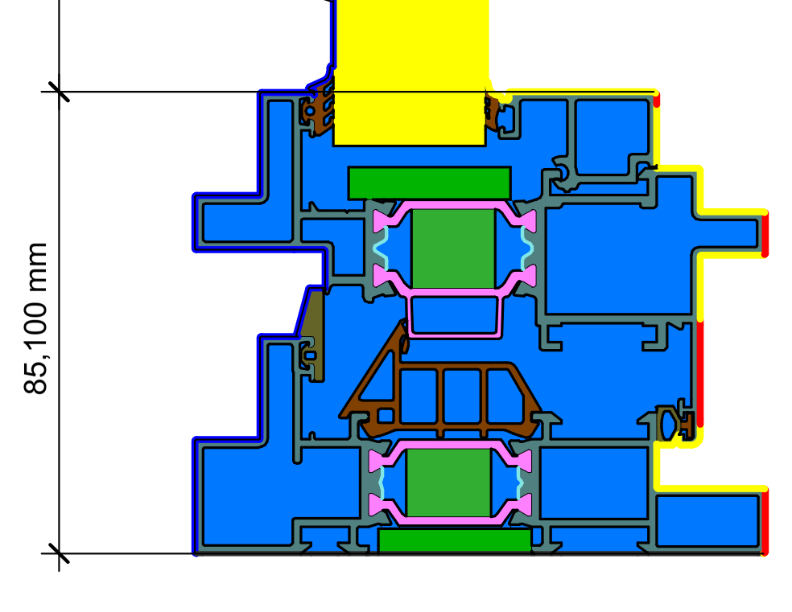
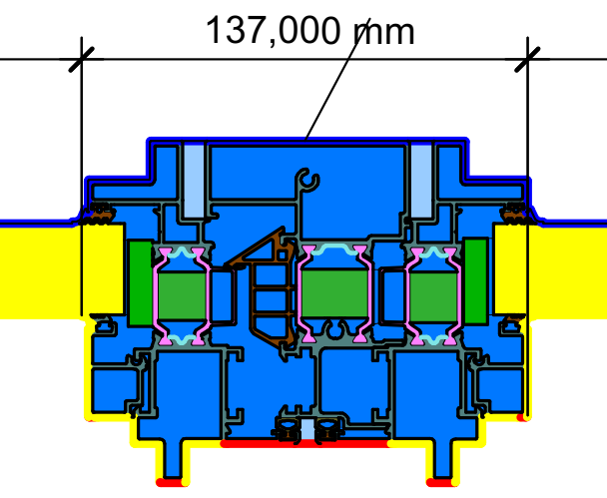
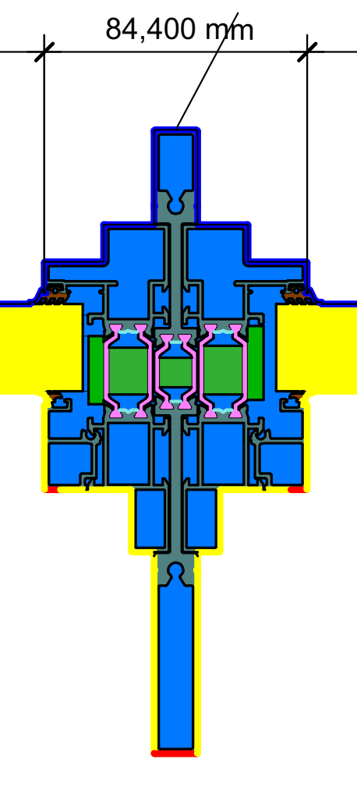
Energy Saving
Maximum
energy saving by reducing energy losses.
Uf=2,2W/m².K
Hi version
Uf=2,5 W/m².K
Hi version
Uf=2,0W/m².K
Hi version

Slide 21
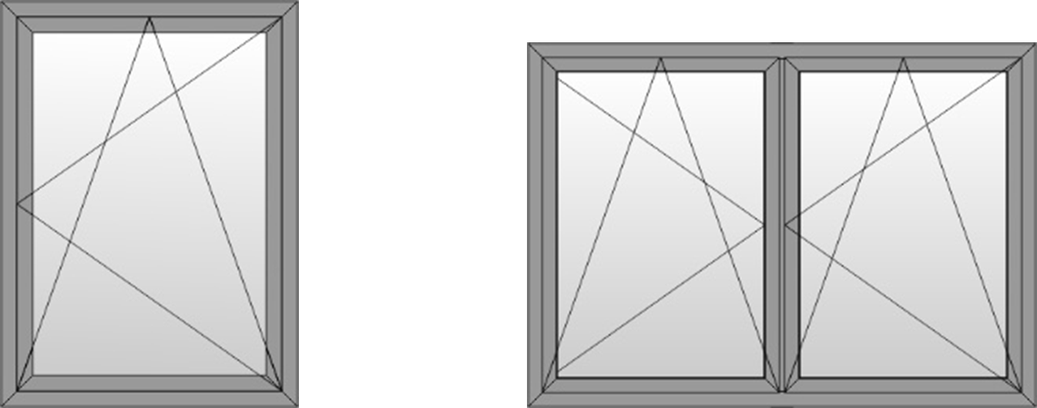
Energy Saving
STANDARD VERSION
STANDARD VERSION
Dimensions | Ug (W/m2.K) | Uw (W/m2.K)
1000x2200 | Ug=1 (psi=0,11) | Uw=1,78
 | Ug=0,6 (psi=0,035) | Uw=1,21
Dimensions | Ug (W/m2.K) | Uw (W/m2.K)
1500x2200 | Ug=1 (psi=0,11) | Uw=1,84
 | Ug=0,6 (psi=0,035) | Uw=1,31
Double Glazing
Triple Glazing

Slide 22
Energy Saving
HI VERSION
HI VERSION
Dimensions | Ug (W/m2.K) | Uw (W/m2.K)
1000x2200 | Ug=1 (psi=0,11) | Uw=1,64
 | Ug=0,6 (psi=0,035) | Uw=1,06
Dimensions | Ug (W/m2.K) | Uw (W/m2.K)
1500x2200 | Ug=1 (psi=0,11) | Uw=1,67
 | Ug=0,6 (psi=0,035) | Uw=1,14
Double Glazing
Triple Glazing

Slide 23
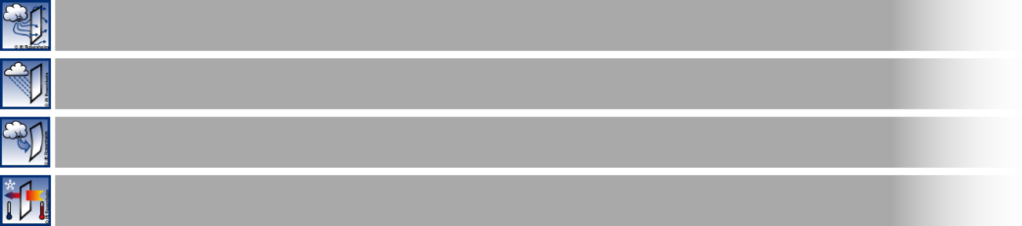

Certifications
Air permeability EN 1026, EN12207
CLASS 4
Watertightness EN 1027
CLASS E750
Resistance to windload EN 12210
CLASS C3/B3
Thermal insulation EN 10077-2
Uf≥1,9W/m².K
Certified performances by IFT Rosenheim

Slide 24
COMMERCIAL TRAINING

Slide 25
What are the winning points of S67 URBAN?

Slide 26
Compared to steel windows:
S67 URBAN is a cost-effective alternative which at the same time, maintain industrial aesthetics.
Maintenance that steel requires is considerably more due to corrosion and rust of material.
S67 URBAN thanks to thermal break profiles offers significantly higher thermal efficiency than a steel window.
Thanks to aluminium robustness and flexibility, S67 URBAN offers slim sightlines even for the most demanding constructions.

Slide 27

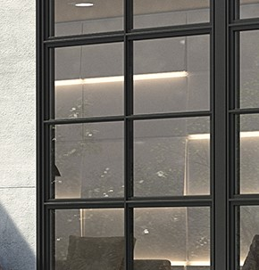
Compared to other steel look aluminium systems:
The intense protrusions on both internal and external surface give SMARTIA S67 URBAN an authentic steel look fully aligned with the trends of modern architecture.
Unlimited freedom design by using both T profiles and muntins in all possible combinations.

Slide 28
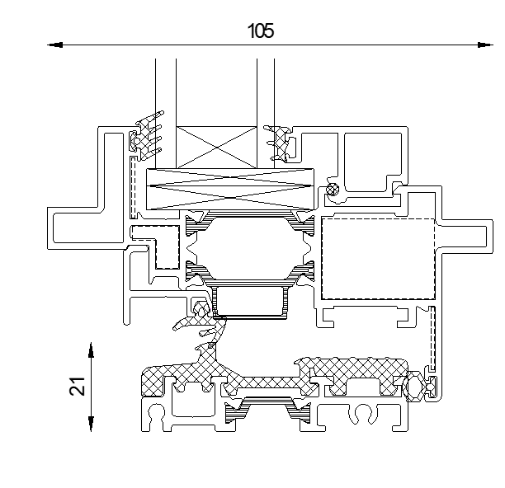
Compared to other steel look aluminium systems:
Low threshold solution, enhancing access to people with disabilities and children.

Slide 29
When should you “propose” S67 URBAN to your customer

Slide 30
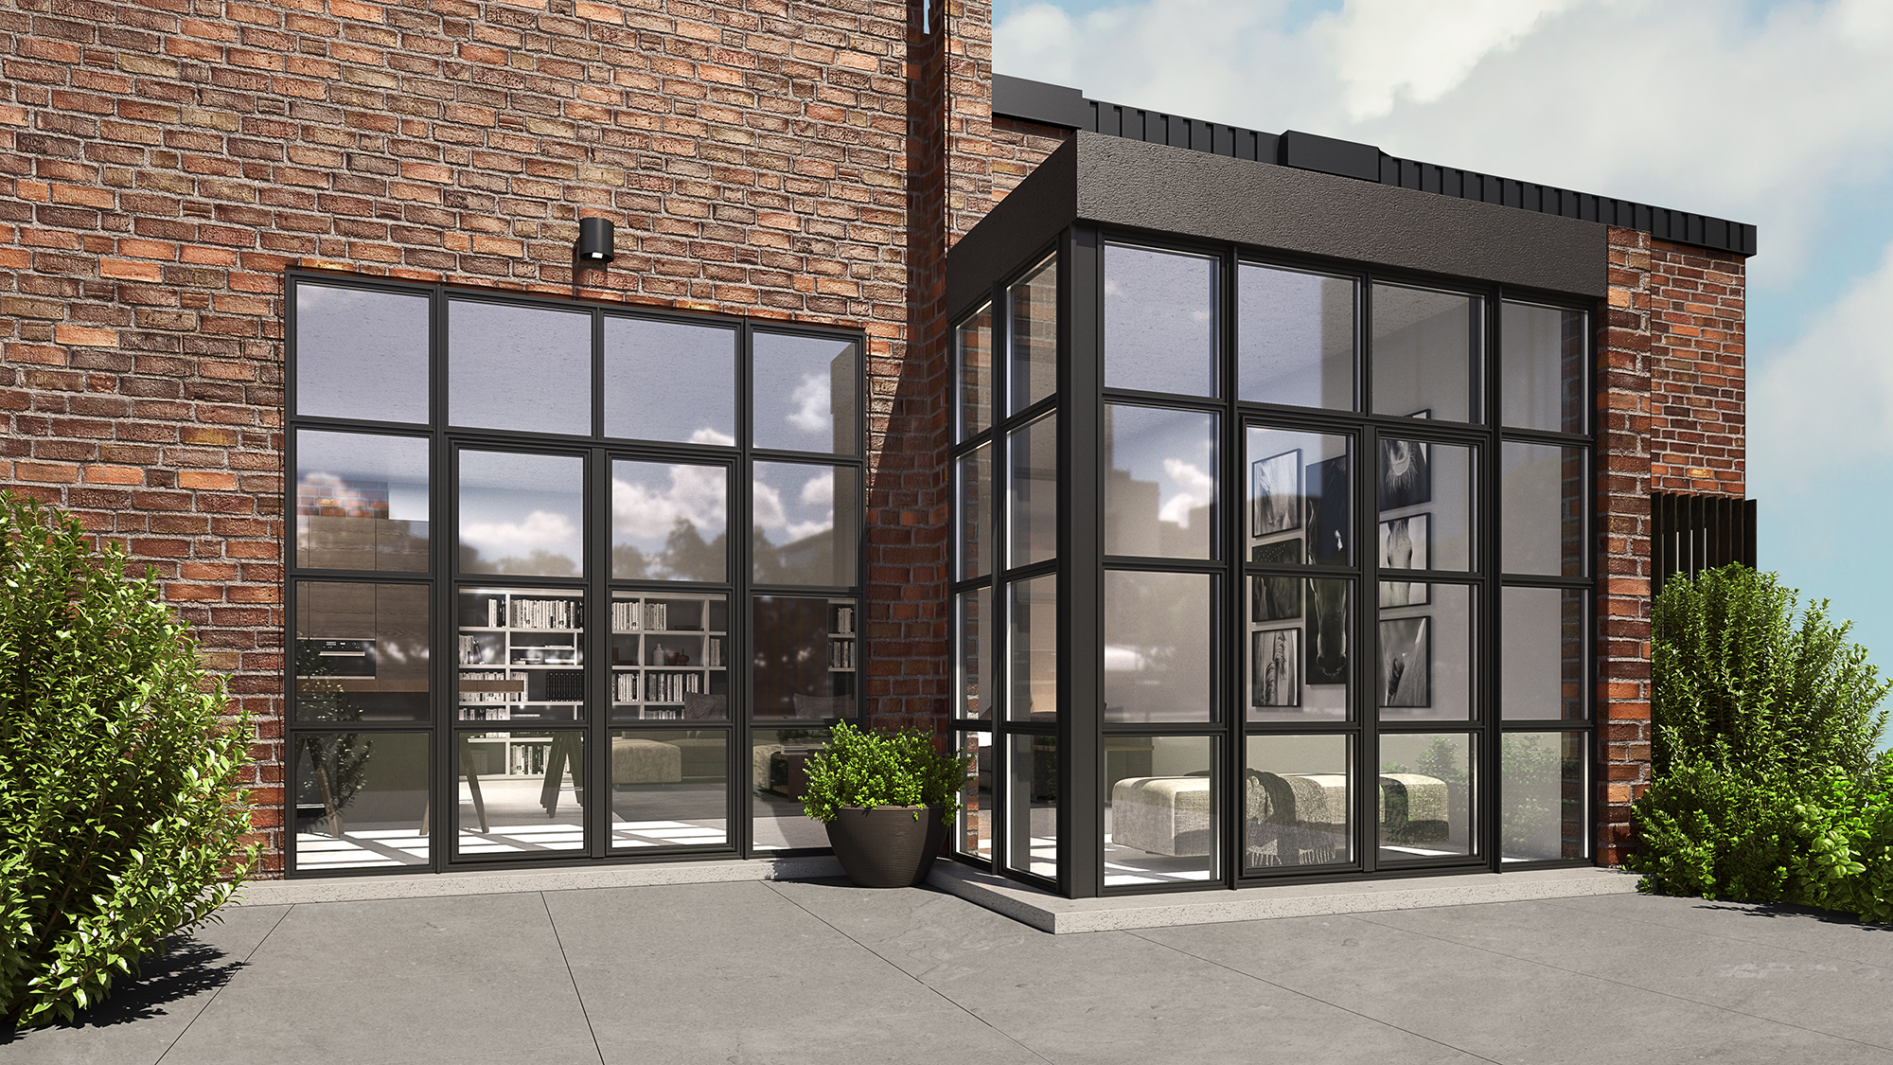
When window sightline must be fully aligned with trends of industrial design in a new modern residence.

Slide 31
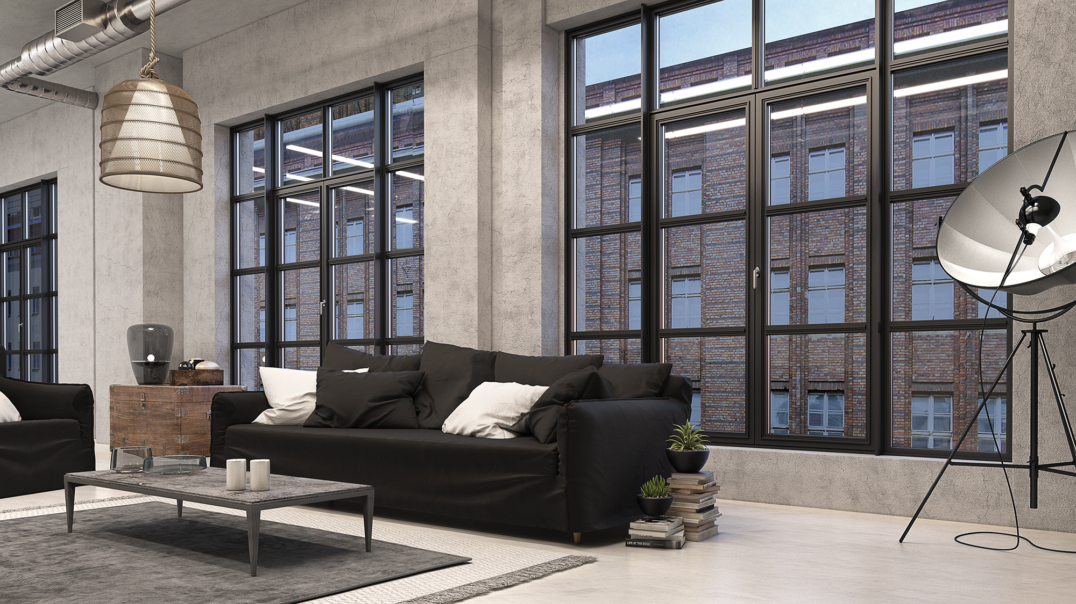
When a renovation of an old building requires maintenance of steel windows aesthetics.

Slide 32
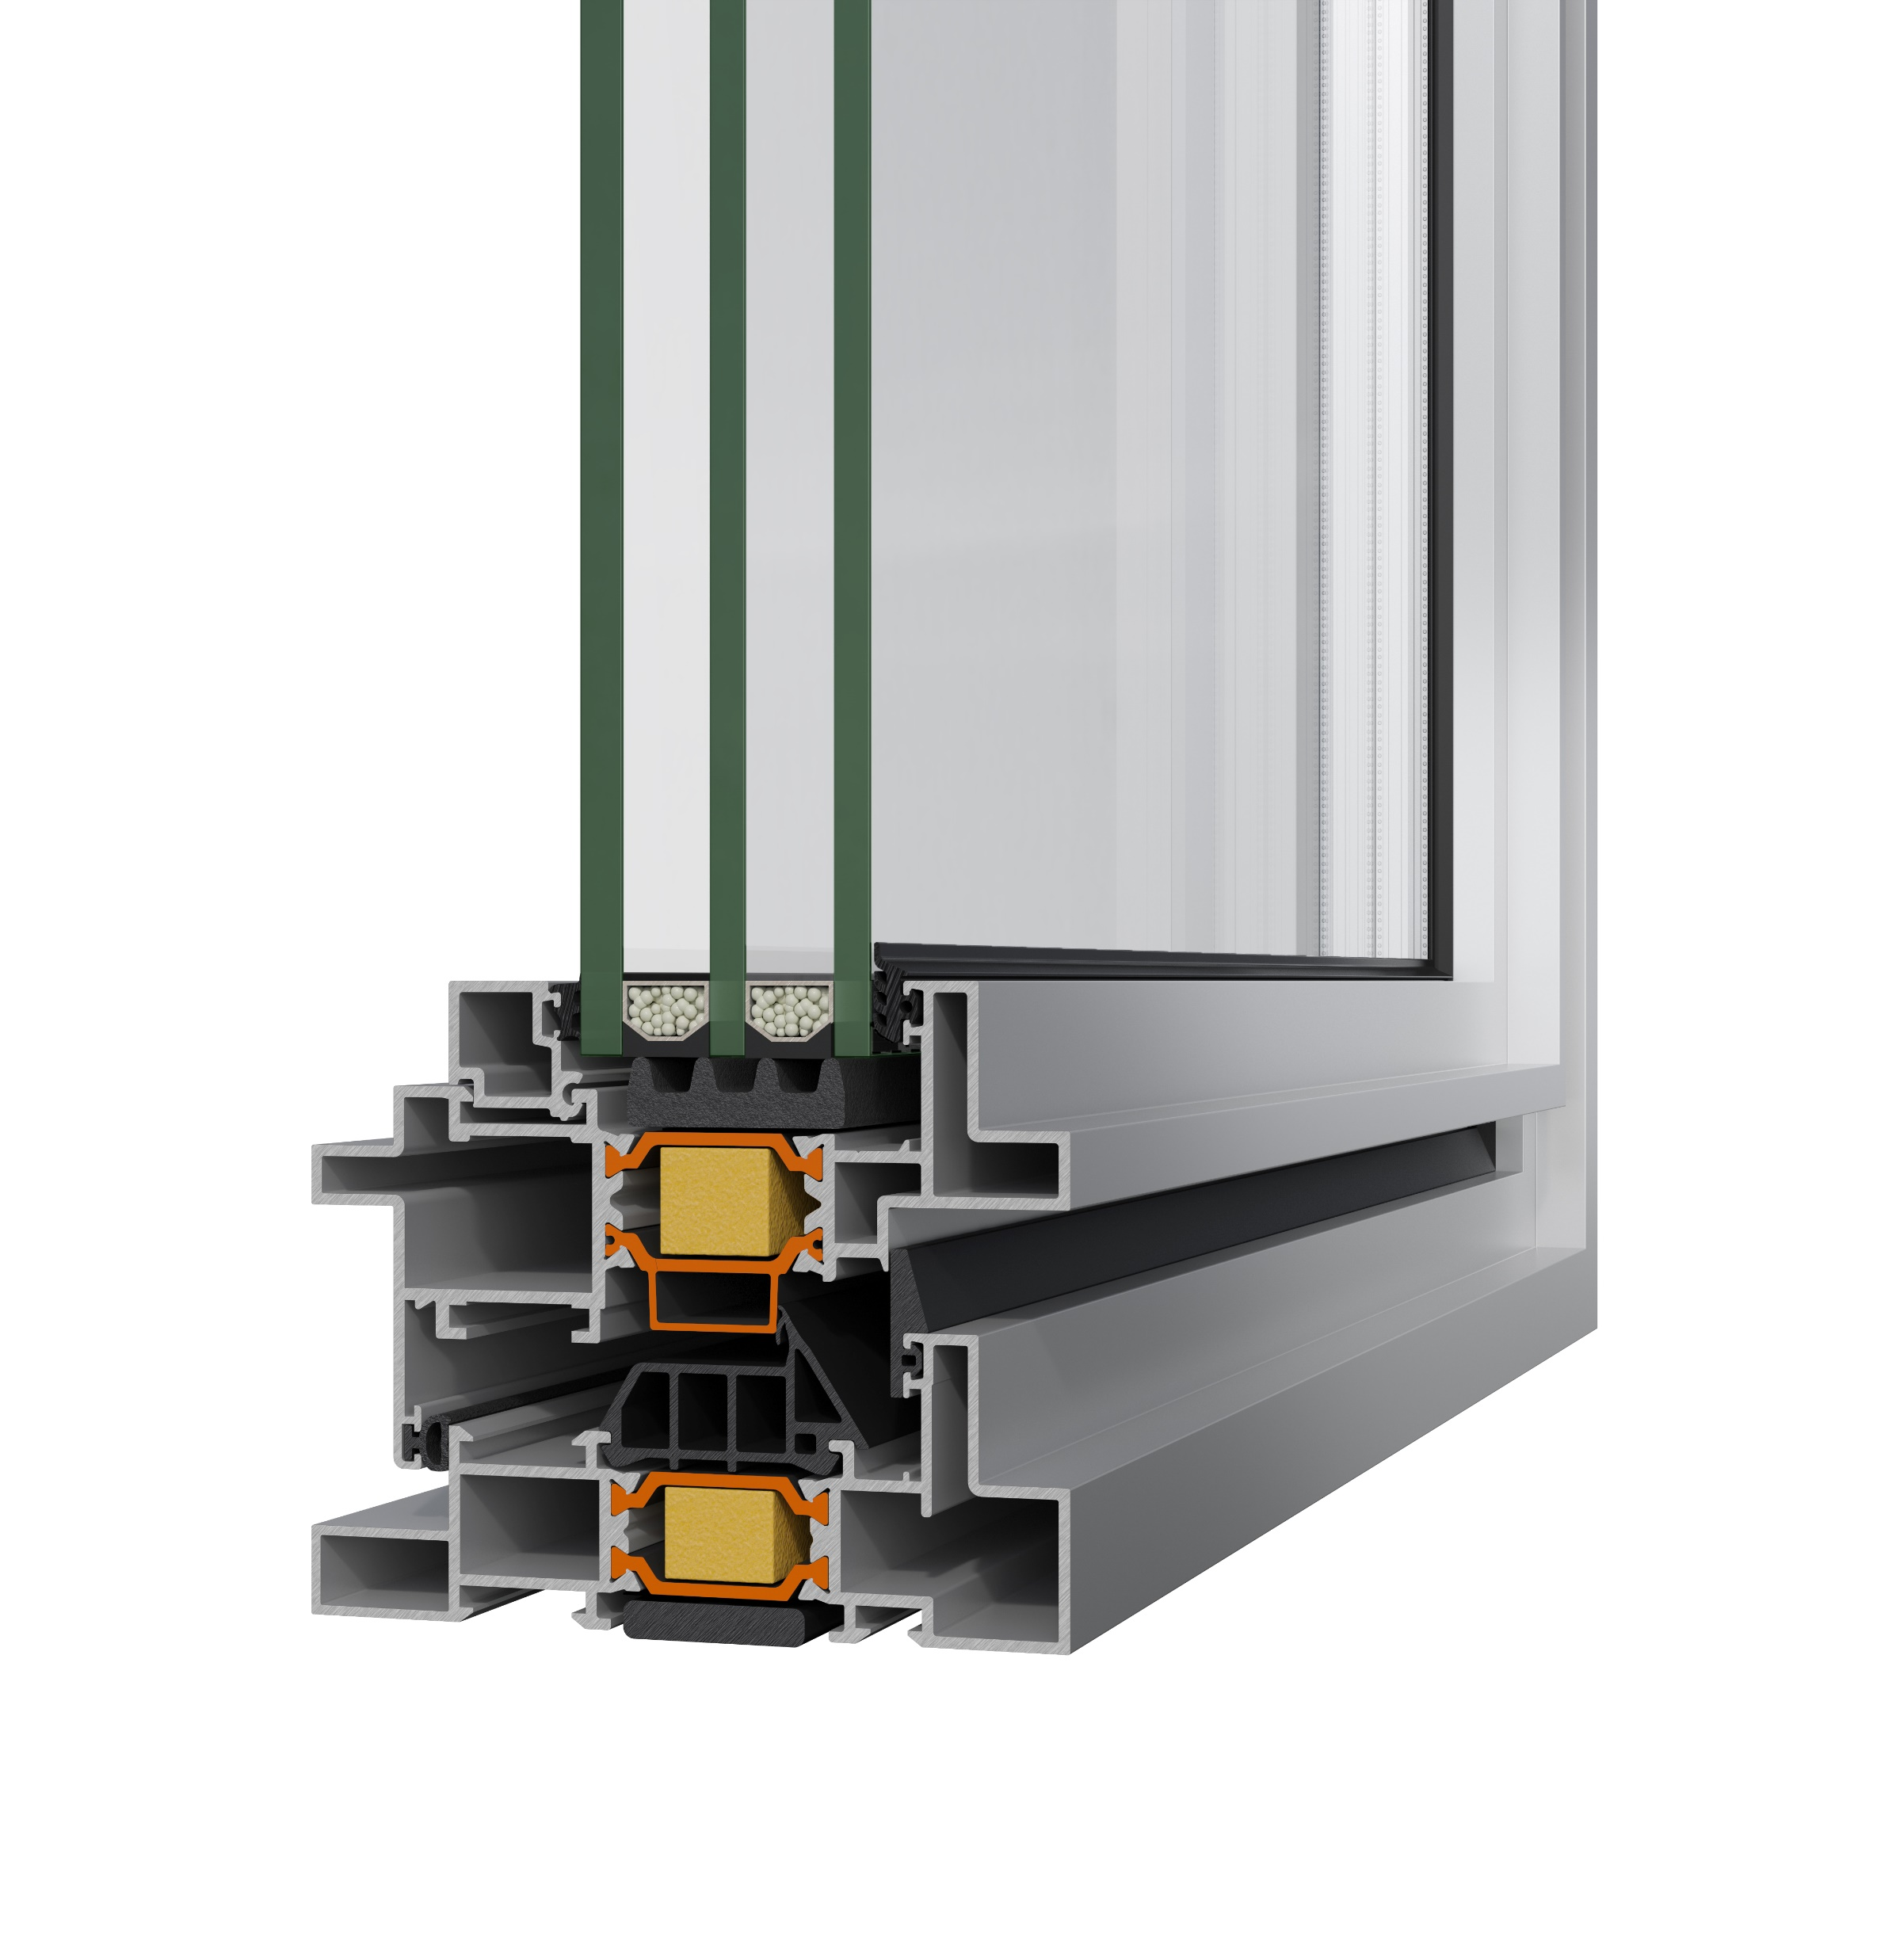
When the authentic look of steel windows accompanied with exceptional performance is a major call, then S67 URBAN is the ideal choice.

Slide 33
Benefits per Customer Persona

Slide 34
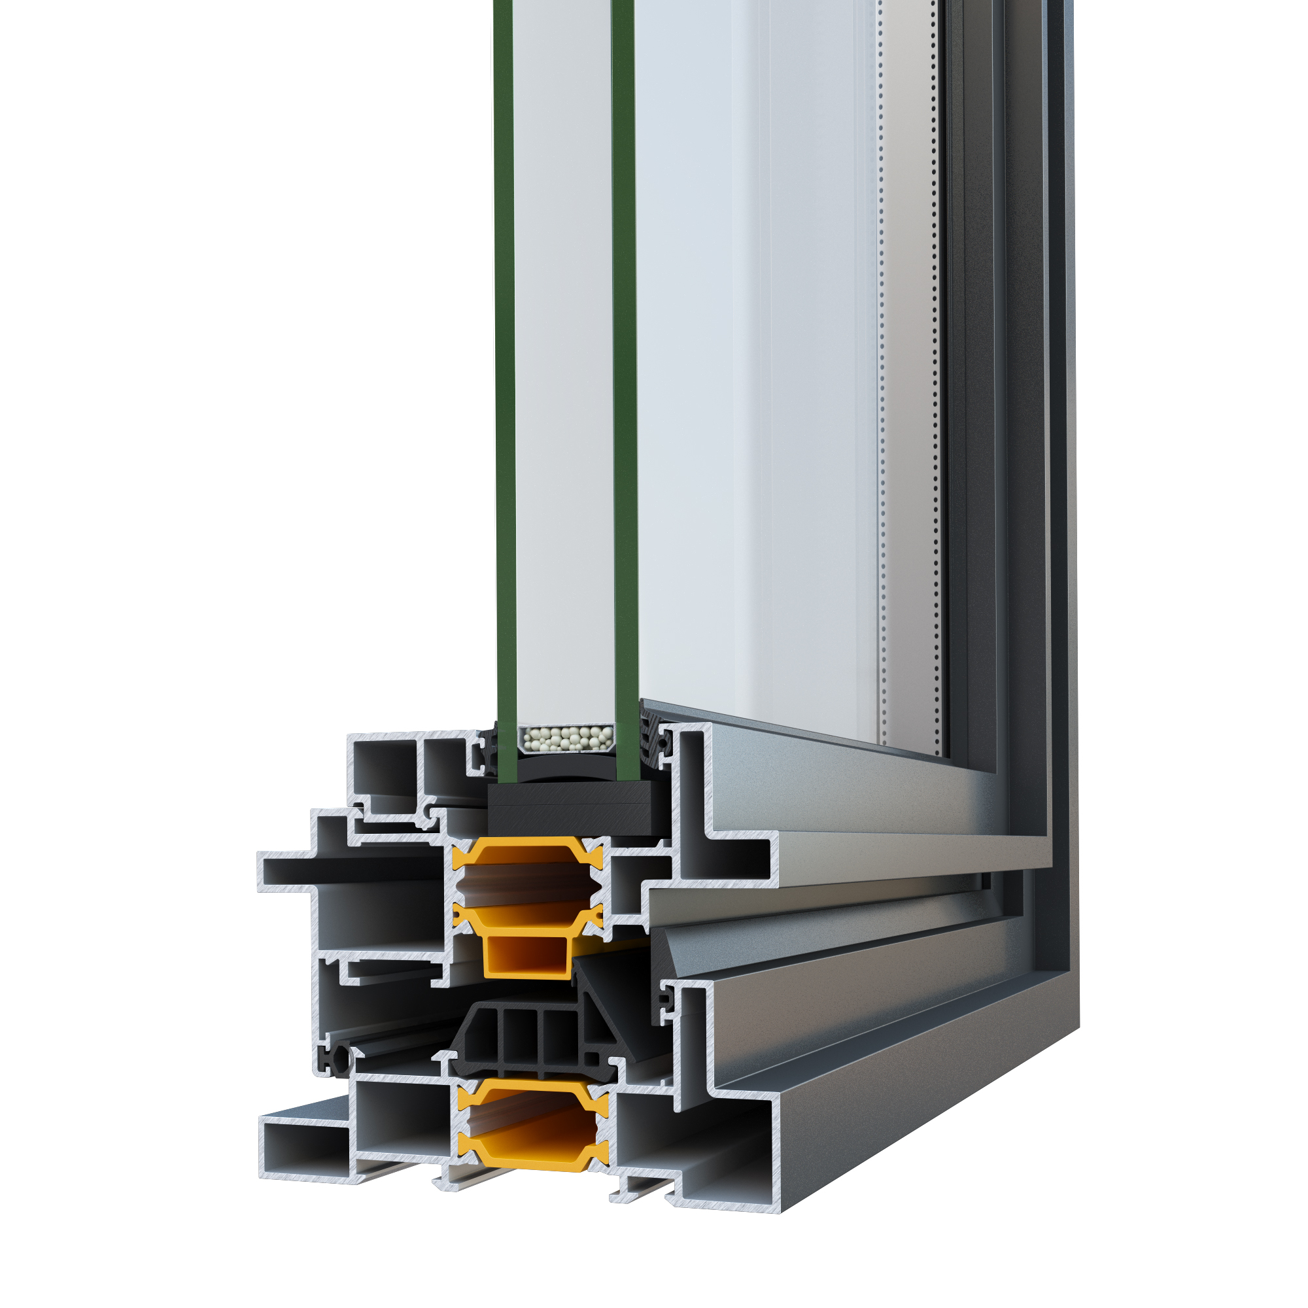
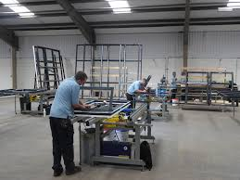

Benefits per Customer Persona
Fabricators
Fixed cost of profiles due to sales per meter €/m (no hidden charges due to packaging)
Use of an advanced and diversified product that many competitors don’t have in their range.
New market opportunities since fabricators can now be involved in projects that industrial look of windows is required.

Slide 35
Benefits per Customer Persona
Fabricators
Different versions of product, by using concealed or standard mechanism, make S67 Urban an extremely competitive system.
Reduce inventory cost by using same accessories(corners and gaskets) with S67
Reduce cost of fabrication by using same crimping knifes like S67.

Slide 36
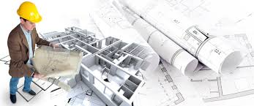
Benefits per Customer Persona
Architects
Product that helps architects to enrich their range of options with a system that successfully combines the classic with the modern.
Variety of architectural solutions providing a complete range of hinged typologies

Slide 37
Benefits per Customer Persona
Architects
Plethora of options in terms of appearance and aesthetics, including concealed hinges, minimal handle and creation of small glass panes with the use of adhesive muntins.
Ideal product for renovation since S67 URBAN replicates the industrial style and look of steel windows, along with added benefits of thermal insulated aluminium windows.

Slide 38
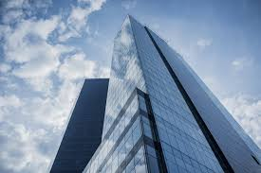
Benefits per Customer Persona
Home Owners-Investors
Product that responds to the increasing trend of industrial design.
Energy saving due to high performances in terms of air and water permeability and thermal insulation.
Ideal product for renovation since S67 URBAN replicates the industrial style and look of steel windows along with added benefits of thermal insulated aluminium windows.
Highly competitive product in terms of cost compared to similar systems.

Slide 39
Available marketing material
Technical brochure, available in Sharepoint
Technical catalogue, available in Sharepoint
Pre-Qualification Brochure
U-shaped sample

Slide 40
Thank you for your attention

