Slide 1


Slide 2
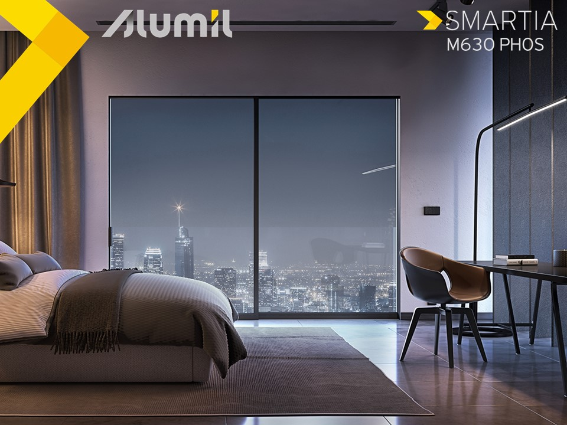
What
Thermally insulated sliding system
Minimal aesthetics similar to S650 PHOS
Competitive price similar to S560

Slide 3
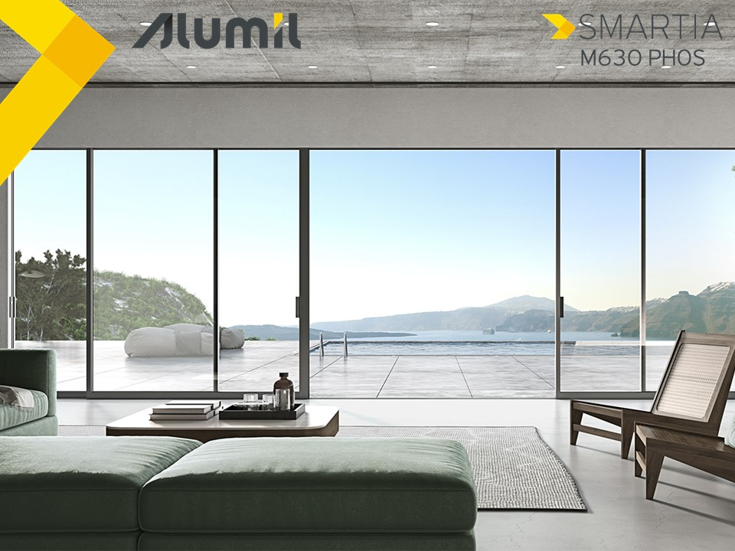
Why
An economical solution for minimal thermally insulated windows
Gain market share from competitors with similar systems in LSP and residential market
SMARTIA system available to all fabricators so as to penetrate the market efficiently

Slide 4

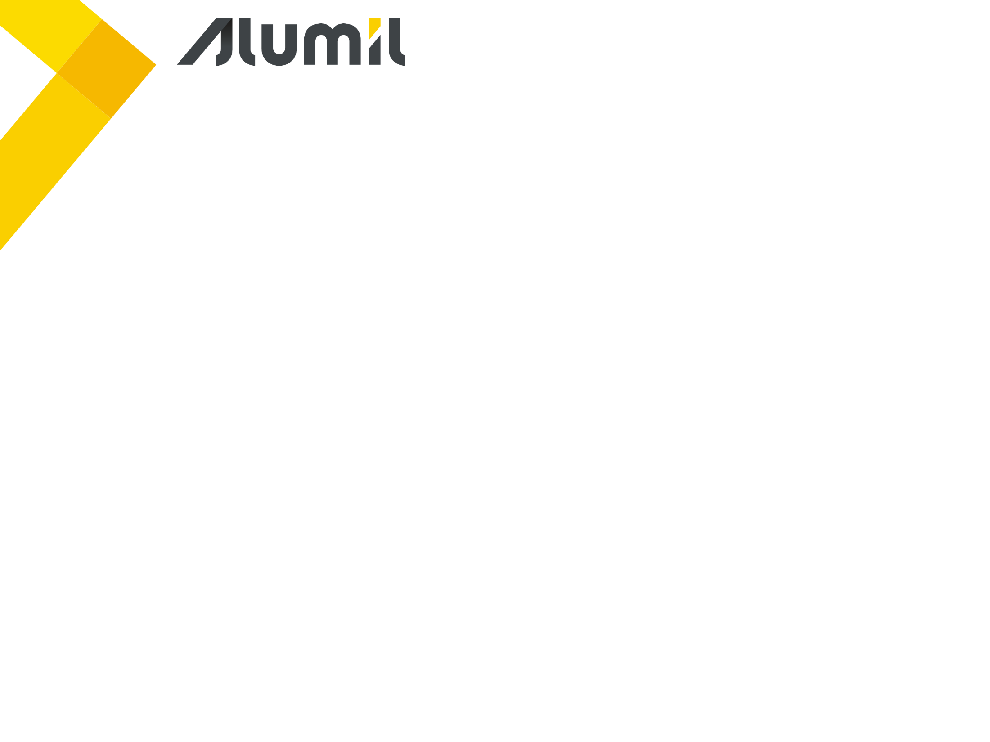
Benefits

Slide 5
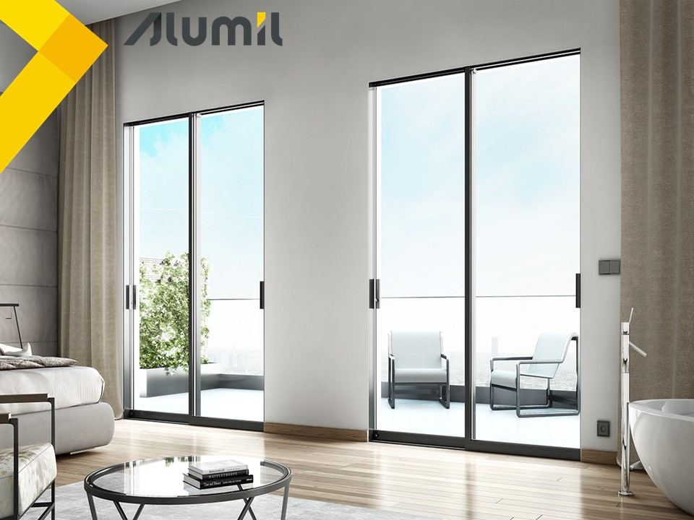

Benefits
Minimal design with concealed frame
5
Total comfort thanks to the high sound reduction level
1
Maximum visibility & sense of freedom
6
Energy & cost saving thanks to the high thermal insulation
2
4
High security with multi-locking mechanism
Easy & safe access with flat frame flush to the floor
3

Slide 6
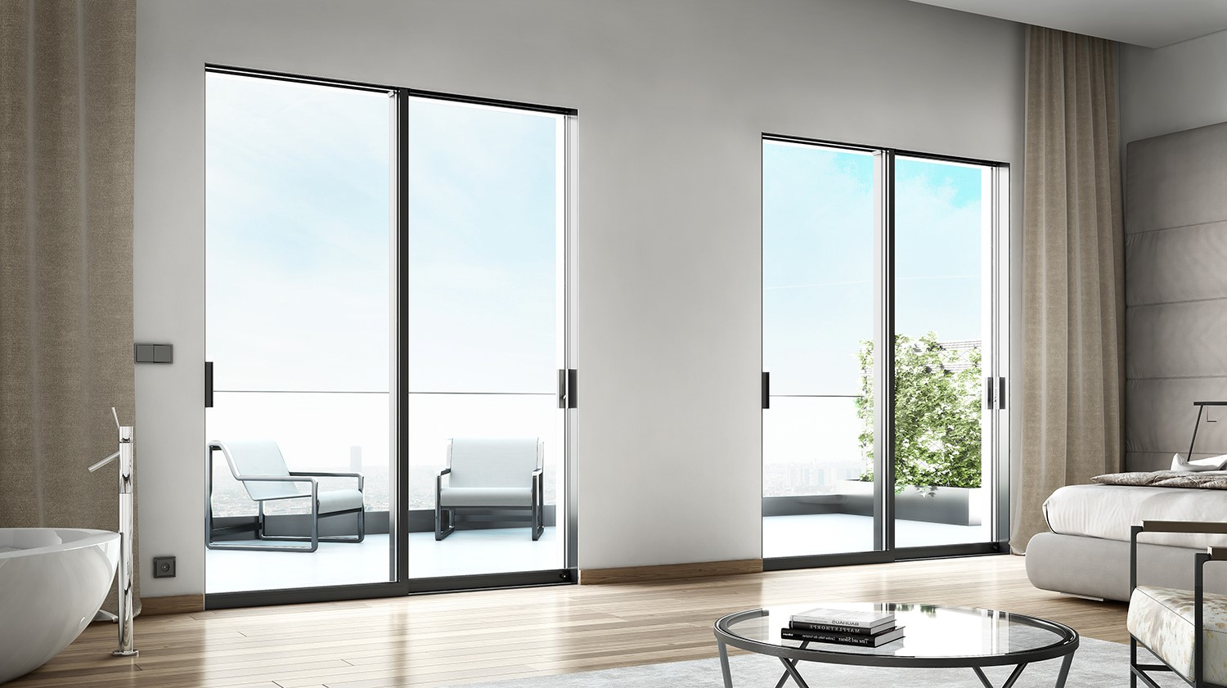

Benefits
Total comfort
Sound reduction 42dB
Certified performance from the Aristotle University of Thessaloniki
IGU 32mm
Minimal installation with concealed frames
Notes:
IGU = Insulated Glass Unit

Slide 7
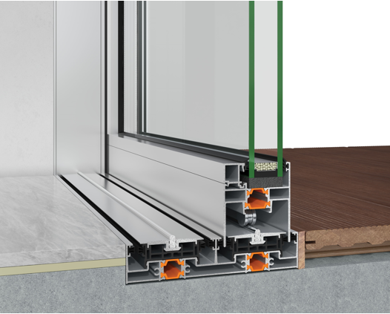
Benefits
Energy & cost saving
Thermal insulated profiles
Fiberglass reinforced polyamides 24 & 20 mm width
PVC profiles at the bottom frame & at the interlocking profile
IGU 32 mm
Notes:
IGU = Insulated Glass Unit

Slide 8



Benefits
Easy & safe access
Easy access with total flat frame
Ideal for children, elders & people with disabilities
On-floor installation with only 32mm frame height
Ideal for renovations
32mm

Slide 9
Benefits
High security
Multi-locking mechanism with 5-year guarantee from ALUMIL
Difficulty to push up the sash with the extra anti-lift accessories of the mechanism for maximum security

Slide 10
Benefits
Minimal design
74mm
PHOS series with less visible aluminium surfaces
Maximizing glass pane
Concealed sash into the frame
Concealed frame into the ceiling and the walls
63mm
95mm

Slide 11
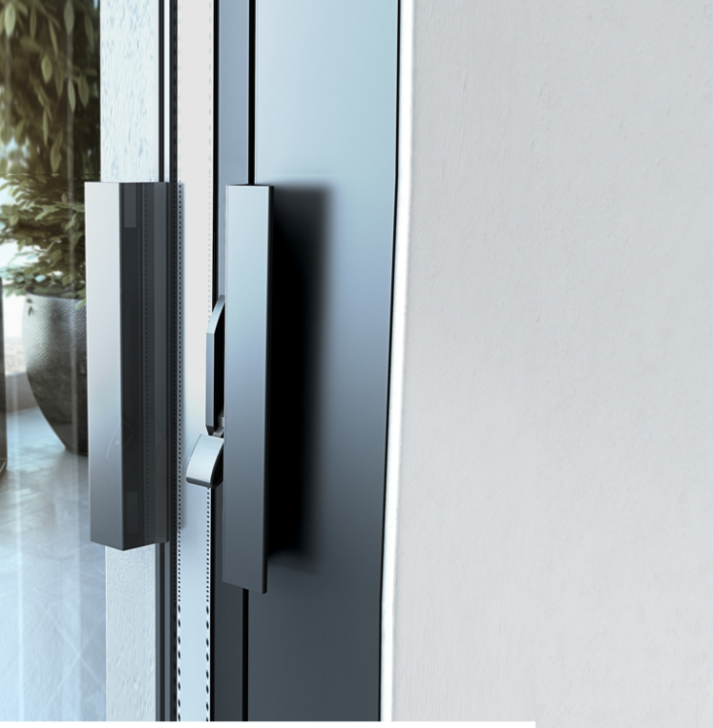
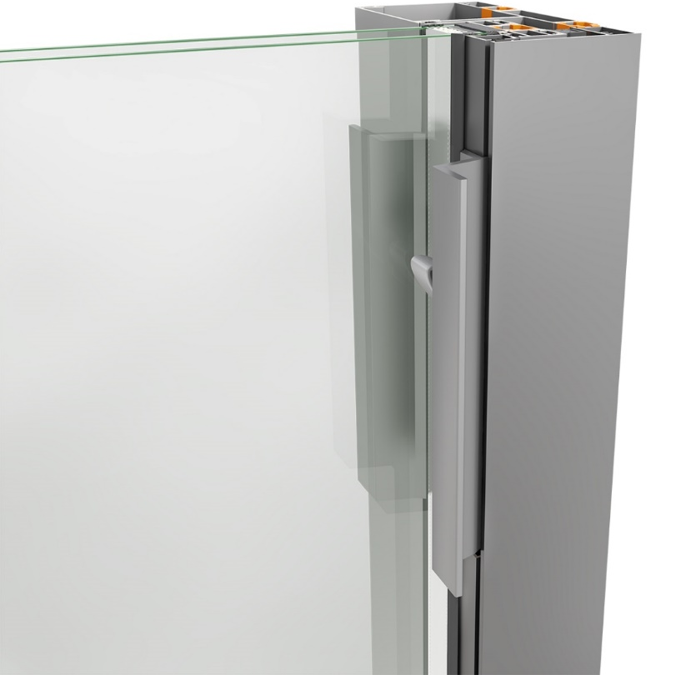
Benefits
Maximum natural light and sense of freedom
Standard version
Frame is visible all around with 74mm aluminium width
Frame flush to the wall
74 mm
Minimal version
Frame is concealed all around with plasterboard

Slide 12
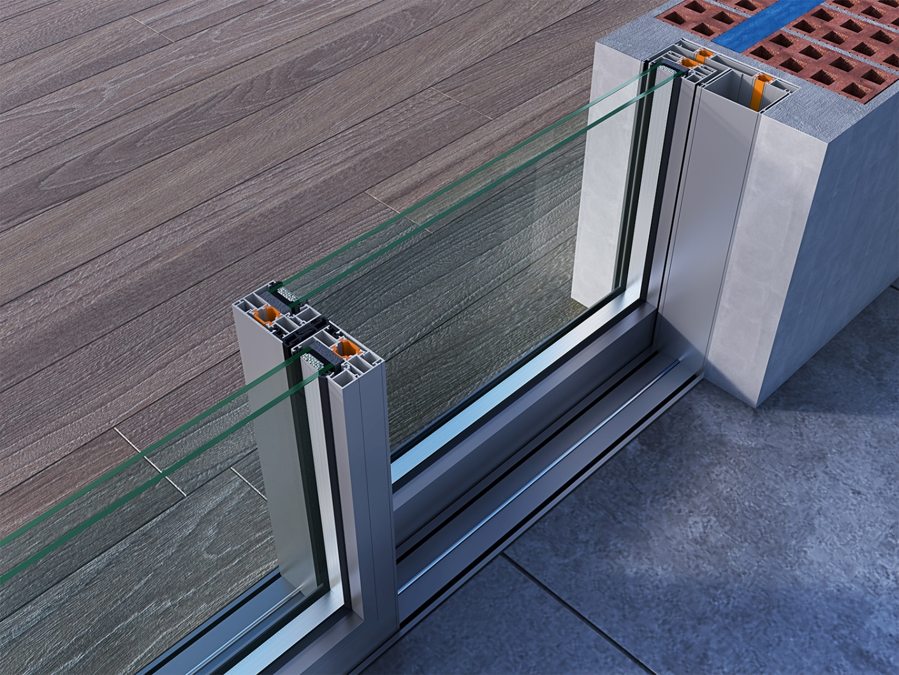
Benefits
Maximum natural light and sense of freedom
Narrow interlocking profile with 44mm visible face width
44mm

Slide 13

Attention to detail

Slide 14
Attention to detail
Technical characteristics
Visible frame-sash height 63/94mm
Frame height 32 mm
Frame width 155 mm
Sash width 63 mm
Interlocking profile width 44 mm
Sash weight up to 250 Kg
Glazing width 32 mm
Thermal insulation Polyamides, PVC
63mm
94mm
32mm
155mm

Slide 15
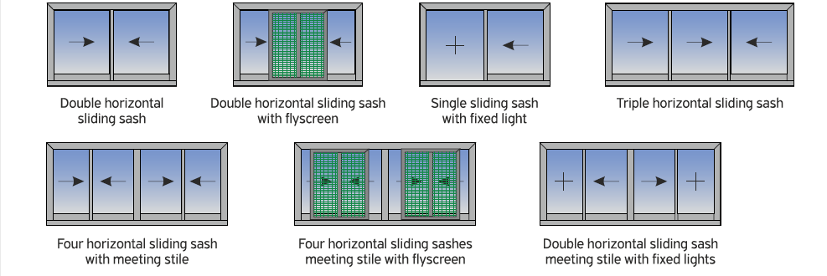
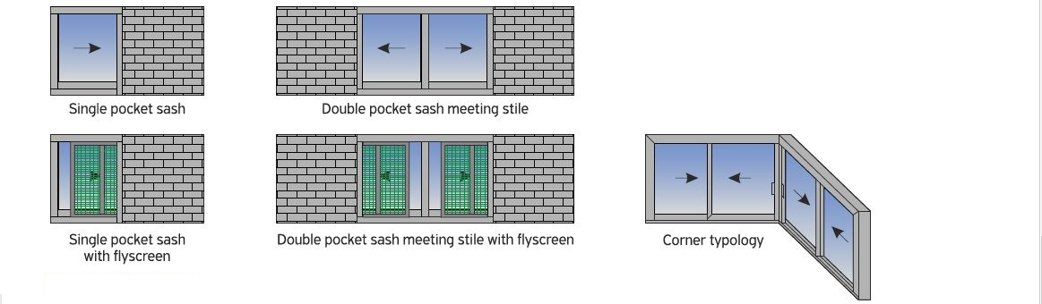
Attention to detail
Available typologies
Double track
Triple track
Meeting stile
Flyscreen
Pocket typology
Corner typology

Slide 16
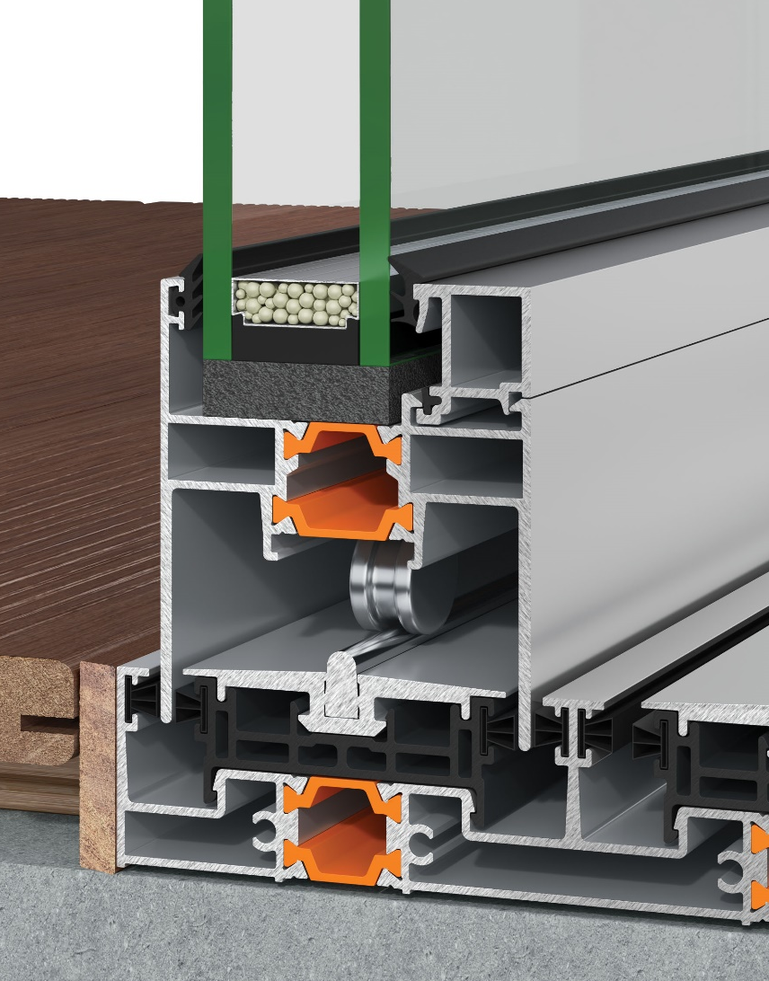
Attention to detail
Glazing
Use of glazing bead for easy glazing installation and sash fabrication
Glazing thickness up to 32mm maximum

Slide 17
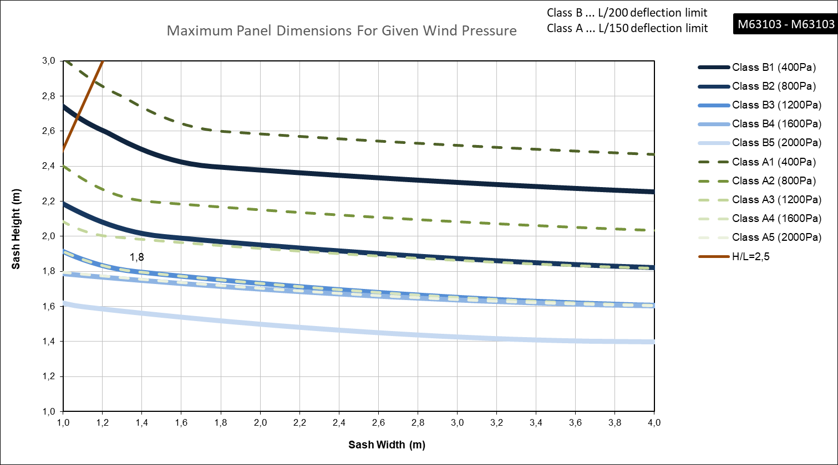
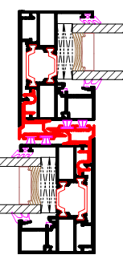
Attention to detail
Static loads

Slide 18
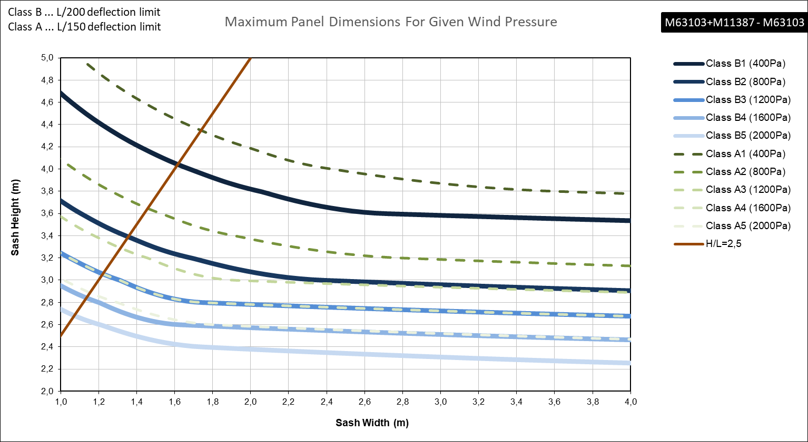
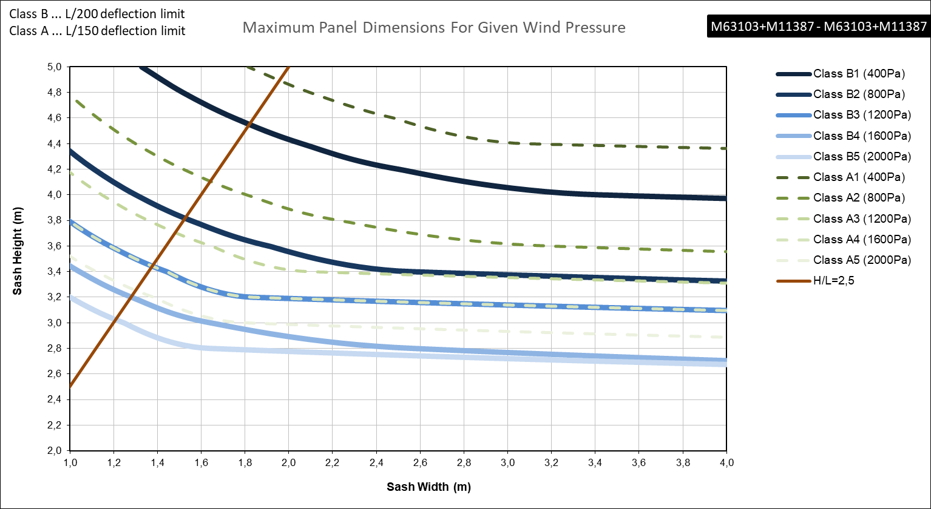
Attention to detail
Static loads

Slide 19
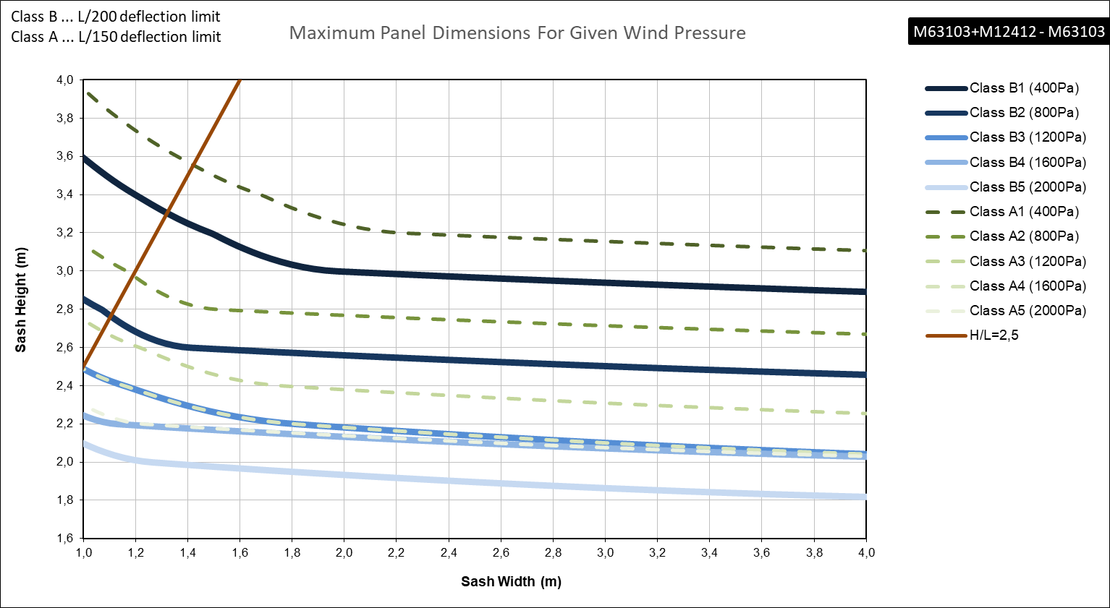
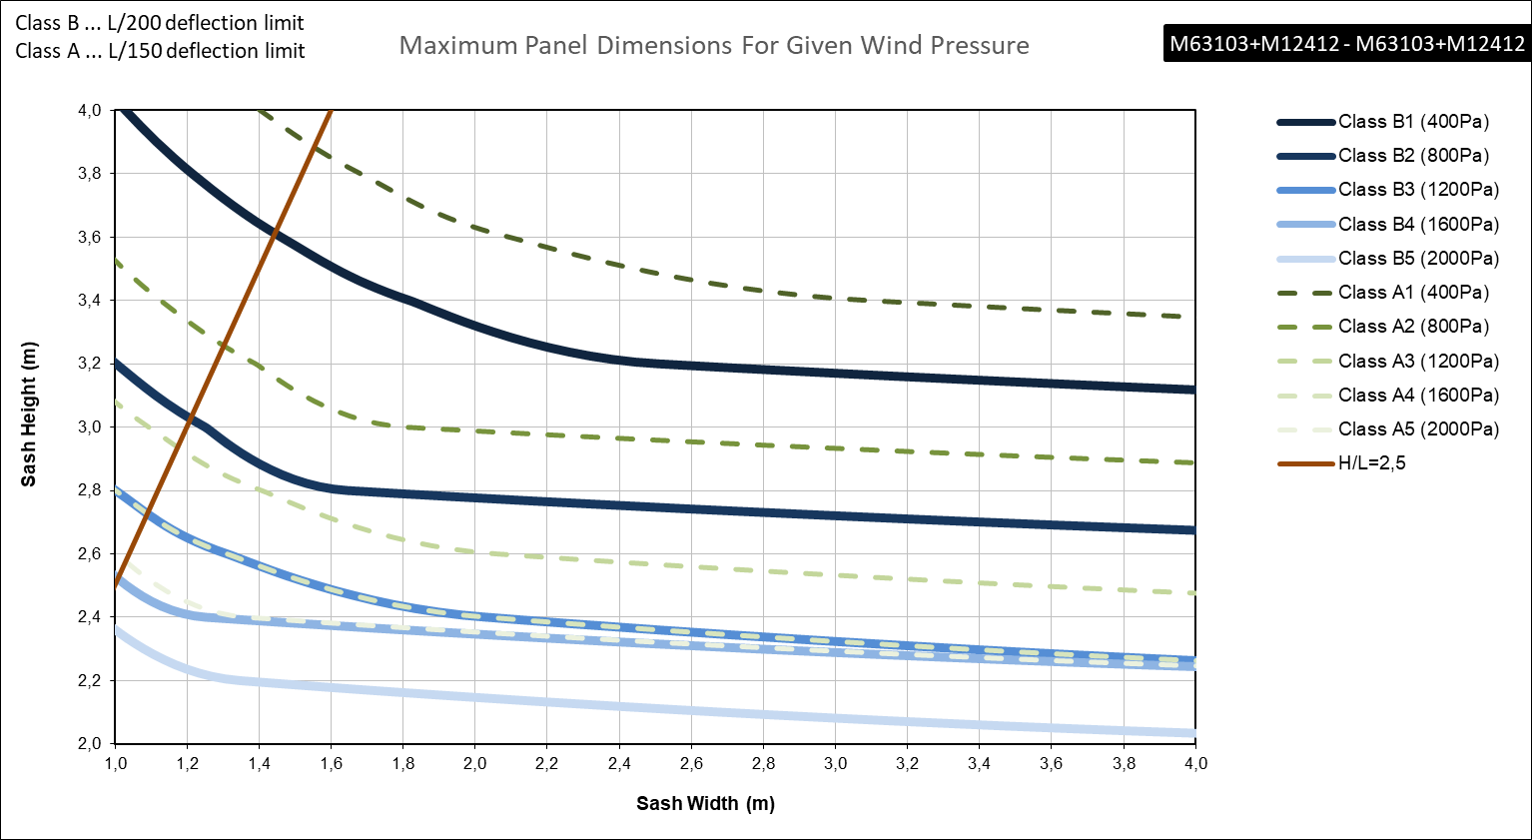
Attention to detail
Static loads

Slide 20
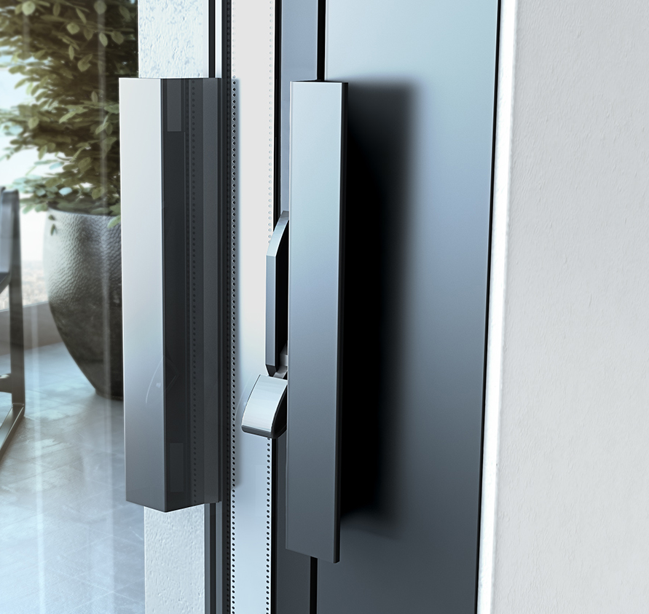
Attention to detail
Locking mechanism
International patented locking mechanism
Minimal aluminium handle designed & developed by ALUMIL

Slide 21
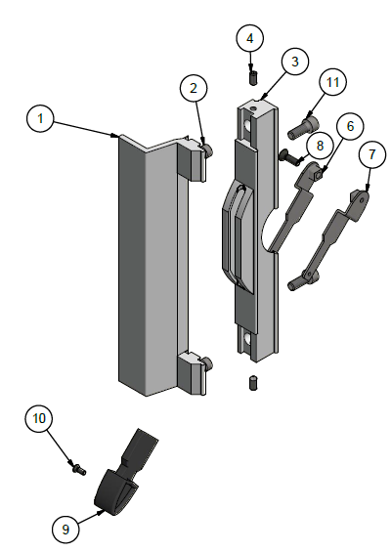
Attention to detail
Locking mechanism
Available in powder coating (black, white & silver)
Easy installation on site
Easy replacement

Slide 22
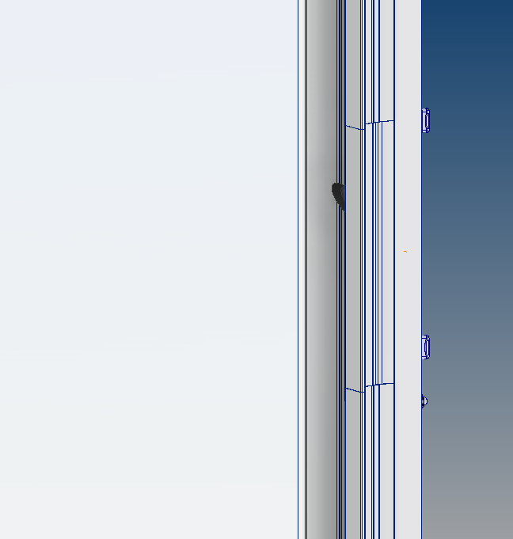
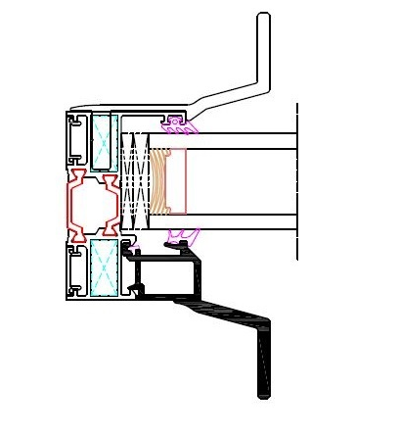
Attention to detail
Locking mechanism
Alternative design with the handle having same height with the total height of the sash
Place the standard handle
Above and below the handle, place the glazing bead M63177 that has the same geometry with the internal handle
Creates the continuity of the handle and offers advanced aesthetics

Slide 23
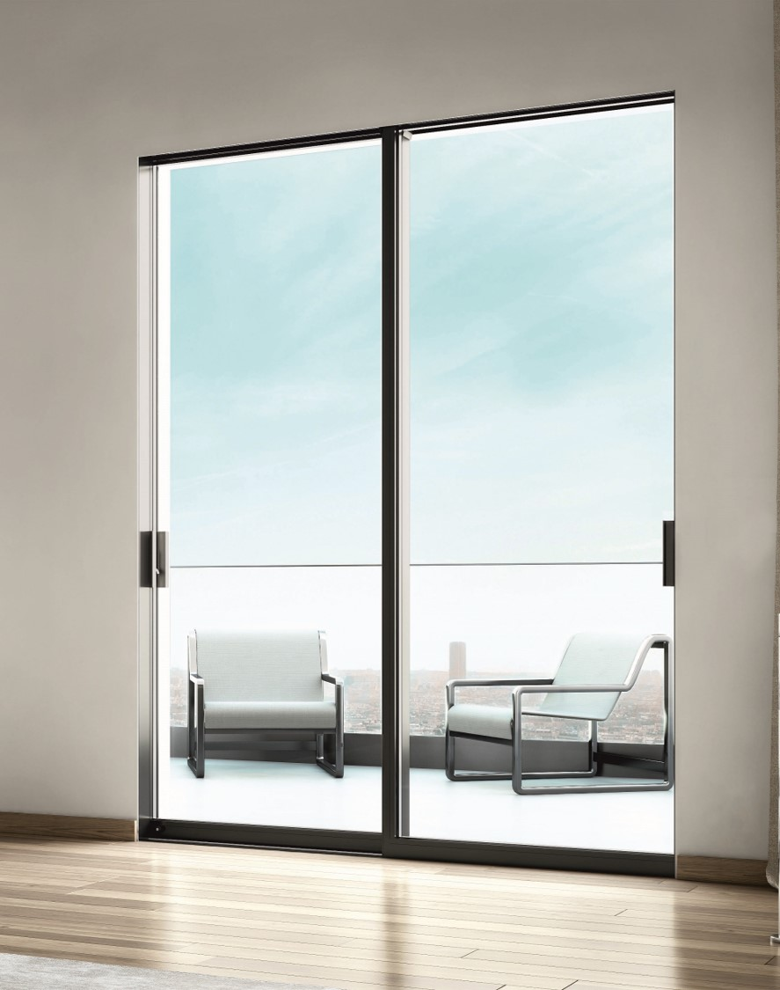
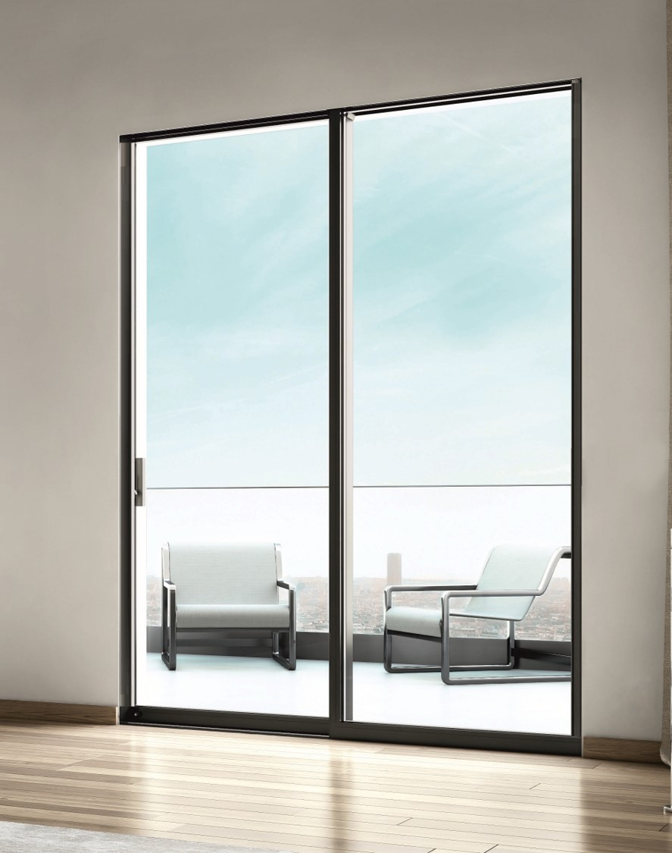
Attention to detail
Locking mechanism
Without M63177
With M63177

Slide 24
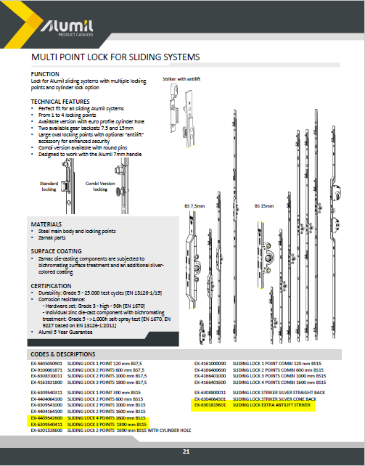
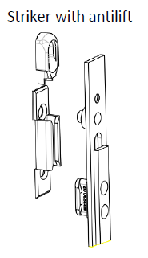
Attention to detail
Locking mechanism
Multi-point lock
Wide range of locks from 300 mm sash height (developed by GU specific for ALUMIL)
From 1 up to 4 locking points
Anti-lift striker for enhanced security

Slide 25
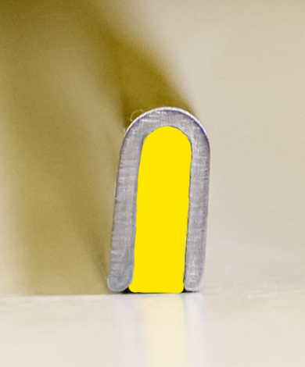
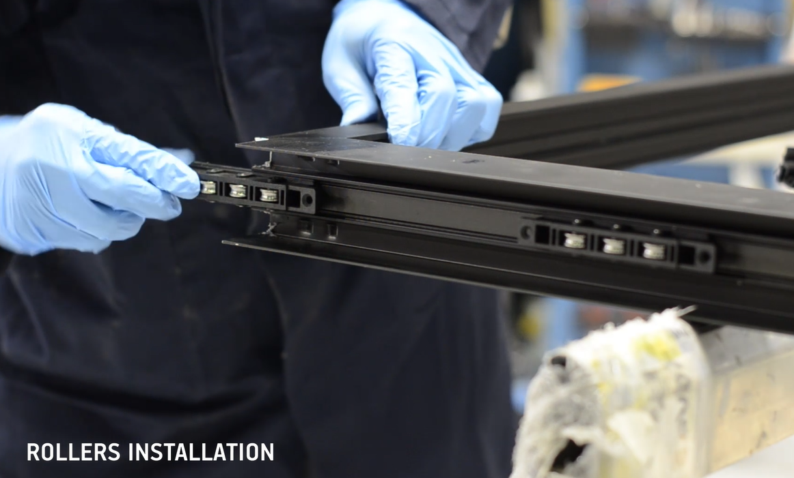
Attention to detail
Gliding
Maximum weight per sash up to 250 Kg
Stainless steel rollers
Use of heavy duty inox rail or U-type inox rail with reinforcement

Slide 26
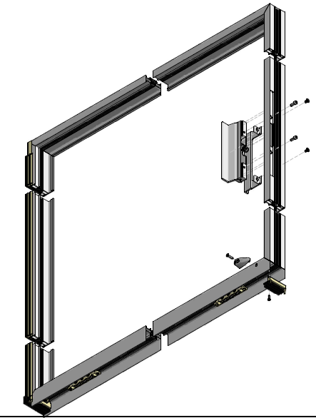
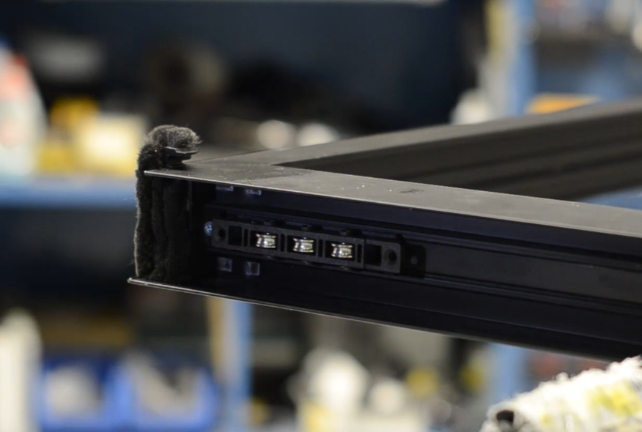
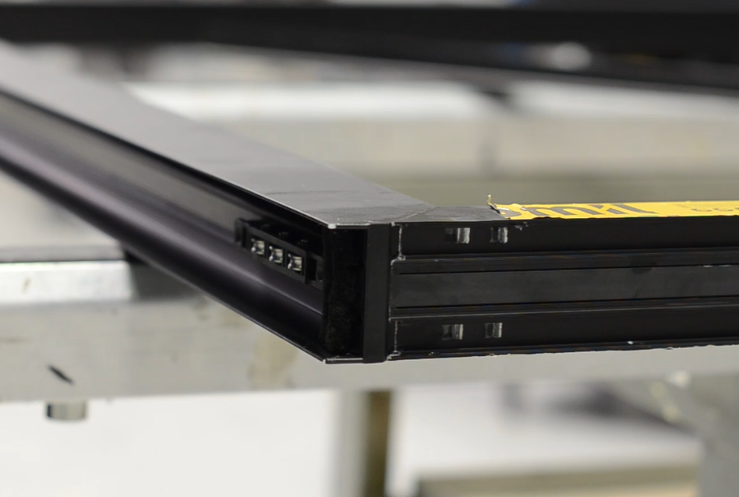
Attention to detail
Gliding
At the bottom of the sash brushes placed at both right & left edge caps protect the rollers from dirt & dust

Slide 27

Functionality & credibility

Slide 28
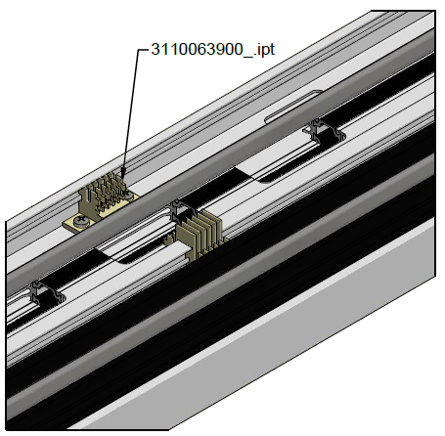
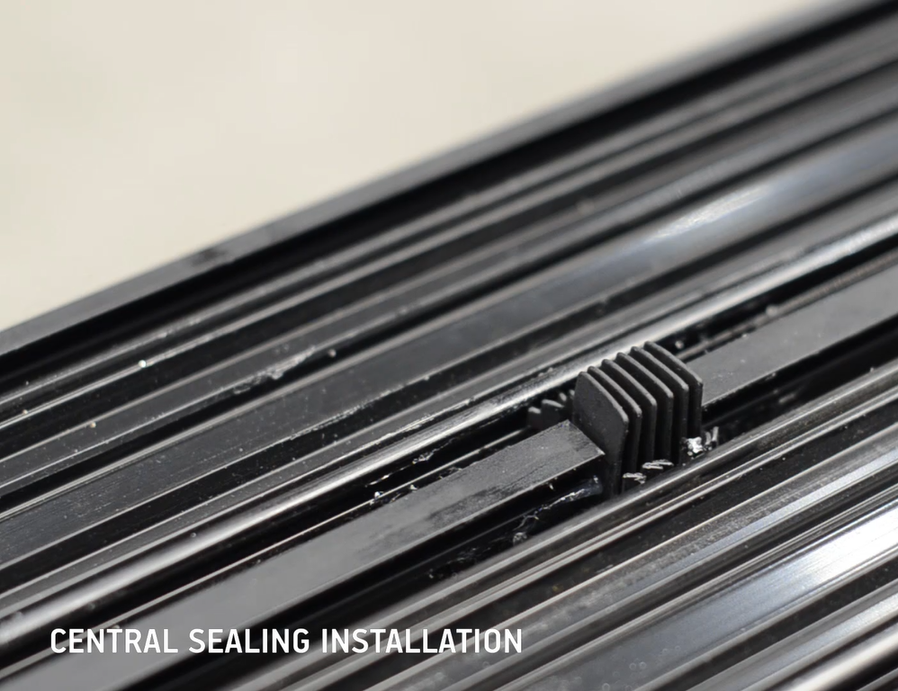
Functionality & Credibility
Central sealing
Set of central seals for the intermediate & the external part of the bottom frame

Slide 29
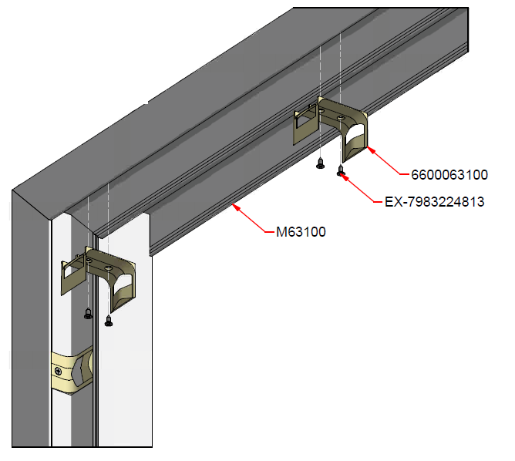
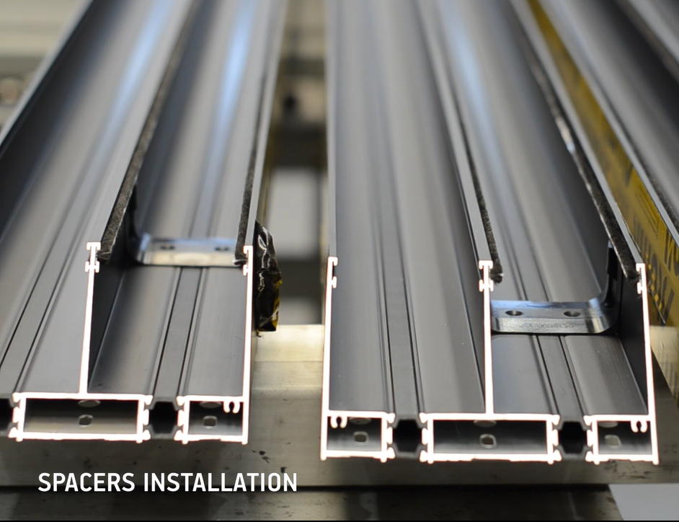
Functionality & Credibility
Central sealing
Sash spacers are installed into the frame
Alignment of the sash
Sash anti-lift

Slide 30
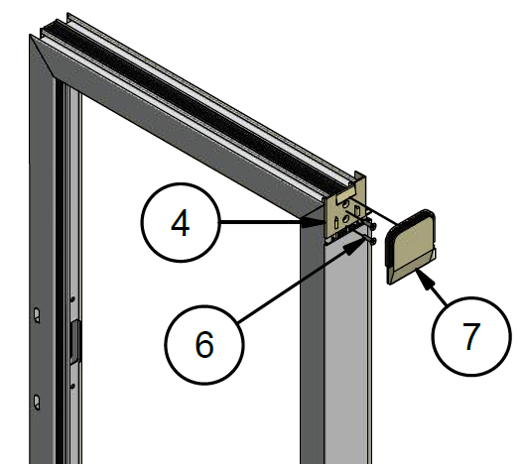
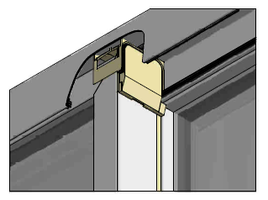
Functionality & Credibility
Central sealing
At the upper side of the frame the brushes of the cap of the interlocking profile seal with the spacer

Slide 31
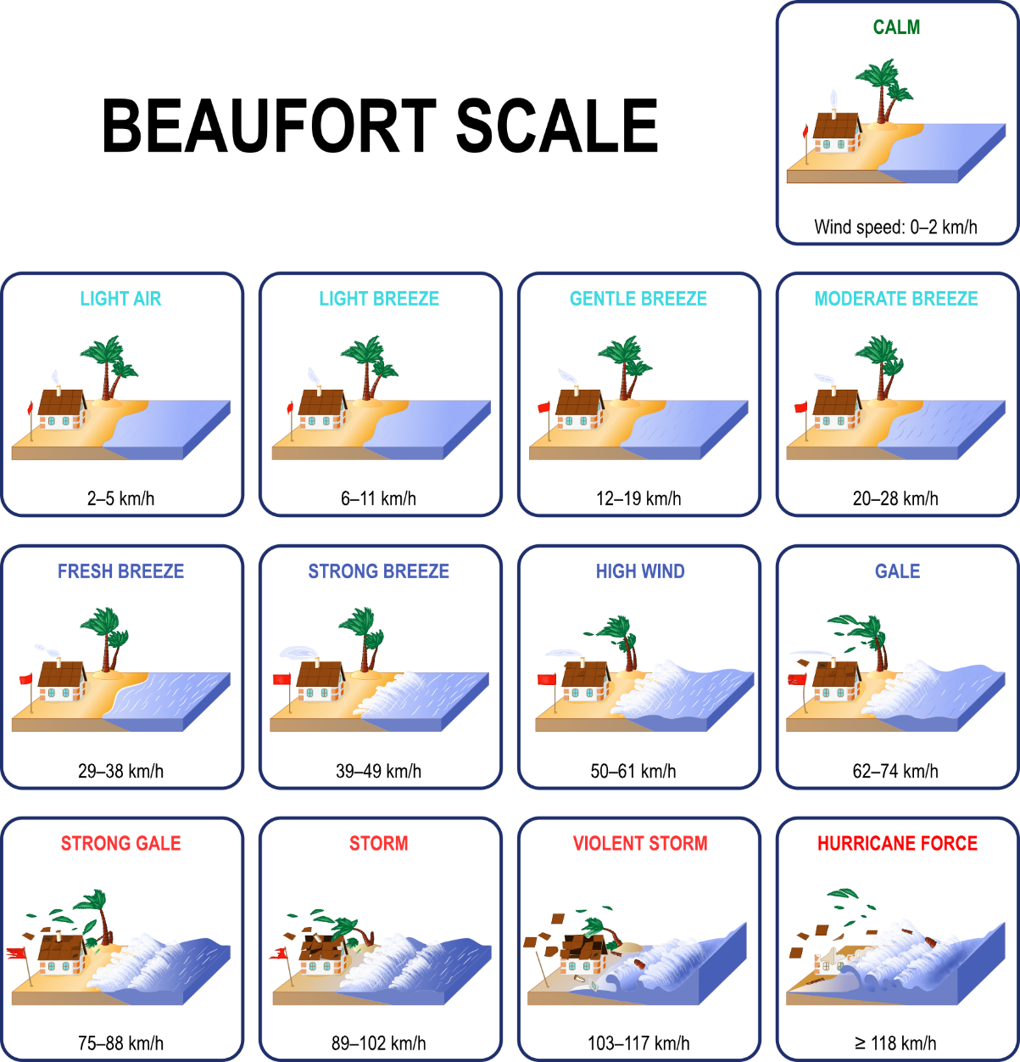
Functionality & Credibility
0
Water evacuation
The low frame 32mm is certified up to 9 Bf (strong gale)
Wind speed 79,6 Km/h
Watertightness 300 Pa (class 7A)
1
2
3
4
5
6
7
8
9
10
11
12

Slide 32
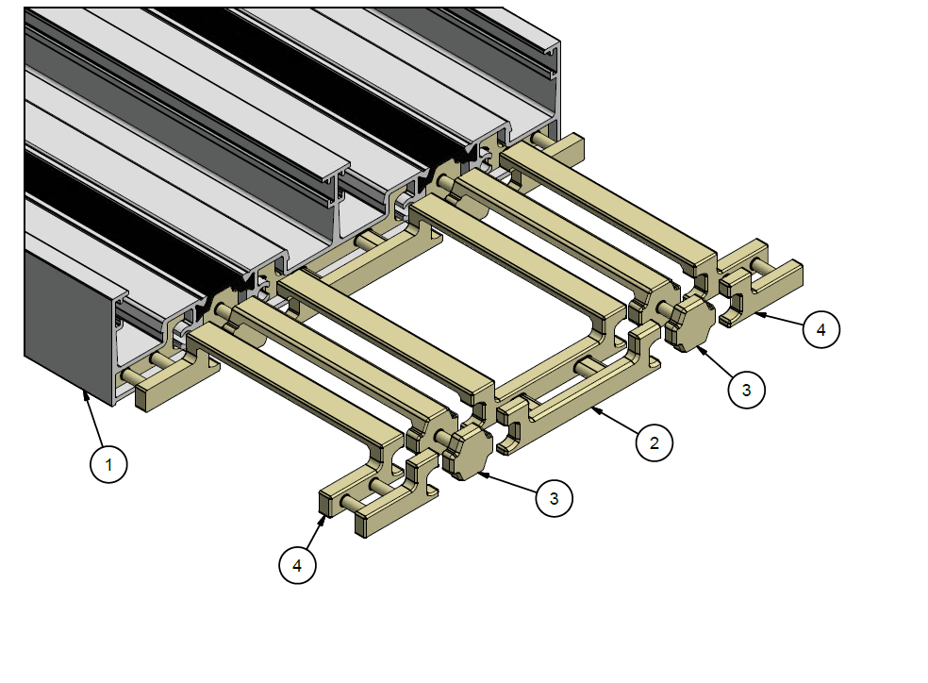
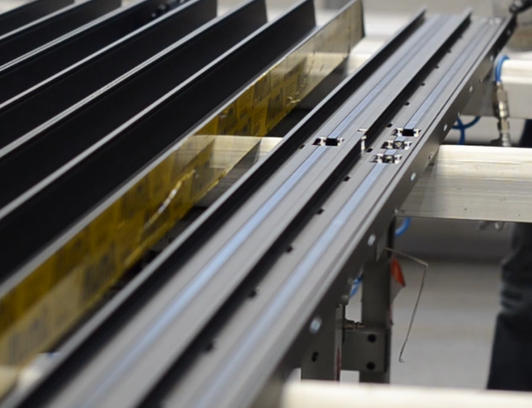
Functionality & Credibility
Water evacuation
Special barriers placed at the chambers of the low bottom frame
For double and triple frame

Slide 33
Functionality & Credibility
Water evacuation
Subsill profile for vertical water drainage
Alternative option for easier fabrication

Slide 34
Functionality & Credibility
Water evacuation
External grid with Subsill profile for vertical water drainage
Alternative option for easier fabrication

Slide 35
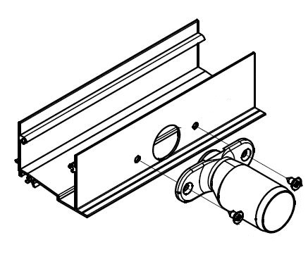
Functionality & Credibility
Water evacuation
External grid with Subsill profile for vertical water drainage
Available drainage adaptor D25/D32
Facilitates water drainage through the subsills of SMARTIA M630 and SMARTIA S560LT series

Slide 36
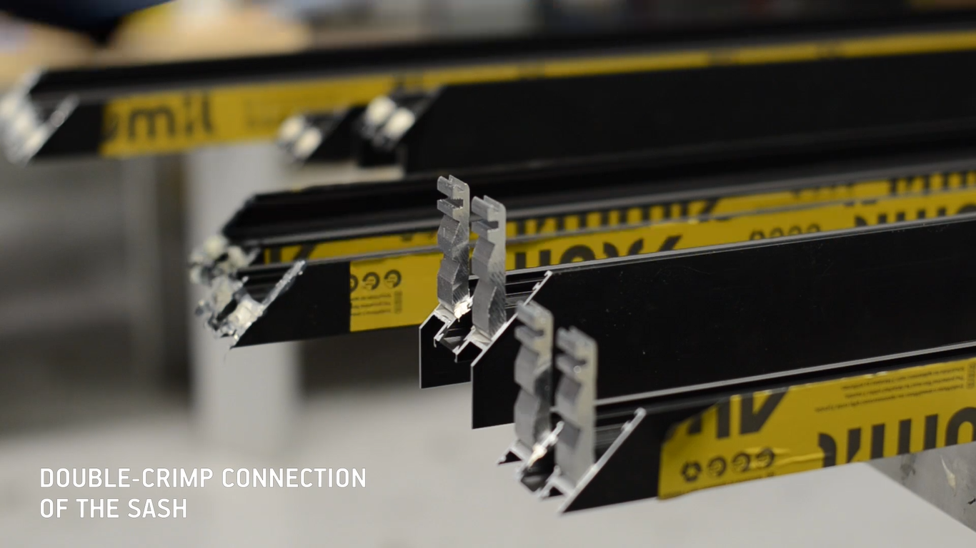
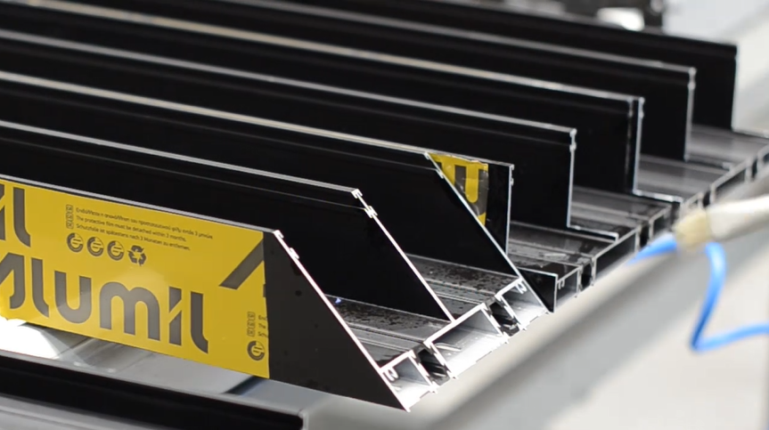
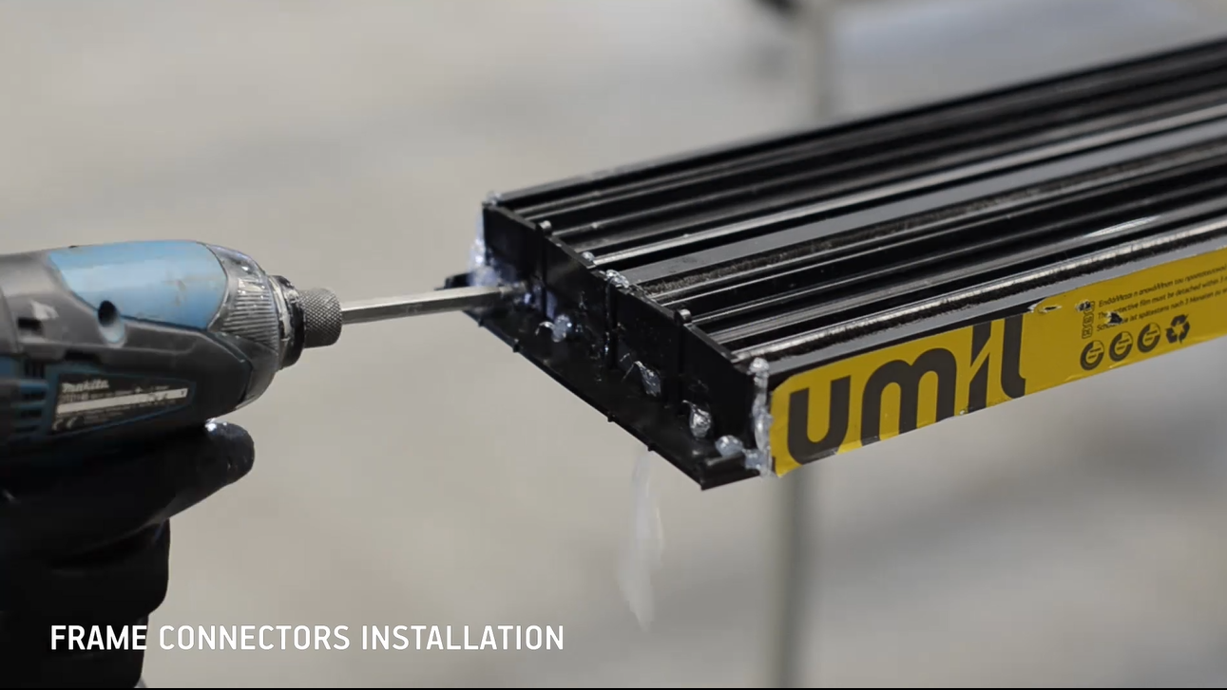
Functionality & Credibility
Fabrication
45º connection of the sash with crimp corners
45º connection of the frame with crimp or mechanical corners
90º connection of the frame with the low threshold with plastic cap connectors

Slide 37
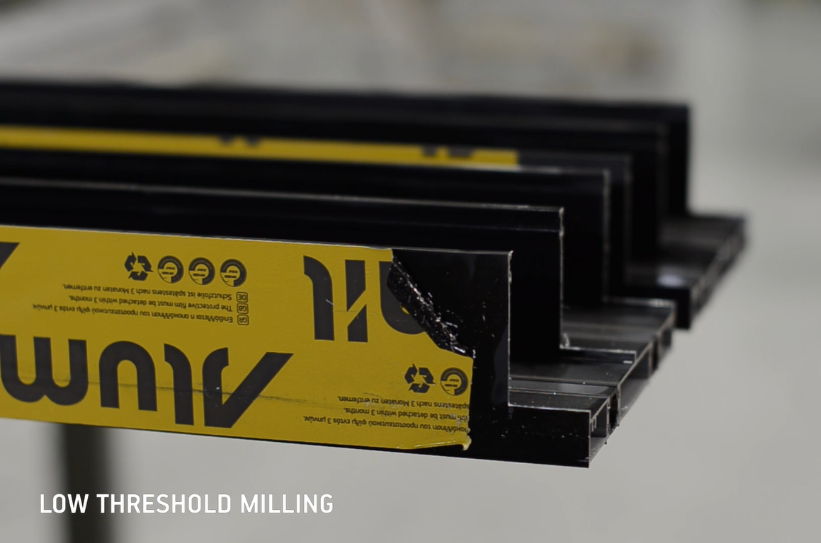
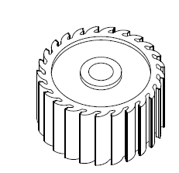
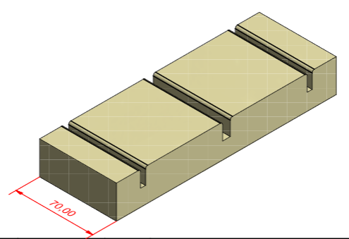
Functionality & Credibility
Fabrication
Set milling tool with spacer
Spacer is inserted into the profile to hold it straight while cutting with the milling tool

Slide 38
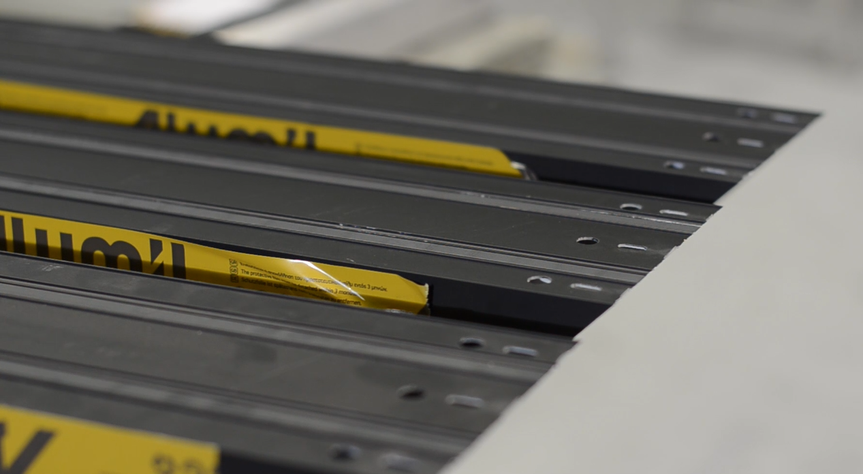
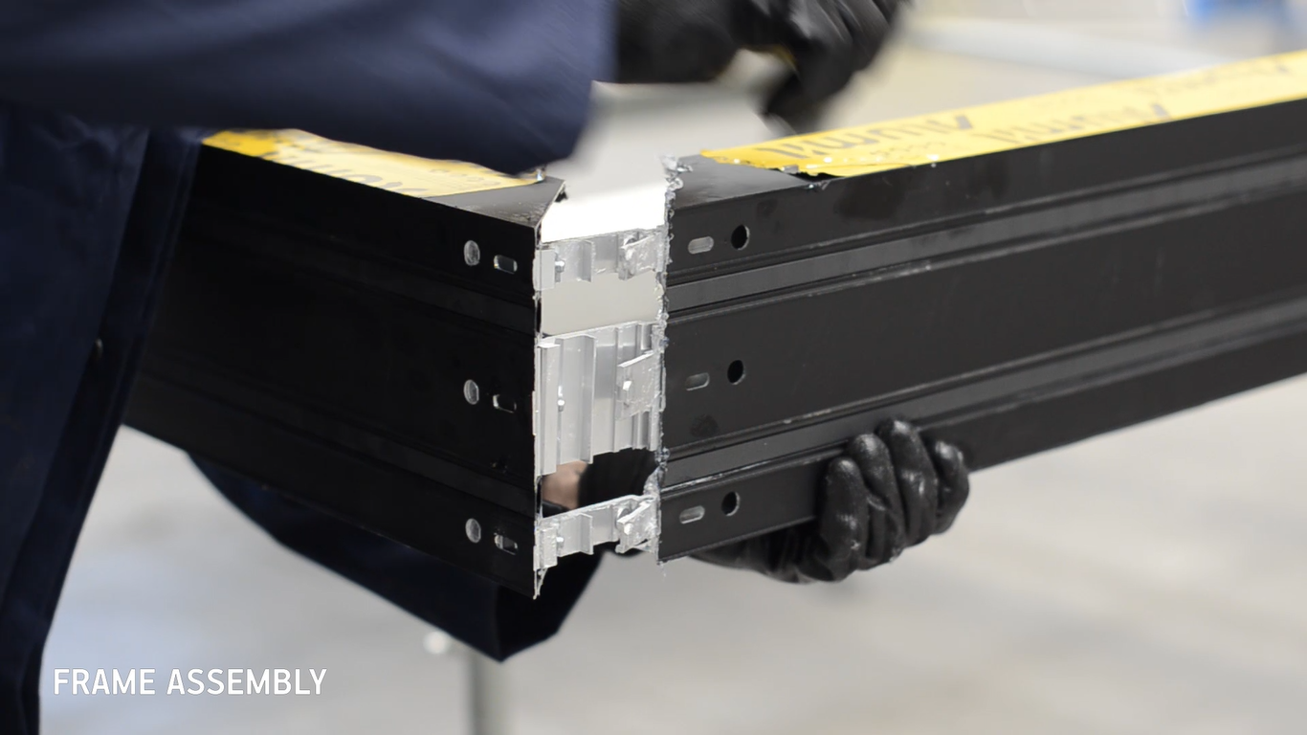
Functionality & Credibility
Fabrication
Punching machine for the mechanical corners treatment
Existing punching machines can be used

Slide 39
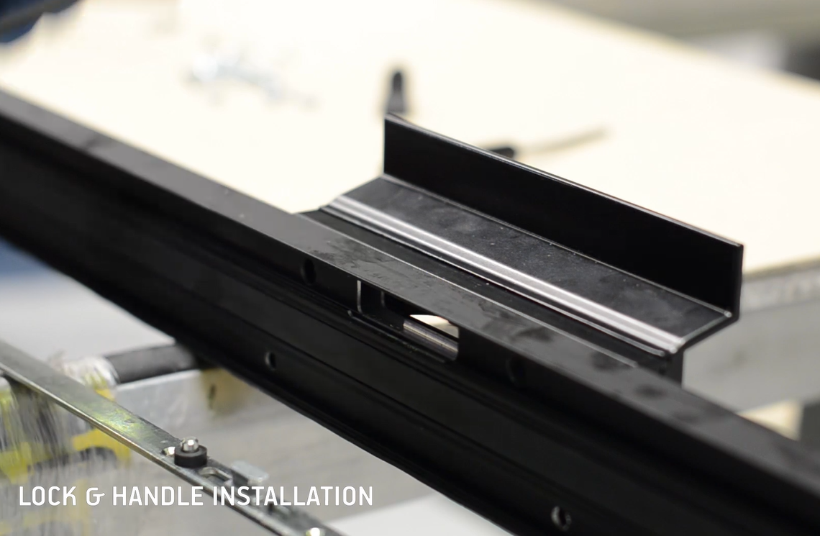

Functionality & Credibility
Fabrication
Special jig for the handle machinings
Reduces alignment faults of the internal & external handle

Slide 40


Functionality & Credibility
Thermal Insulation
 | Ug = 1,3 | Ug = 1,1 | Ug = 1,0 | Ug = 0,8
U_{w} | 1,69 | 1,52 | 1,43 | 1,26
For a 2-sash typology 3,00m x 2,20m (W x H) and psi = 0,035

Slide 41

Functionality & Credibility
Certifications

Slide 42

Commercial session

Slide 43

M630 vs ALUMIL series
SMARTIA
SUPREME

Slide 44



M630 vs ALUMIL series
Technical characteristics | SMARTIA S560 sliding | SMARTIA M630 | SUPREME S650 low threshold
Visible alu face width | 108,5mm | 63mm | 42,5mm
Frame height | 31mm | 32mm | 35mm
Frame width | 136mm | 155mm | 164mm
Sash width | 56mm | 63mm | 62mm
Interlocking width | 49/86mm | 44mm | 25mm
Sash weight (max) | 180Kg | 250Kg | 1000Kg
Glazing | Up to 45mm | Up to 32mm | 46mm
Thermal insulation | 24 & 16mm polyamides, PVC | 24 & 20mm polyamides, PVC | 22 & 18mm polyamides, PVC

Slide 45
M630 vs ALUMIL series
Performance | SMARTIA S560 sliding | SMARTIA M630 | SUPREME S650 low threshold
Air permeability | 4 | 4 | 3
Watertightness | 7A (300Pa) | 7A (300Pa) | 7A (300Pa)
Resistance to windload | C2 | C5 | C3
Sound reduction | 38dB* | 42dB | 41dB**
Burglar resistance | RC2* | - | RC2**
Thermal insulation Uw*** | 1,67 | 1,43 | 1,50
* Performance for S560 L&S with standard frame
** Performance for S650 with concealed frame (in-floor installation)
*** For a 2-sash typology 3,00m x 2,20m (W x H) with Ug = 1,0 W/m²K and psi = 0,035

Slide 46

Benefits
per personas
Fabricators
Differentiating in the market through minimal systems, following the modern architectural trends and with higher margins
Easy installation & maintenance
Fixed cost of sales due to sales per meter €/m
Product that meets a wide range of needs thanks to the variety of solutions
Increased clientele with minimal products ideal for hotel solutions & LSP

Slide 47
Benefits
per personas
Architects
Minimal design with extensive glazing surfaces for ‘transparent’ architecture
Differentiating in the market through brand new innovative solutions
Product that meets a wide range of needs thanks to the variety of solutions with modern, minimal design and the structures for people with special needs
Designing “green” buildings with energy / money saving systems
Satisfying their clients and increasing their credibility

Slide 48
Benefits
per personas
Home owners
Elegant coziness full of natural light thanks to the system's minimal design and the wide glazing surfaces
Cost & energy saving due to the great overall performance
Ease of use and long-lasting flawless functionality
Product that meets a wide range of needs thanks to the variety of solutions and the structures for people with special needs

Slide 49


Catalogs
Technical catalog
Fabrication manual

Slide 50


Promotional material
Pre-qualification brochure
Technical data sheet

Slide 51
Thank you
for your attention

