Slide 1


Slide 2
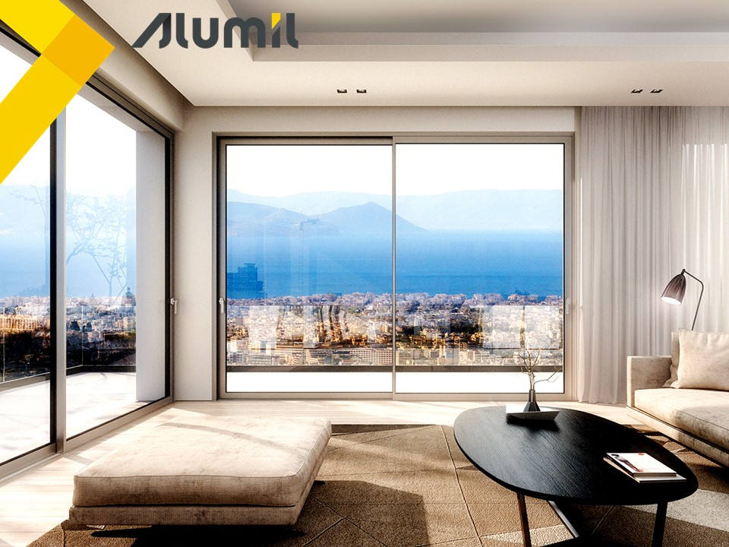
What
Thermally insulated sliding system
Modern flat design with minimum visible sightlines
Ease & flexibility of construction
Of the highest performance for its category

Slide 3
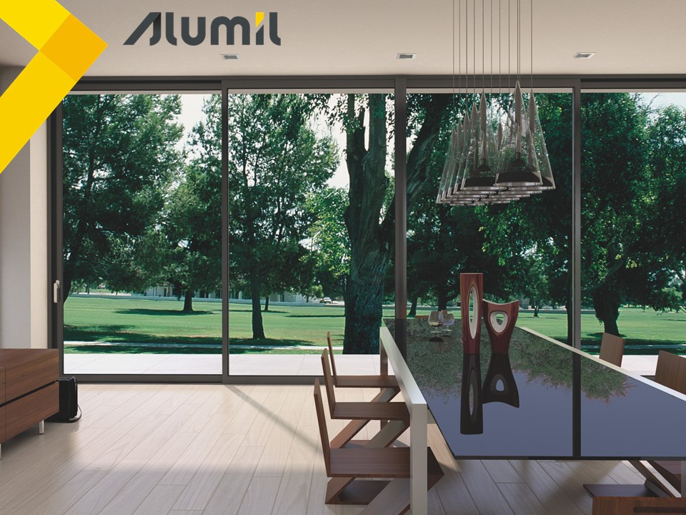
Why
A value for money solution for sliding thermally insulated windows & doors
Follows the architectural trends for less visible aluminium frames
Gain market share from competitors with similar systems in LSP and residential market

Slide 4


Benefits

Slide 5
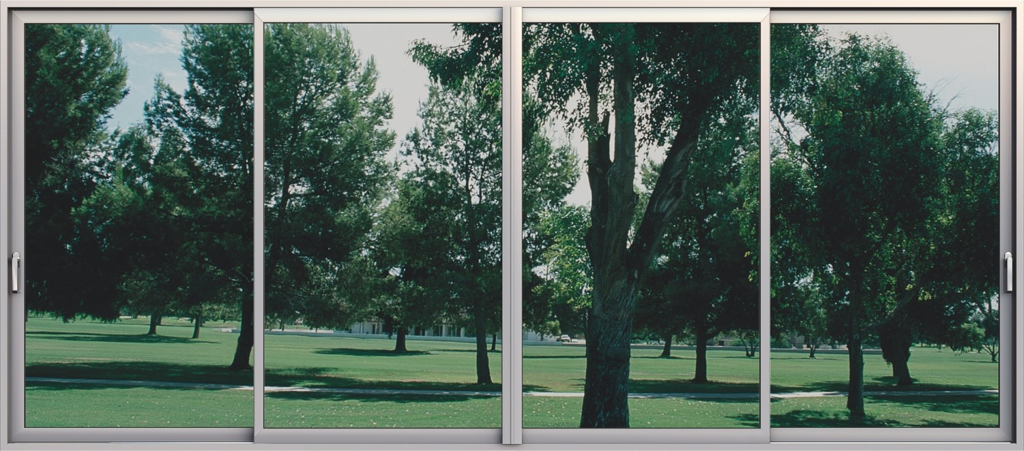
Energy & cost saving thanks to the thermally insulated profiles
Higher sound reduction with glazing up to 28mm
3
4
Maximum visibility with only 25mm sightline
High security with multi-locking mechanisms
5
1
Easy access with low threshold
2

Slide 6
Benefits
Maximum visibility
85 mm
76 mm
116 mm
107 mm
38mm
38 mm
Sash S350
Sash S350 LT

Slide 7
Benefits
Maximum visibility
Standard interlocking profile
S350
S350 LT
88,5mm
79,5mm

Slide 8
Benefits
Maximum visibility
Narrow interlocking profile
S350
S350 LT
50,5mm
25mm

Slide 9
Benefits
Maximum visibility
Adjoining profile
S350
102mm
S350 / S350 LT
162mm

Slide 10
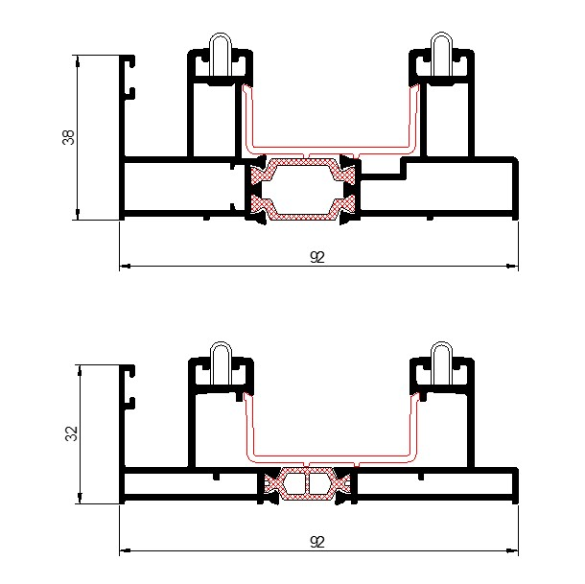
Benefits
Easy & safe access
Standard frame 38mm
Alternative use of low frame 32mm ideal for renovations
The only change is the height of the chambers
All sashes are applicable with both frames
S350
S350 LT

Slide 11
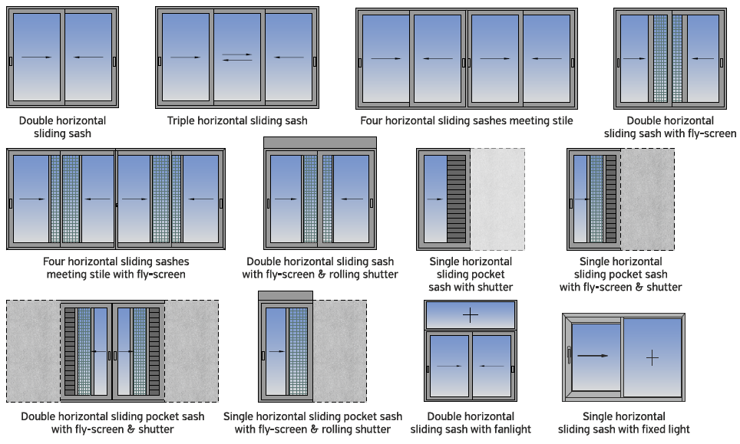
Benefits
Available typologies

Slide 12
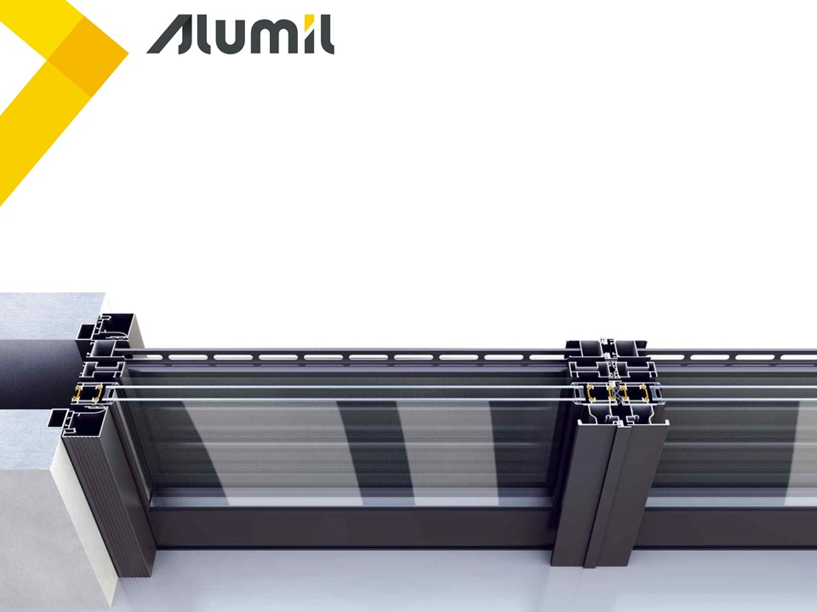
Benefits
Pocket typologies
Sash slides into the wall cavity
Ideally combined with sliding flyscreen & shutter

Slide 13
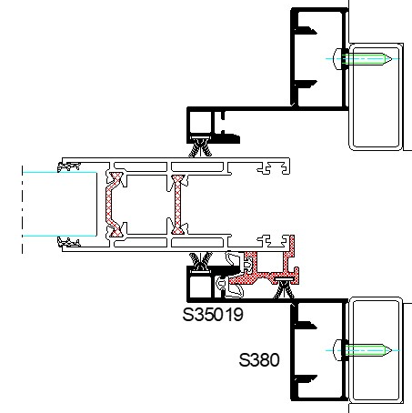
Benefits
Pocket typologies
Updated pocket cover profile that creates a hook with the pvc profile
Improved sealing with 2 rows of gaskets and brushes
Improved thermal insulation between wall and sash
Improved aesthetics between wall and sash

Slide 14
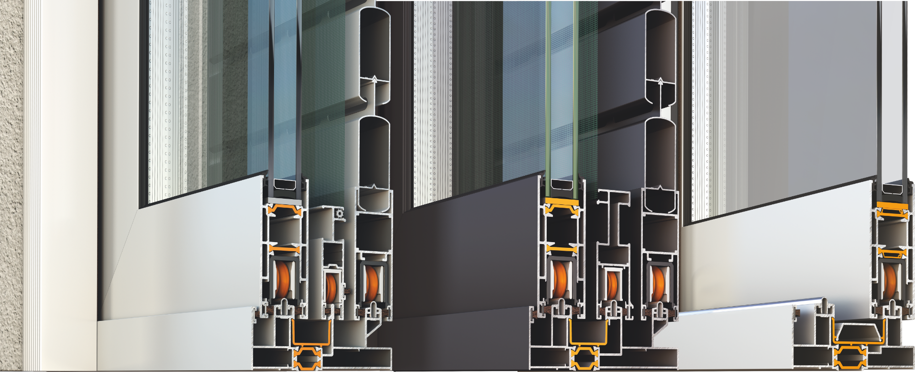
Benefits
Flyscreen
Two types of flyscreens:
Heavy duty S490
Light M868
PVC accessory to hold the insect screen fabric for:
High aesthetics
Improved fabric stretch
Available in 3m bars

Slide 15
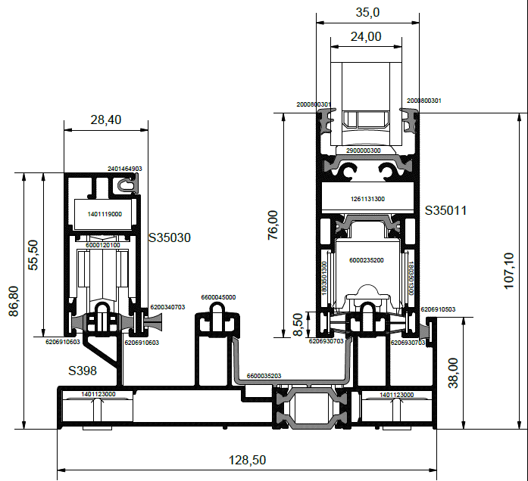
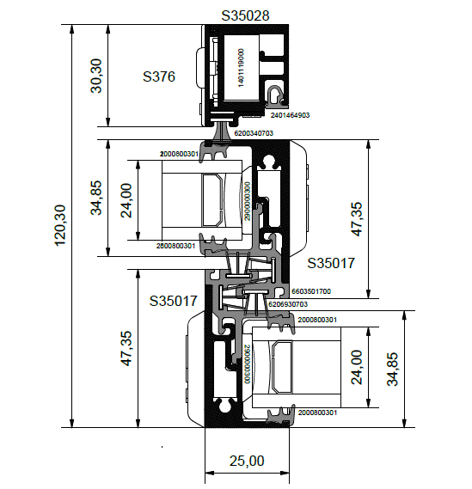
Benefits
Flyscreen
Narrow flyscreen for S350 LT with narrow interlocking 25mm

Slide 16
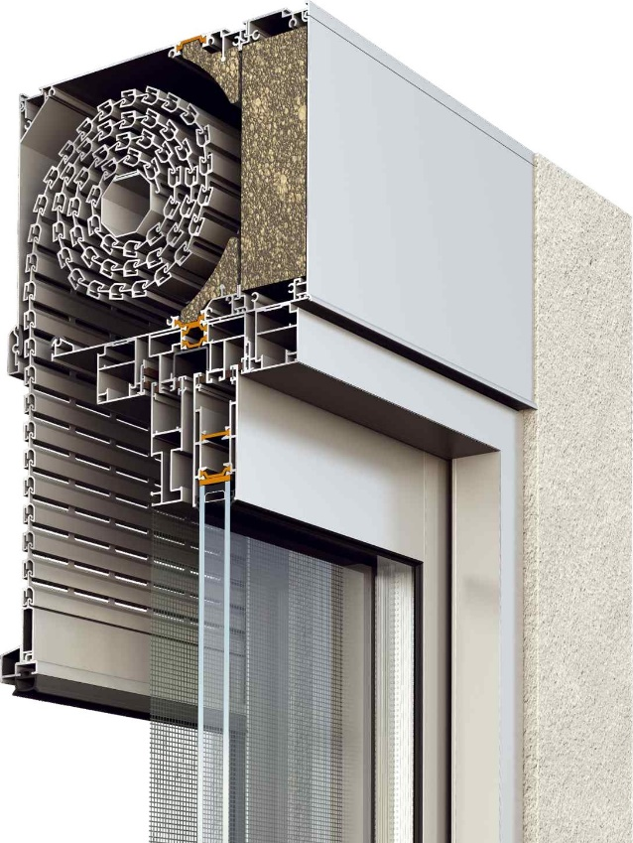
Benefits
Rolling shutter
Ideally combined with rolling shutter system M13800
Unified thermal insulating zone
Special design for pocket sliding typologies to easily visit & repair the rolling shutter

Slide 17
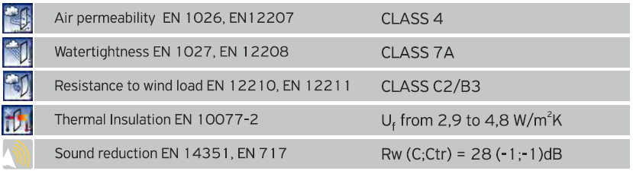


Benefits
Certifications

Slide 18
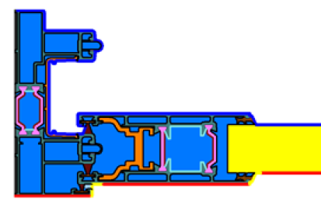
Benefits
Thermal Insulation
 | Ug = 1,3 | Ug = 1,1 | Ug = 1,0
U_{w} | 1,89 | 1,73 | 1,66
For a 2-sash typology 3,00m x 2,20m (W x H) and psi = 0,036

Slide 19

Attention to detail

Slide 20
Attention to detail
Energy & cost saving
Sash profile S384
Thermal insulated profiles
Fiberglass reinforced polyamides 24 & 22 mm width
PVC profiles perimetrically of the frame (same for standard and low frame)
1
1
116mm
2
1
Notes:
IGU = Insulated Glass Unit

Slide 21
Attention to detail
Energy & cost saving
Sash profile S390
Thermal insulated profiles
3. Alternative use of sash with anti-distorsion fiberglass reinforced polyamides 24 mm width ideal for dark frames (reduces banana effect due to high temperature differences)
3
3
116mm
Notes:
IGU = Insulated Glass Unit

Slide 22
Attention to detail
Energy & cost saving
Sash profile S35013
Thermal insulated profiles
4. Alternative use of smaller sash with fiberglass reinforced polyamides 30 & 22 mm width
4
4
107mm
Notes:
IGU = Insulated Glass Unit

Slide 23
Attention to detail
Energy & cost saving
Sash profile S35011
Thermal insulated profiles
Alternative use of smaller sash - compatible with narrow interlocking profile 25mm - with fiberglass reinforced polyamides 30 & 22 mm width
4
4
107mm
Notes:
IGU = Insulated Glass Unit

Slide 24
Attention to detail
Energy & cost saving
Interlocking profile
S384, S390
Thermal insulated profiles
PVC profiles at the interlocking profile
Compatible with sash profiles S384, S390
5
5
88,5mm
Notes:
IGU = Insulated Glass Unit

Slide 25
Attention to detail
Energy & cost saving
Interlocking profile
S35011, S35013
Thermal insulated profiles
PVC profiles at the interlocking profile
Compatible with sash profiles S35011, S35013
5
5
79,5mm
Notes:
IGU = Insulated Glass Unit

Slide 26
Attention to detail
Energy & cost saving
Interlocking profile S356
Thermal insulated profiles
PVC profiles at the narrow interlocking profile
Compatible with sash profiles S384, S390
5
5
50,5mm
Notes:
IGU = Insulated Glass Unit

Slide 27
Attention to detail
Energy & cost saving
Interlocking profile S35017, S35027
Thermal insulated profiles
6. PVC profiles at the narrow interlocking profile
Available as an accessory & easily placed by the fabricator
Compatible with sash profile S35011
6
6
25mm
Notes:
IGU = Insulated Glass Unit

Slide 28
Attention to detail
Glazing
18-26mm
28mm
2 types of double glazing with the use of:
Wedges up to 26mm glazing thickness
‘U shape’ gasket up to 28mm glazing thickness
Analytical glazing list available at the system’s technical catalog

Slide 29
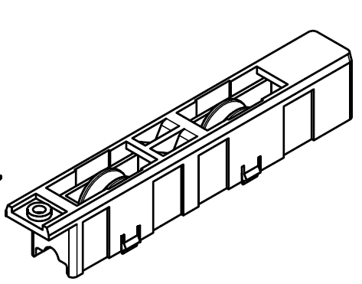
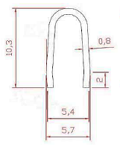
Attention to detail
Gliding
Double rollers with maximum weight up to 180 Kg per sash
Αdjustable rollers for easier installation & maintenance
U-type stainless steel rail

Slide 30
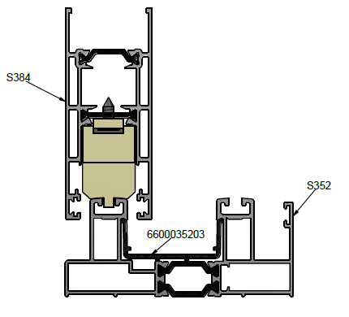
Attention to detail
Fixed lights
Use of special spacers fixed at the bottom of the sash
Available for all sash profiles

Slide 31

Functionality & credibility

Slide 32
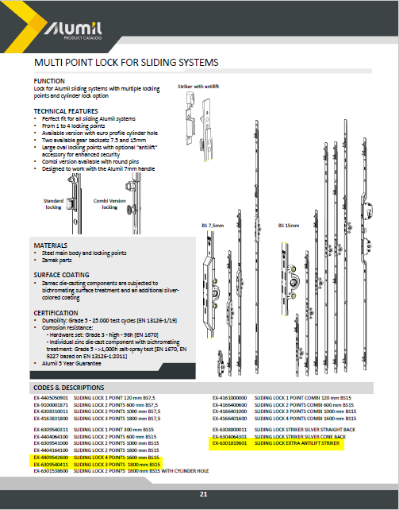
Functionality & credibility
Locking mechanism
Multi-point lock
Wide range of locks from 300 mm sash height (developed specific for ALUMIL)

Slide 33
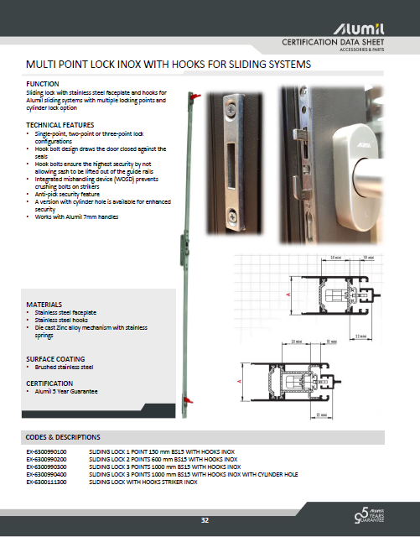
Functionality & credibility
Locking mechanism
Multi-point lock with hooks
Available only for standard sash 85mm

Slide 34
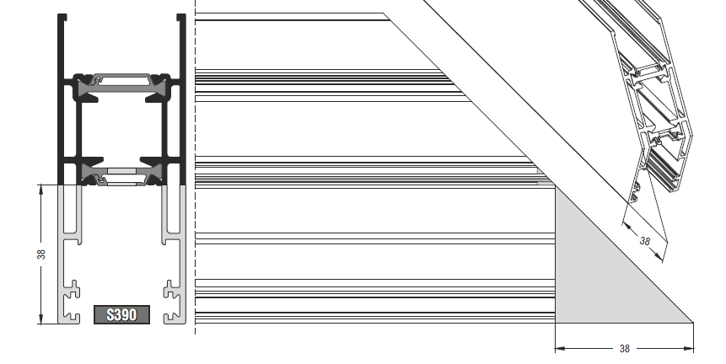
Functionality & credibility
Sash assembly
Sash 45º connection perimetrically
Compatible with all sash profiles
1
Standard interlocking profile
Sash 45º connection
Interlocking profile 45º/90º connection
Compatible only with sash profiles S384 & S390
2
Narrow interlocking profile 50,5mm

Slide 35
Functionality & credibility
Sash assembly
Sash 45º connection
Interlocking profile 90º connection
Compatible only with sash profile S35011
3
Narrow interlocking profile 25mm
Sash 90º connection
Interlocking profile 90º connection
Compatible only with sash profile S35011
4
Standard or Narrow interlocking 25mm with 28mm glazing

Slide 36
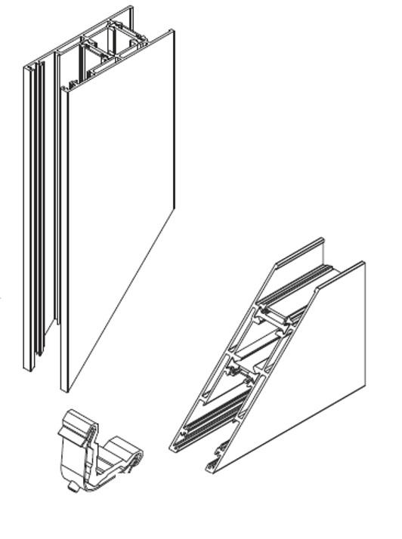
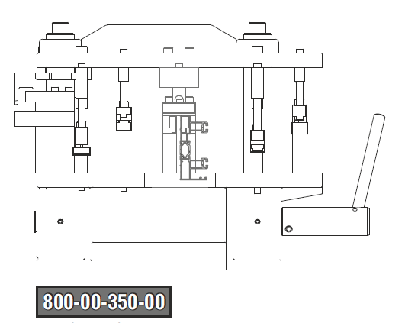
Functionality & credibility
Sash assembly
Sash 45º connection with mechanical corners
Punching machine for mechanical corners treatment

Slide 37
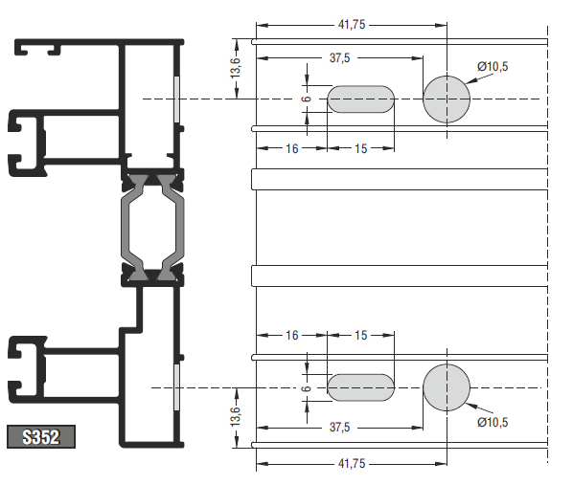
Functionality & credibility
Frame assembly
Standard frame 45º connection with mechanical corners
Punching machine for mechanical corners treatment

Slide 38
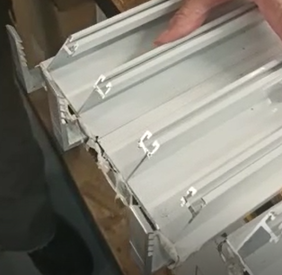
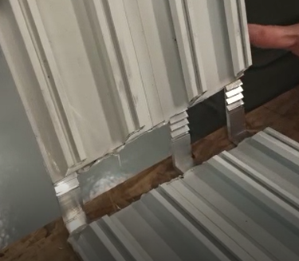
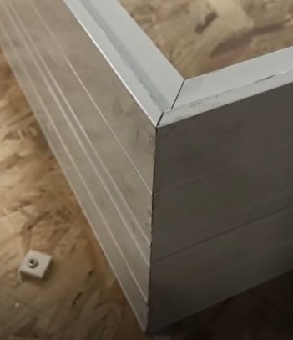
Functionality & credibility
Frame assembly
Low frame 45º connection with force fitting corners
New patented corner design by Alumil
No treatment needed

Slide 39
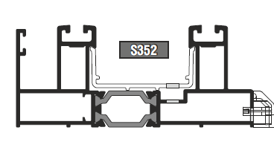
Functionality & credibility
Water evacuation
Standard frame
The water follows its way out through the chamber of the frame
Punching machine for frame’s weep holes treatment

Slide 40
Functionality & credibility
Water evacuation
Low frame
The water follows its way out through the rail wing
Existing punching machine can be used for frame’s weep holes treatment

Slide 41
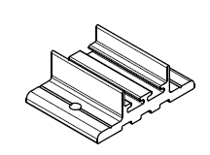
Functionality & credibility
Central sealing
Set of elastic central seals for the upper & bottom frame
Same accessories used for the standard and low frame
Standard interlocking profile
Narrow interlocking profile 25mm

Slide 42
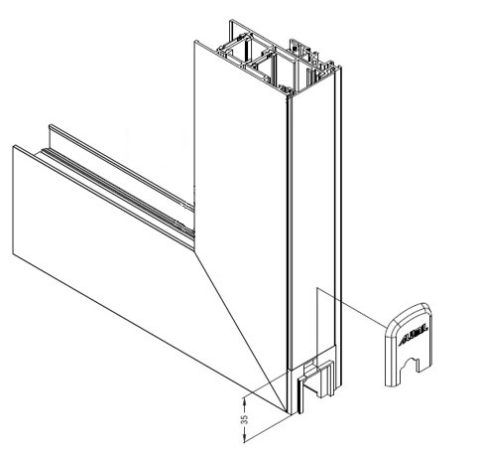
Functionality & credibility
Interlock assembly
Special design of end caps when the same sash is used perimetrically
No treatment needed for the cover of the interlocking profile
Straight cut of the cover profile
Easier and faster fabrication

Slide 43
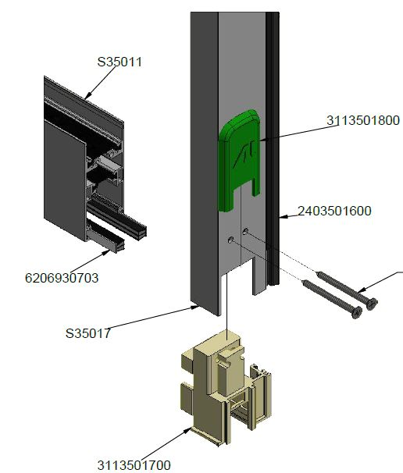
Functionality & credibility
Interlock assembly
Special design of end caps when the narrow interlocking profile 25mm is used
The caps are also connectors between the interlocking profile & the horizontal sash
No treatment needed for the horizontal sash

Slide 44
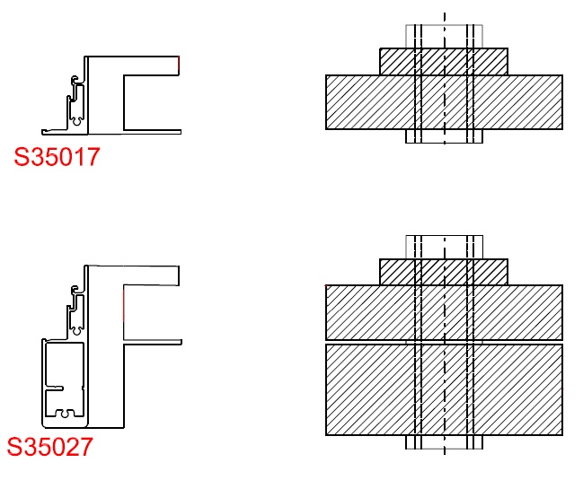
Functionality & credibility
Interlock assembly
Milling tool available
Same tool with an add-on accessory for the reinforced interlocking profile

Slide 45
Functionality & credibility
Machinings's guide
 | S350 | S350 LT
Sash’s Corner machining | Yes | Yes
Frame’s Corner machining | Yes | No
Standard interlocking Profile’s machining | No | No
Narrow interlocking Profile’s machining | No | Yes

Slide 46
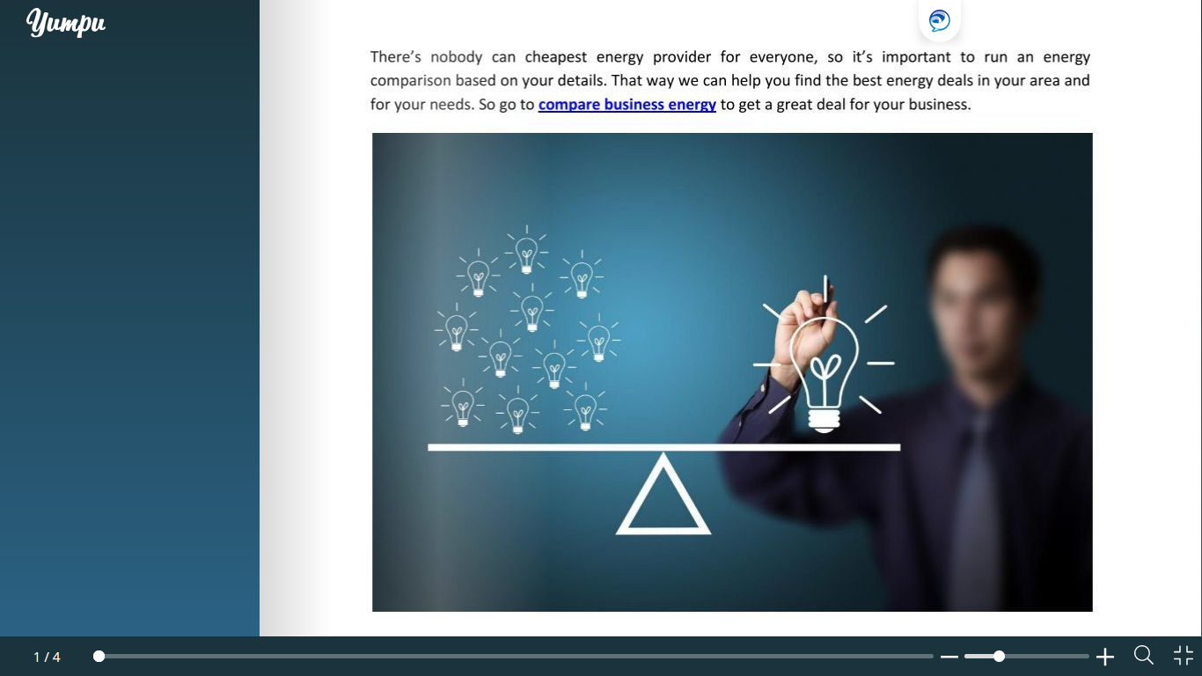
Comparisons

Slide 47
Comparisons
Sash
-17,6%
-22,5%
S35011
1,348Kg/m
S384
1,637Kg/m
S35013
1,268Kg/m

Slide 48
Comparisons
Frame
S352
1,610Kg/m
-15,3%
S35352
1,363Kg/m

Slide 49
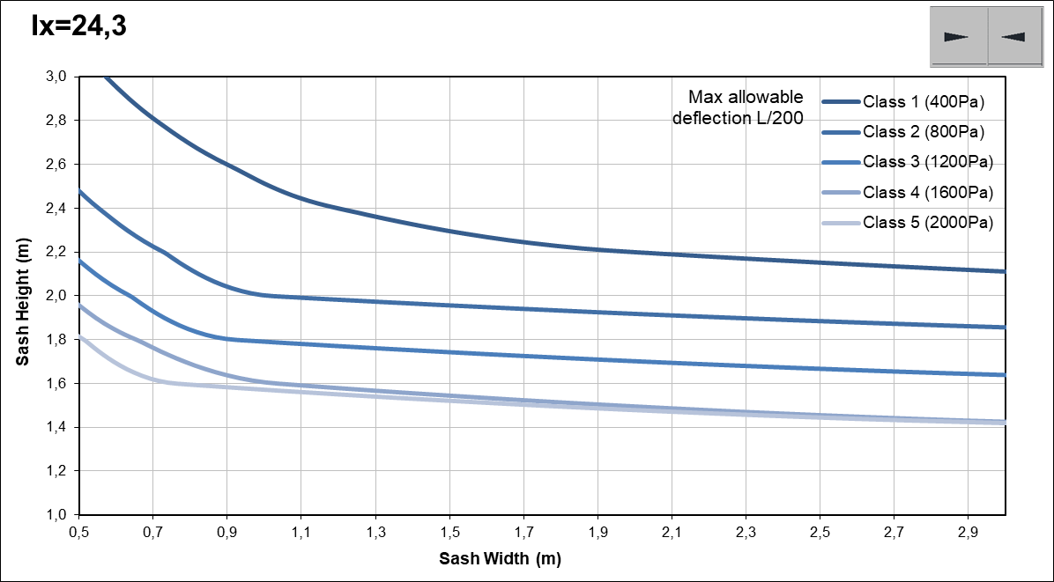
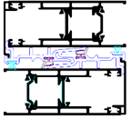
Comparisons
Maximum dimensions

Slide 50
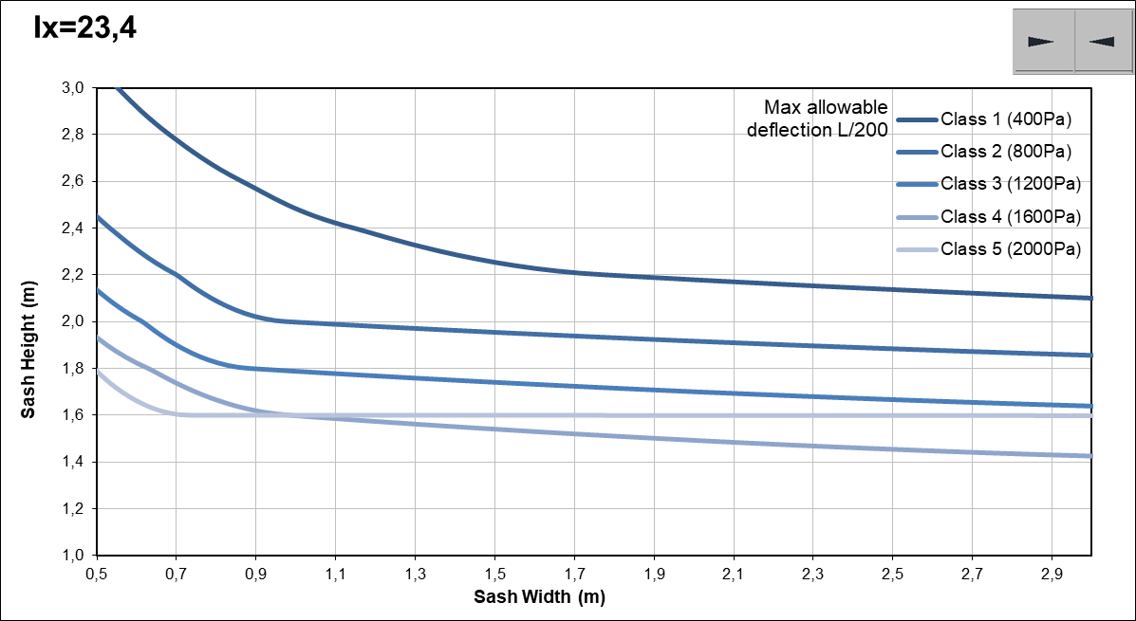
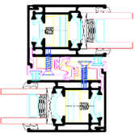
Comparisons
Maximum dimensions

Slide 51
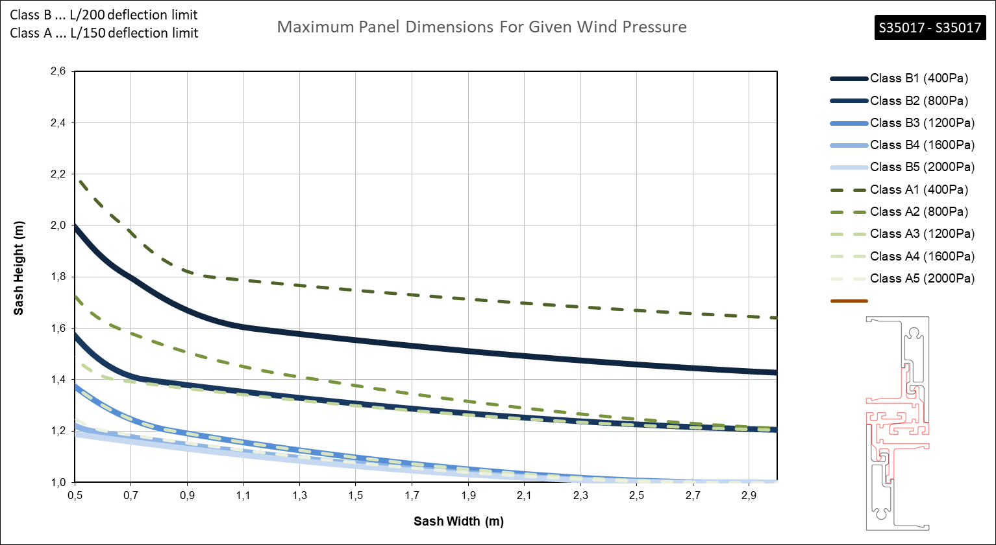
Comparisons
Maximum dimensions
Ix=6,4

Slide 52
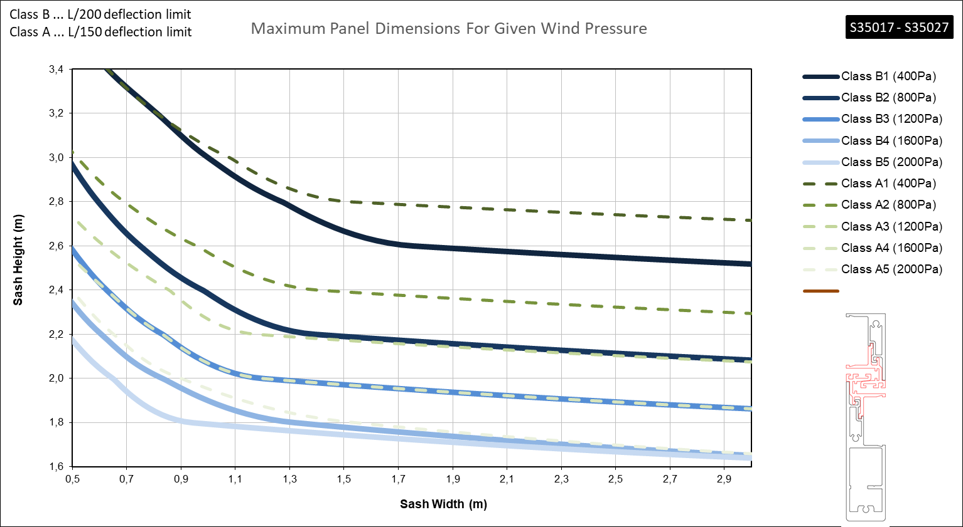
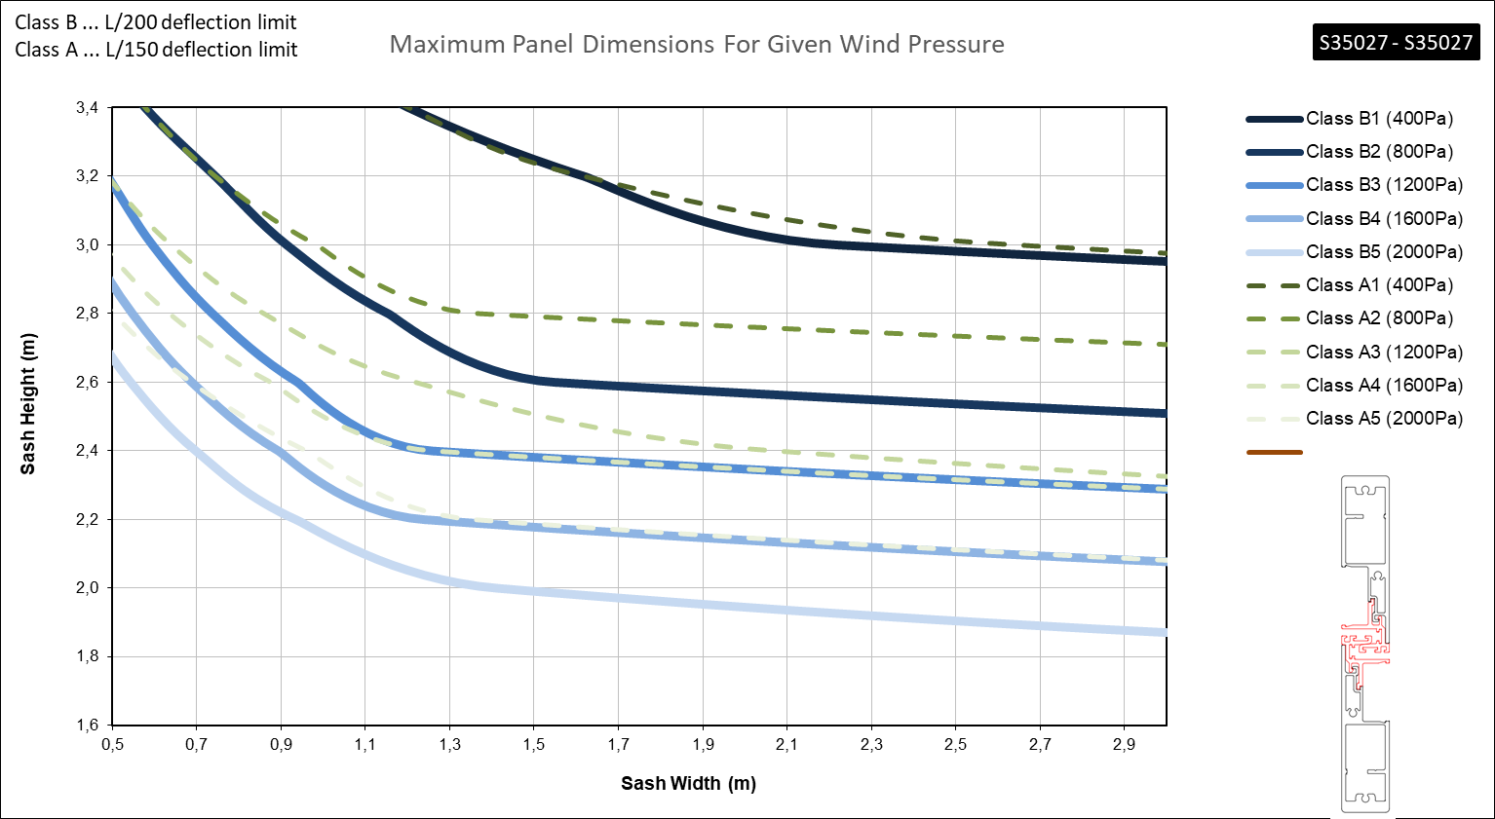
Comparisons
Maximum dimensions
Ix=41,1
Ix=75,8

Slide 53
Commercial session

Slide 54
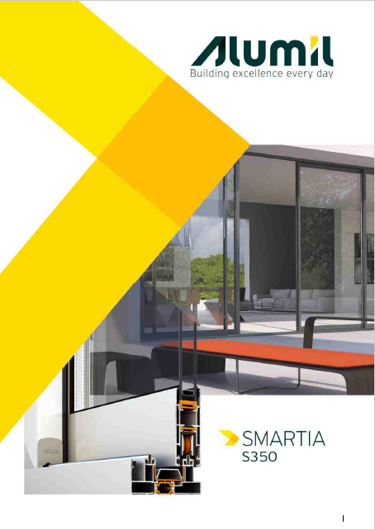
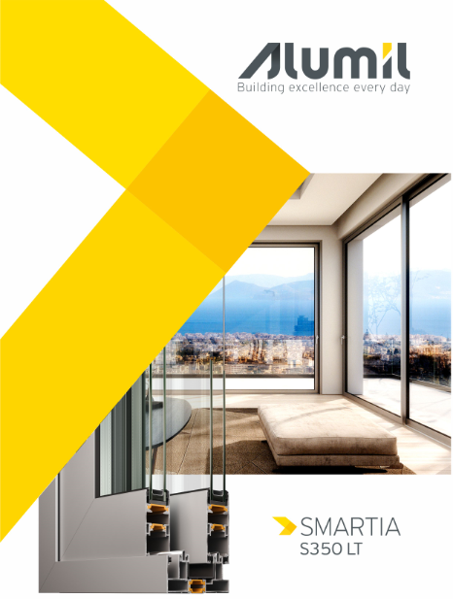

Technical catalogs
Standard frame
Standard sash
Narrow interlocking profile 50mm
Low frame
Low sash
Narrow interlocking profile 25mm

Slide 55

Benefits
per personas
 | Fabricators | Architects | Home owners
Modern design
Wide range of solutions
Increased clientele
Differentiation
Green buildings design
Cost & energy saving
Ease of use
Long-lasting functionality
Coziness
Easy fabrication

Slide 56
Summarize
The new solutions of SMARTIA S350 - S350 LT - offer:
Advanced modern aesthetics
Same thermal & sealing performance with older version
Easy and fast fabrication
Less cost with common accessories
Ideal solution for large scale projects
Ideal solution for renovations with low frame

Slide 57
Thank you
for your attention

