Slide 1



Slide 2

What
Lift & slide system &
Regular sliding system
Thermally insulated system
Robust constructions
Application versatility and ability to cover wide spans

Slide 3
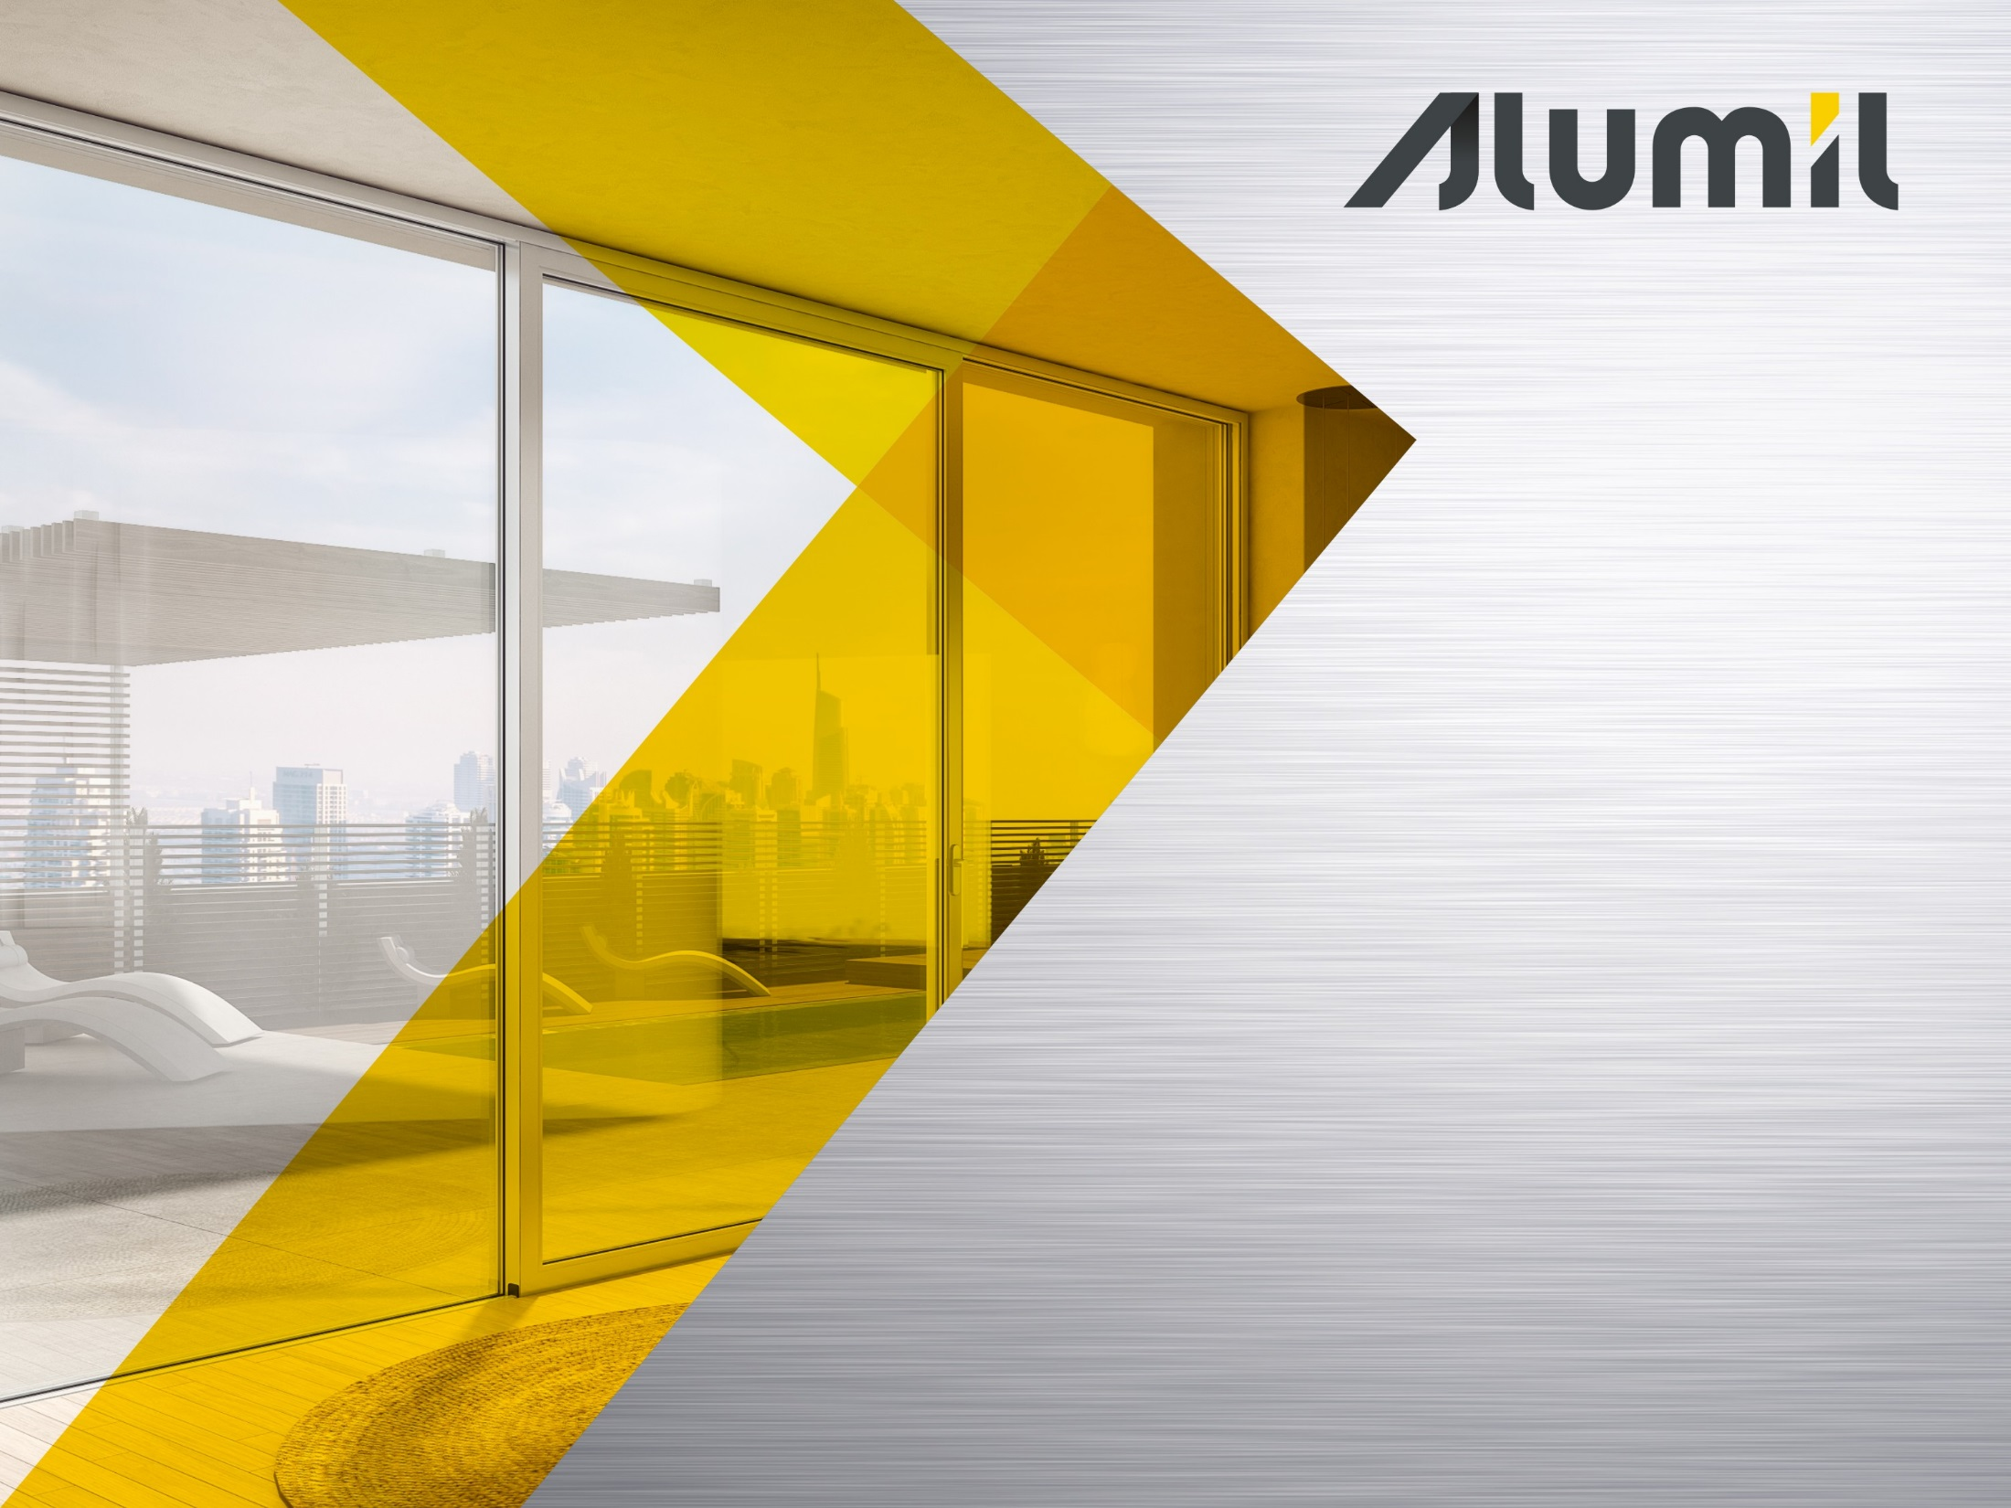
Why
Value for money solution
Impressive performance
Easy access with low threshold (S560 LT)
Wide variety of typologies that cover any construction need

Slide 4


Benefits

Slide 5
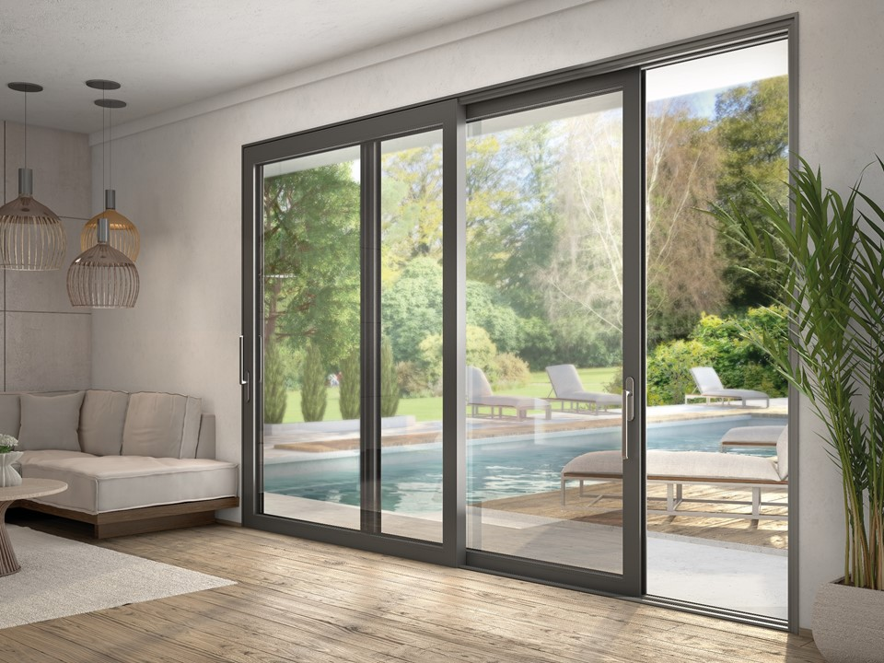


Benefits
Flexibility
Enhanced natural light
Energy saving
Security & functionality
High performance

Slide 6
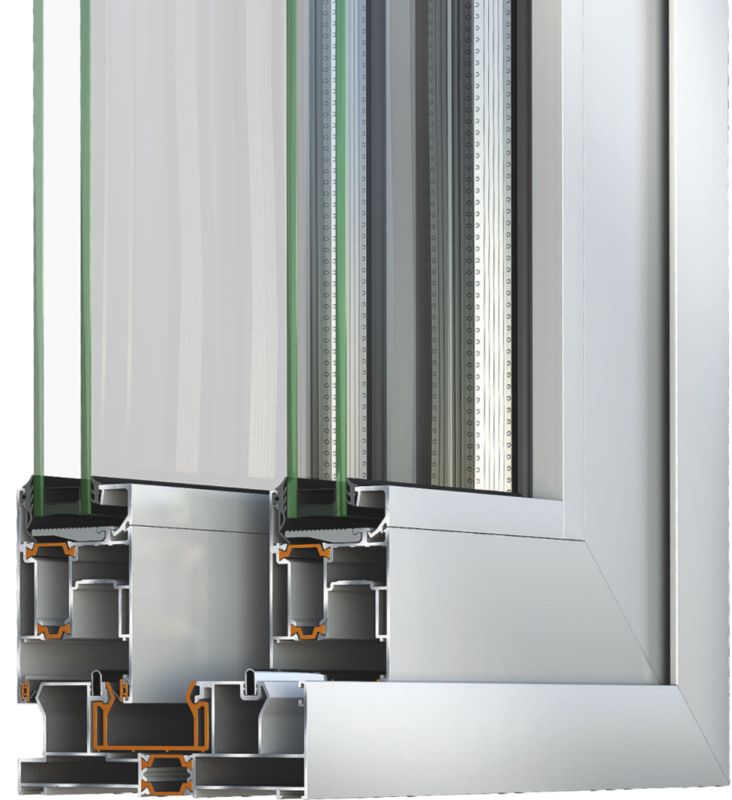
Benefits
1. Flexibility
The system uses the lift & slide mechanisms of 90, 200, 300 Kg
Sliding mechanism up to 180 Kg
Glazing thickness (IGU) from 22 up to 45 mm

Slide 7
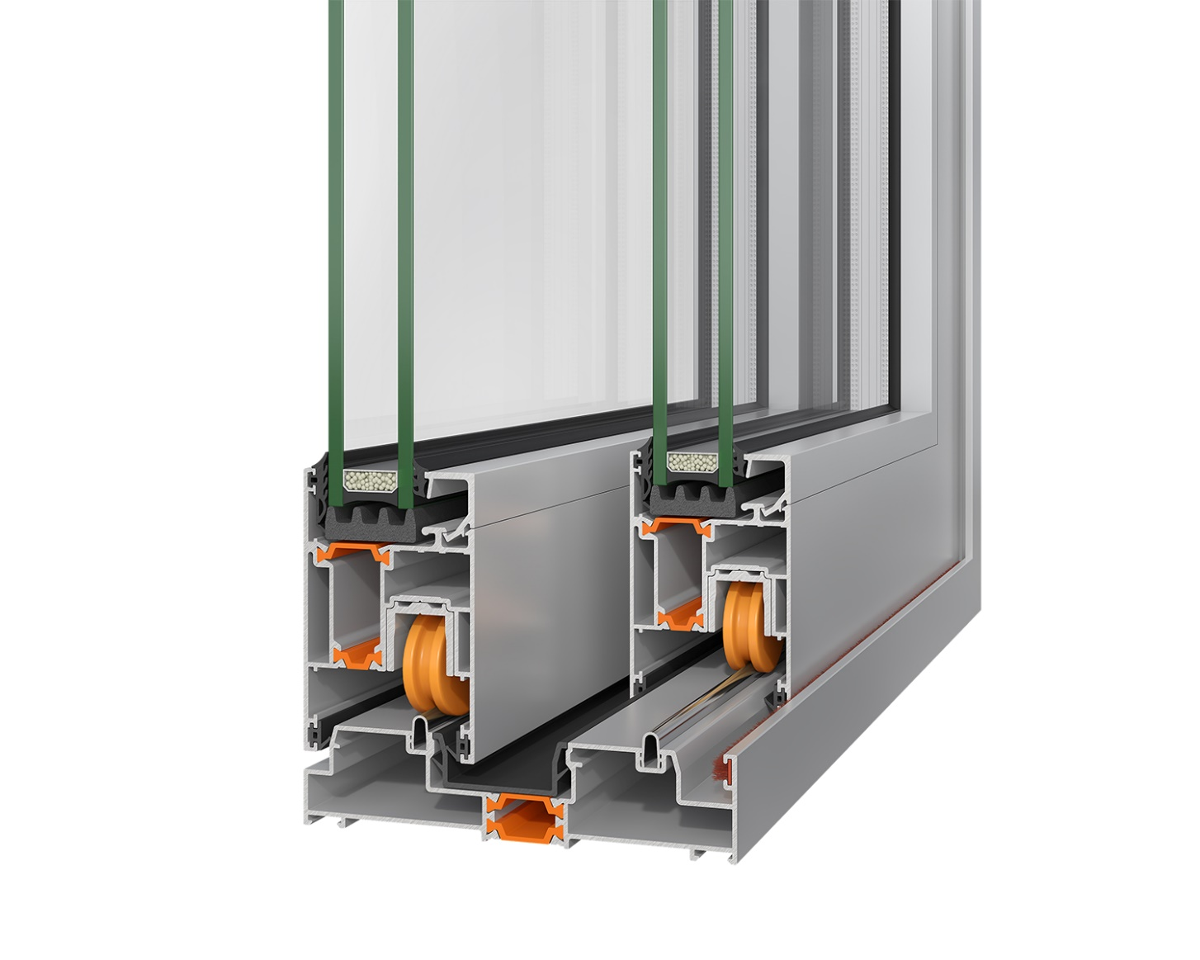
Benefits
1. Flexibility
Low Threshold 31mm
Minimal aesthetics 108,5mm
Easy access
Ideal for renovations

Slide 8
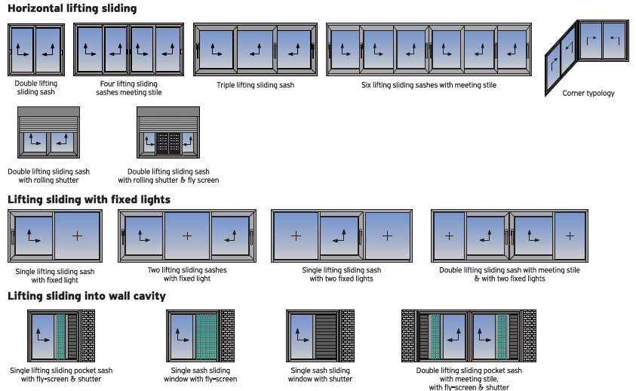
Benefits
1. Flexibility
Wide range of typologies are available for Sliding or Lift & Slide solutions

Slide 9
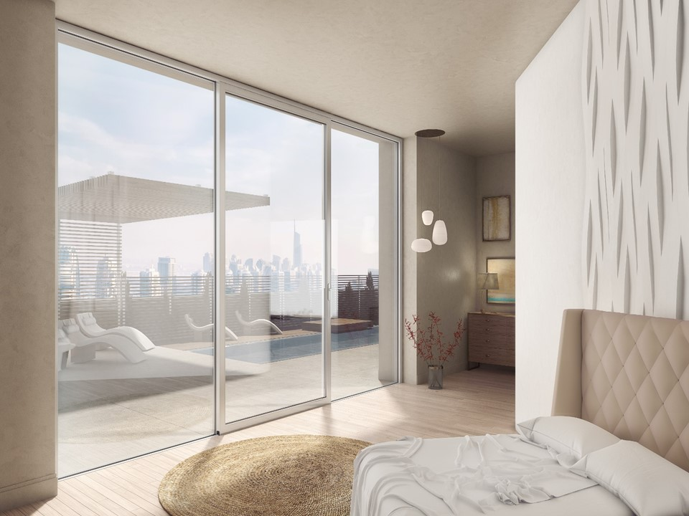
Benefits
1. Flexibility
Specific typologies for Hotels : Fixed + parallel sliding door

Slide 10
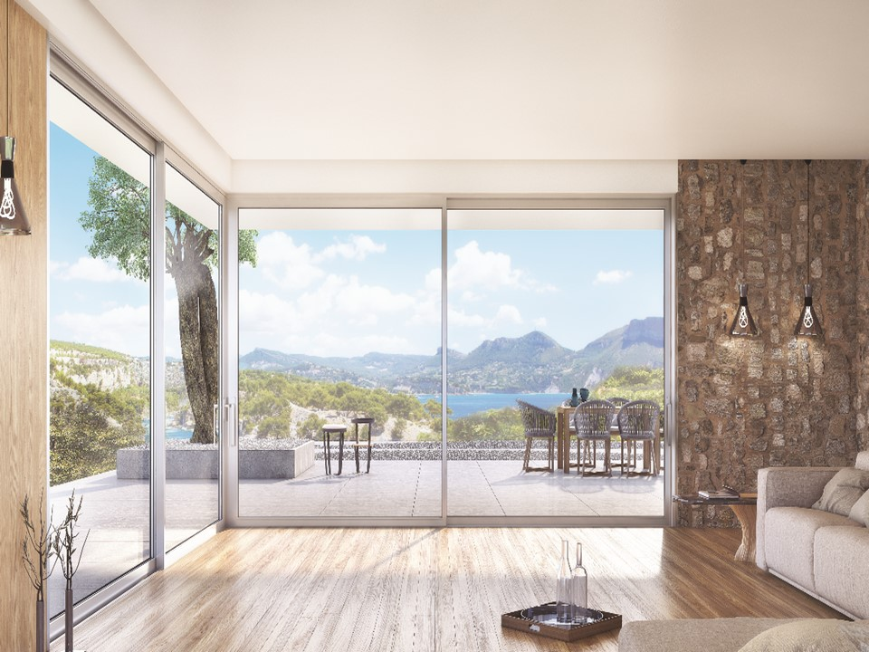
Benefits
1. Flexibility
Corner Typology
Corner constructions without using intermediate mullion for:
  Maximum natural light
  Easy access
  High functionality
Notes:
Μόνο φωτογραφία 560 γωνιακό

Slide 11
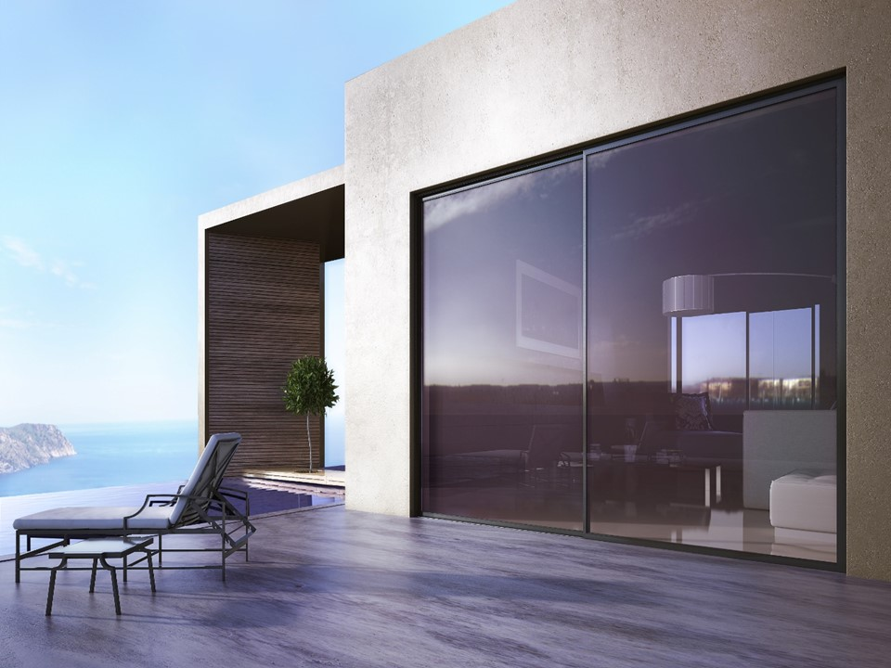
Benefits
1. Flexibility
Unlimited widths of constructions by using special joining components for spans greater than 6 m
Cooperation with Rolling Shutter system S13600
Combination with shutters & fly screen

Slide 12
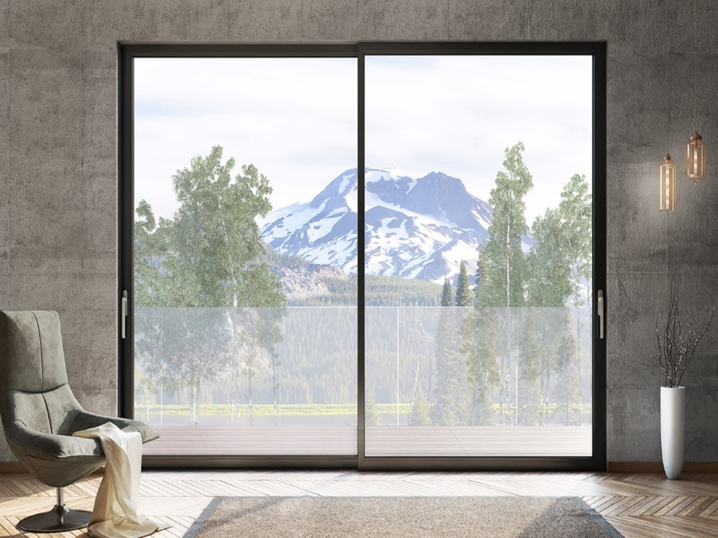
Benefits
Narrow interlocking profile
ONLY 49 mm

Slide 13
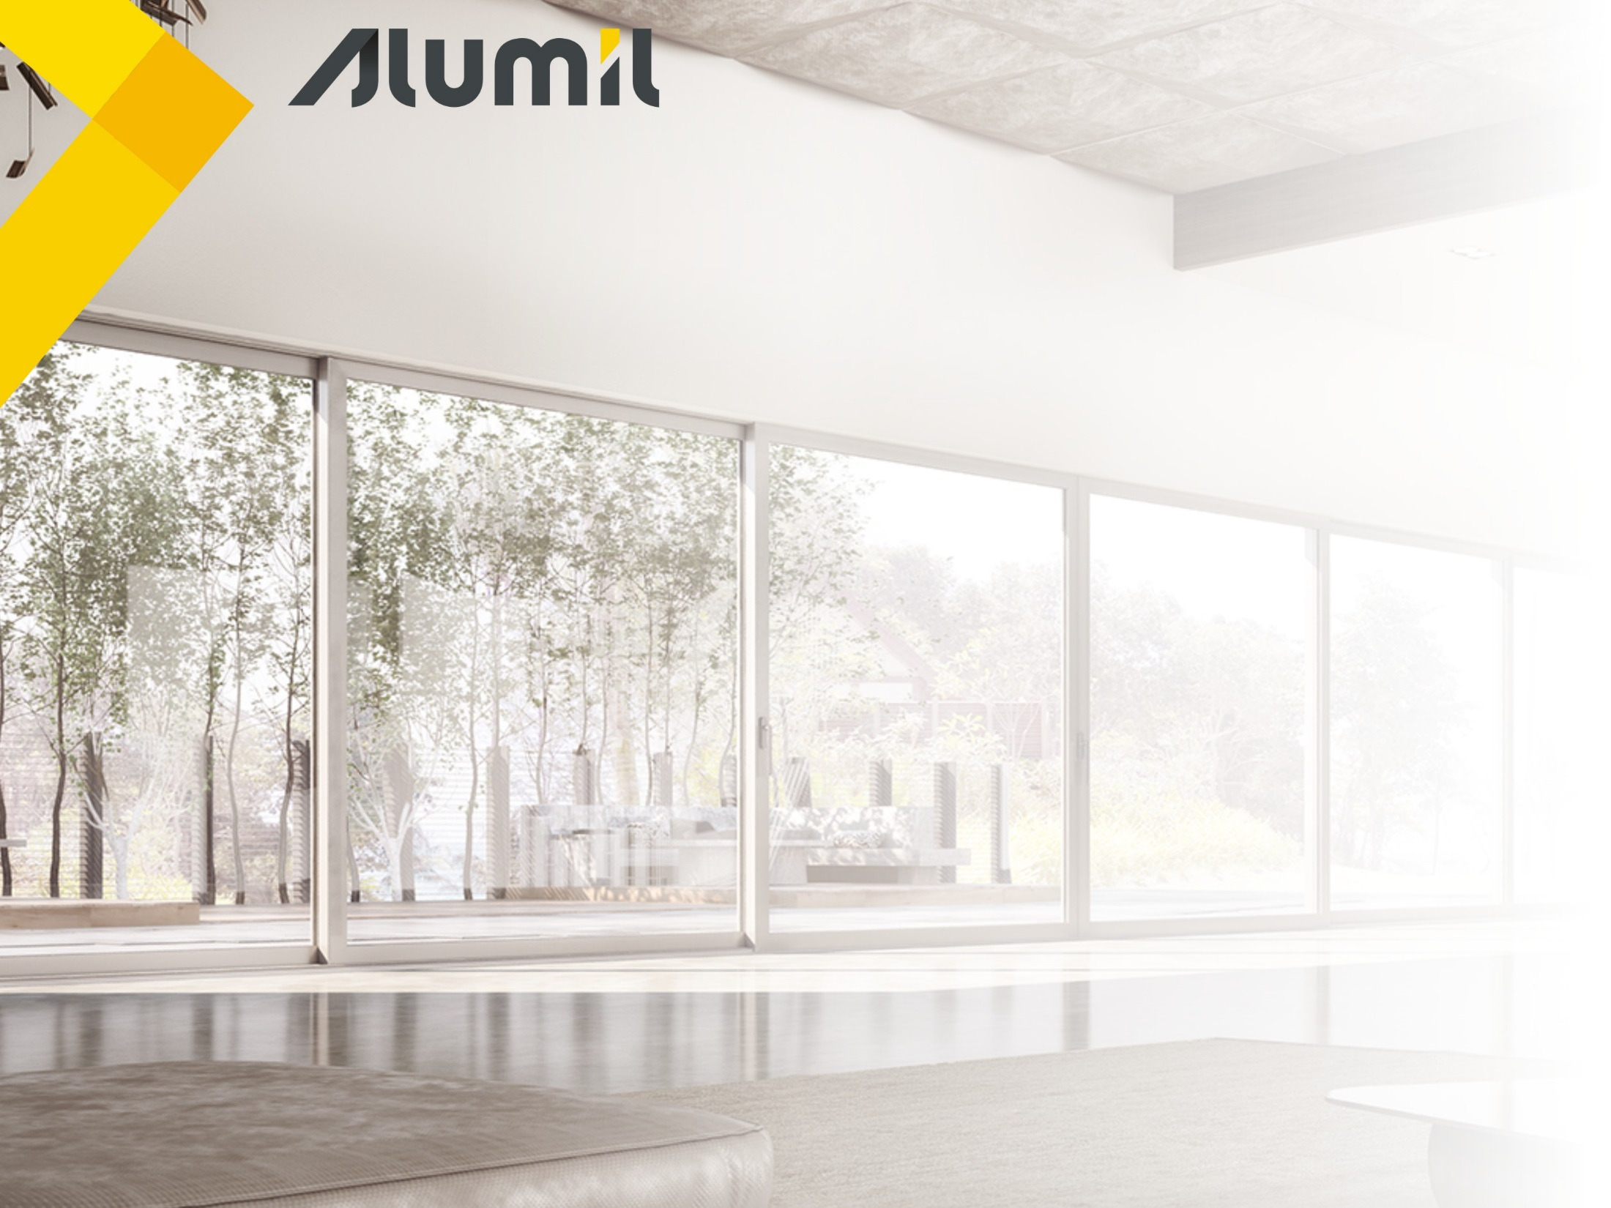
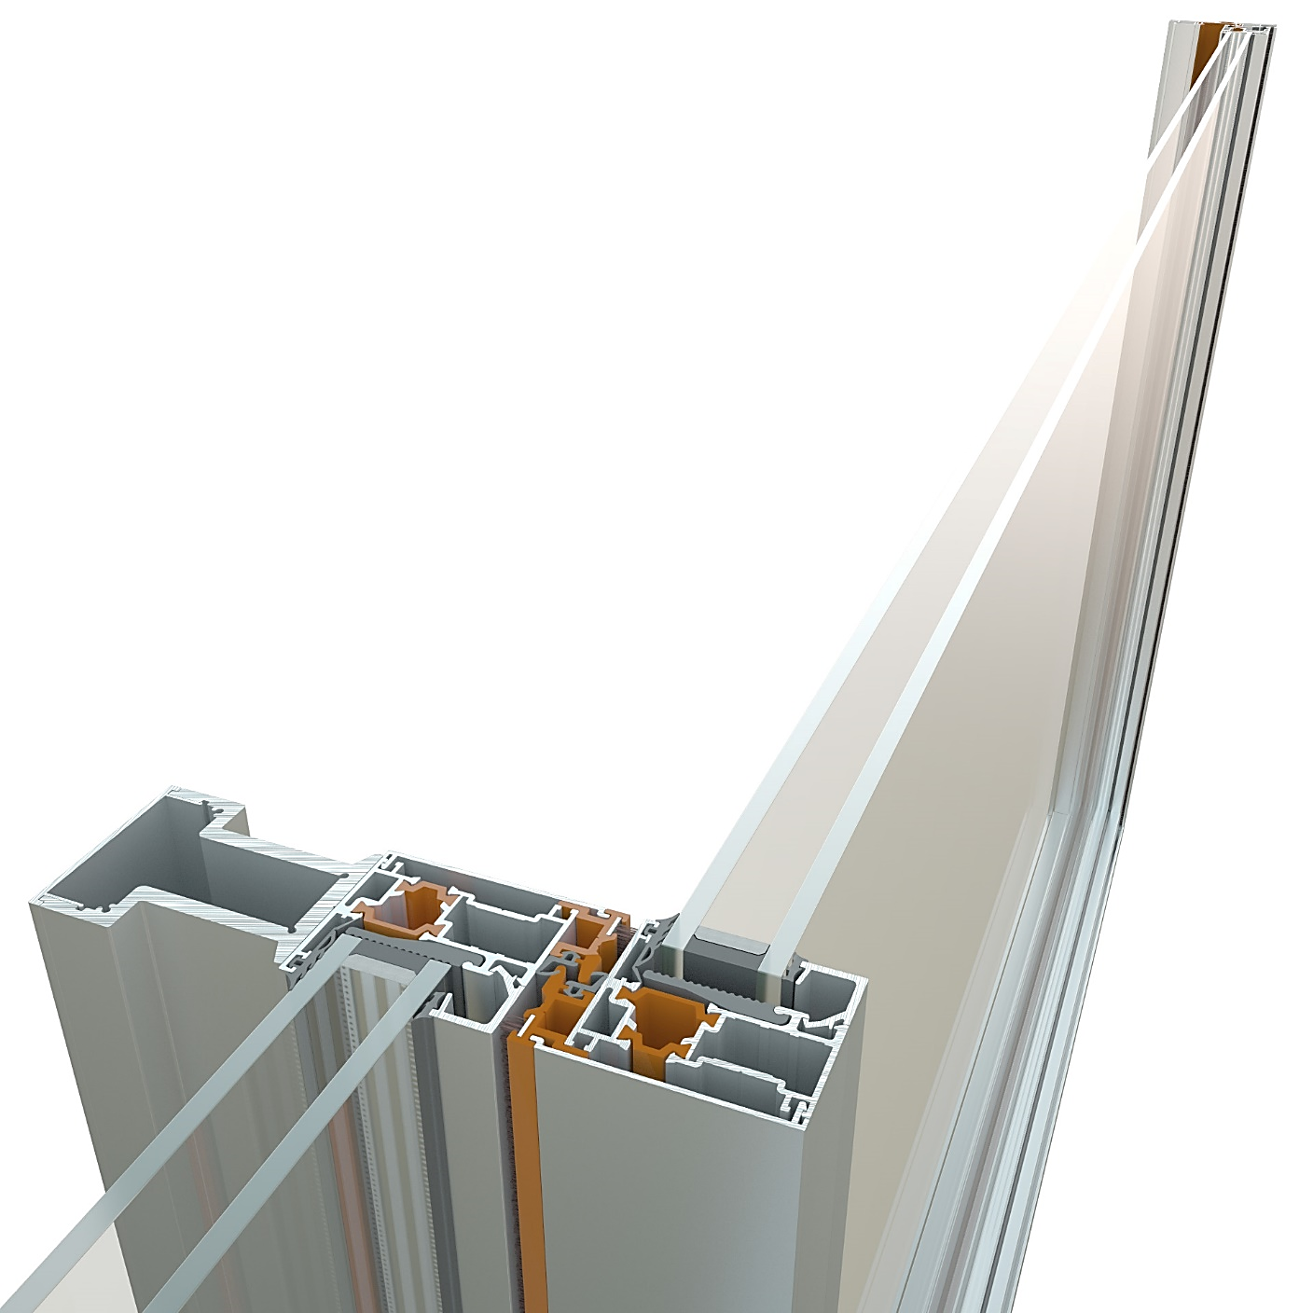
Benefits
2. Enhanced natural light
Narrow interlocking profile only 49 mm width
Extra reinforcement profiles available for higher wind loads

Slide 14
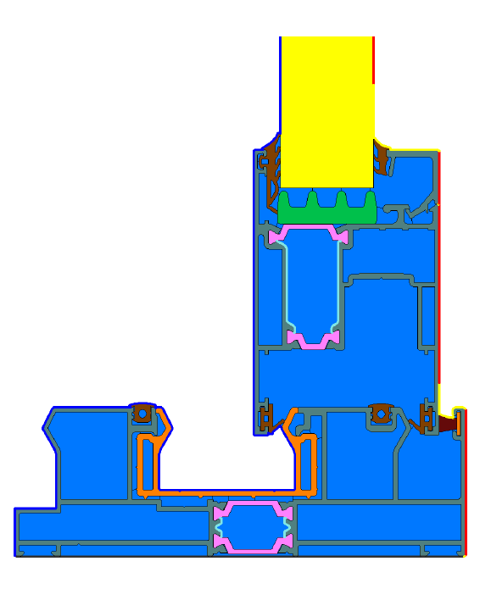
Benefits
3. Energy Saving
Significant energy savings thanks to high thermal insulation
U_{f} from 2,3 - 6,8 W/m²K

Slide 15
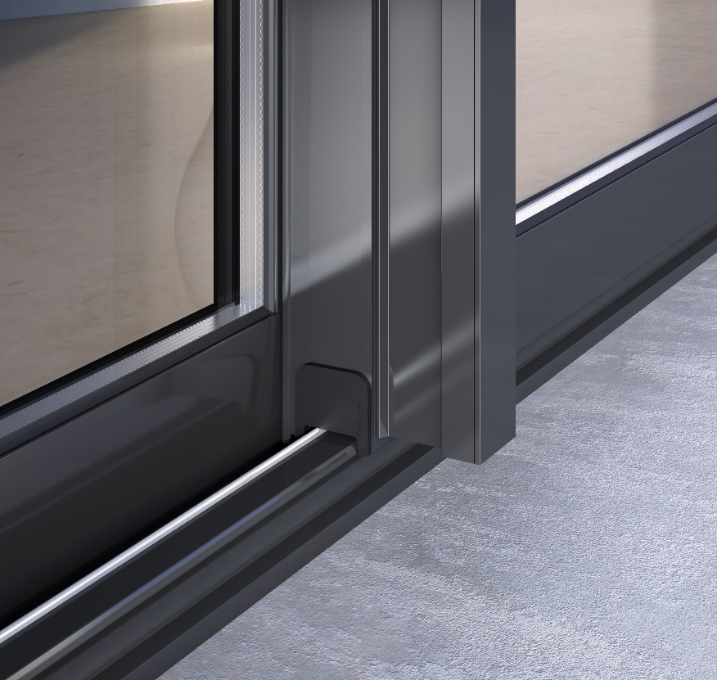
Benefits
4. Security & functionality
Extremely noiseless operation & easy gliding of the sashes
Easy handling even in case of large & heavy sashes

Slide 16
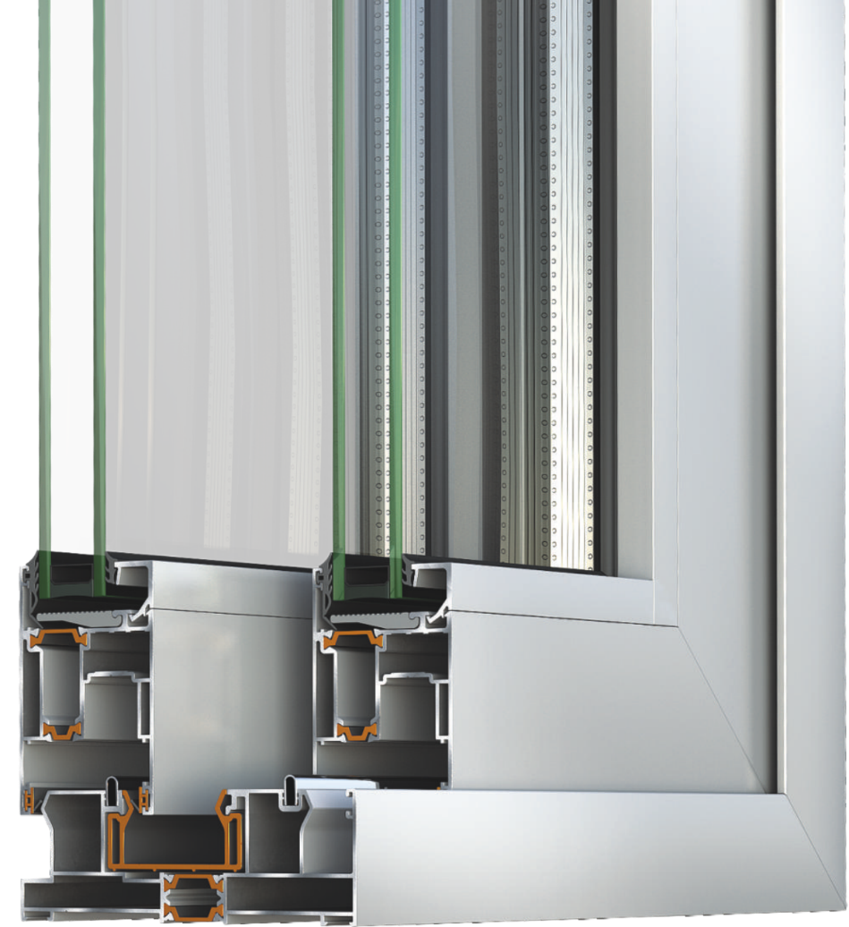
Benefits
4. Security & functionality

Slide 17
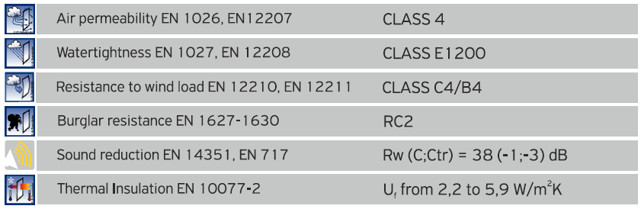
Benefits
5. Certifications
Certified performances by the German IFT ROSENHEIM institute

Slide 18
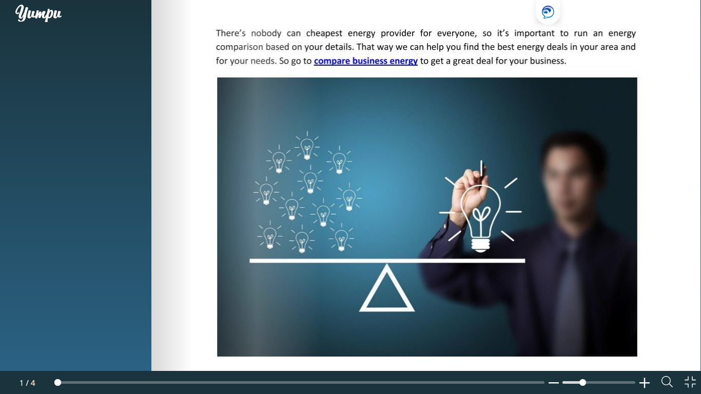
Commercial session

Slide 19

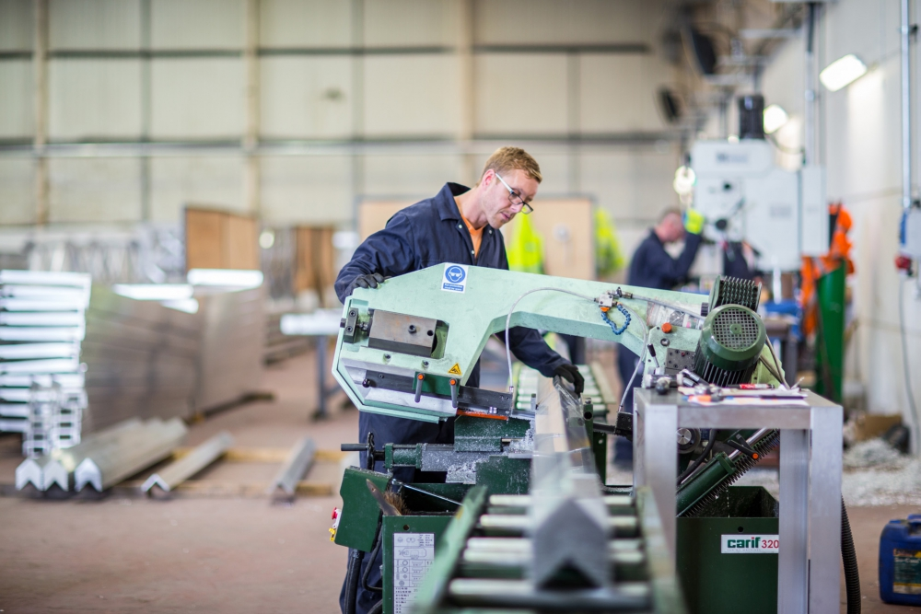
Benefits per Personas
Fabricators
Easy & time saving construction - Increase of productivity
Easy installation & maintenance
Product that responds to a wide range of needs thanks to the variety of solutions
Increased clientele with products ideal for hotel solutions & LSP

Slide 20
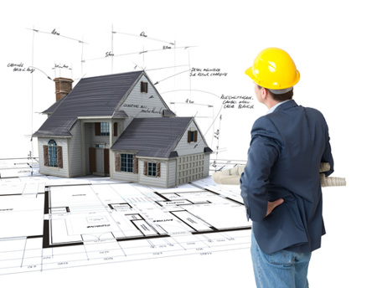
Benefits per Personas
Architects
Freedom of design
Product that responds to a wide range of needs thanks to the variety of solutions with modern design
Designing buildings with energy & money saving systems
Proving clients a comfort living

Slide 21

Benefits per Personas
Home Owners - Investors
Enhanced natural light thanks to the wide glazing surfaces
Enhanced Security & Burglar resistance
Money & energy saving
Easy use and high functionality
Product that responds to a wide range of needs thanks to the variety of solutions

Slide 22
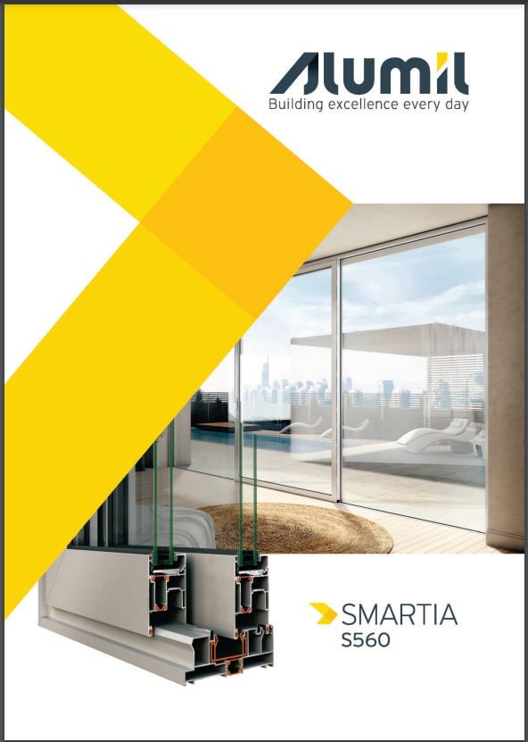
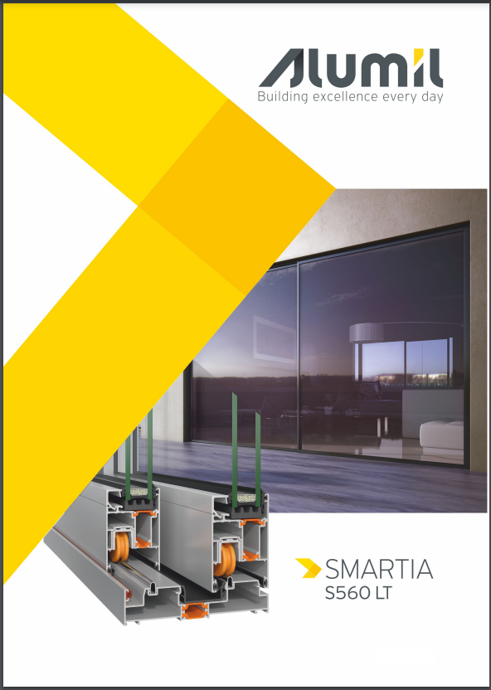
Catalogs
Technical catalog S560
Technical catalog S560 LT

Slide 23

Catalogs
Fabrication manual S560 LT

Slide 24
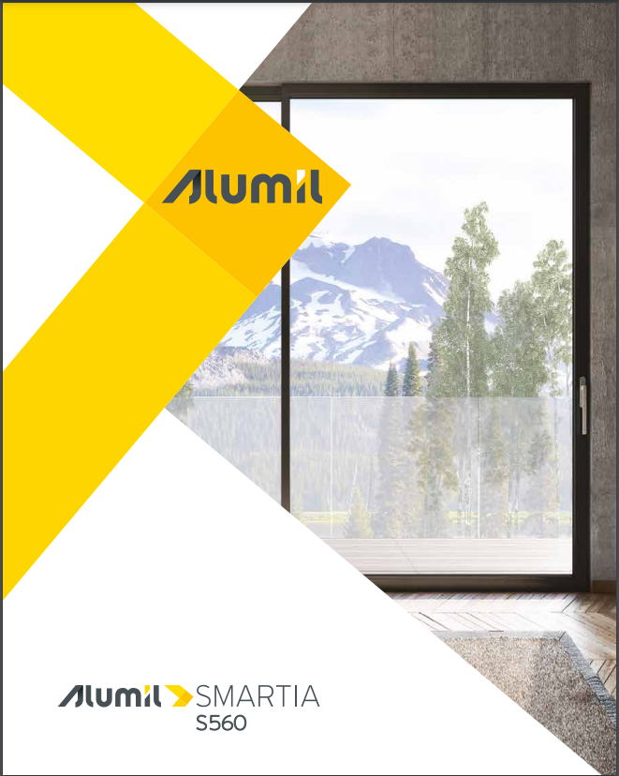
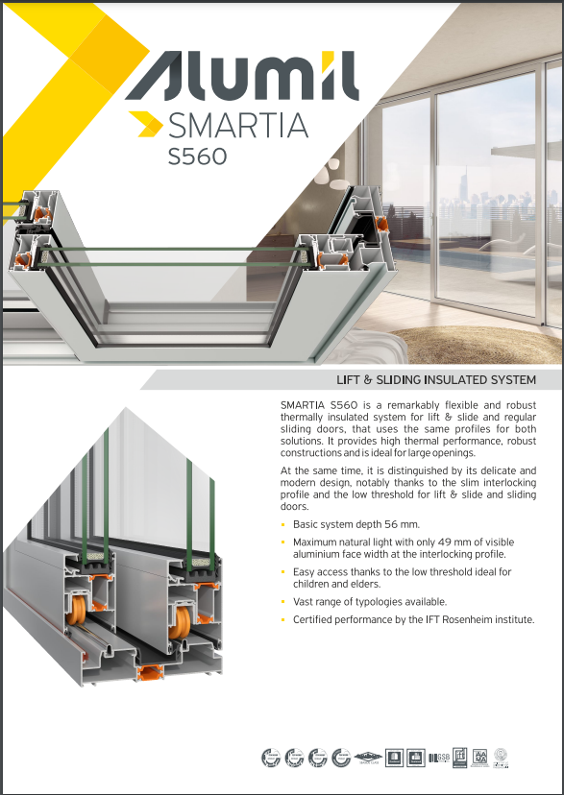
Promotional material
Pre-qualification brochure
Technical data sheet

Slide 25
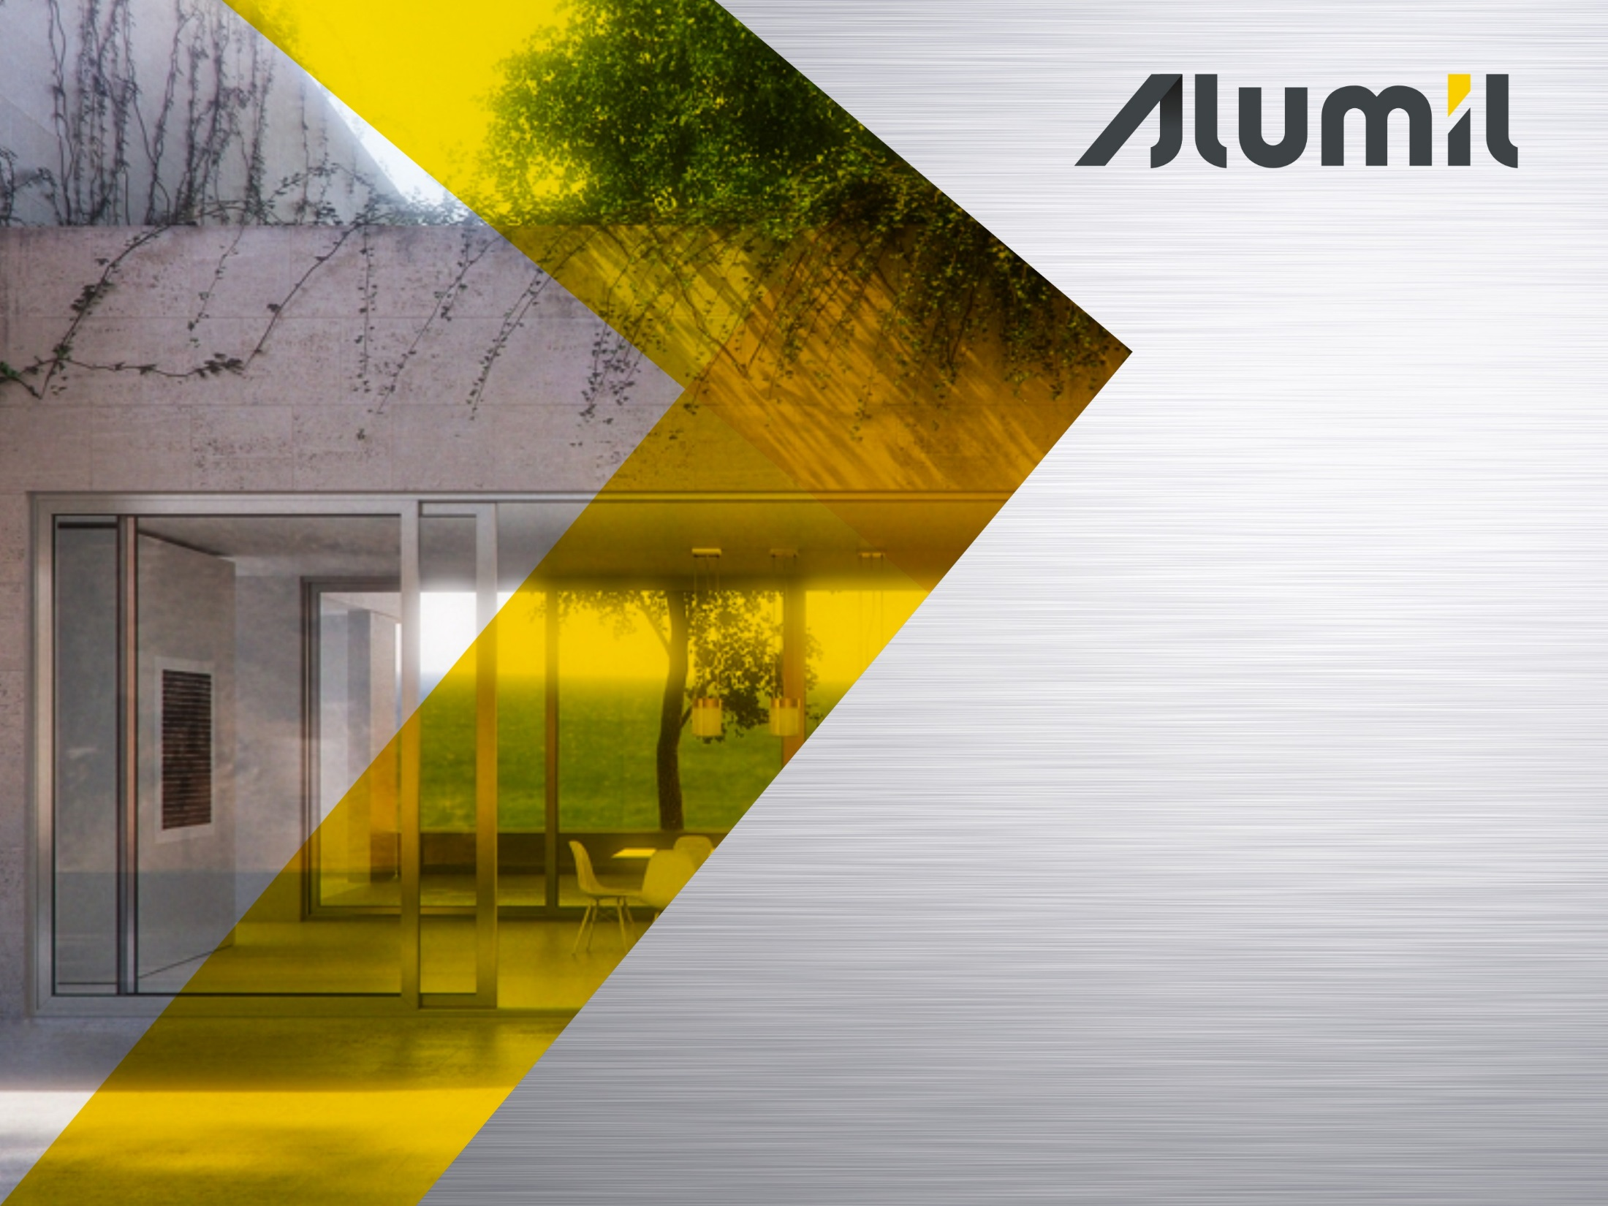
Thank you for your attention

