Slide 1
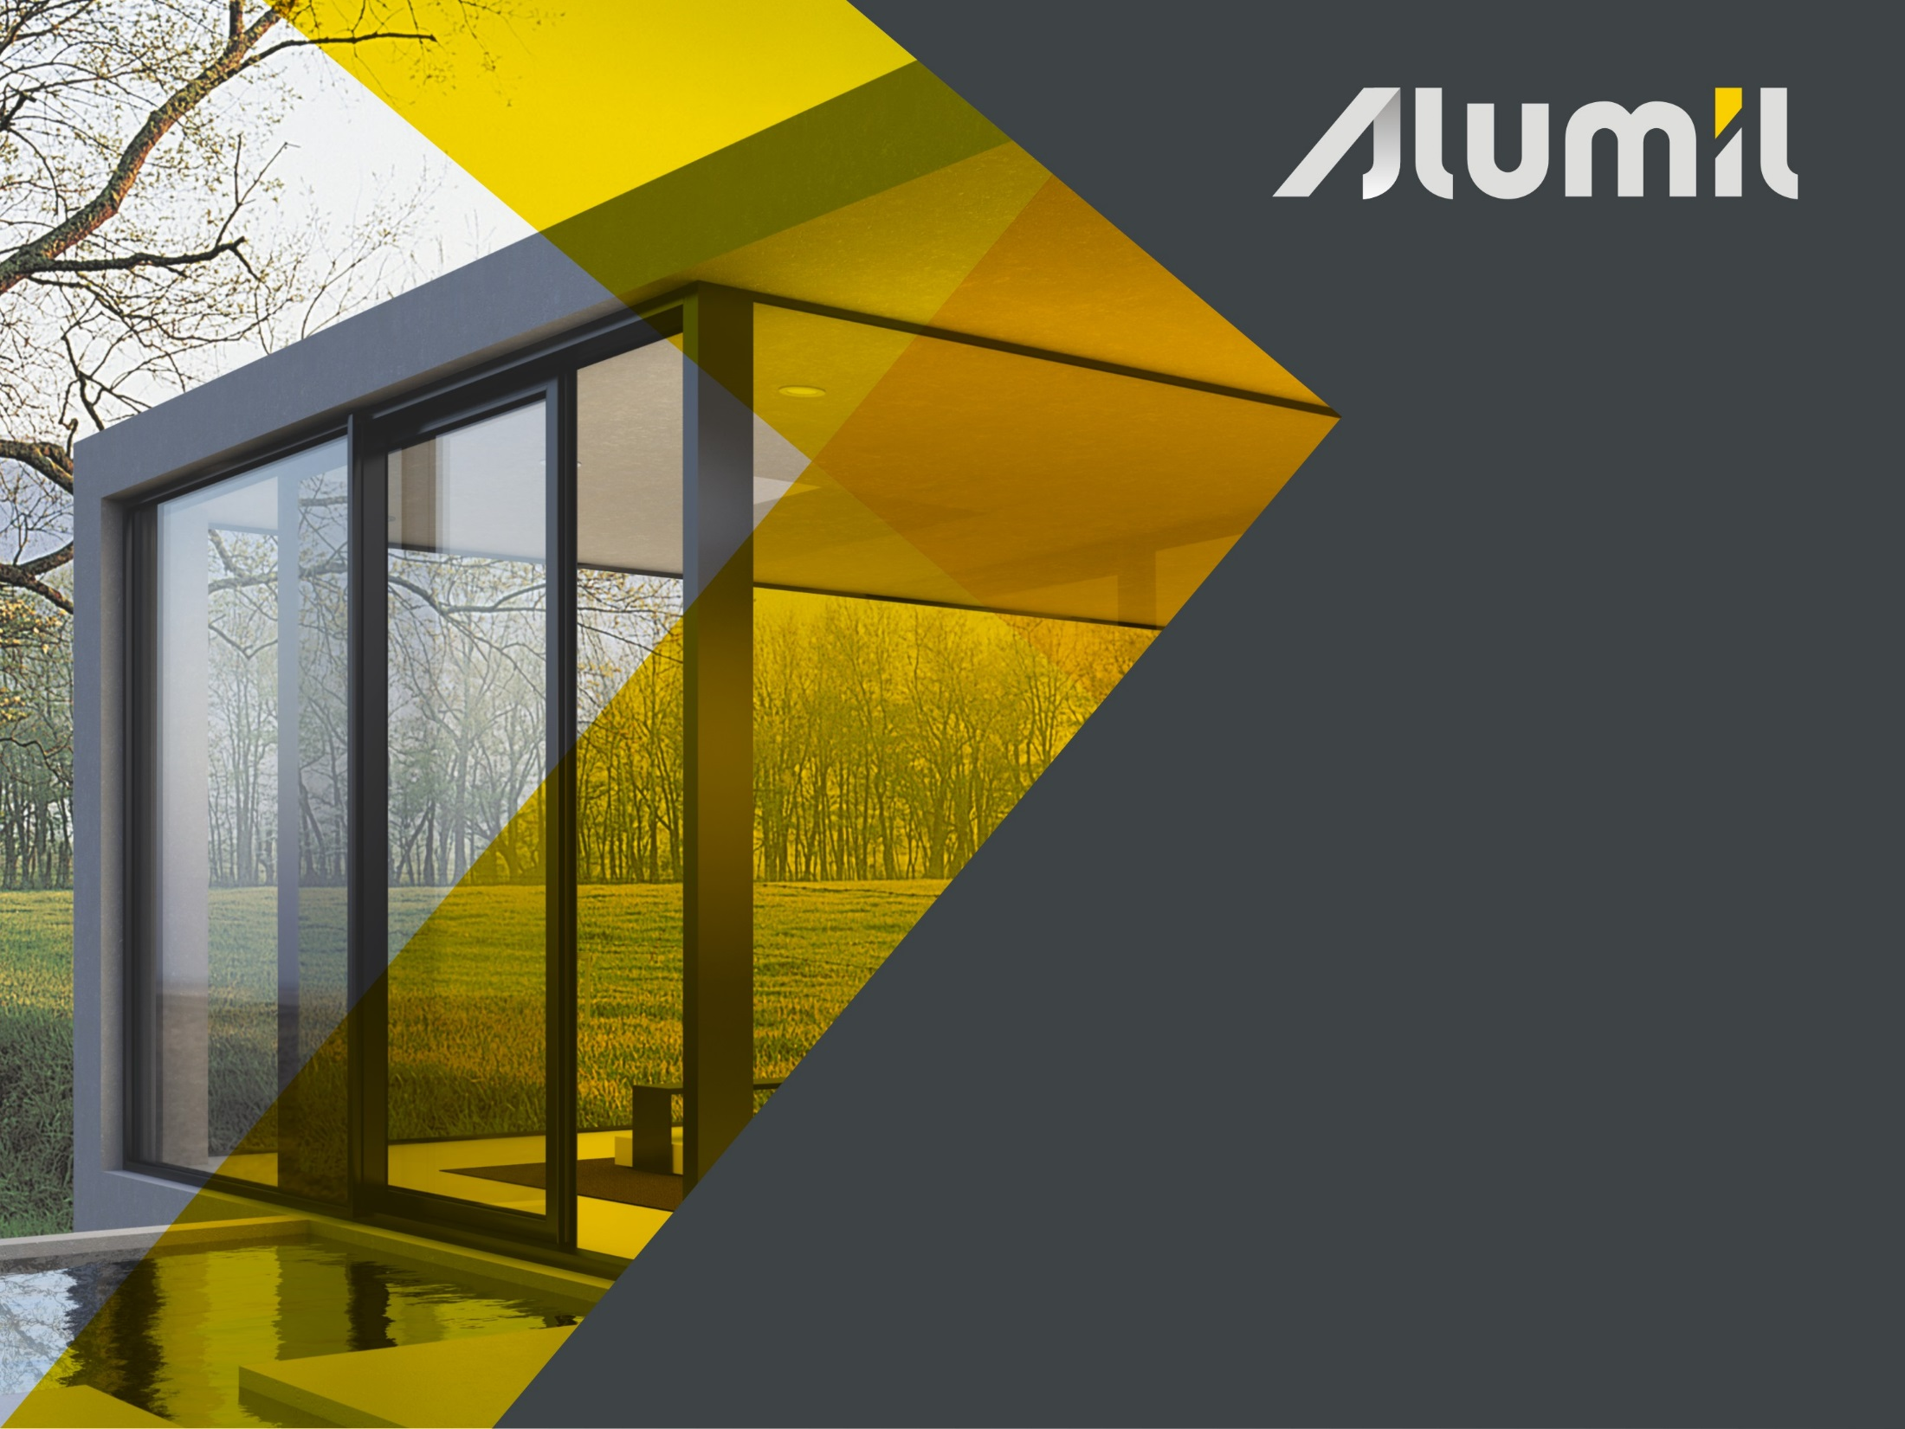



Slide 2
Contents
What & Why
Benefits
Attention to detail
Functionality & Credibility
Promotional material
Reference Projects

Slide 3

What
Thermally insulated lift & slide system
Perfect for wide spans
Minimal and innovative design
Invisible bottom track totally integrated into the floor (S700 Eclipse version)

Slide 4
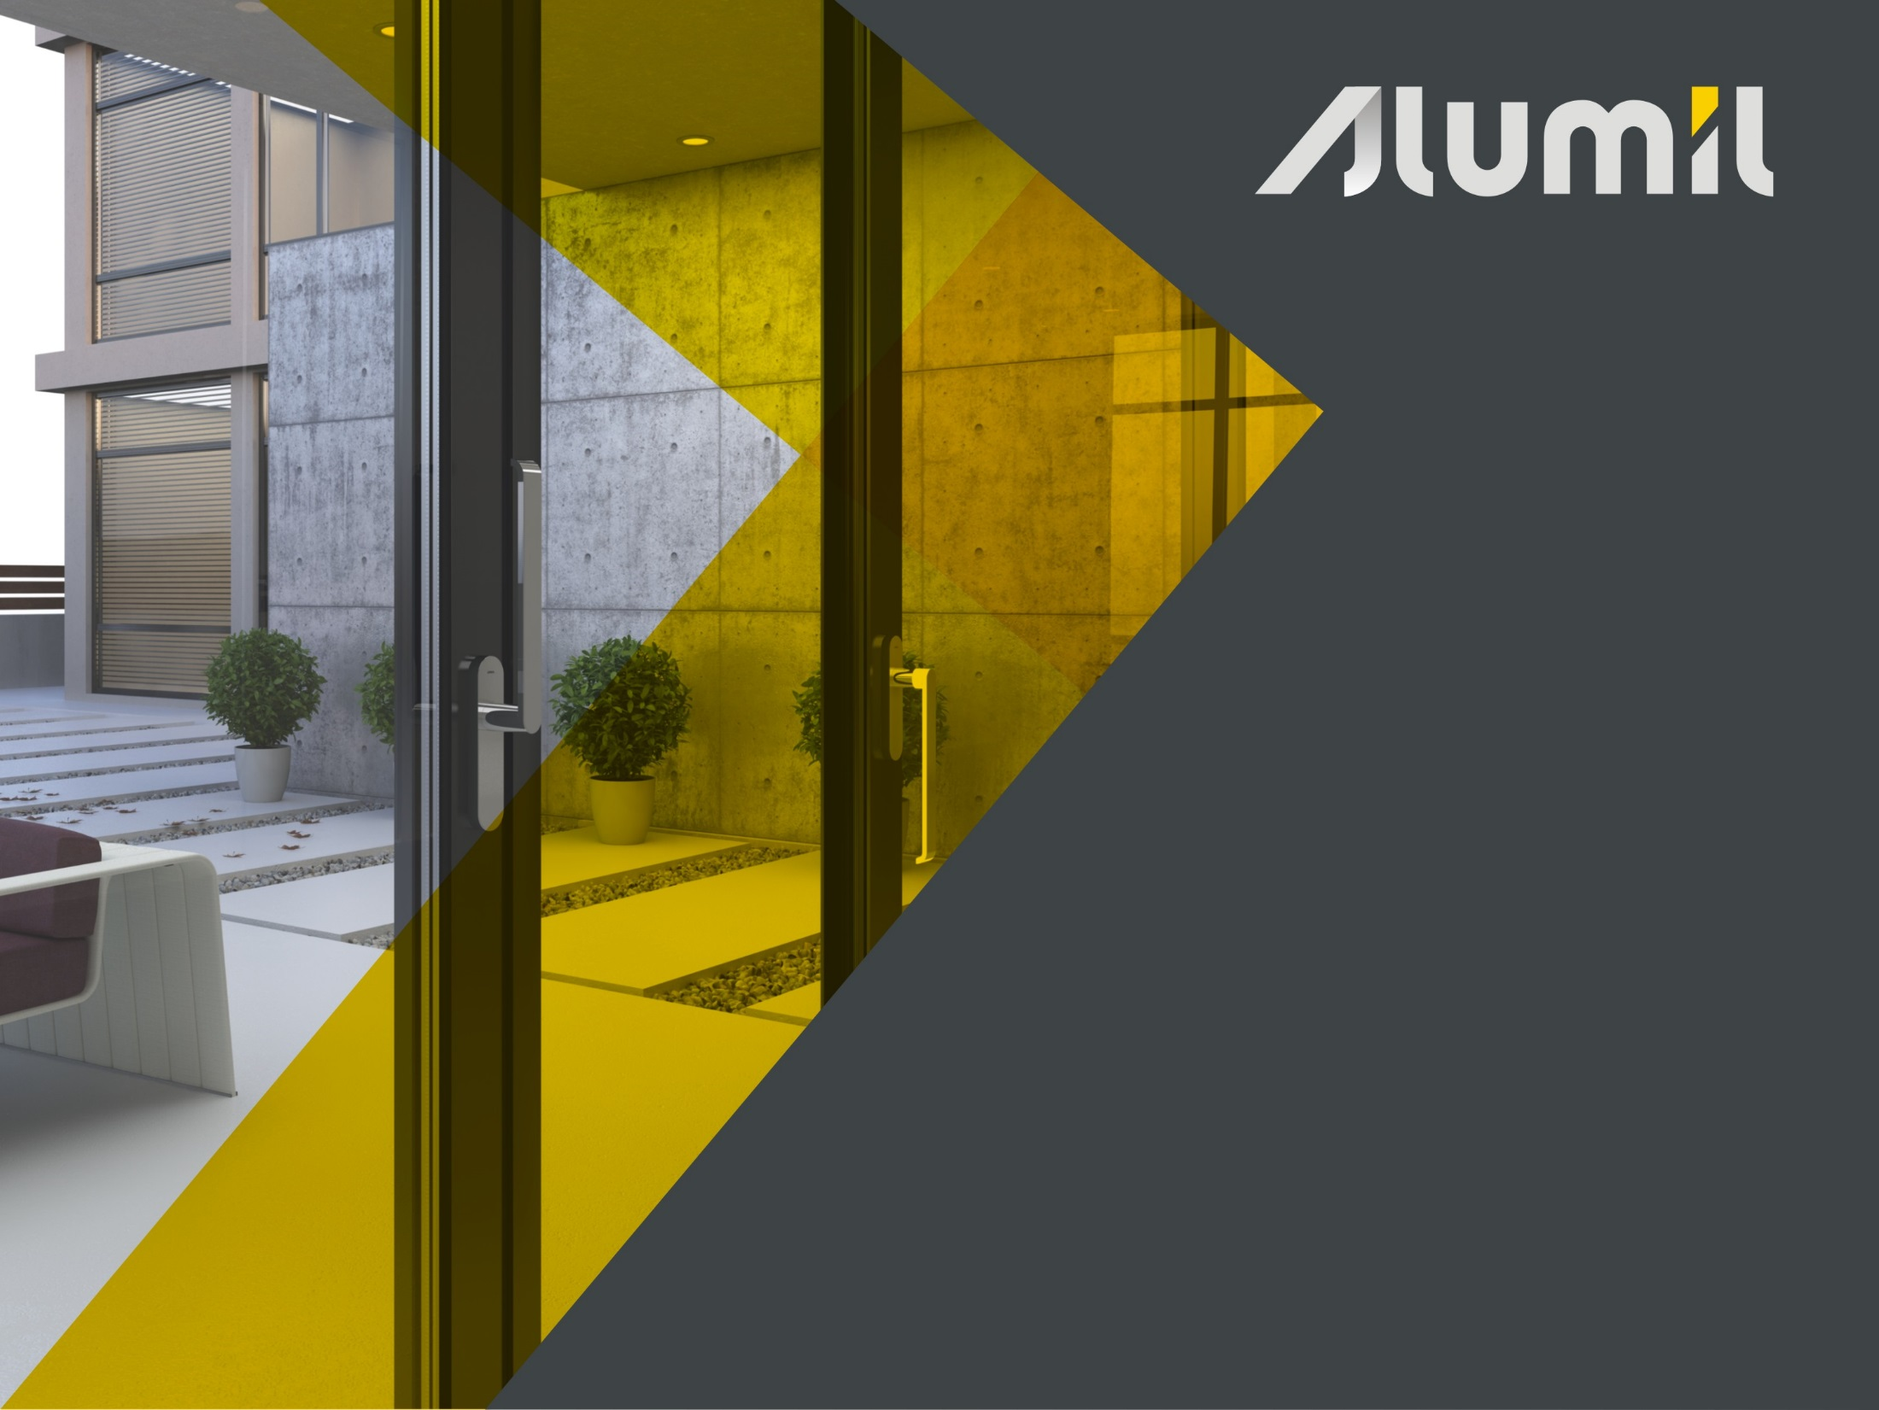
Why
High thermal insulation, sound reduction, safety and overall performance
Impressive functionality and stability
Sense of continuity between interior and exterior environment (S700 Eclipse version)

Slide 5

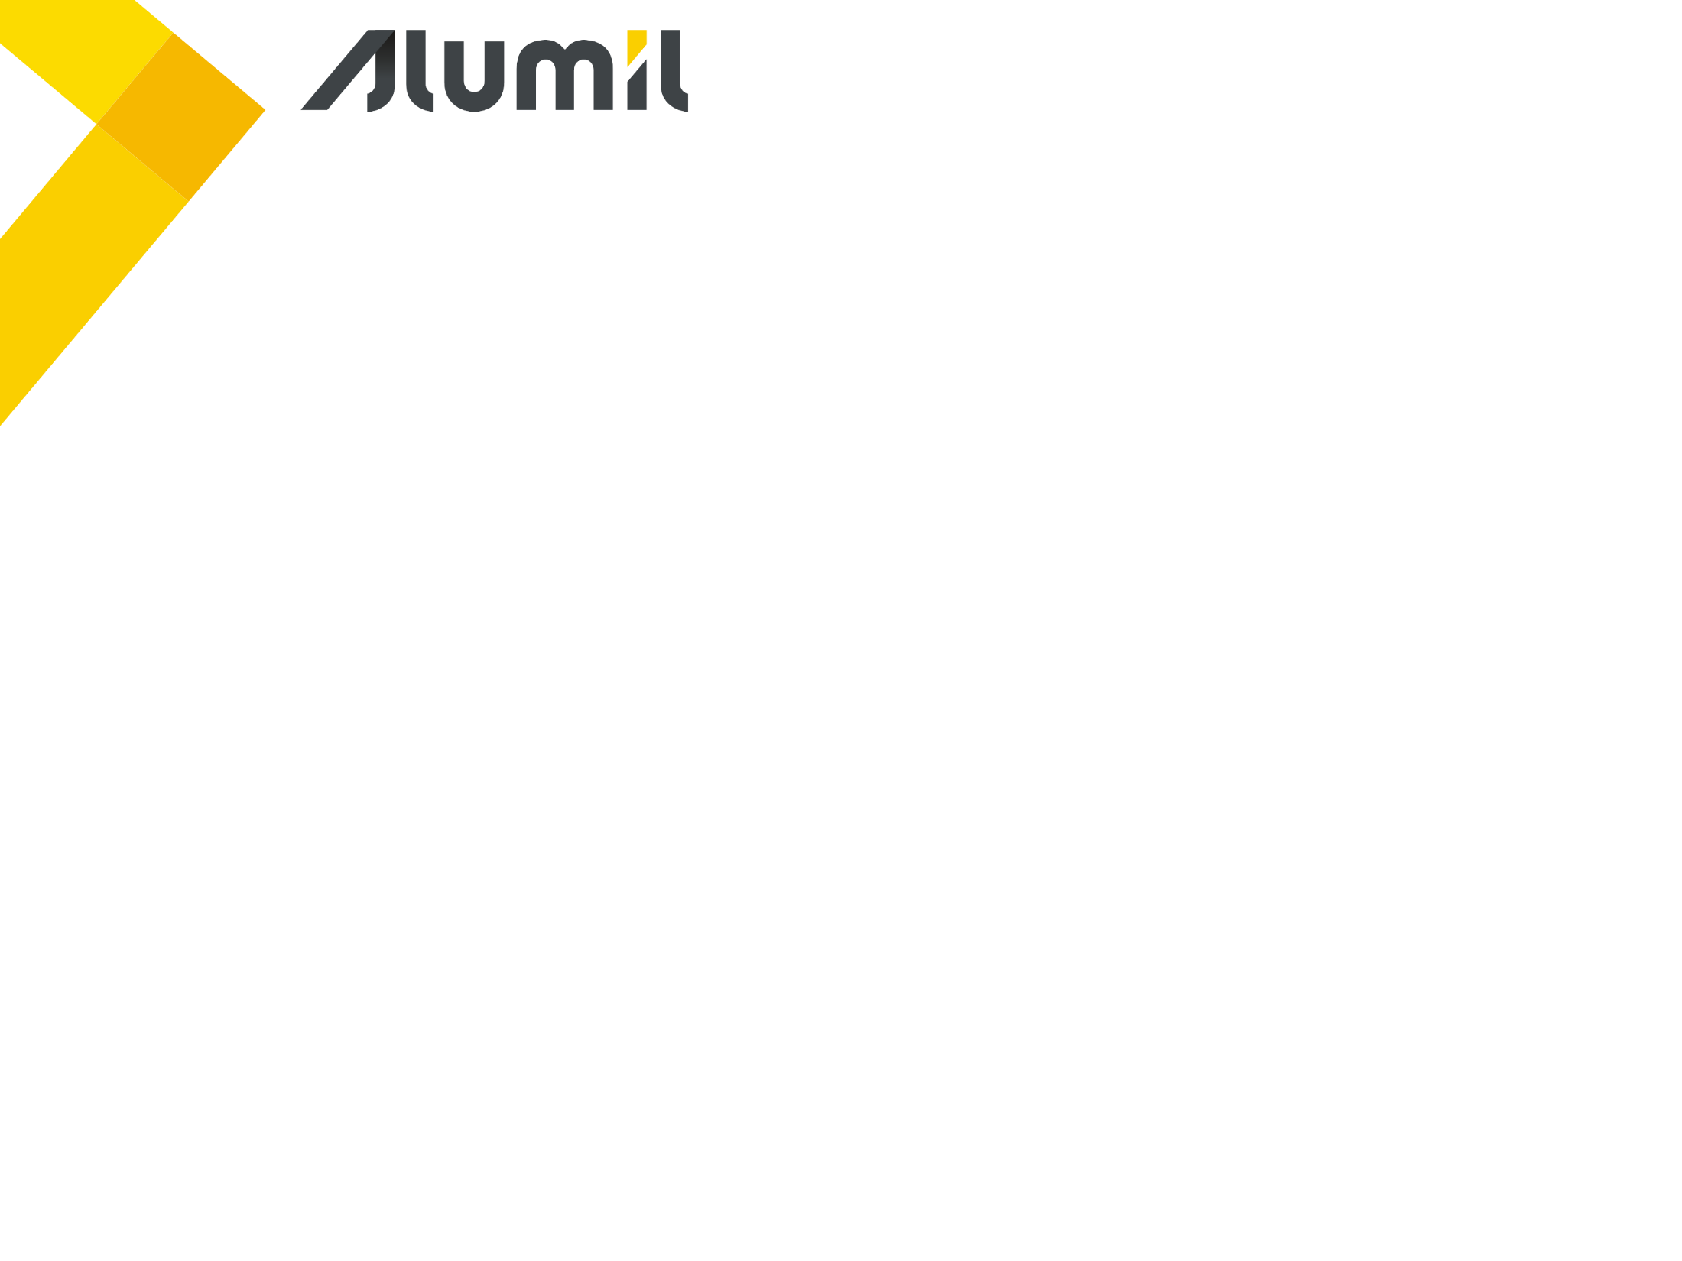
Benefits

Slide 6
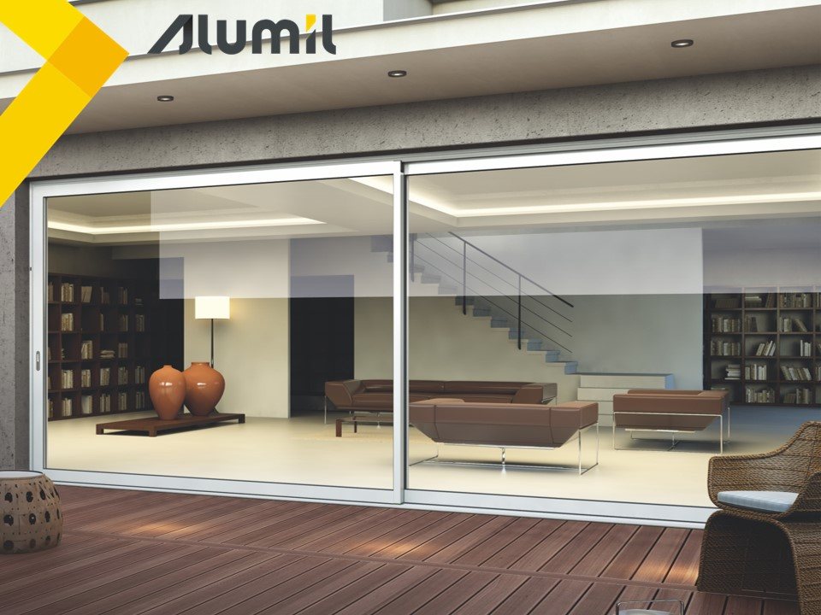
Benefits
Total comfort thanks to the high sound reduction level
1
3
Enhances visibility & sense of freedom
2
High security with multi-locking mechanism
Energy & cost saving thanks to the high thermal insulation
4
5
Easy & safe access with flat or eclipse track

Slide 7
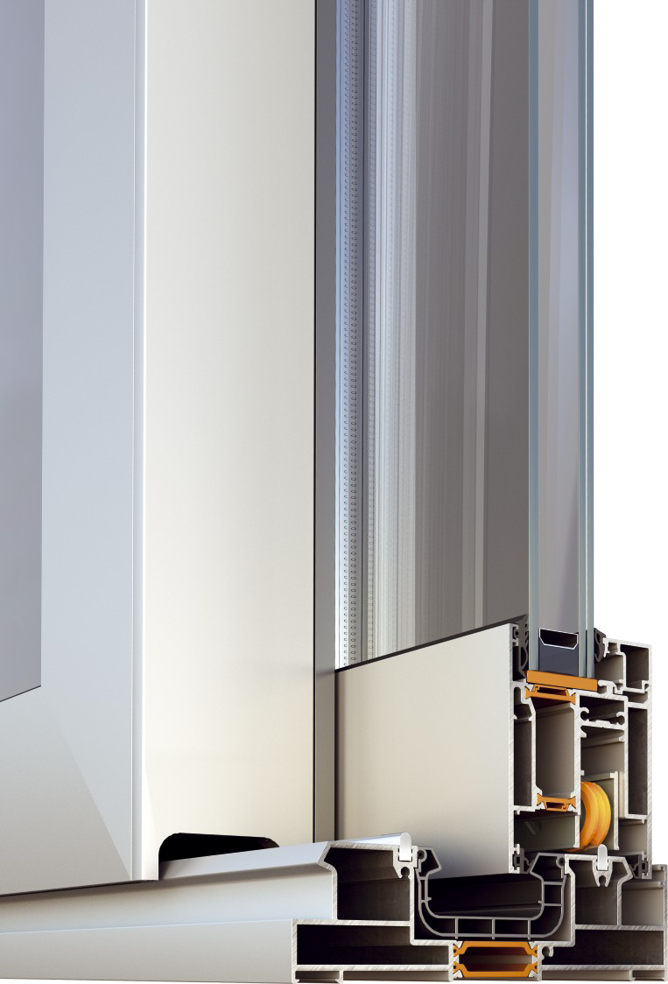
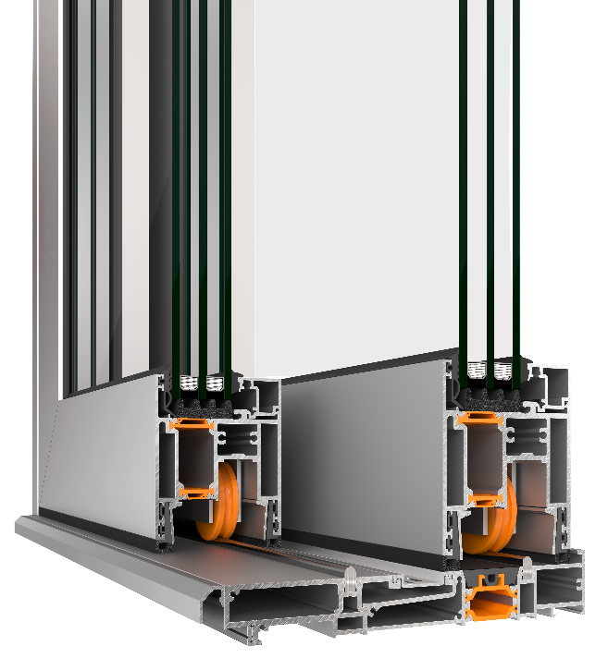
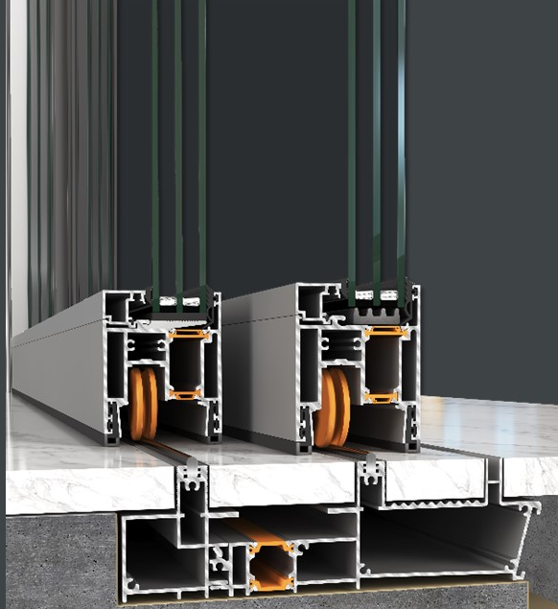
Benefits
Available 3 alternative bottom track solutions offer flexibility in construction!
Standard track solution
Flat track solution
Eclipse track solution

Slide 8
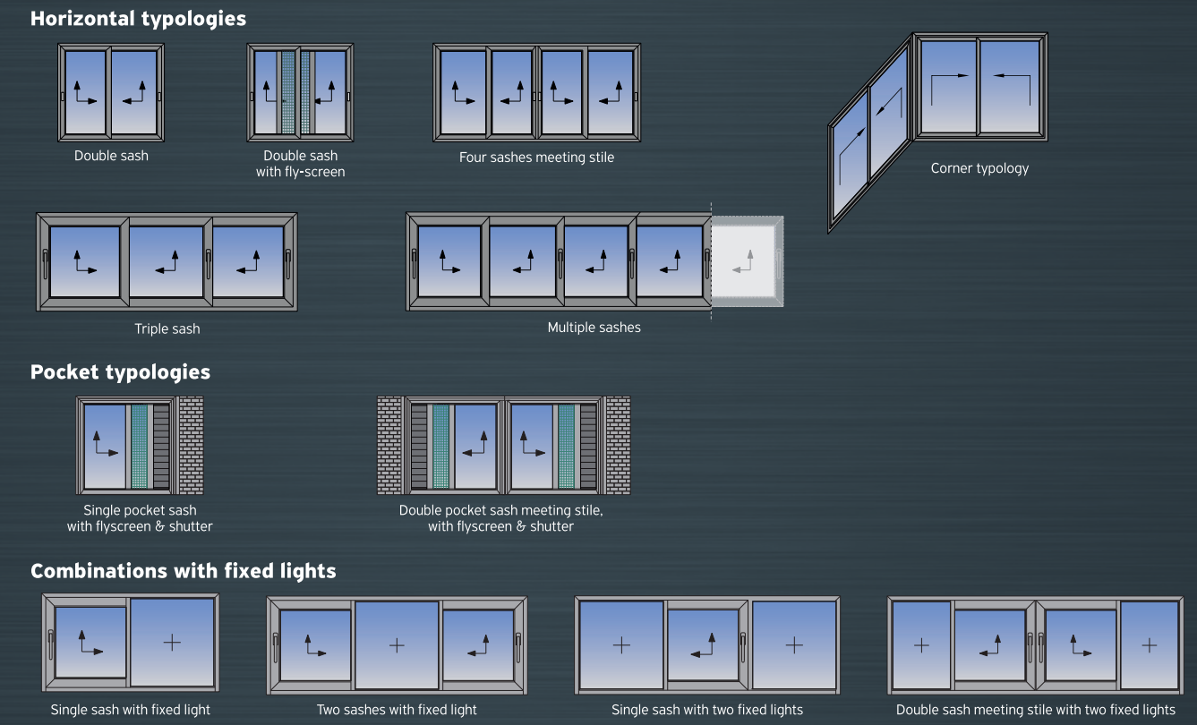
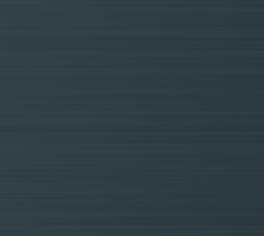
Benefits
Available typologies
Available also for Eclipse version
*Available with standard & eclipse track profiles

Slide 9
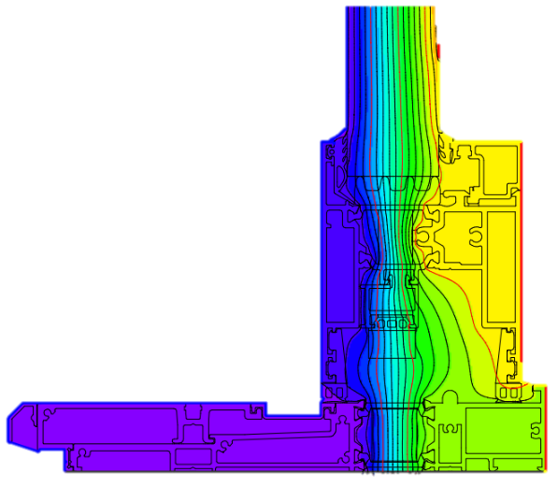

Benefits
Energy saving & Thermal Comfort
Excellent thermal insulation
Maximum energy saving by minimizing thermal losses
Uw=1,1 W/m²K
For double lift & slide sash with dimensions 5,0 x 2,5 m & Ug=0,7 W/m²K

Slide 10

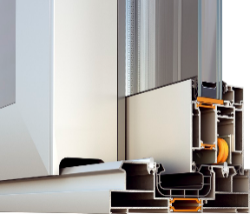
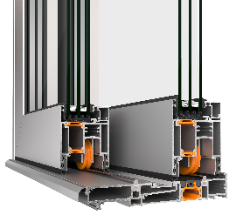

Benefits
Certifications
 | SUPREME S700 Standard track | SUPREME S700 Flat track | SUPREME S700 Eclipse track
Air permeability | 4 | 4 | 4
Watertightness | Ε900 (900 Pa) | 5A (200 Pa) | E900 (900 Pa)
Resistance to windload | C4 | C3 | C2
Sound reduction | 41dB | - | -
Burglar resistance | RC2 | - | -
Thermal insulation Uf | From 1,6 to 7,1 W/m²K | From 1,6 to 7,1

Slide 11





Benefits
Certifications
Notes:
IFT (Germany)
ATG (Belgium)
PAS24 (UK)
AAMA (USA)
AS (Australia)

Slide 12
Attention to detail

Slide 13
Attention to detail
Standard track
70 mm
95,5 mm
137 mm
48 mm

Slide 14
Attention to detail
Standard track
EPDM gasket for sash
PVC profile for track profile
Polyamides anti-bi-metal 24mm & 18,6mm at sash
Solid inox rail
Polyamides 38mm at track

Slide 15

Attention to detail
Flat track
70 mm
84 mm
115 mm
24 mm

Slide 16
Attention to detail
Flat track
EPDM foam gasket for sash
EPDM gasket for flat track
Polyamides anti-bi-metal 32mm & 28mm at sash
Solid inox rail
Polyamides 28mm at track

Slide 17

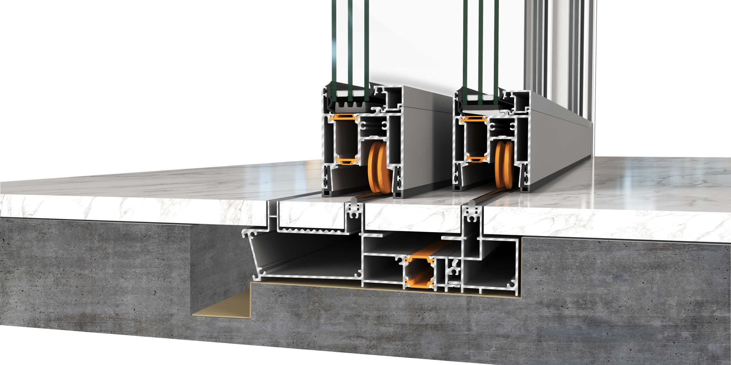
Attention to detail
Eclipse track
70 mm
84 mm
64 mm

Slide 18
Attention to detail
Eclipse track
Solid inox rail
Polyamides anti-bi-metal 24mm & 18,6mm at sash
EPDM foam gasket for sash
Polyamides 22mm at track

Slide 19
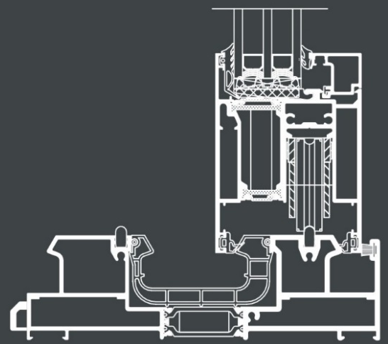


Attention to detail
Sash profiles - Uf
Hi version
U_{f} = 2,1 W/m²K
U_{f} = 2,8 W/m²K
U_{f} = 2,8 W/m²K
Sash S70706
Polyamides 24 & 18,6mm
NGR bars
Compatible with standard track
Sash S70710
Polyamides 24 & 18,6mm
NGR bars
EPDM foam sash gaskets
Compatible with flat & eclipse track
Sash S70776
Polyamides 32 & 28mm
NGR bars
EPDM foam sash gaskets
EPDM foam infills
Sash PVC
Compatible with flat & eclipse track

Slide 20
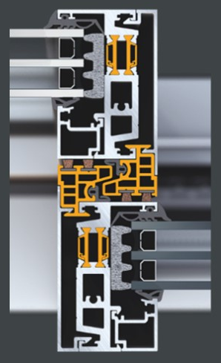
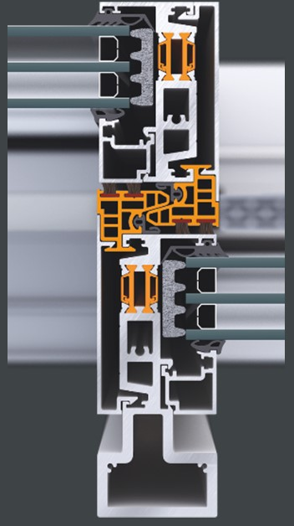
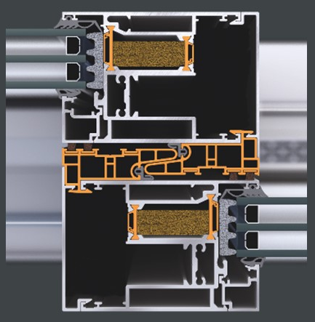
Attention to detail
Compatible with all the available bottom tracks
Interlocking profiles
Standard interlocking profile
Narrow interlocking profile
Reinforced interlocking profile
S70706: 106mm
47 mm
47 mm
S70710: 94 mm
PVC for narrow interlocking profiles
PVC for standard interlocking profiles
Reinforced profile for greater resistance to wind pressures

Slide 21
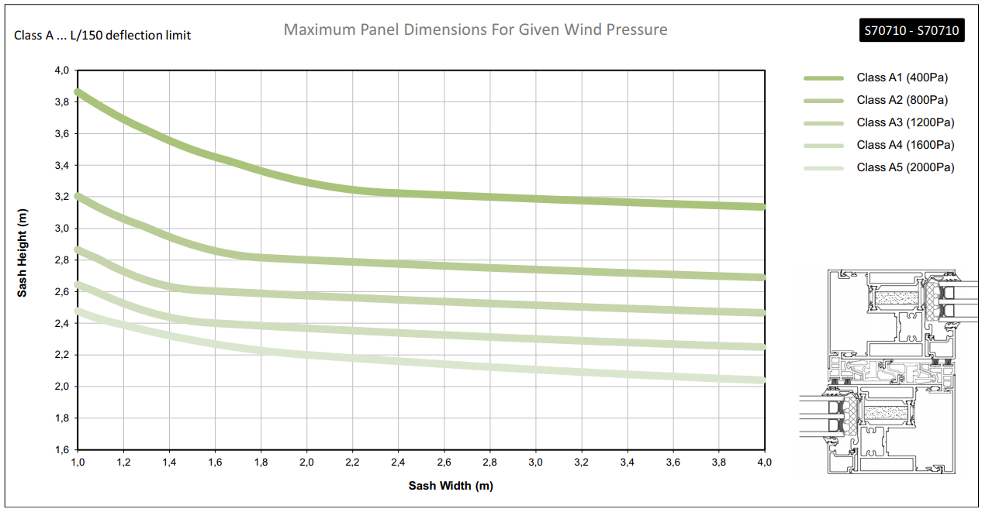
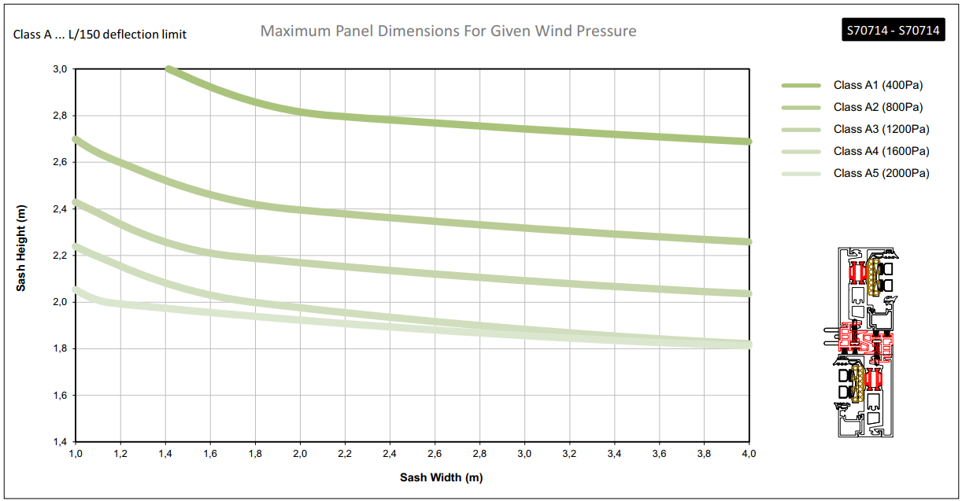
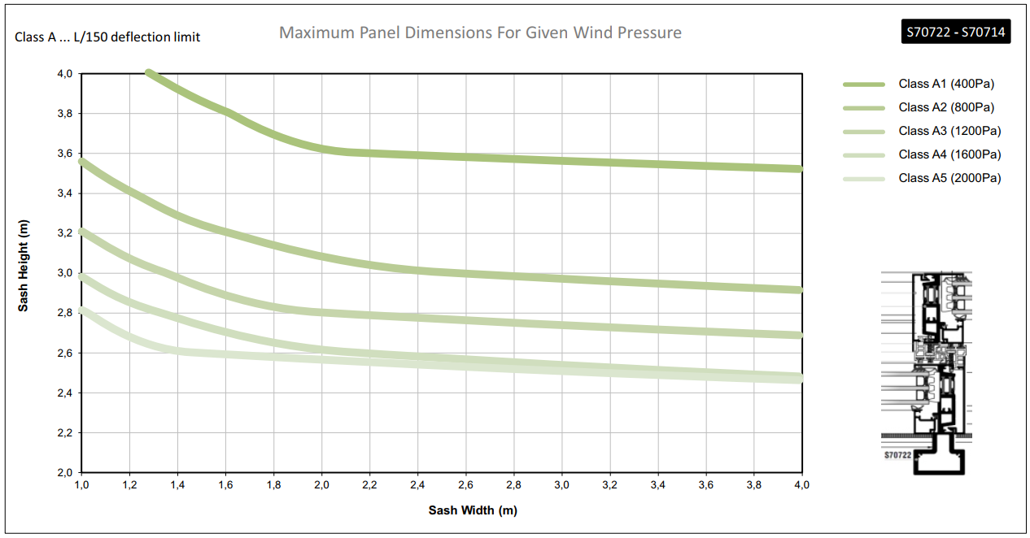
Attention to detail
Max Sash dimensions
Maximum sash dimensions depending on wind pressure & max sash weight
Static diagrams included in technical catalog

Slide 22
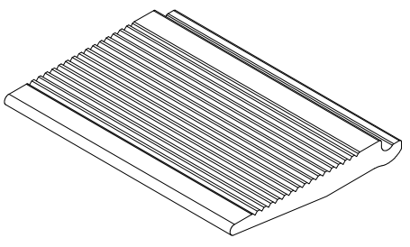
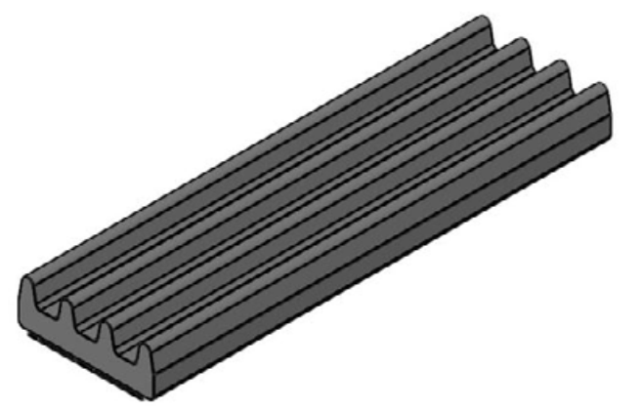
Attention to detail
Glazing
Glazing
bridge
Glazing thickness from 22 up to 50 mm
Triple or double glazing
Use of glazing bead for easier installation
Sturdier tubular glazing bead for maximum security
Insulation foam installed perimetrically of the glazing
Aluminium glazing bridge to support glazing loads
Insulation
foam

Slide 23
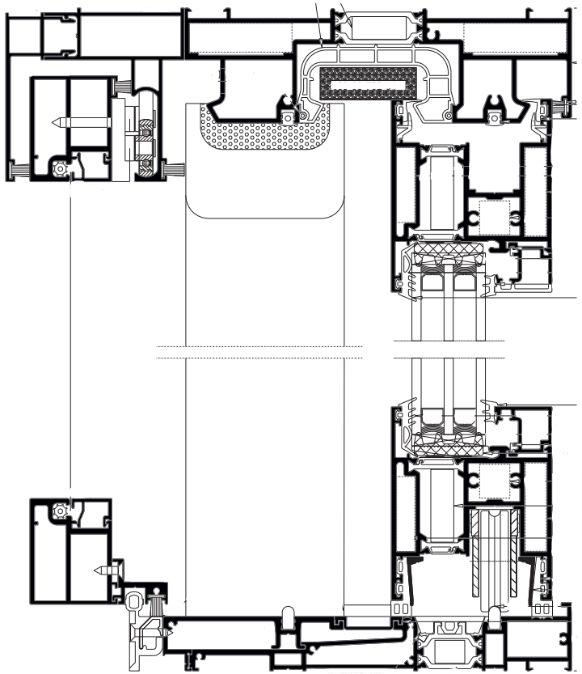
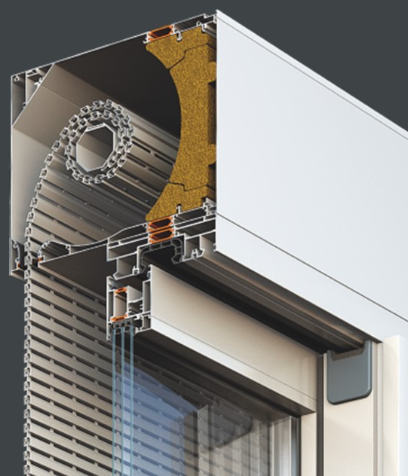
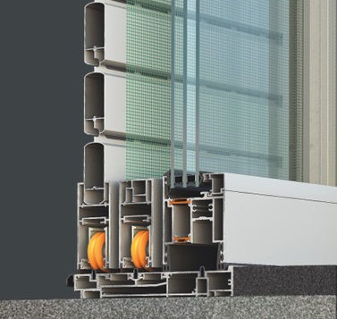
Attention to detail
Cooperation with
Shutters & Fly-screens
Top-hunged fly-screen available for 2-sash typologies
Pocket sash typologies can be combined with sliding fly-screen and shutter
Cooperates perfectly with the rolling shutter system S13600
Notes:
Shading and sun protection

Slide 24
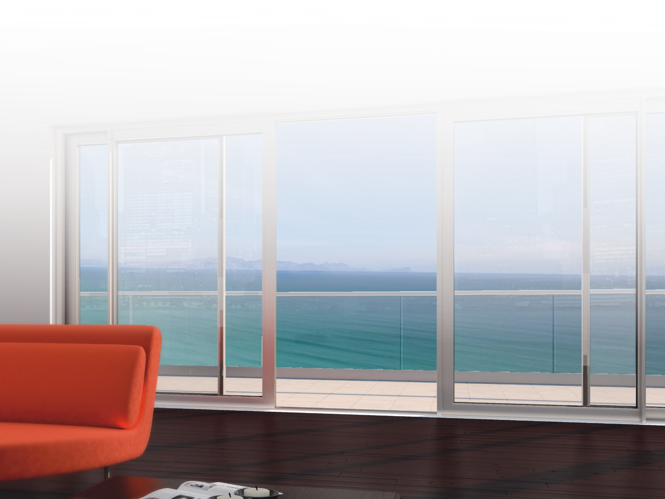
Attention to detail
Automatic version
SUPREME S700 is also available in automatic version for lift & slide typologies with fixed lights

Slide 25

Functionality & Credibility

Slide 26
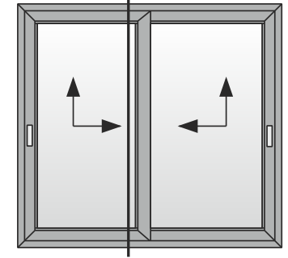
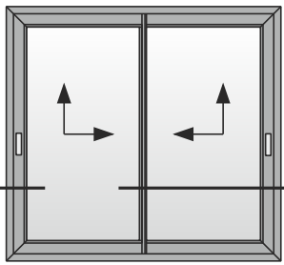
Functionality & Credibility
Assembly
45º connection of the track perimetrically with crimp or mechanical corners
Standard bottom track – Standard Interlocking profile
1
45º connection of the sash perimetrically with crimp corners
1
Standard bottom track – Narrow Interlocking profile
45º connection of the sash with crimp corners
90º connection with plastic cap connectors at the Interlocking profile
2
2

Slide 27
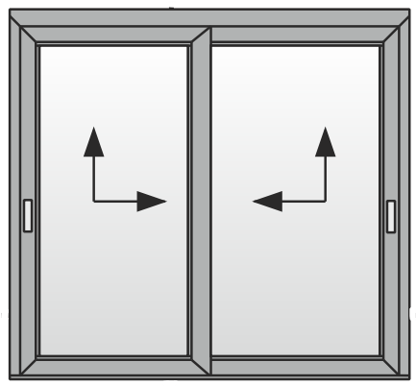
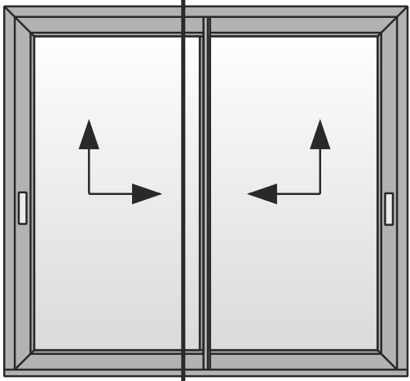
Functionality & Credibility
Assembly
45º connection of the track with crimp or mechanical corners
90º connection and special end caps for the bottom track
Flat or Eclipse bottom track – Standard Interlocking profile
3
45º connection of the sash perimetrically with crimp corners
3
Flat or Eclipse bottom track – Narrow Interlocking profile
4
45º connection of the sash with crimp corners
90º connection with plastic cap connectors at the Interlocking profile
4

Slide 28
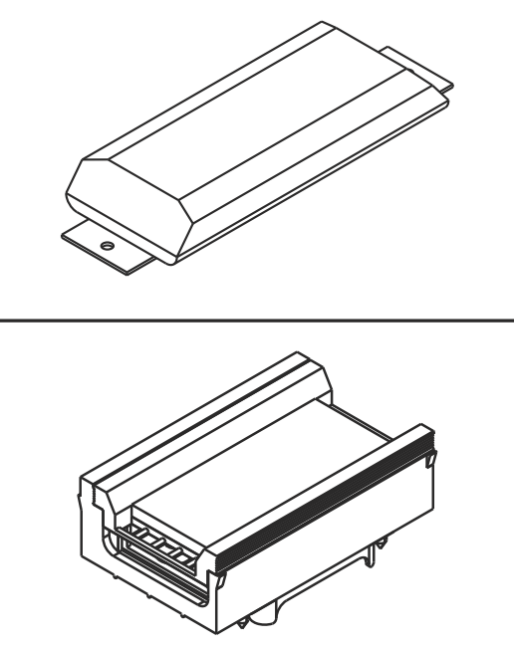
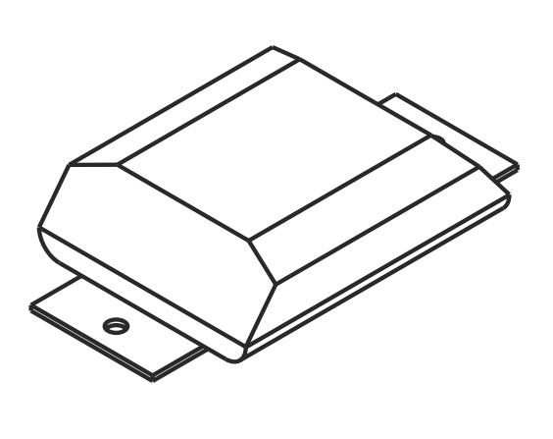
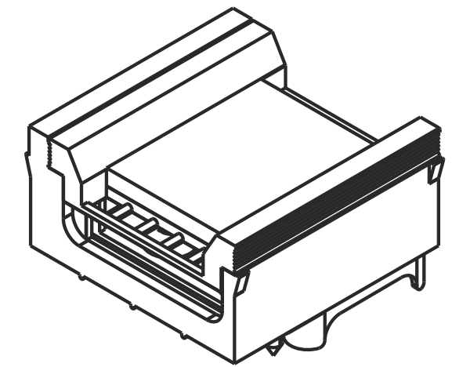
Functionality & Credibility
Central seals
For standard track
With standard Interlocking profile
With narrow Interlocking profile
Top central seals are placed over the PVC profile of the upper track
Bottom PVC profile is interrupted for the installation of the bottom central seals

Slide 29
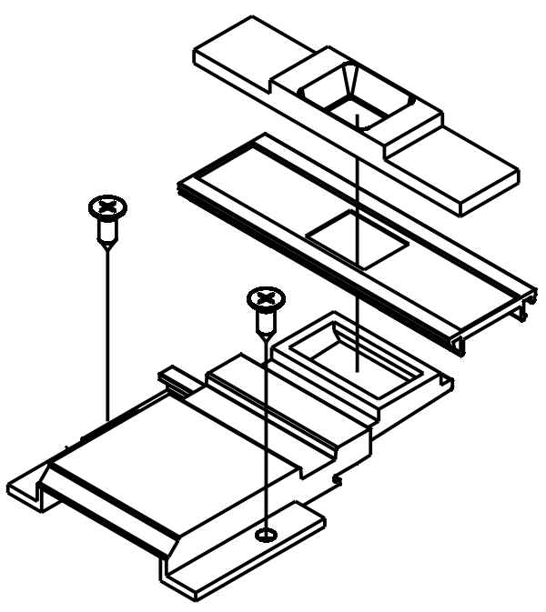
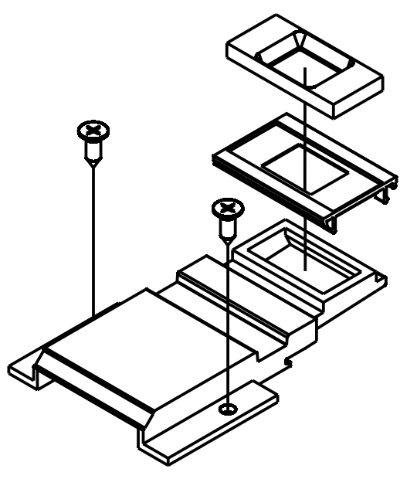
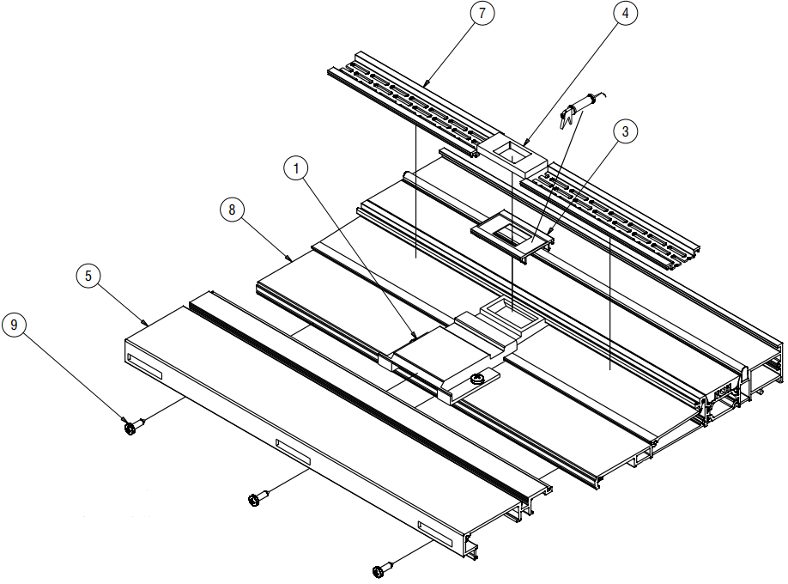
Functionality & Credibility
Central seals
For flat track
With standard Interlocking profile
With narrow Interlocking profile
Top central seals same with standard track
Bottom central seals for flat track:

Slide 30

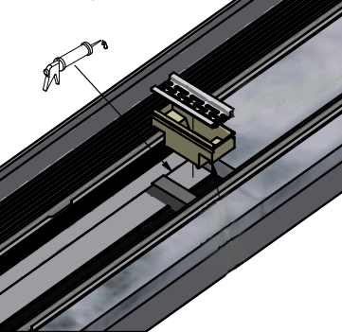
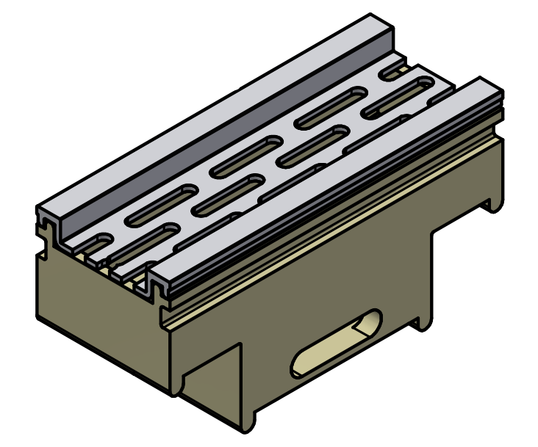
Functionality & Credibility
Central seals
For eclipse track
Top central seals same with standard track
Bottom central seals for eclipse track

Slide 31
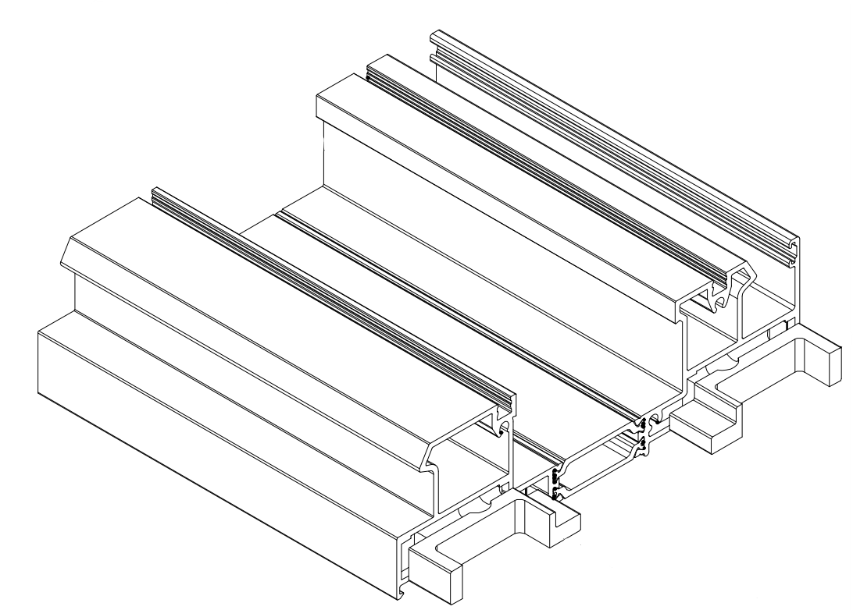
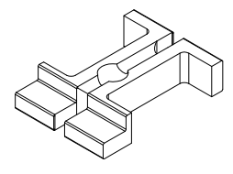
Functionality & Credibility
Porthole barriers
Optimizes the evacuation of the water
Enhances the sealing of the bottom track
Available for all typologies
For standard track

Slide 32
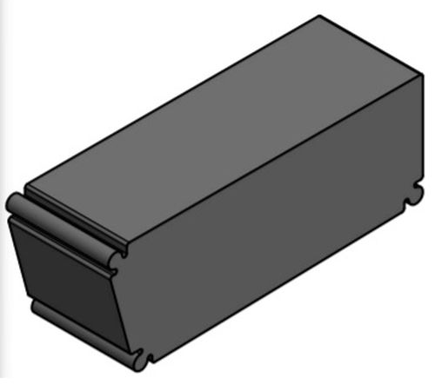
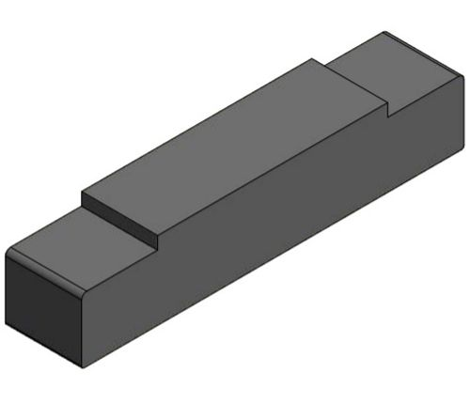
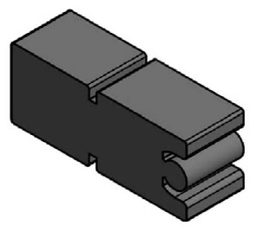
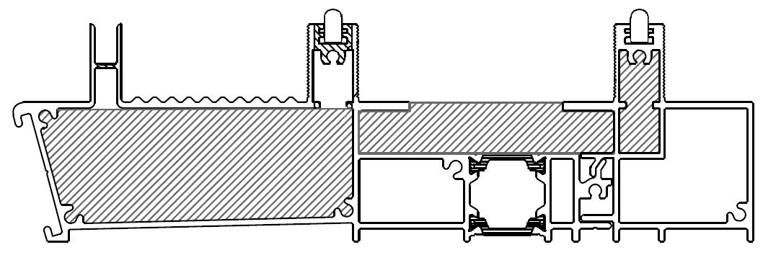
Functionality & Credibility
Porthole barriers
For eclipse track

Slide 33
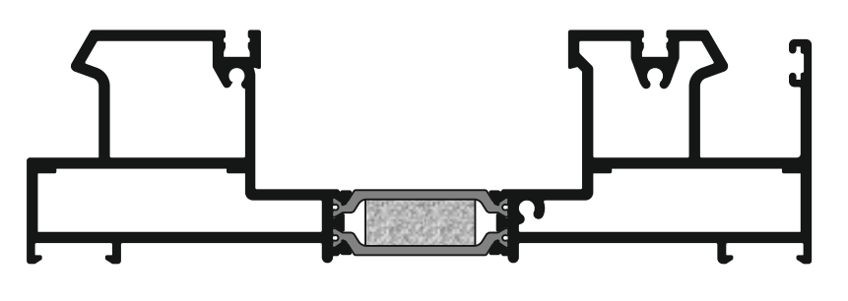
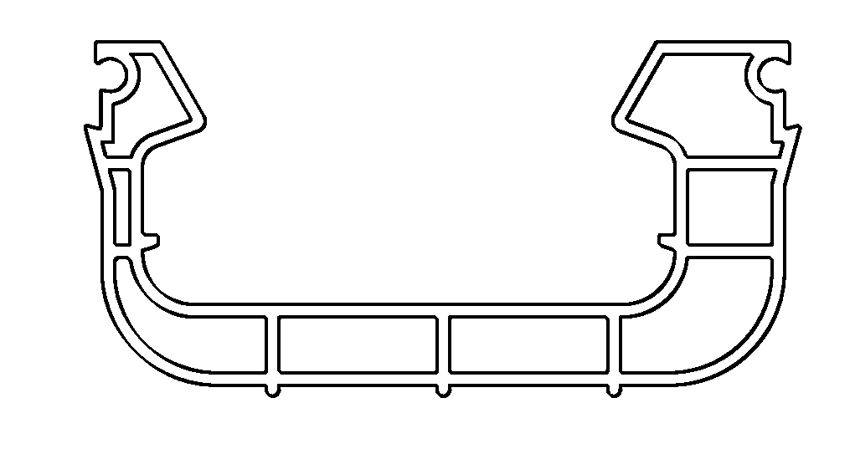
Functionality & Credibility
Water evacuation
For standard track
Water follows the way out through the external chamber of the track
PVC profile machining also necessary for water evacuation

Slide 34
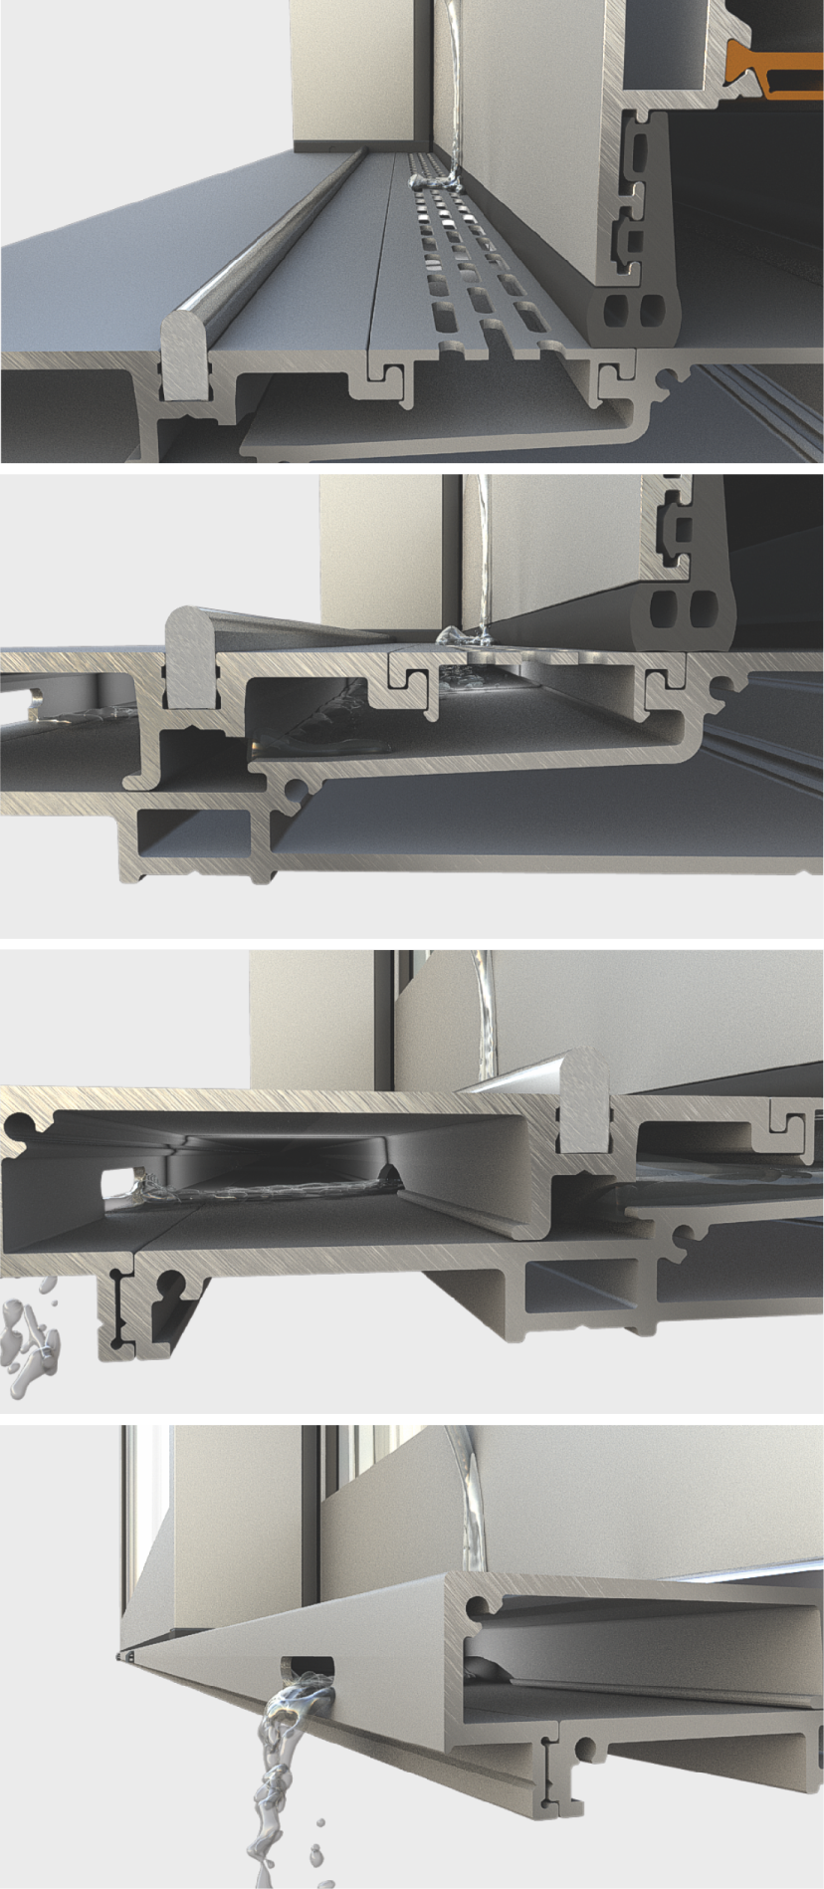
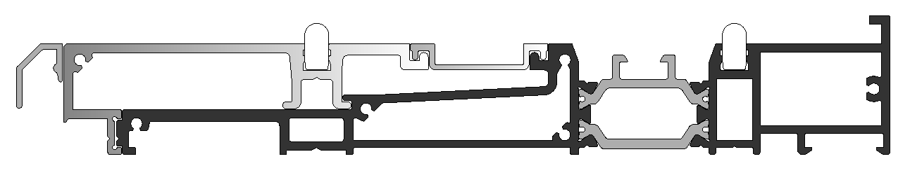
Functionality & Credibility
For flat track
Water evacuation
Smart water drainage system even under adverse weather conditions
Specially patented water drainage accessory, placed under the central interlocking, offering a high level of watertightness
Specially perforated profiles, allow the water to flow through the profiles to its way out
Track profiles at the bottom are pretreated by ALUMIL to make the installation easier for the manufacturer

Slide 35
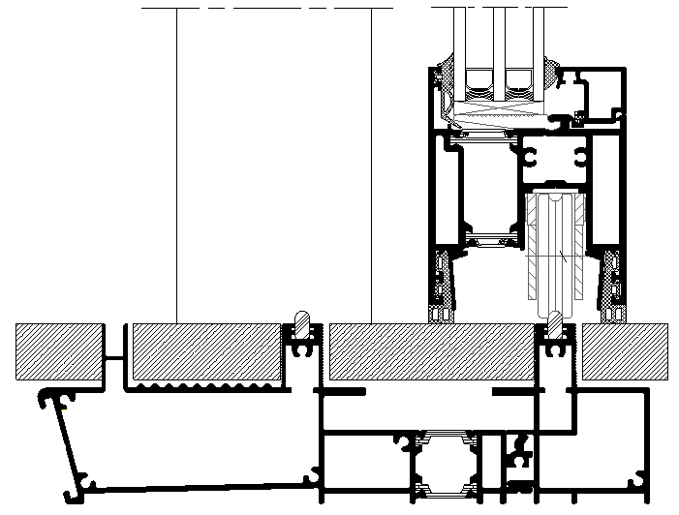
Functionality & Credibility
Water evacuation
For eclipse track
Water drainage through the bottom track, without affecting its thermal insulation
Water ends up in the system’s gutter connected with the plug system through a 32mm pipe

Slide 36
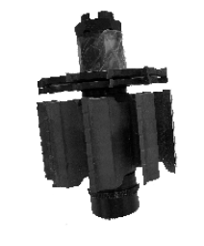


Functionality & Credibility
Milling tools
S700 milling tools for:
Narrow interlocking profiles’ machinings
Sash machinings for 90º connection
Adjoining profile machinings

Slide 37

Functionality & Credibility
Punching machine
ALUMIL pneumatic punching machine
For SUPREME hinged & sliding systems
Insert detachable tools for S700

Slide 38


Functionality & Credibility
Lift & Slide mechanism
Up to 300 kg per sash with standard lift & slide version
Up to 400 kg with extra set of rollers
Up to 600 kg by adding lift unit

Slide 39


Functionality & Credibility
Lift & Slide mechanism
Standard pin
Mushroom pin

Slide 40
Promotional material

Slide 41


Technical Catalogues

Slide 42


Pre-Qualification file (Pre-q)
Technical data sheet

Slide 43
Reference Projects

Slide 44


Slide 45


Slide 46


Slide 47
Thank you!

