Slide 2



Slide 3

What
SUPREME SD115 PIVOT is the epitome of elegance for entrance doors with coplanar surfaces and structural design.
Be the first pivot entrance door system in the market so as to set the standards and go one step further compared to competitors.

Slide 4

Why
SUPREME SD115 PIVOT is a “one-of-a-kind” product that targeting at the heart of the high-end market increases margins, prestige & brand awareness

Slide 5

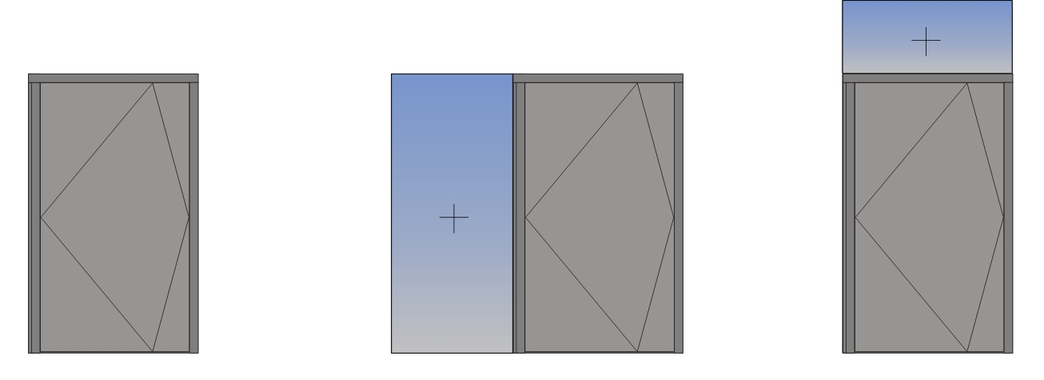

The Benefits
1. Flexibility of construction

Slide 6
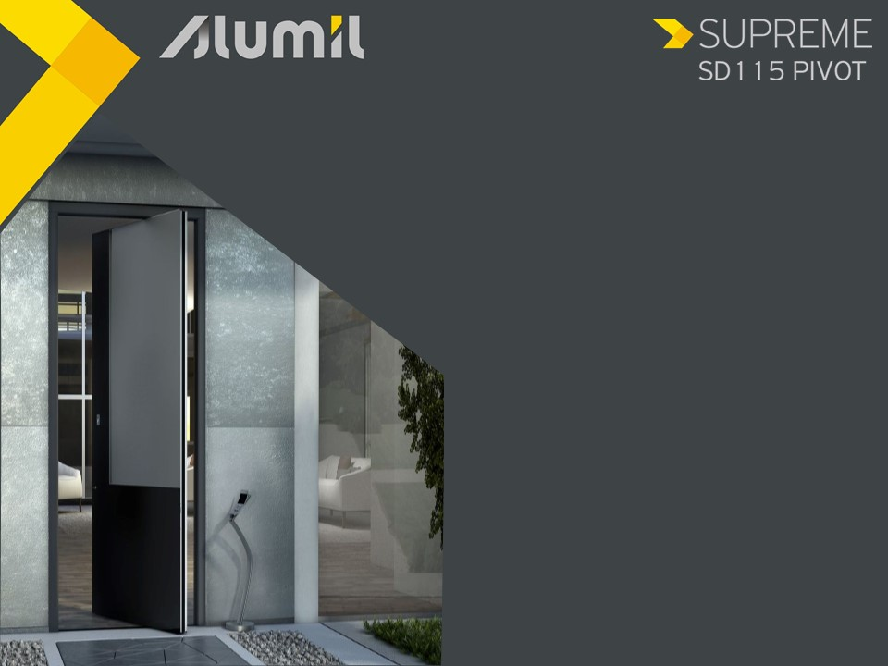
The Benefits
1. Flexibility of construction
Single-leaf typologies with:
Panel internally & externally

Slide 7
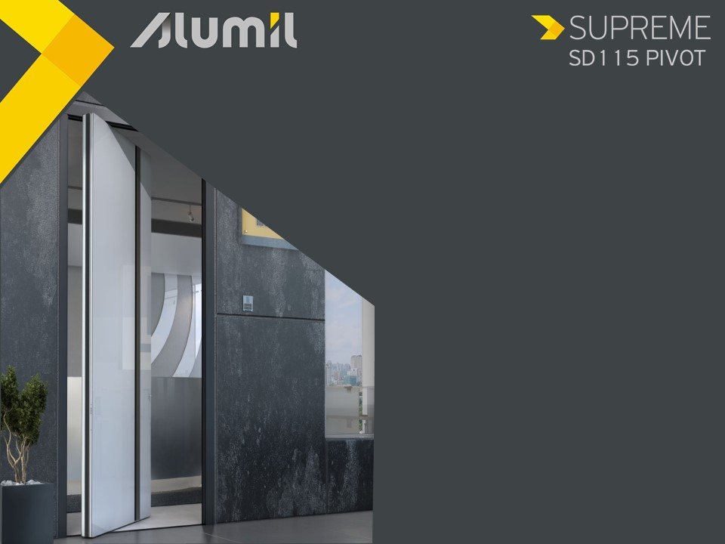
The Benefits
1. Flexibility of construction
Single-leaf typologies with:
Panel internally & Glass pane externally
Glass pane internally & externally

Slide 8
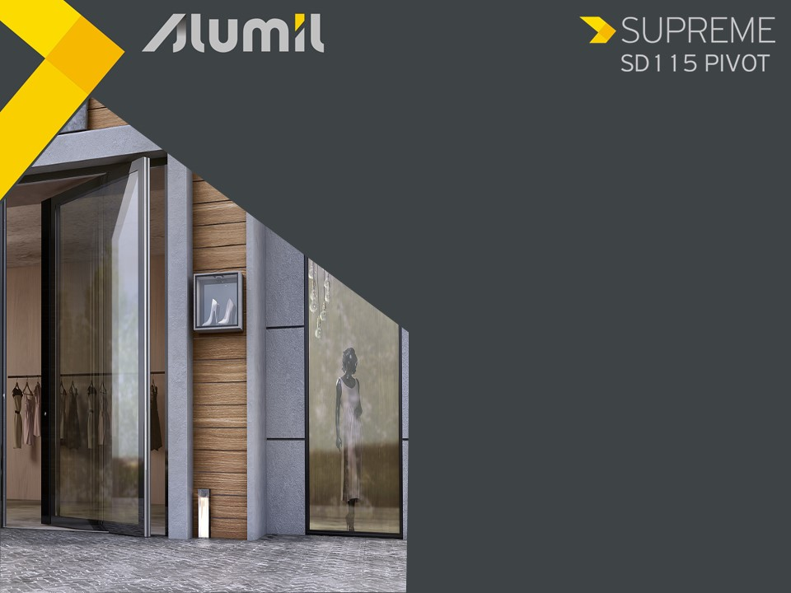
The Benefits
1. Flexibility of construction
Single-leaf typologies with:
Transparent glass internally & externally

Slide 9
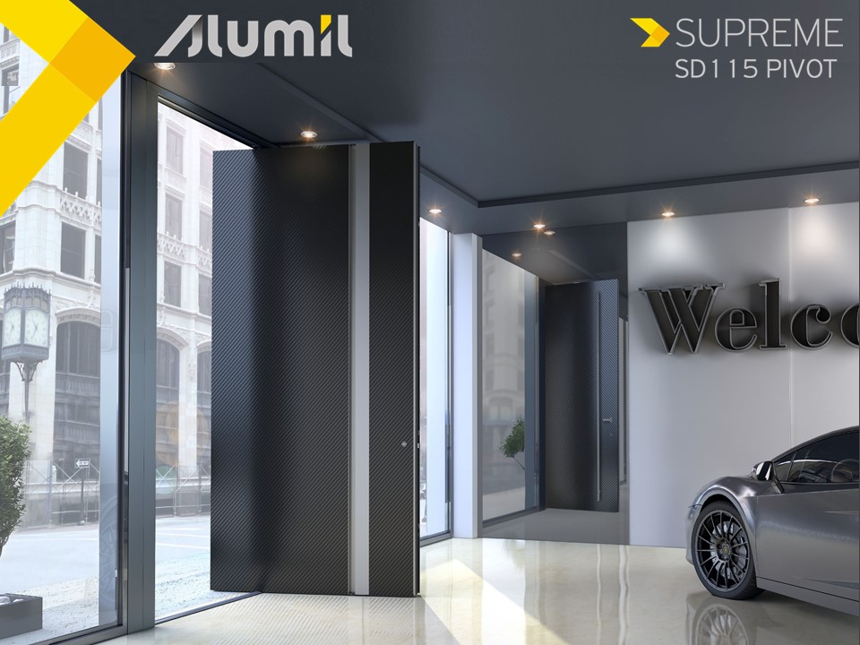
The Benefits
2. Minimal aesthetics
Total co-planarity between wall – frame – sash
Integrated recessed external handle
Enhanced with LED light

Slide 10
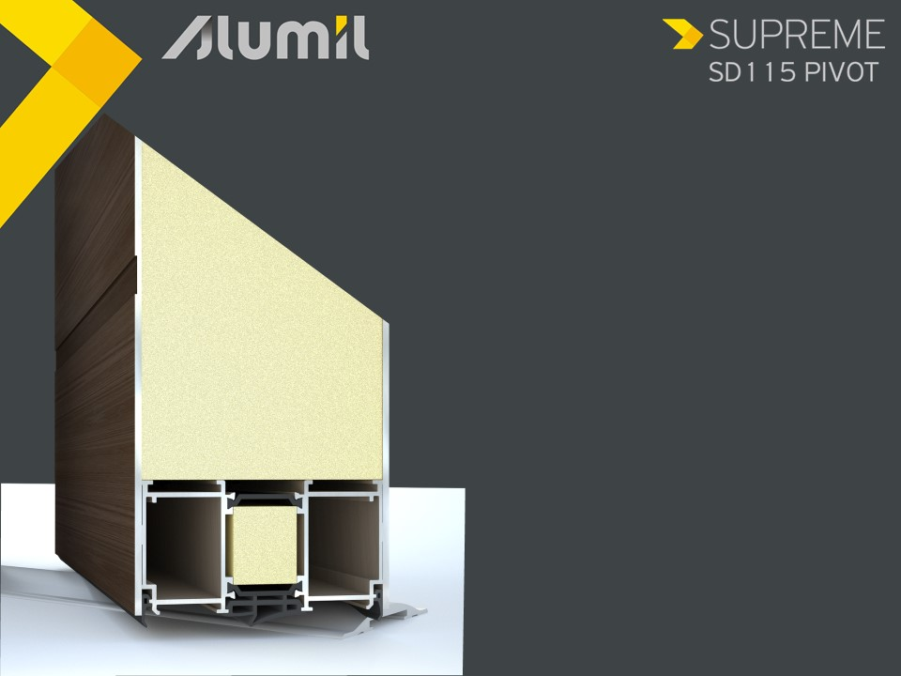
The Benefits
3. Comfort
Prohibits the transfer of sound from and to the inside of the space
Frame / sash thickness 115mm
Insulation panel from 115 up to 126mm

Slide 11


The Benefits
4. Easy access
Easy access with the low threshold of only 7mm height
Ideal for children, elders & people with special needs
7 mm

Slide 12
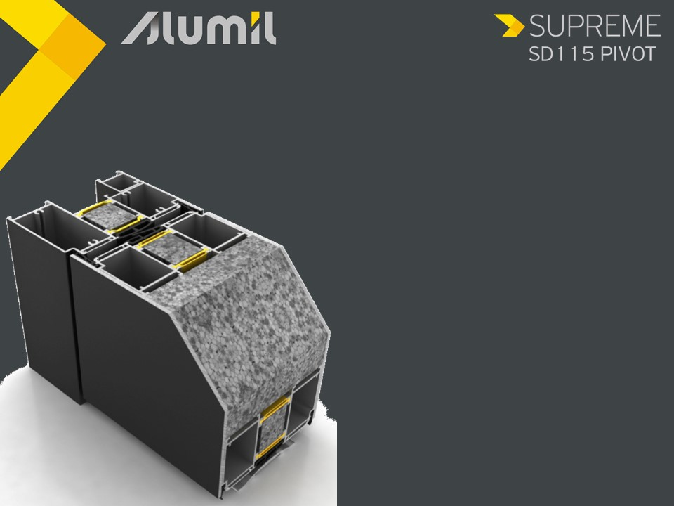
The Benefits
5. Energy saving
Excellent levels of thermal insulation
Ud = 0,7 W/m²K
* 1-leaf door 1,30 x 3,00m & Up=0,3

Slide 13
The Benefits
5. Energy saving
Glass reinforced polyamides distorsion resistant with 34mm width
Energy bars into the chambers of the profiles
Insulation foam perimetrically of the frame
Sealing with EPDM gaskets and pre-fabricated corner gaskets

Slide 14
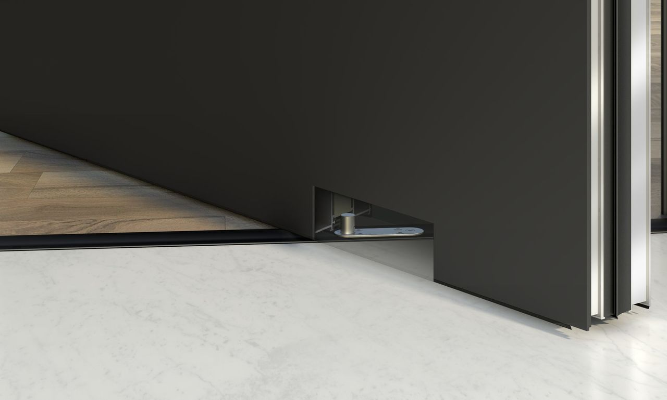
The Benefits
6. Security and functionality
Pivot hinge with adjustable pins
Oversized robust doors with maximum dimensions 3,0m width x 2,0m height
Leaf weight up to 250 Kg

Slide 15
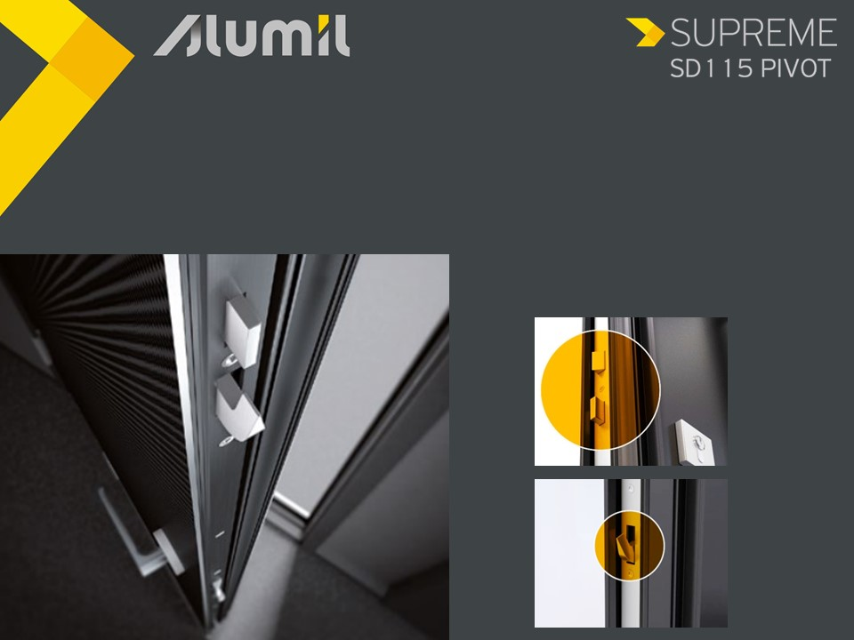
The Benefits
6. Security and functionality
5-point automatic lock

Slide 16
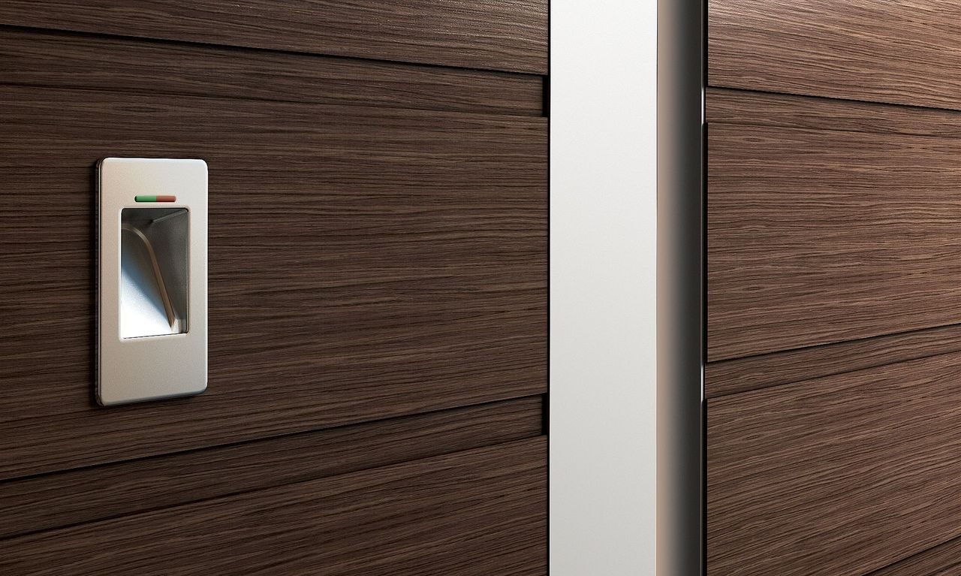
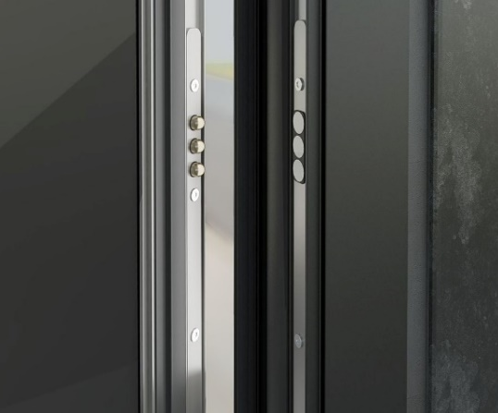
The Benefits
6. Security and functionality
Electronic access with:
finger scanner
digital keypad
smart house apps
Wireless power supply contacts

Slide 17
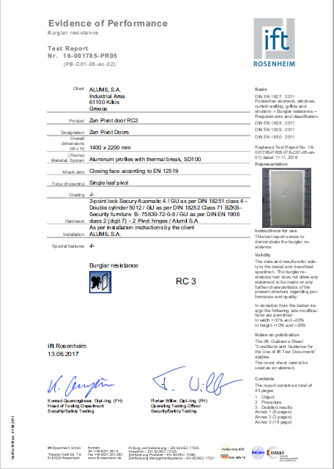
The Benefits
7. Certifications
Burglar resistance RC3
Certified by the ift Rosenheim Institute

Slide 18
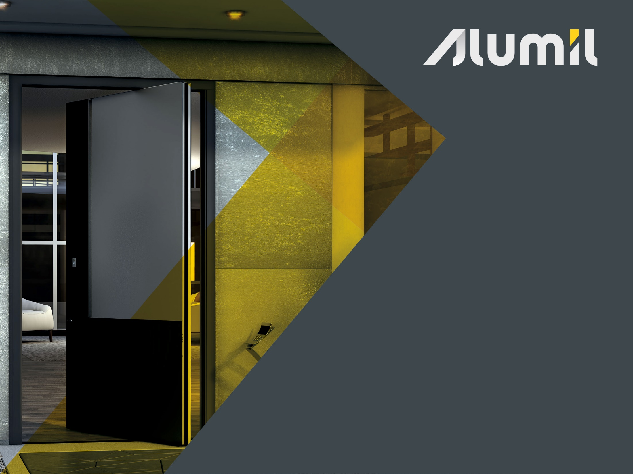
Thank you for your attention
Notes:
Sea horse villas, Dubai: S600, M11000 & M8200

