Slide 2
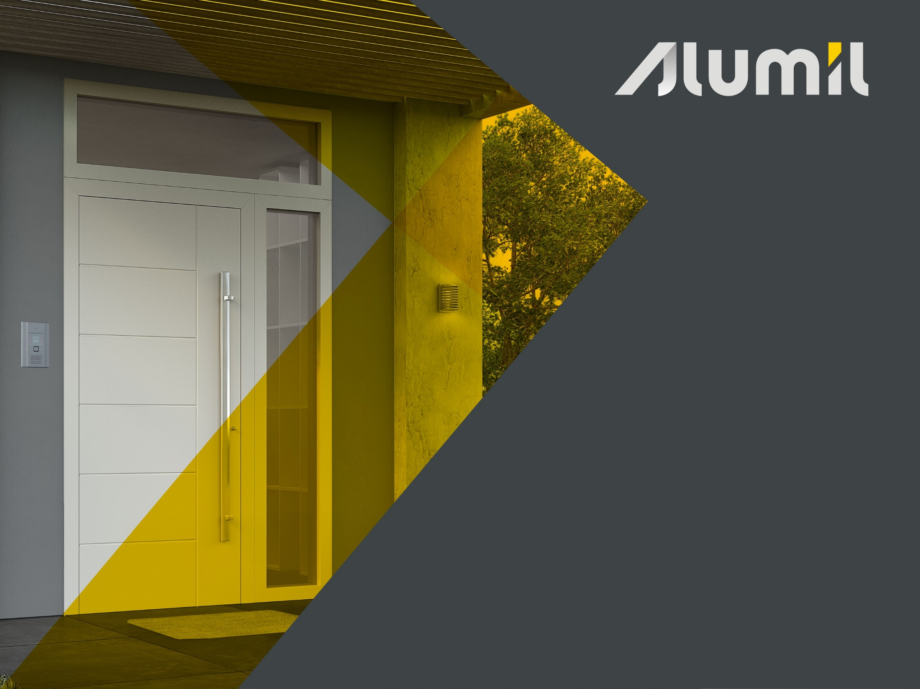


Slide 3
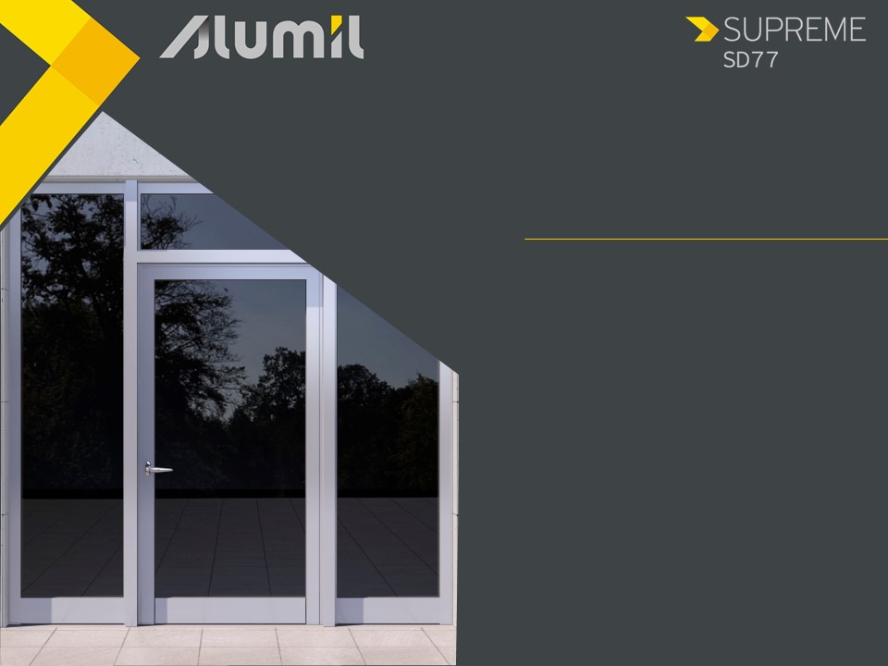
What
SUPREME SD77 is ALUMIL’s system for high quality entrance doors requiring:
modern coplanar design between wall – frame - leaf
high performance
emphasis on safety

Slide 4
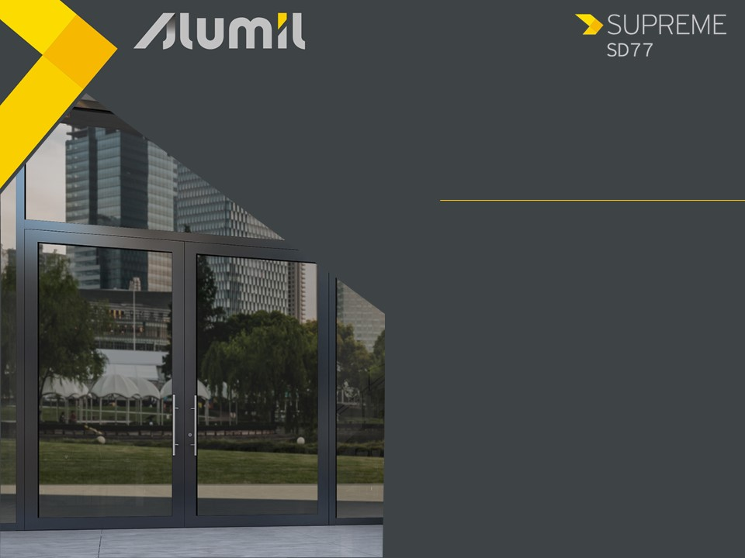
Why
SUPREME SD77 can be combined perfectly with the casement series SUPREME S77 to provide complete architectural solutions
Increase margins at the middle -high end market
Offer a wide variety of entrance doors typologies of high performance

Slide 5
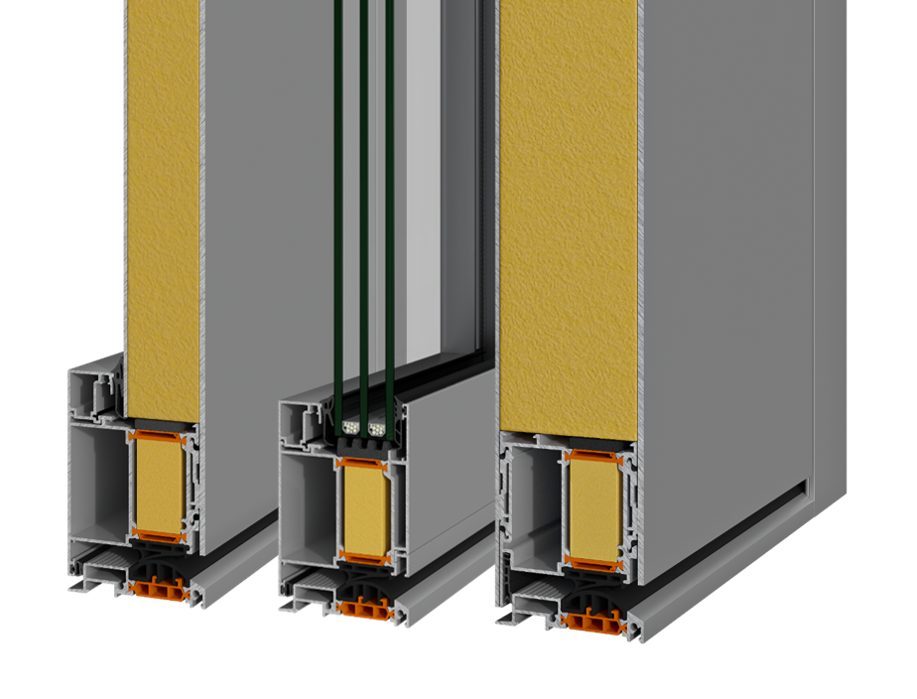
The Benefits
1. Flexibility of construction
Frame width 77 mm
Sash width 77 mm
Combined either with aluminium or glass panels
Glazing thickness 23 up to 59 mm

Slide 6
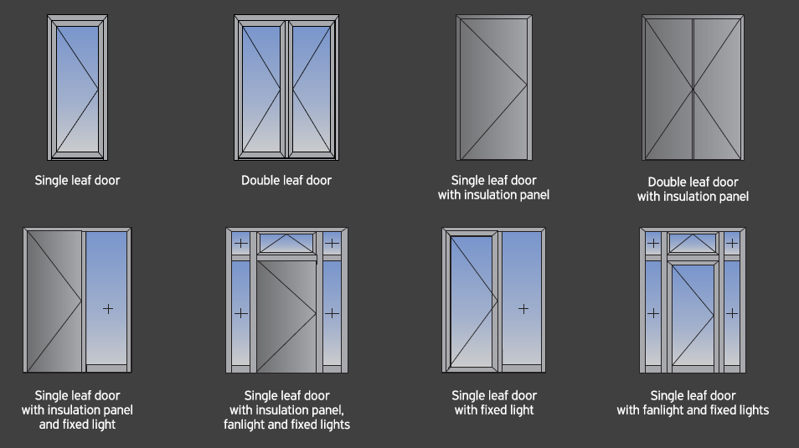
The Benefits
1. Flexibility of construction
Implementation of all entrance doors typologies
Inwards / outwards opening
Up to 180 Kg/leaf

Slide 7
The Benefits
2. Easy access
Easy and safe access for kids and people with special needs
Low threshold of only 22 mm height
Special slip-resistant design
22 mm

Slide 8
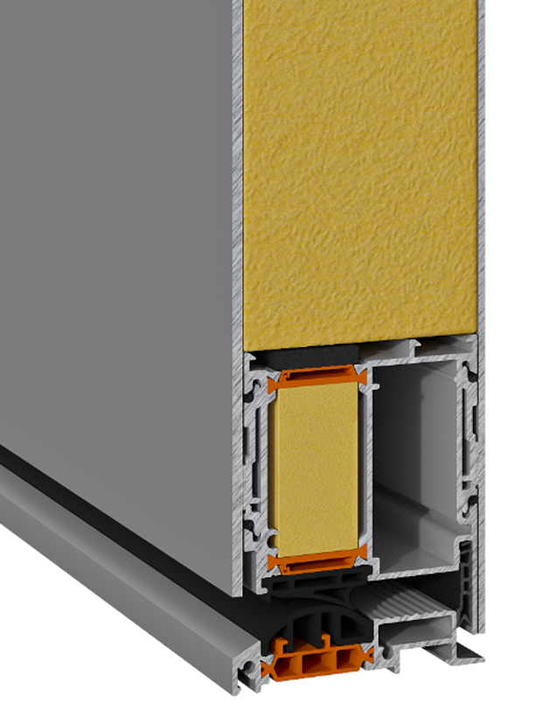
The Benefits
3. Energy saving
Insulation foam perimetrically of the panel
2
1
Anti distortion polyamides 34 & 30mm width
Insulated bars inserted into the profiles
3
4
PVC profile perimetrically of the frame

Slide 9
The Benefits
3. Energy saving
Anti distortion glass reinforced polyamides 34 & 30mm width
Insulated bars inserted into the profiles
Insulation foam perimetrically of the panel
PVC profile perimetrically of the frame

Slide 10
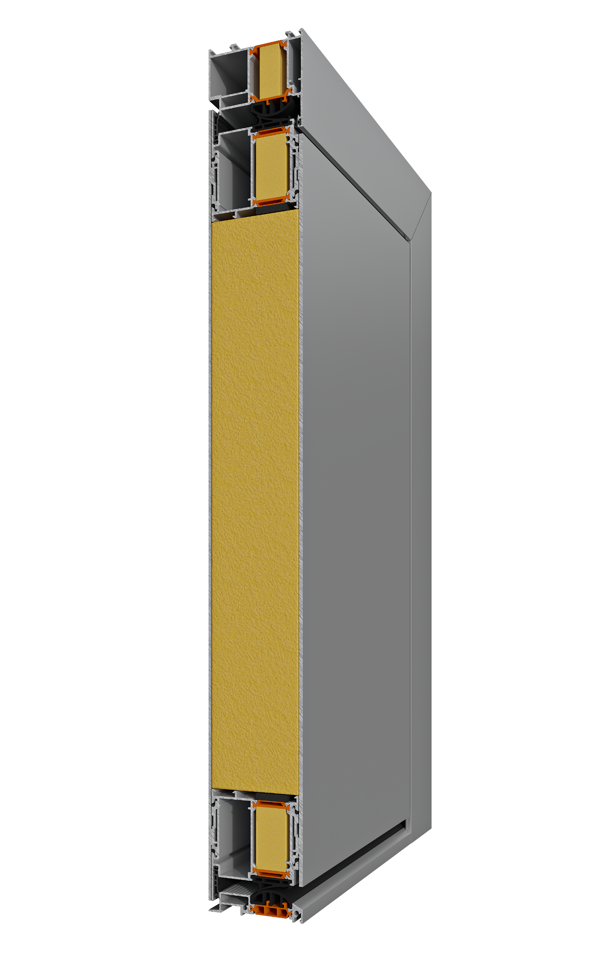
The Benefits
4. Security and functionality
Floating profile inserted into the leaf
The panel is glued over the floating profile
Offers a flexibility between the internal and the external part of the panel

Slide 11

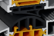
The Benefits
4. Security and functionality
Continuous sealing
Frame:
  Perimetrical with EPDM gaskets
  Pre-fabricated EPDM corner gaskets
  Sash:
    Perimetrical with PVD
    PVC corner

Slide 12
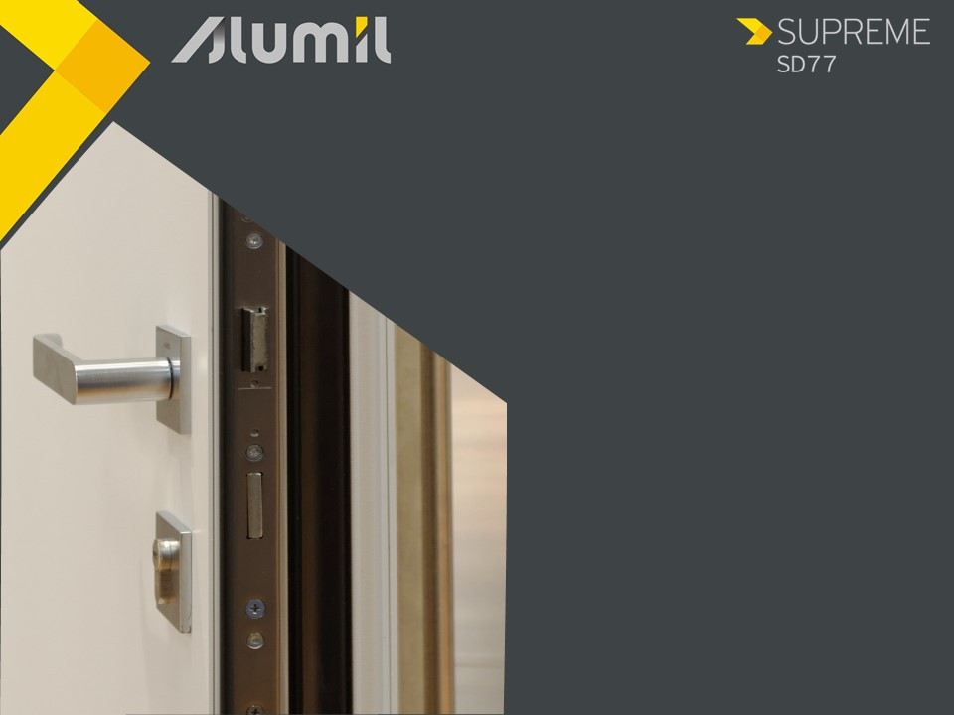
The Benefits
4. Security and functionality
Wide range of locking systems
3-point or 5-point lock
Standard or a security 6-pin or 12-pin cylinder
Electric lock is also available

Slide 13
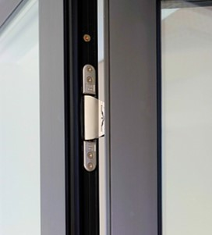
The Benefits
4. Security and functionality
ALUMIL‘s cylindrical aluminium hinges
Perfectly fitted and aligned so as to offer a 3D micro adjustment
Ideal for leaves up to 160 Kg
Concealed hinges
Modern aesthetics
For leaves up to 120 Kg

Slide 14
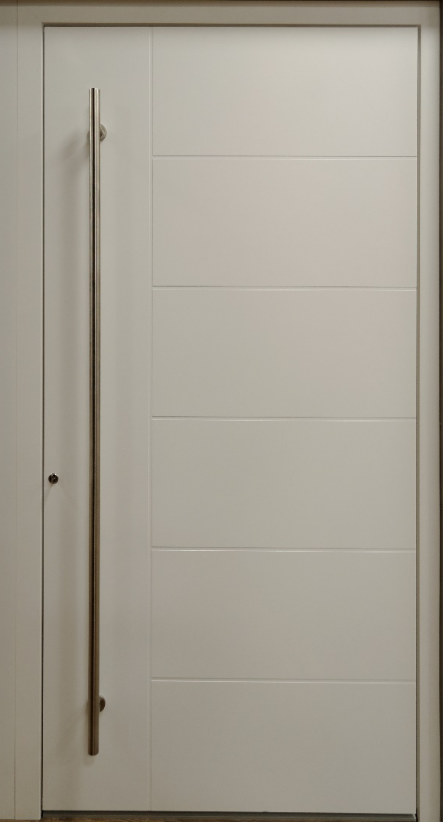
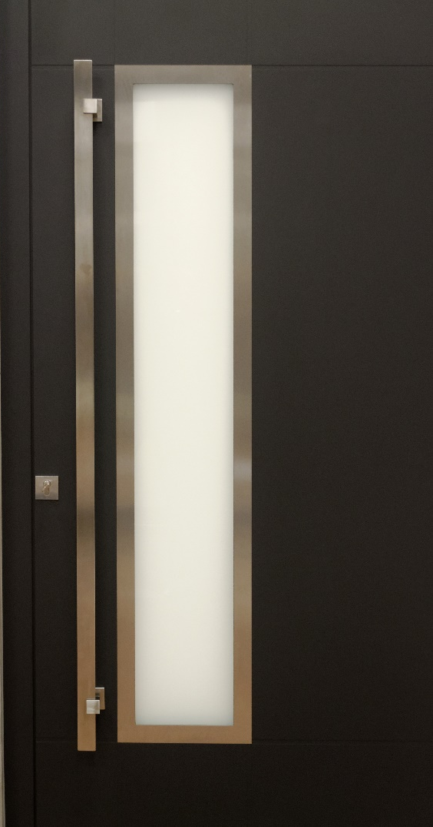
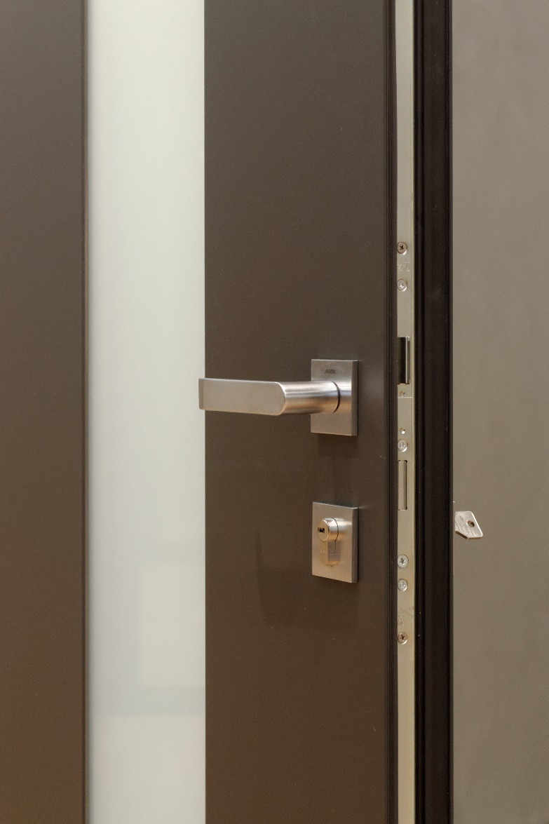
The Benefits
4. Security and functionality
Standard door handles with ALUMIL patented design available in various colors
Stainless steel exterior bars available in various lenghts

Slide 15
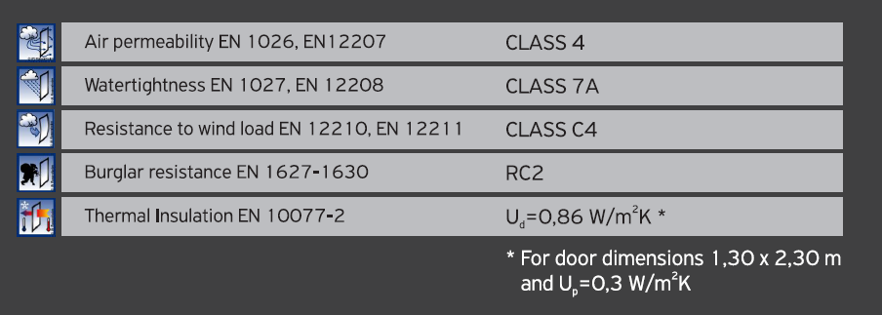
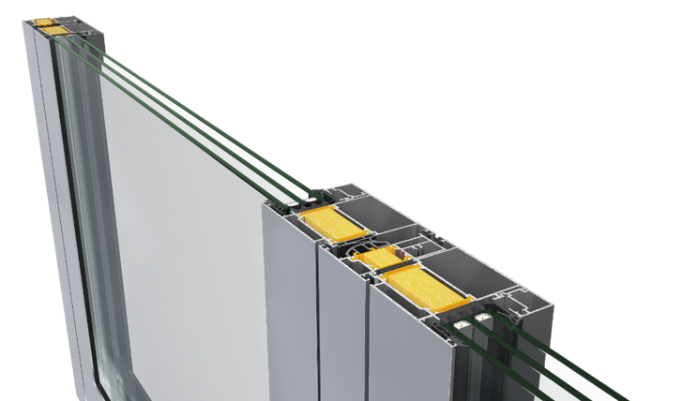
Benefits
5. Certifications

Slide 16
Thank you for your attention

