Slide 1
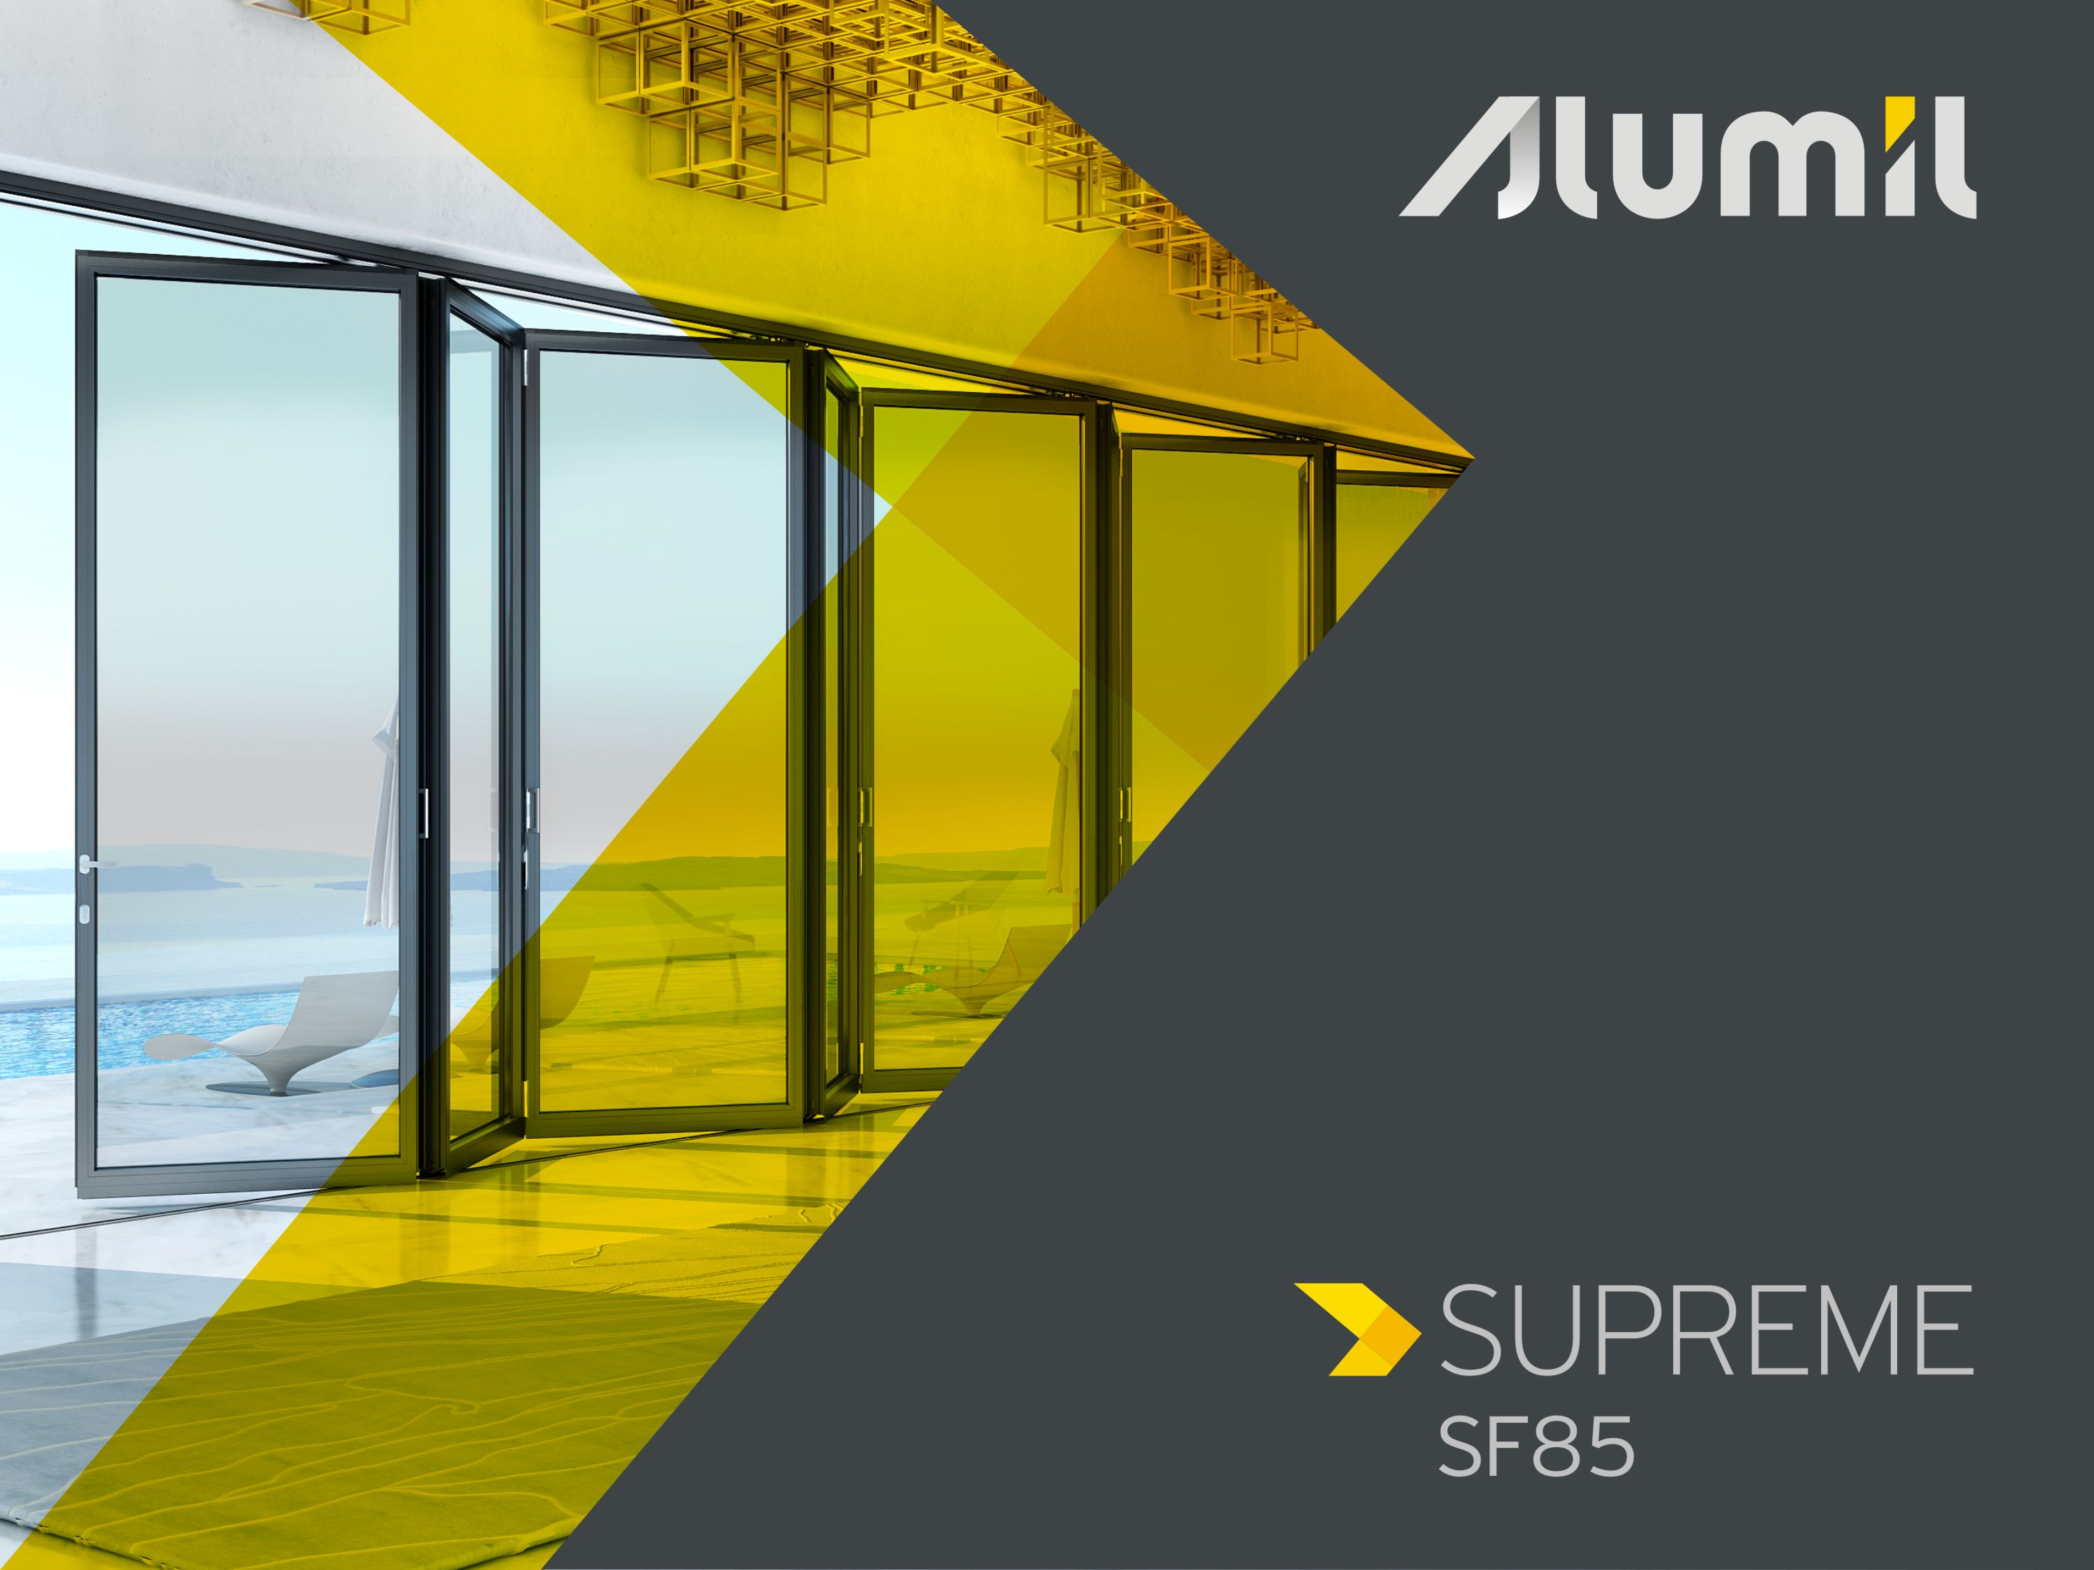

Slide 2



Supreme SF85 is ALUMIL’s proposal for a world-class folding door,
highly-insulated and bottom-slide,
with minimal aesthetics and outstanding performance,
for very large dimensions and extremely low sight-lines
In addition to SMARTIA MF65
Notes:
Με άλλη εικόνα

Slide 3


SUPREME SF85 was designed to offer competitive solutions for
high-end projects (extreme performance and large dimensions)
residential use (minimal design, long-lasting flawless use)
and strengthen the brand of ALUMIL by creating a unique product in the segment of high-end folding doors
Notes:
Με άλλη εικόνα

Slide 4
Technical Session

Slide 5
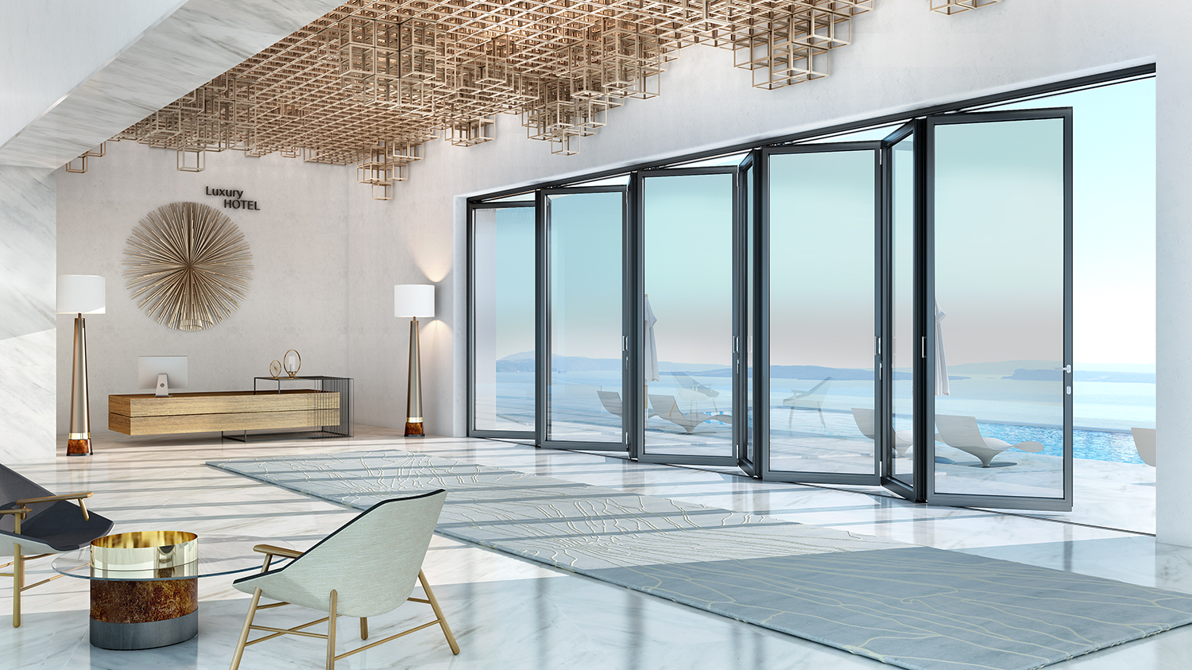
Emphasis to detail
Technical Characteristics
Sash depth: 85 mm
Operation bottom slide
Insulated highly
Glazing: 20-53mm standard 34-75mm structural
Max weight: 200 Kg/vent
Max height 4.0 m
Vent width up to 1.5 m

Slide 6
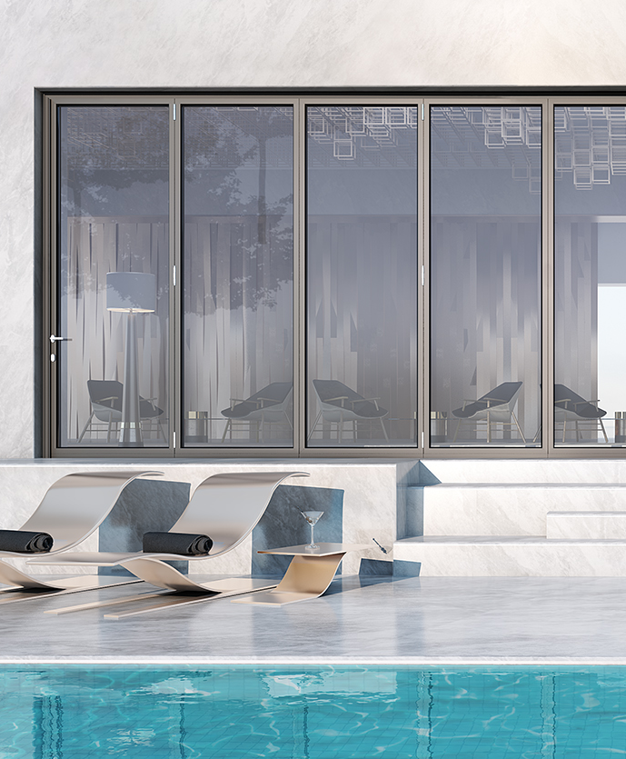
Flexibility of construction
Typologies*
Odd numbers
n+0 e.g. 3+0
n+1 e.g. 3+1
n+m e.g. 5+7
Semi-structural sash version
Corner construction
Inward / outward opening
Even numbers
m+0 e.g 4+0
m+1 e.g 2+1
m+n e.g 2+3
m+m e.g 2+2
Notes:
Εικονίδια για τυπολογίες

Slide 7
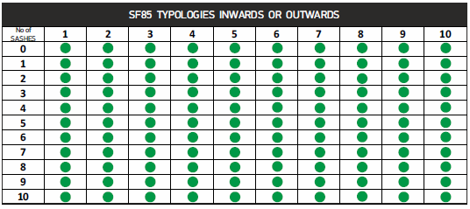
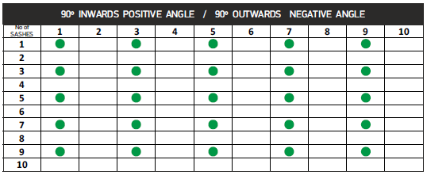


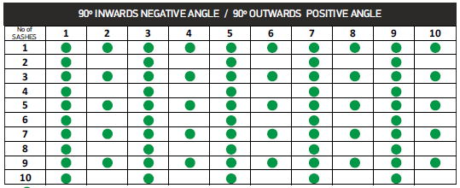
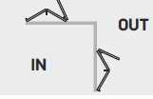
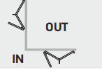
Standard structure
Corner structure
Corner structure
Notes:
Εικονίδια για τυπολογίες

Slide 8
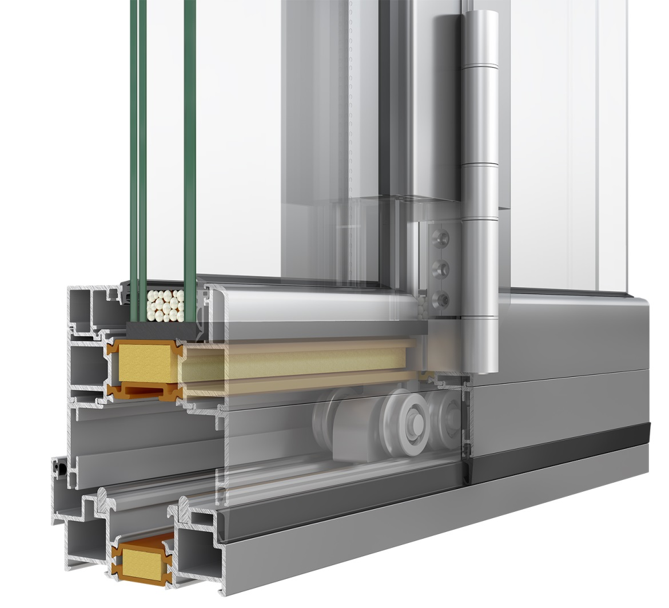
Emphasis to detail
Features & Fittings
Special bottom roller-hinge
Max weight 500Kg (compet. 200Kg)
Anodised body, stainless steel rollers and rust-protected bearings
Allows very large dimensions (height, panel width and overall width)
Enables very easy installation and long-lasting flawless operation
Anti-lift protection for burglar protection

Slide 9
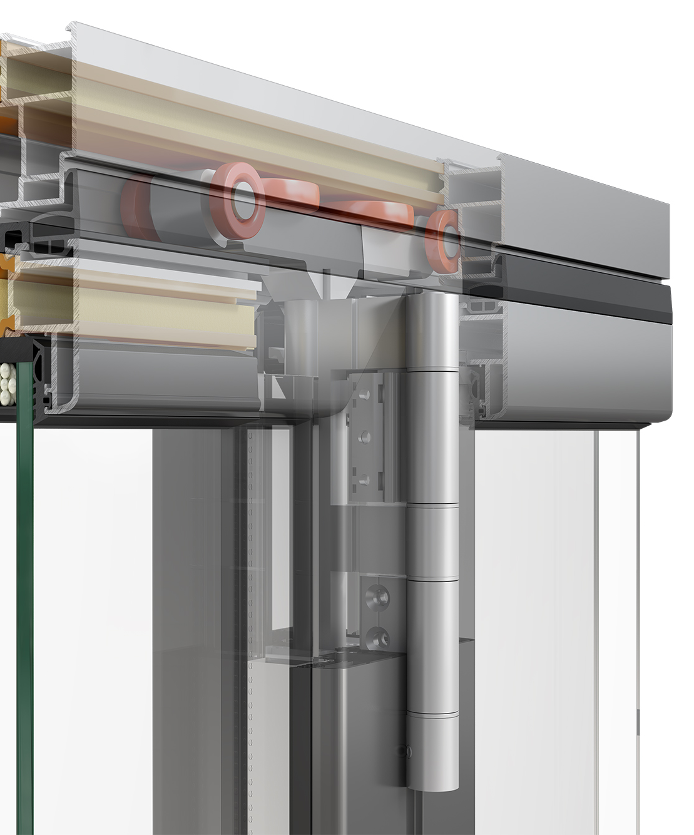
Emphasis to detail
Features & Fittings
Special top roller-hinge
Apart from just guiding the vents,
it takes some of the weight “helping out” the bottom one (special spring system)
it is quite longer than usual to prevent vents from turning while operation

Slide 10
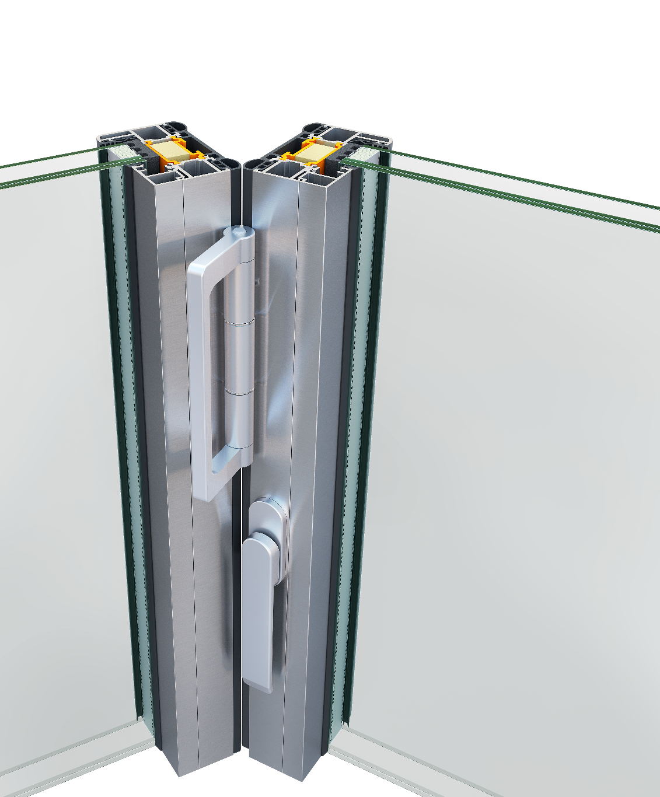
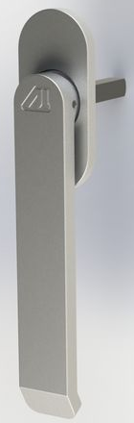
Emphasis to detail
Features & Fittings
Heavy-duty hinges, with 3 sets being adequate for normal structures, i.e. 2.6m high. Available in silver and black anodising
Pull-handle attached on the hinge to easily move the vents together
Flat handle for the intermediate vents, with Alumil logo and option to be locked
Standard handle with spindle for the door, with Alumil logo and design
1
3
2
3

Slide 11
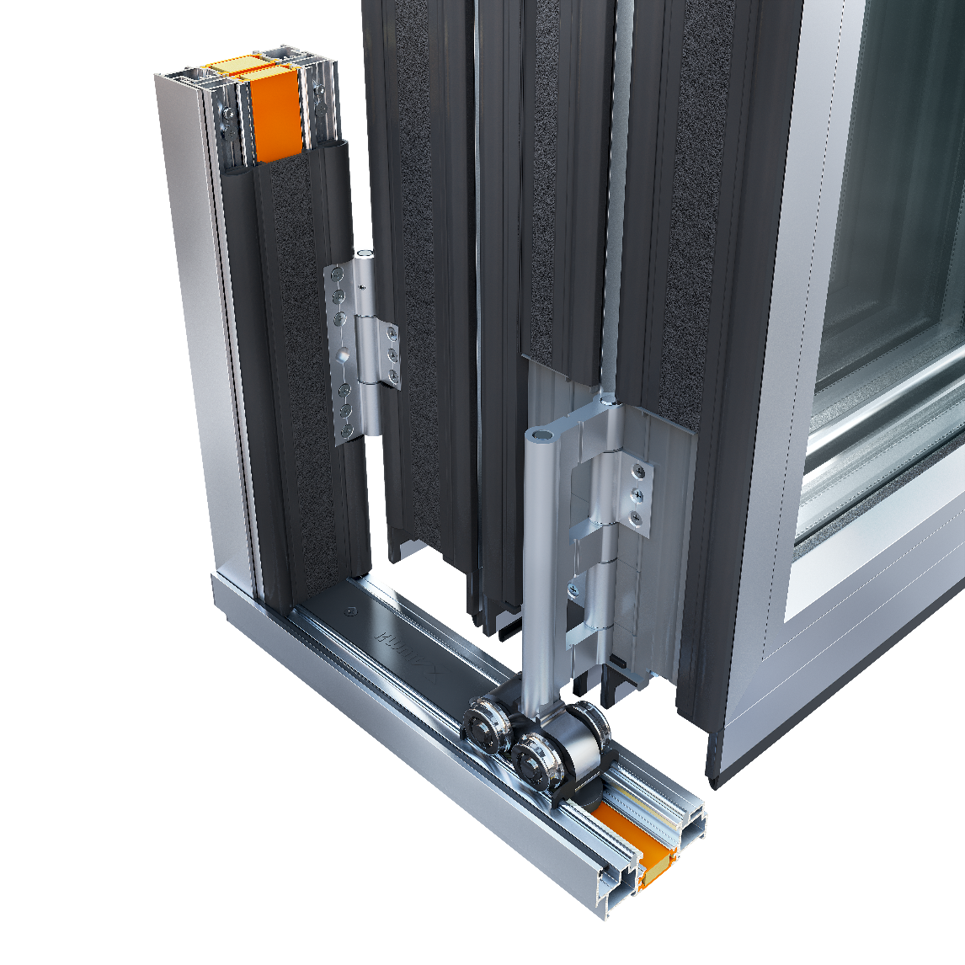

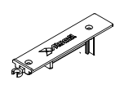
Emphasis to detail
Emphasis to detail
Features & Fittings
2
Double guide rail, made of inox, solid or hollow
Adjustable frame easily set with special fittings (5mm left & 5mm right)
Rubber fitting placed around the roller-hinge to allow simple cut of the sash gasket
Special cap to cover the milled part of the track (for inserting the vents)
Gasket to cover the track beneath the door
3
4
4
1

Slide 12
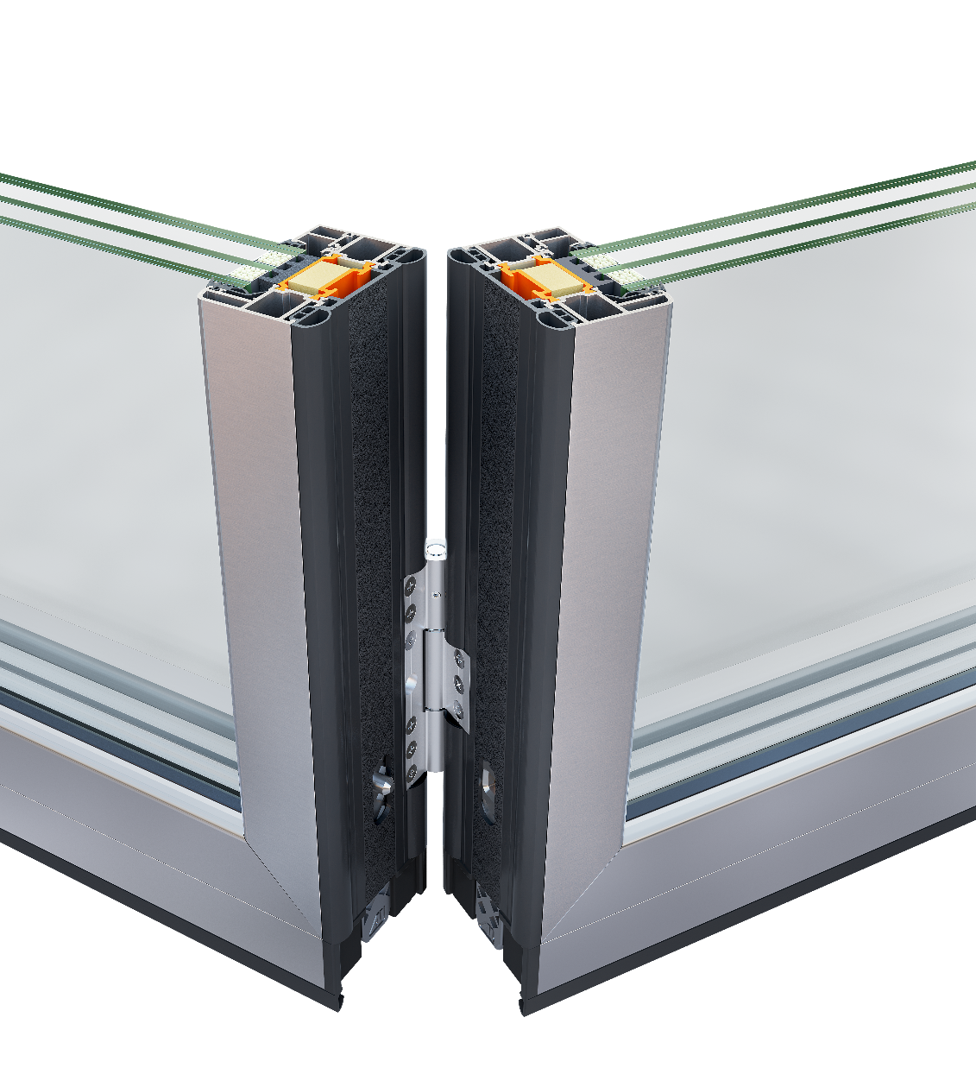
Emphasis to detail
Features & Fittings
3
4
Quadruple (not double) locking latches made of glass reinforced polyamide or aluminium (RC2)
Single gasket from co-extruded EPDM and foam
Double polyamides 40mm and “Alumil energy bar”
PE insulation foam (under the vent, around the glass, etc)
Lock extensions (>2550, 2750, 3050mm
2
1

Slide 13
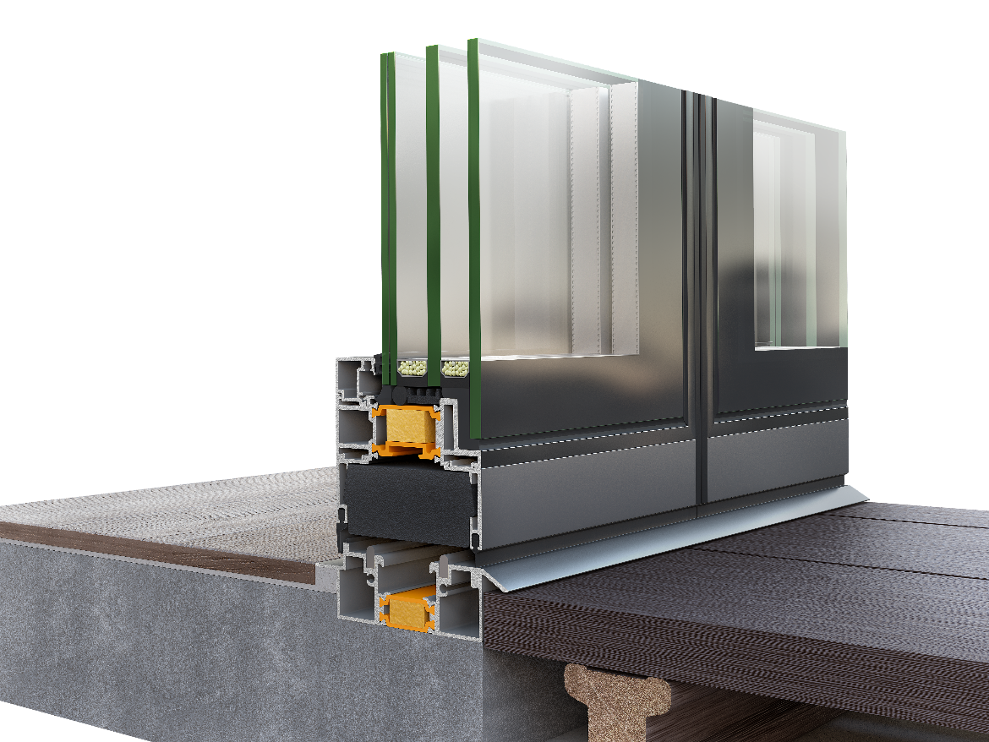
Emphasis to detail
Features & Fittings
Sealing gasket at the bottom for enhanced tightness, and possibility for brush
Special foam bar at the bottom part of the sash apart from the NRG bars infills
Hollow glazing beads for enhanced security
3
2
1

Slide 14

Emphasis to detail
Features & Fittings
Three (3) sash options
Standard sash
Straight lines sash
Semi-structural sash

Slide 15
Emphasis to detail
Features & Fittings
Three (3) threshold options
Standard threshold
Low threshold
Embedded, concealed threshold
Sub-sill add-on for extra watertightness
1
3
2

Slide 16
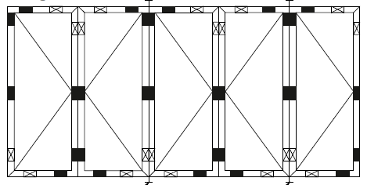
Emphasis to detail
Features & Fittings
2
top rail
Door holdback magnet
Adequate space for applying ventilation trickle
Easy plaster application (due to the frame wing)
Generally, thin less-noticed glazing gaskets (aesthetical)
Glazing setting blocks (instructions)
3
frame profiles
4
sash profile
5

Slide 17
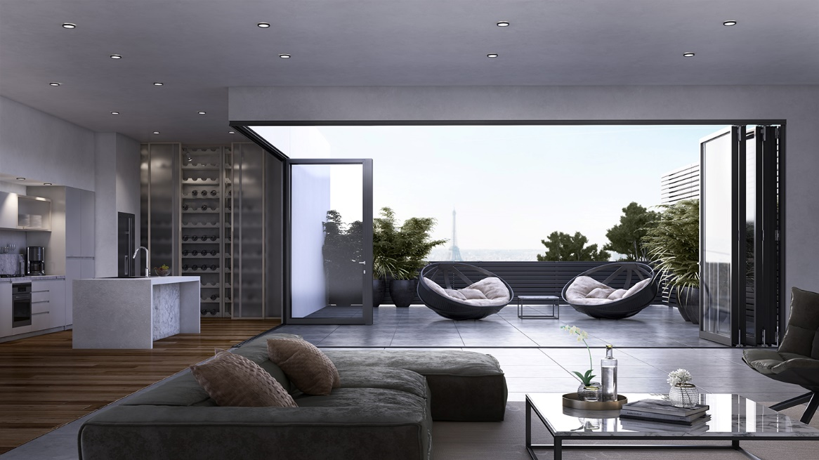
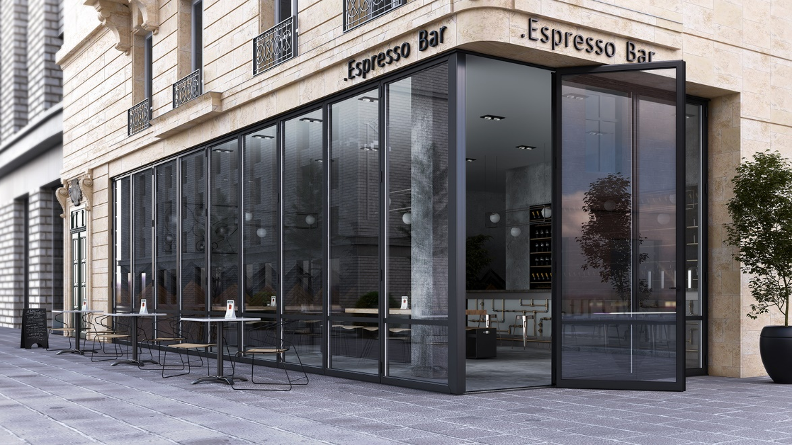
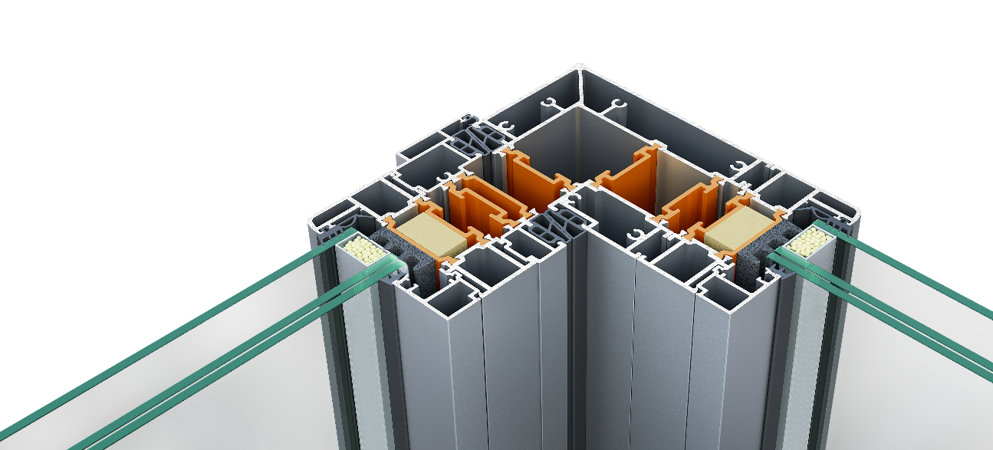
Emphasis to detail
Features & Fittings
Corner construction for commercial and residential use
Compatible with all solutions (inward/outward, normal/low threshold, semi-structural sash)

Slide 18
Basic sections
Sash & bottom rail (threshold)
Sash & top rail
Horizontal section with adjustable frame profiles and sash ones

Slide 19
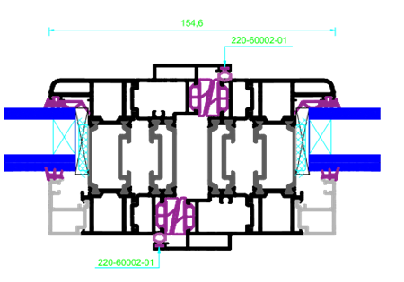
Basic sections
Sash & door panel meeting point
Door closing point at a corner structure

Slide 20
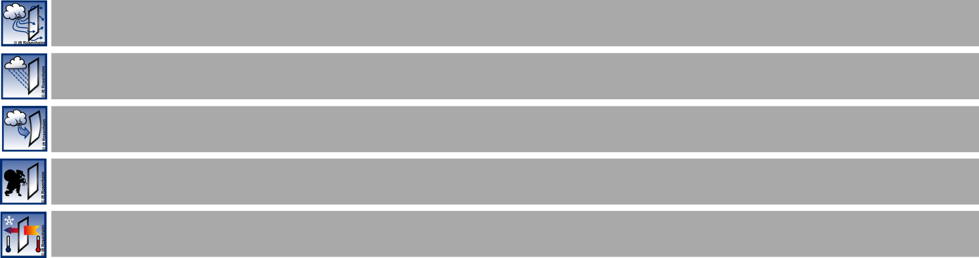
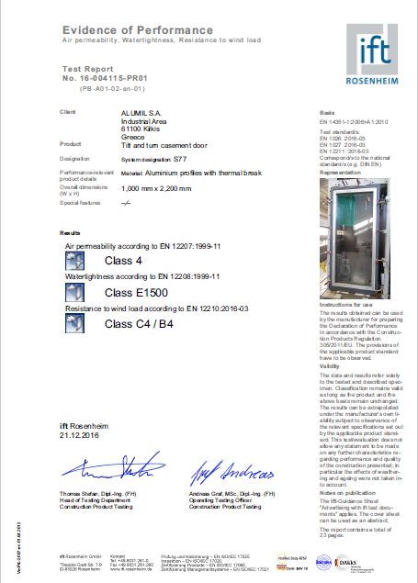

Certifications
Remarkable performance certified by German Institute IFT ROSENHEIM
Air permeability EN12207:2016-12
CLASS 4
Watertightness EN 12208:1999-11
CLASS 7A / 9A (subsill)
Resistance to windload EN 12210:2016-03
CLASS C3/B3
Burglar resistance EN 1627-1630
RC2 (and PAS24 UK)
Thermal insulation EN 10077-2
Uf from 1.5 W/m²K
U_{w}= 1.00 W/m²K (2.6x3.0m with 3 vents and U_{g}=0.6 W/m²K
U_{w}= 1.16 W/m²K (2.6x3.0m with 3 vents and U_{g}=0.8 W/m²K
U_{w}= 1.03 W/m²K (3.45x3.0m with 3+1 vents and U_{g}=0.6 W/m²K
U_{w}= 1.18 W/m²K (3.45x3.0m with 3+1 vents and U_{g}=0.8 W/m²K

Slide 21
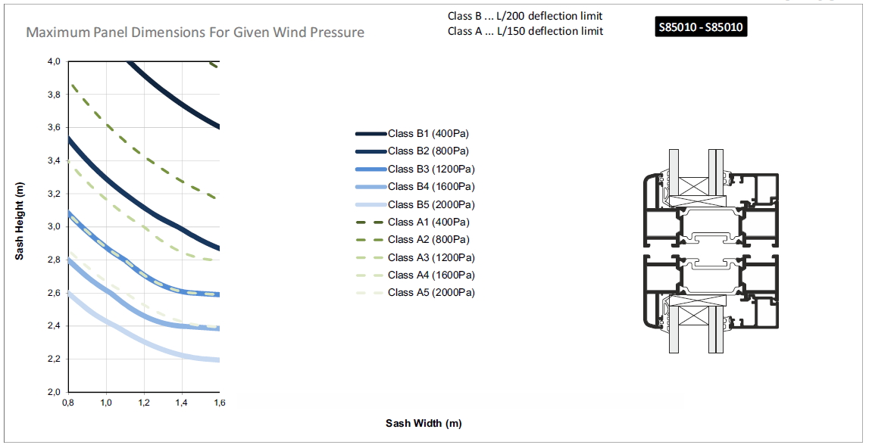
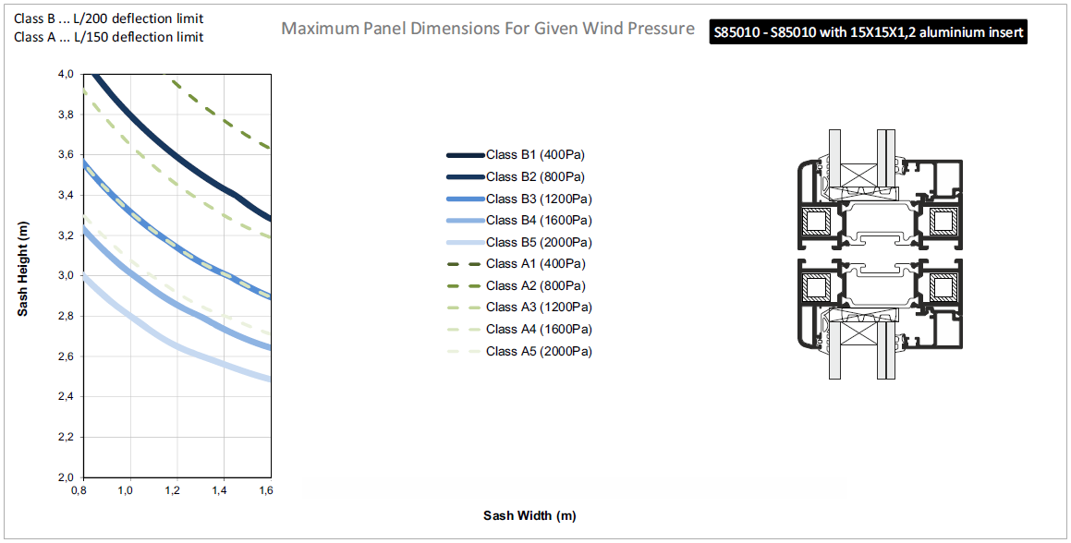
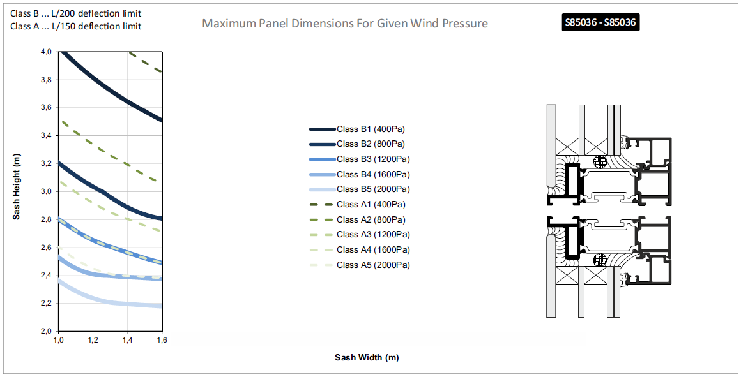
with out steel stiffeners
Maximum Panel Dimension for given Wind pressure
E.g. 800Pa with steel stiffeners
Vent width 1.2m and height 3.6m
with steel stiffeners
semi-structural sash

Slide 22
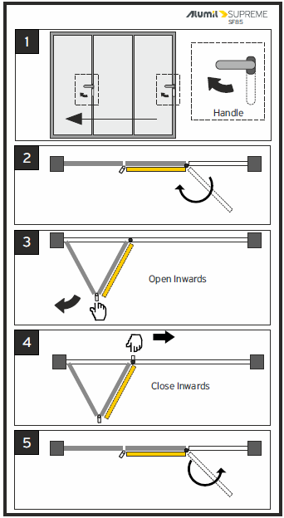
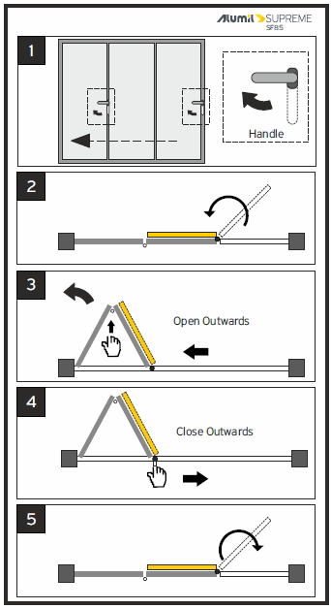
Folding door operation
Inwards
Outwards
Door
first to open, last to close
Notes:
new

Slide 23
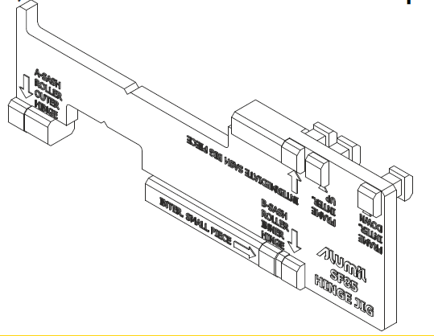
Fabrication details
The technical catalogue serves as a fabrication manual, presenting a wide set of machining instructions
CNC is required
Special Jig tool for hinges installation
Adjustable frame profiles come predrilled
Notes:
new

Slide 24
Commercial Training

Slide 25
Unparalleled benefits
1. Extremely Large Dimensions
height up to 4.0m, (competition stays at 3.0m)
total width almost “infinite”
vent width up to 1.5m (competition stays at 1.2m)
Ideal for modern residences, esp. when fewer panels are requested (5 panels of 1.4m instead 7 panels of 1.0m)
Unique for projects with 4.0m high structures and many vents

Slide 26
Unparalleled benefits
2. Incomparable Aesthetics
MINIMAL DESIGN with much less aluminium and amazingly reduced sight lines. Elegance without compromise.
vent/vent 105mm (competition usually at 120-125mm)
frame/vent 110mm
vent width 1.5m
which reduces the number of the necessary panels, e.g. five instead of seven.

Slide 27
Unparalleled benefits
3. Complete Range of Solutions
WIDE VARIETY of solutions
All odd & even numbers of vents, i.e. 3+0, 4+1 and 2+3
Corner construction
Semi-structural version (vents)
In and outwards opening

Slide 28
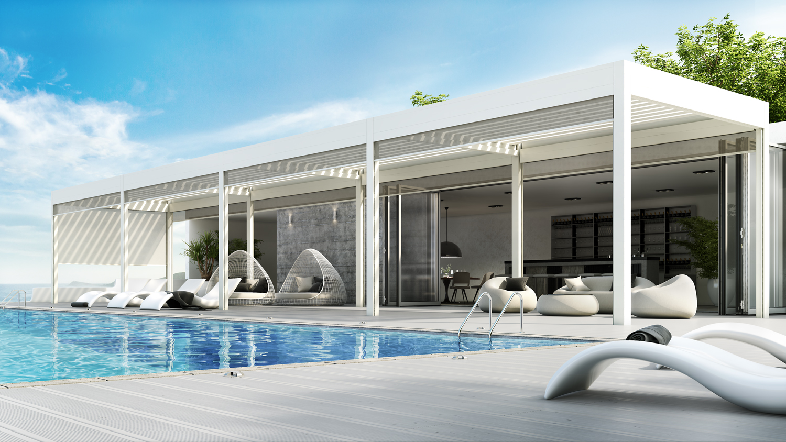
Unparalleled benefits
4. Extreme Performance
EXTREME PERFORMANCE as with all ALUMIL SUPREME series
air permeability, class 4
wind load resistance, class C3/B3
water tightness, class 9A
IFT Rosenheim certified
thanks to co-extruded special central gaskets, NRG, quadruple locking latches, profile sturdiness, etc.

Slide 29
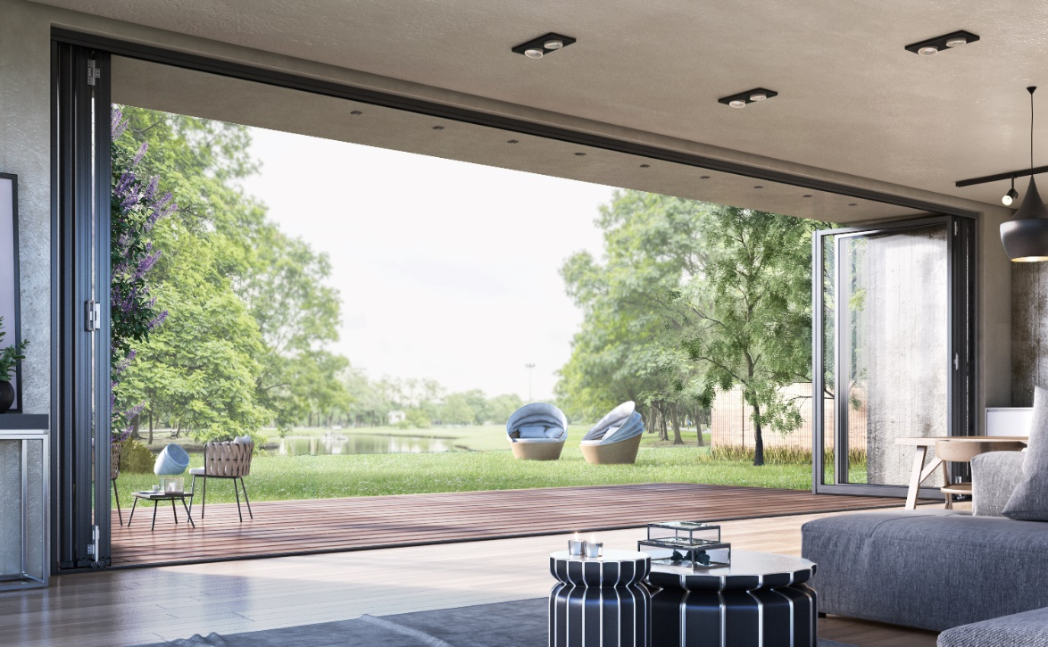
Unparalleled benefits
5. Energy Saving
Market-leading THERMAL EFFICIENCY and excellent overall U-values
U_{f} from 1.5 W/m²K
2.6x3.0m with 3 vents U_{g}=0.6 W/m²K
U_{w}= 1.0 W/m²K with U_{g}=0.6 W/m²K
U_{w}= 1.16 W/m²K with U_{g}=0.8 W/m²K
U_{w}= 1.39 W/m²K with U_{g}=1.1 W/m²K
co-extruded foam EPDM central gasket, kooltherm core, double 40mm polyamides, PE insulation foam

Slide 30
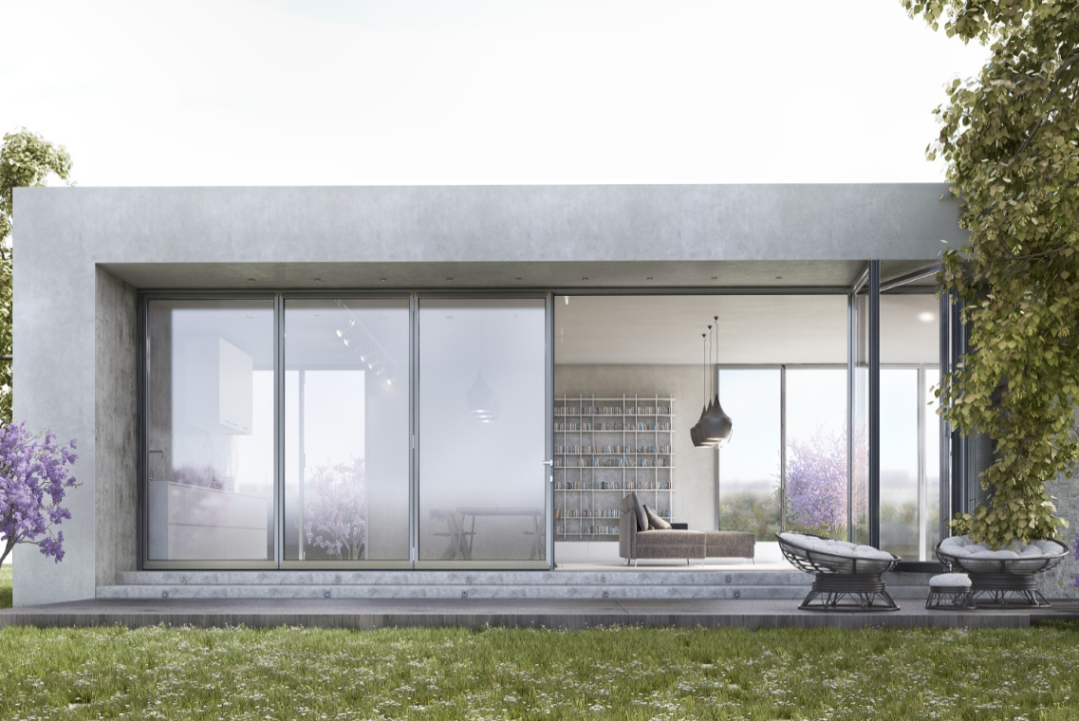
Unparalleled benefits
VIDEO RC2
6. Burglar Resistance &
Safety Feeling
Top levels of SECURITY and burglar protection, meeting all industry security standards.
quadruple locking latches from glass reinforced polyamide (instead double)
Bottom roller-hinge with anti-lift mechanism, profile and hinges sturdiness, 5-point lock, extensions, thick glazing
“PAS24:2016” and RC2 certification
Speaking of safety, there’s no risk of injuring fingers when operating (sufficient space)

Slide 31

Unparalleled benefits
7. Flawless & Long-lasting Operation
Smooth OPERATION and long-lasting flawless FUNCTIONALITY
Special roller hinges, both bottom and top
Heavy-duty hinges
A 5+1 structure (6 vents) which may weigh more than 1tn, is operated just with two sets of roller-hinges

Slide 32
Unparalleled benefits
8. Fabrication & Installation Ease
Easy FABRICATION and trouble-free INSTALLATION
roller-hinges can hold the unhinged vents
single gasket instead of pair
frame adjustment -6 & +10mm
easy plaster application
easily applied vent trickle

Slide 33
Unparalleled benefits
9. Surface treatment
Coating & Anodising by ALUMIL
Rust free fittings
Great variety of colors
Unparalleled quality
Possibility for pre-anodizing for maximum corrosion protection
Possibility for bi-color profiles (in/out side) for multiple aesthetic needs

Slide 34

Benefits for
ARCHITECTS
A very helpful architectural tool, which offers freedom of design, thanks to the great variety of solutions (vent number combinations, corner, semi-str, oversizing)
The series meets the standards required in high-end projects and provides the architect with a competitive advantage against other bidders
Allow the designing of buildings with energy / money saving systems
Help them differentiate from the market with a world-class product, thus upgrading of his/her status with such innovative solutions
Have their clients satisfied and architects credibility guaranteed

Slide 35
Benefits for
FABRICATORS
Manufacturing: easy & time-saving, with simple cuttings and millings, without any punching machines required
Installation: easy and without risk of damaging the structure due to the special set of roller-hinges
Fixed cost of profiles due to sales per meter €/m
Higher margins since the product meets the specs of the demanding high-end projects
Product that responds to a wide range of needs thanks to the variety of solutions
Increased clientele with minimal products ideal for hotel solutions & LSP

Slide 36
Benefits for
OWNERS
Elegant coziness full of natural light thanks to the limited sight lines and the fewer vents needed
Money & energy saving due to the great overall performance
Smooth operation and long-lasting flawless functionality
Product that responds to a wide range of needs (m+n, corner, semi-str.) and the structures for people with disabilities (low threshold)
Increased security feeling thanks to the high levels of burglar resistance (RC2, PAS24)

Slide 37
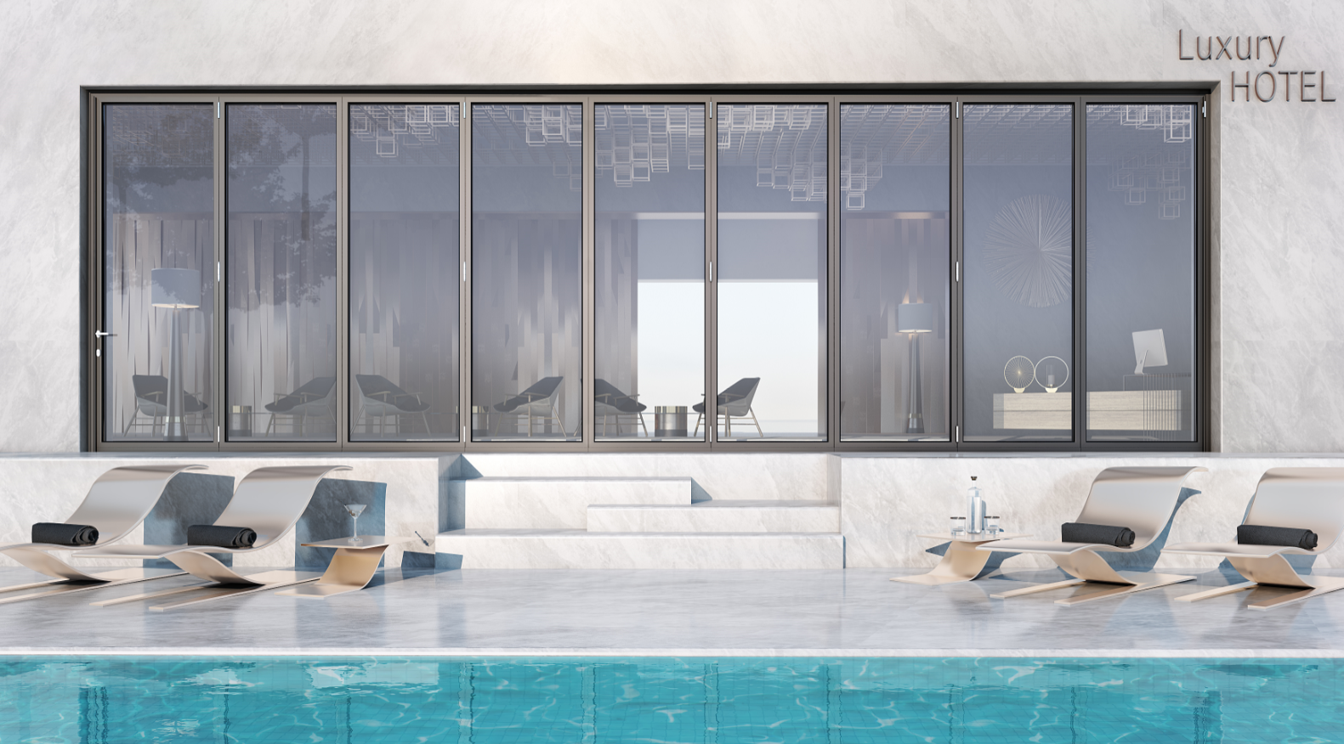

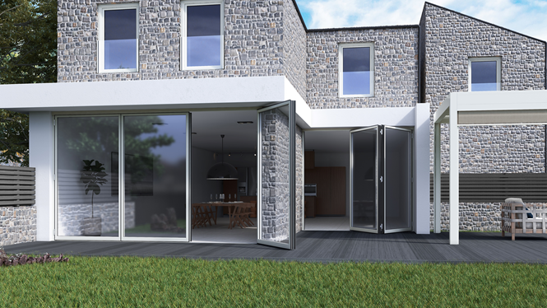


Slide 38
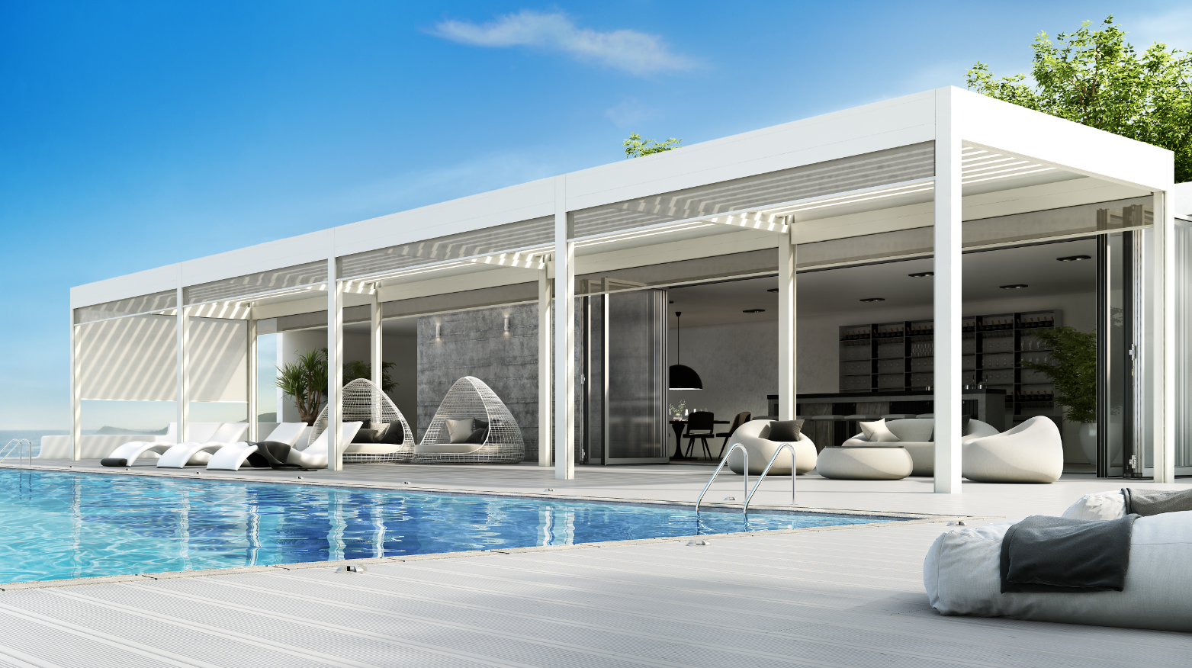
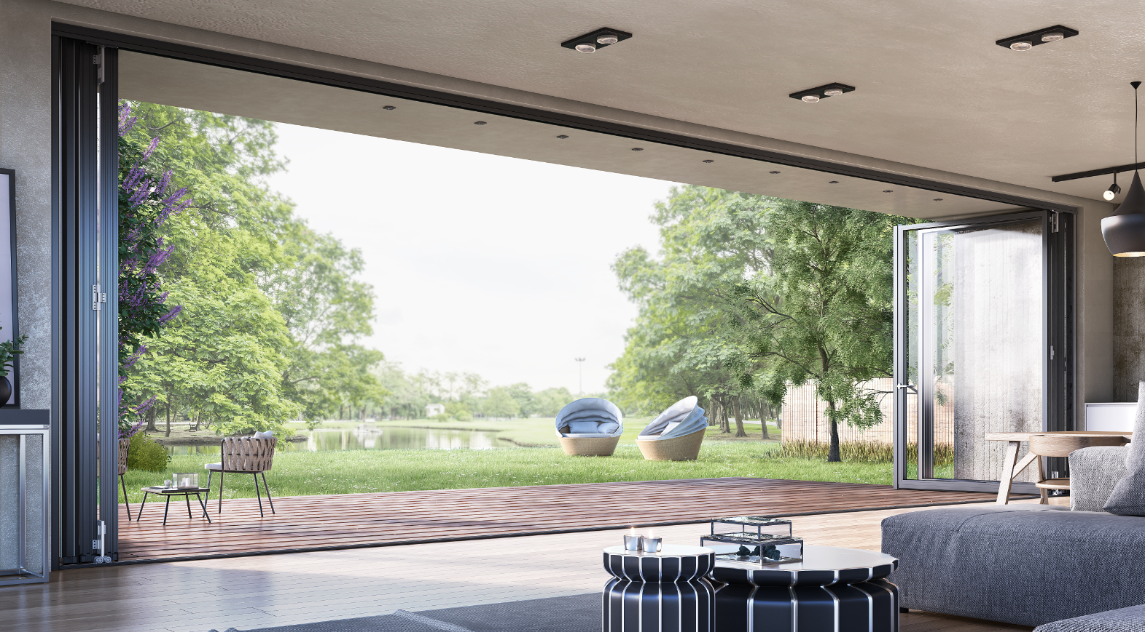
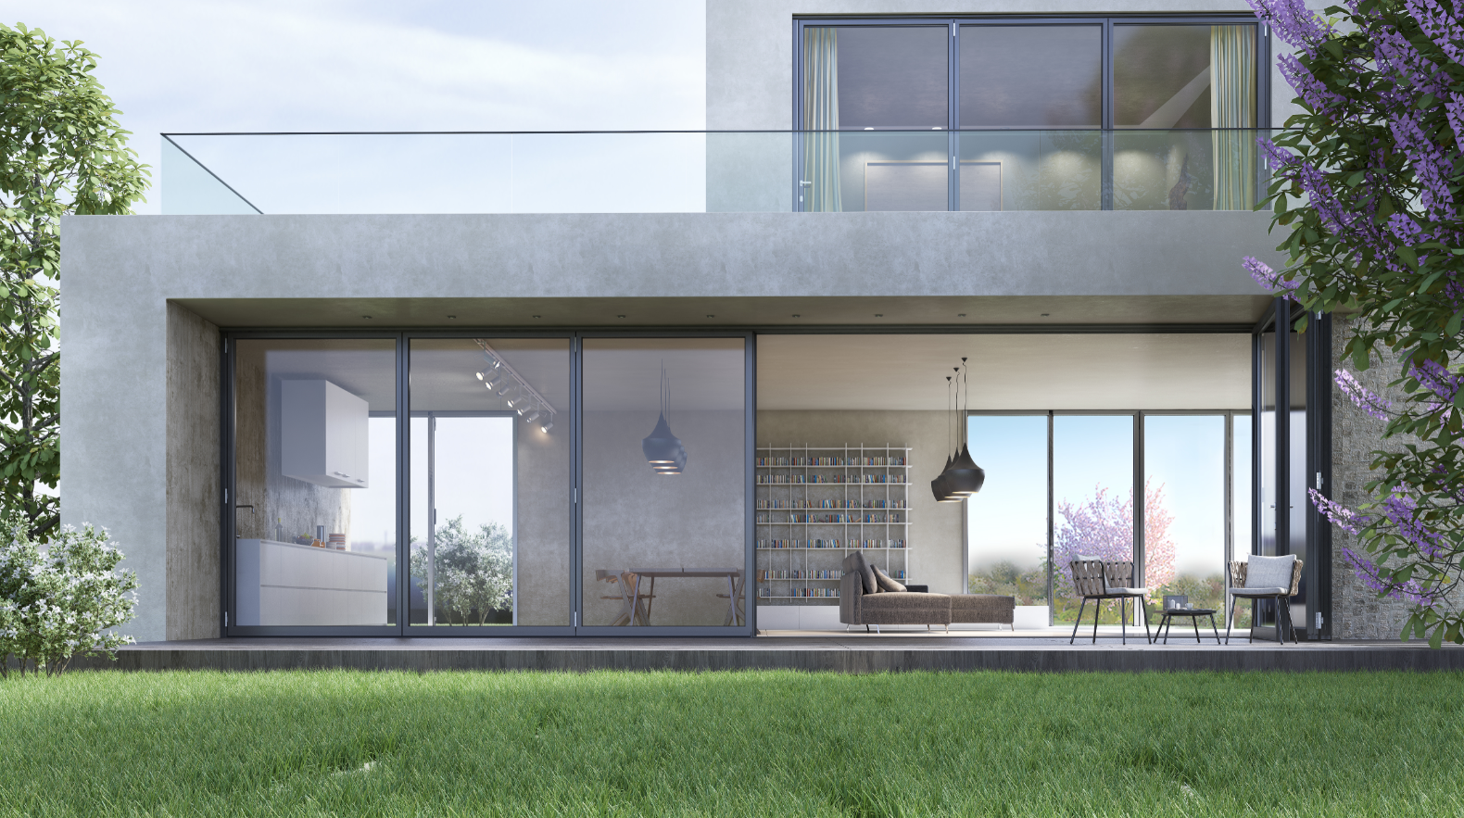


Slide 39
THANK YOU
FOR YOUR ATTENTION

