Slide 1
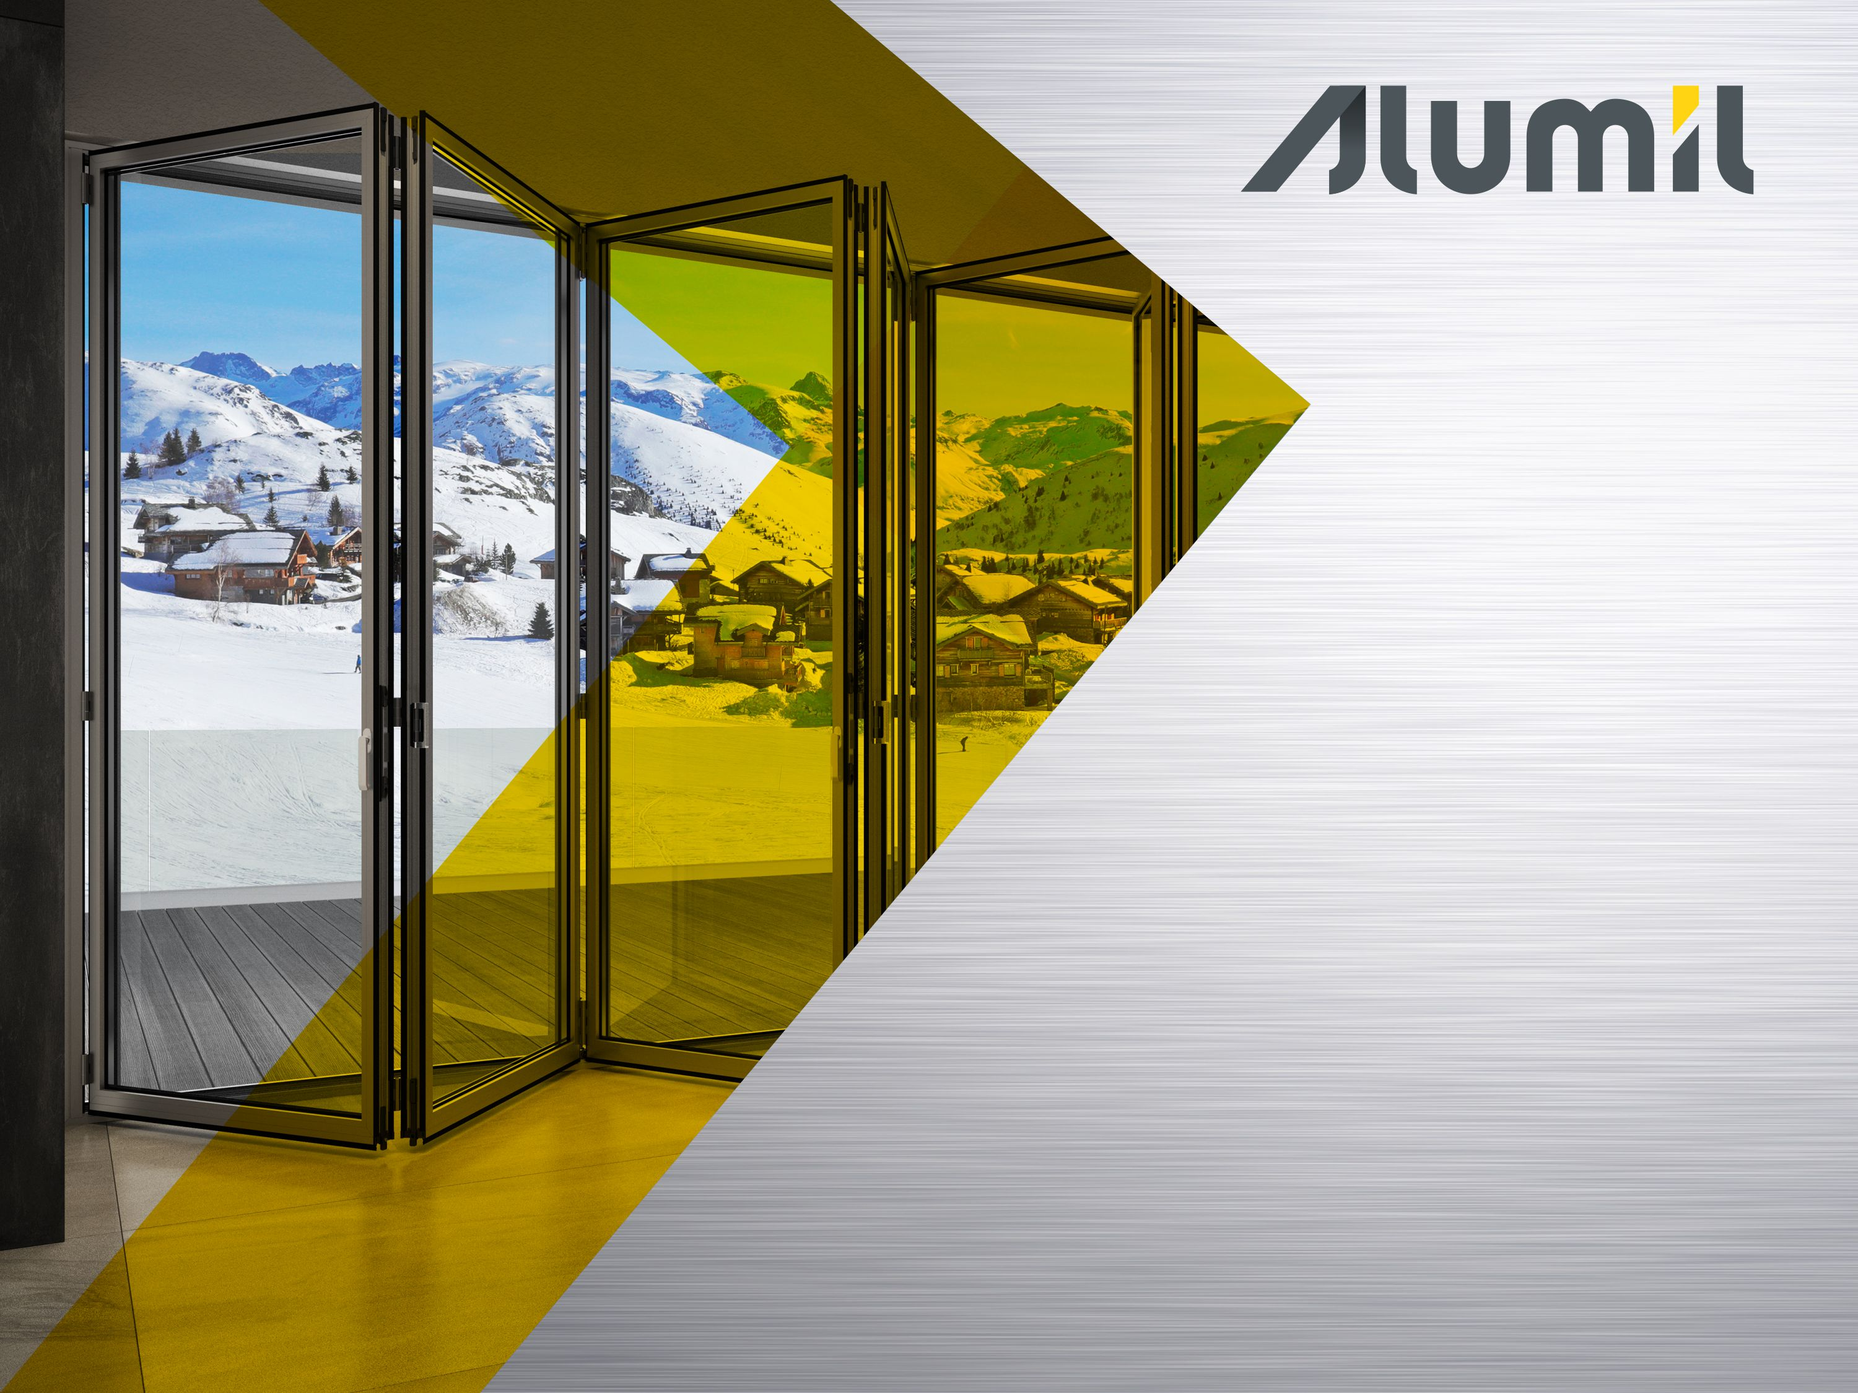


Slide 2
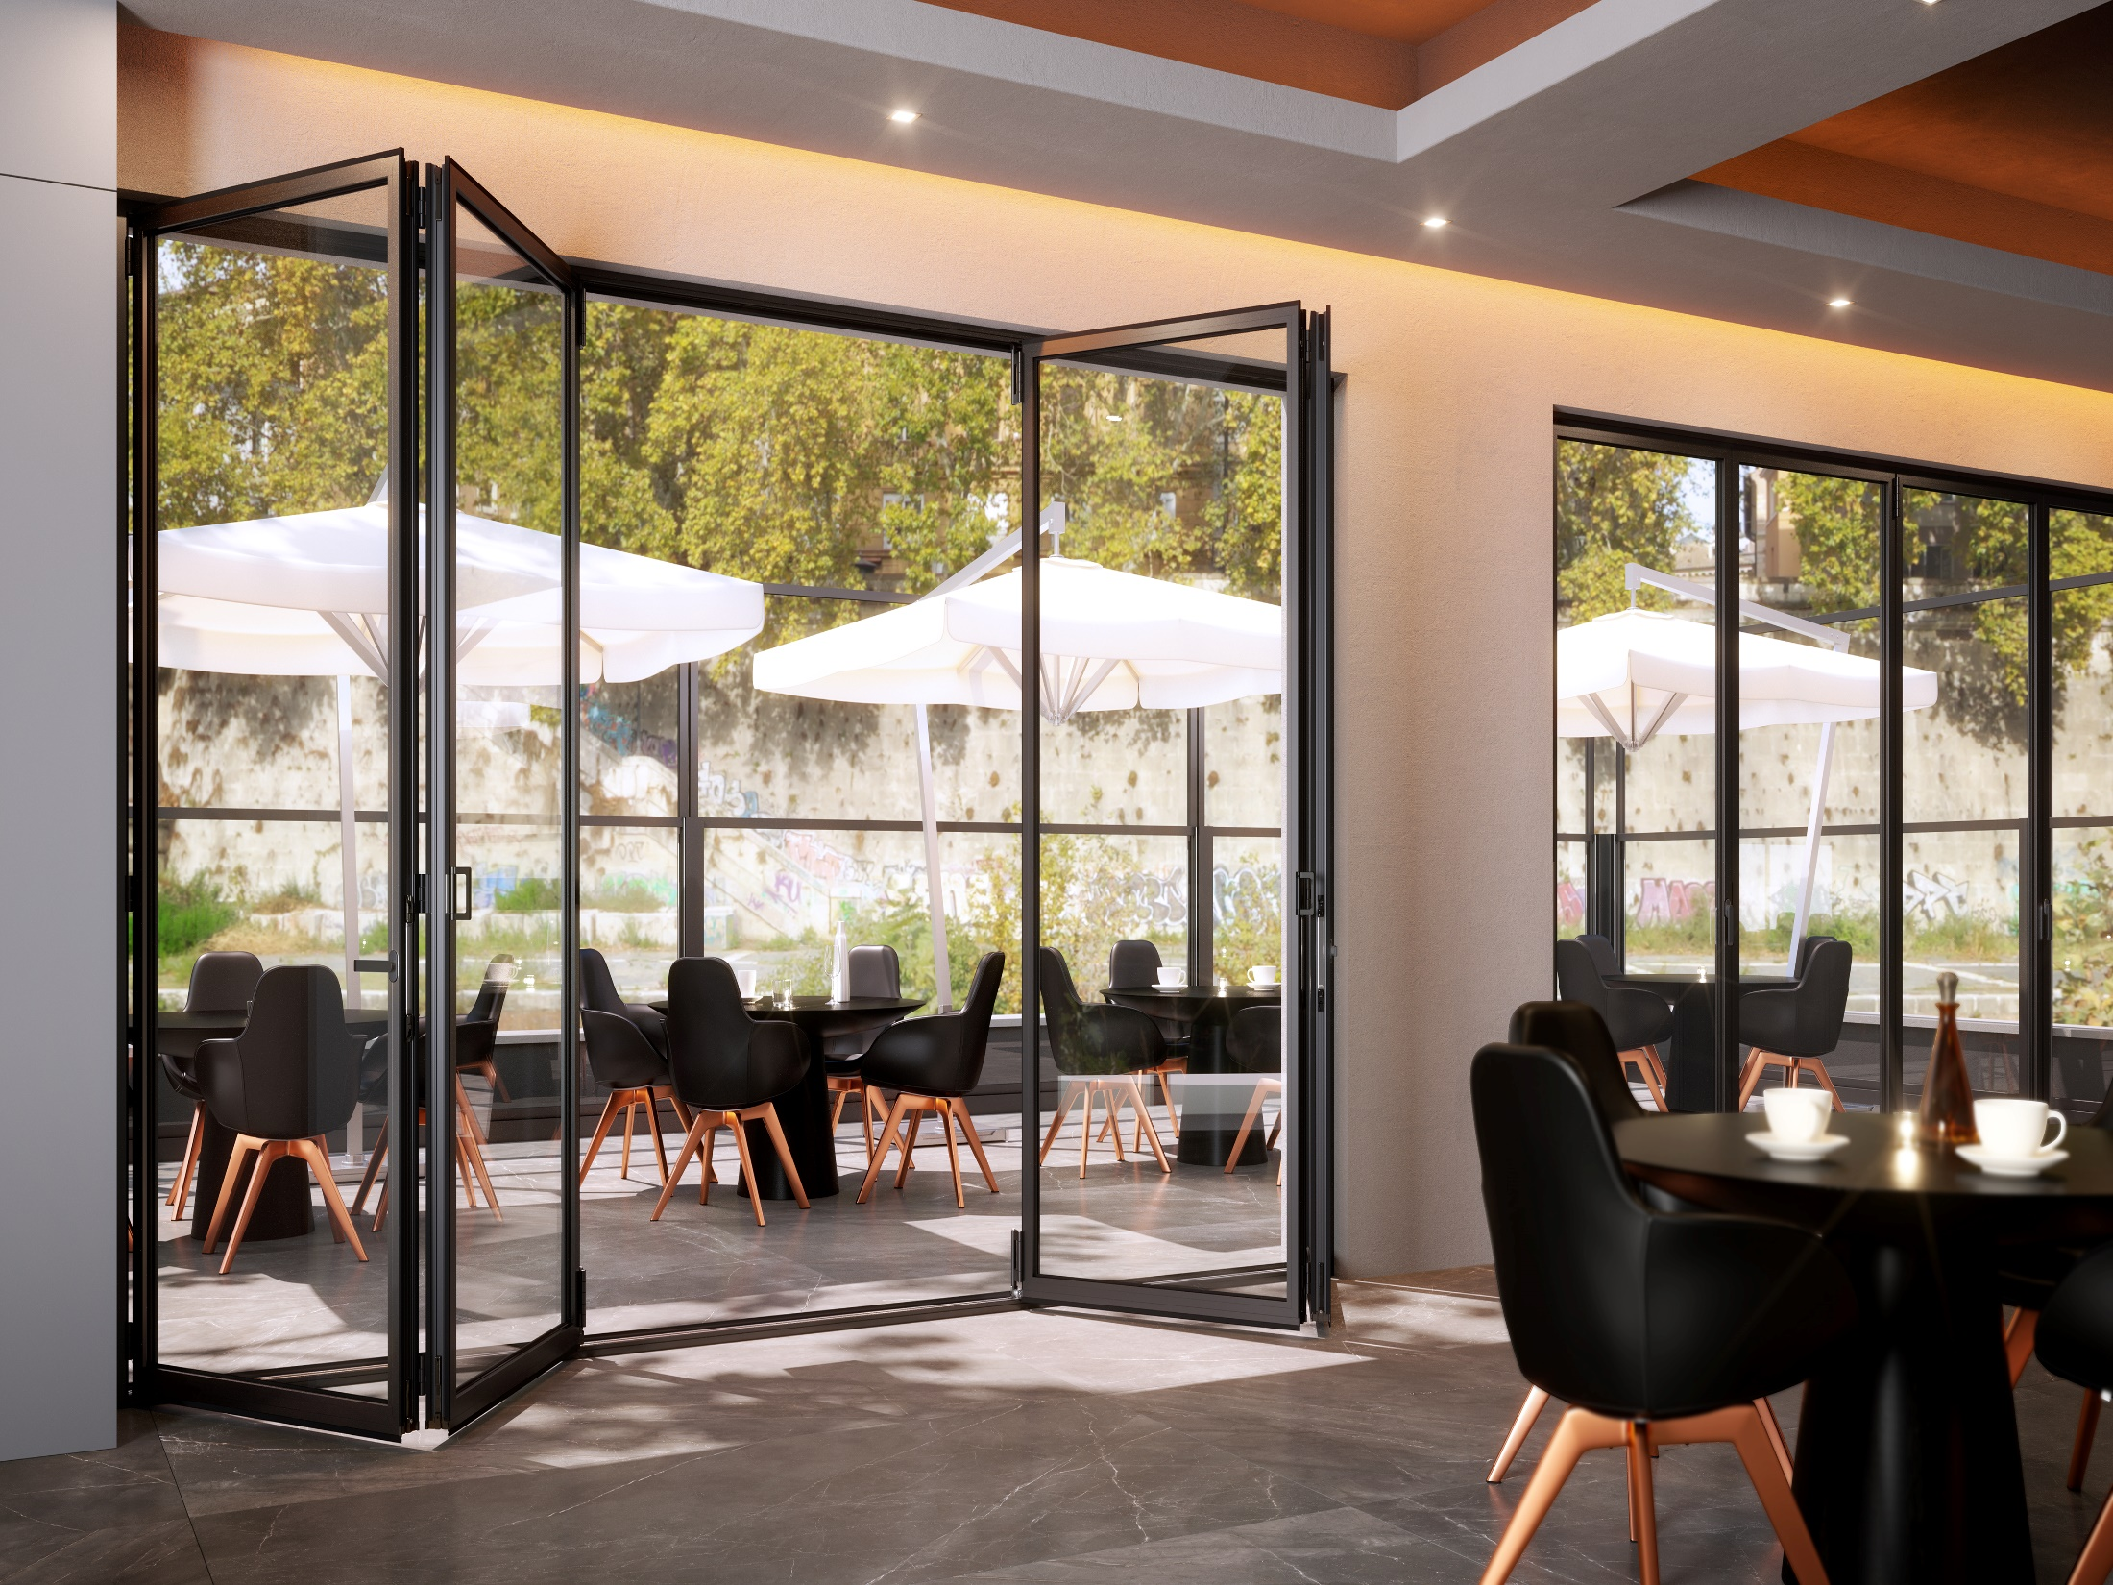


What
SMARTIA MF65 and SMARTIA MF6500 are the bottom-slide, insulated & non-insulated folding door systems with minimal aesthetics & of very high performance.

Slide 3

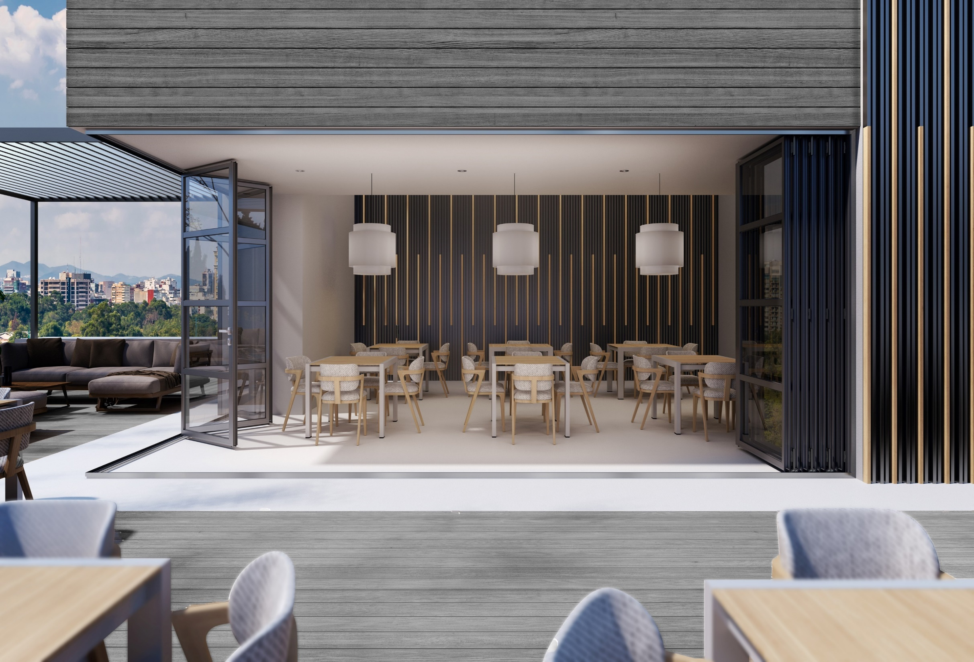
Why
Upgrade our folding door product-range & meet SMARTIA segment specifications
Change to bottom-slide operation and incorporate state-of-the-art accessories
Follow architectural trends for minimal design and low face-width
Present a competitive solution in terms of technical features, performance & cost
Meet every need for use in residential and commercial premises

Slide 4
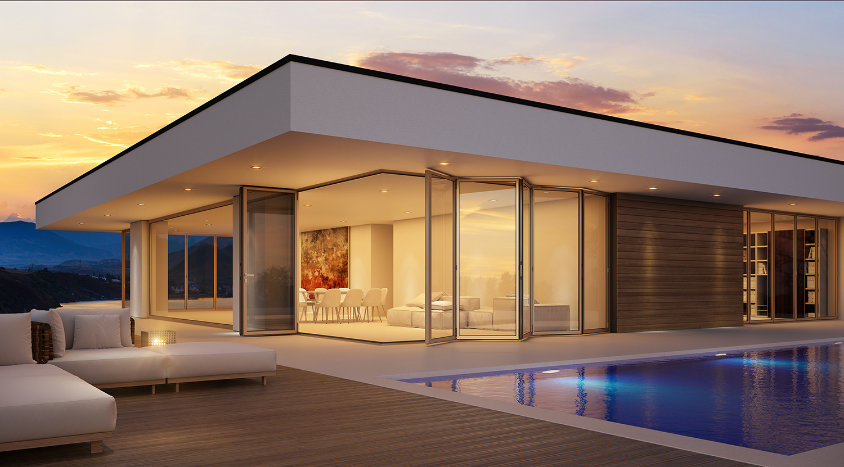

Technical section

Slide 5
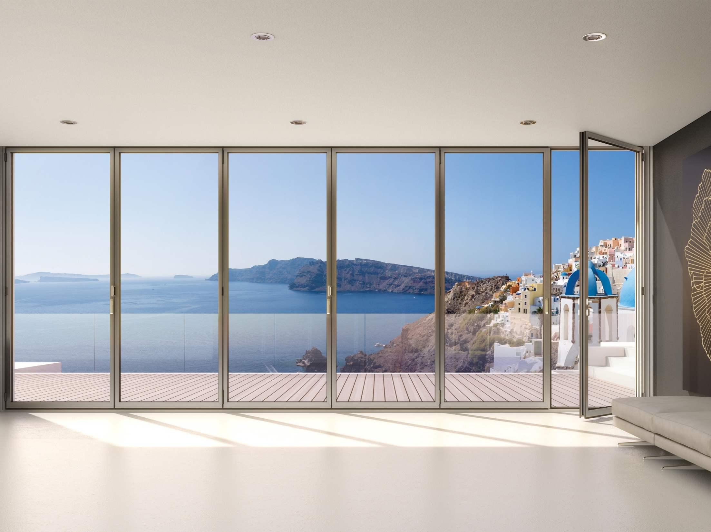
Technical Characteristics
Sash to sash sightline 88mm
Glazing width 24-44mm (double & triple)
3
5
2
Sash thickness
65mm
Max weight: 140 Kg/vent
Max dimensions, e.g. 1.0x2.8m
7
6
4
1
Same frame perimetrically (45° cut)
Frame to sash sightline
100mm
Bottom-slide operation

Slide 6
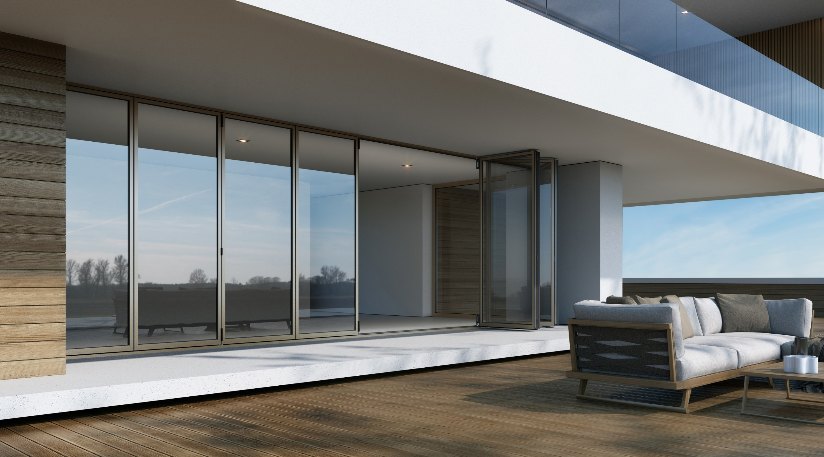


Typologies
Inwards / outwards opening
Odd / even numbers
n+0 e.g. 3+0, 2+0
n+1 e.g. 3+1, 2+1
n+m e.g. 7+3, 4+4
Corner construction

Slide 7
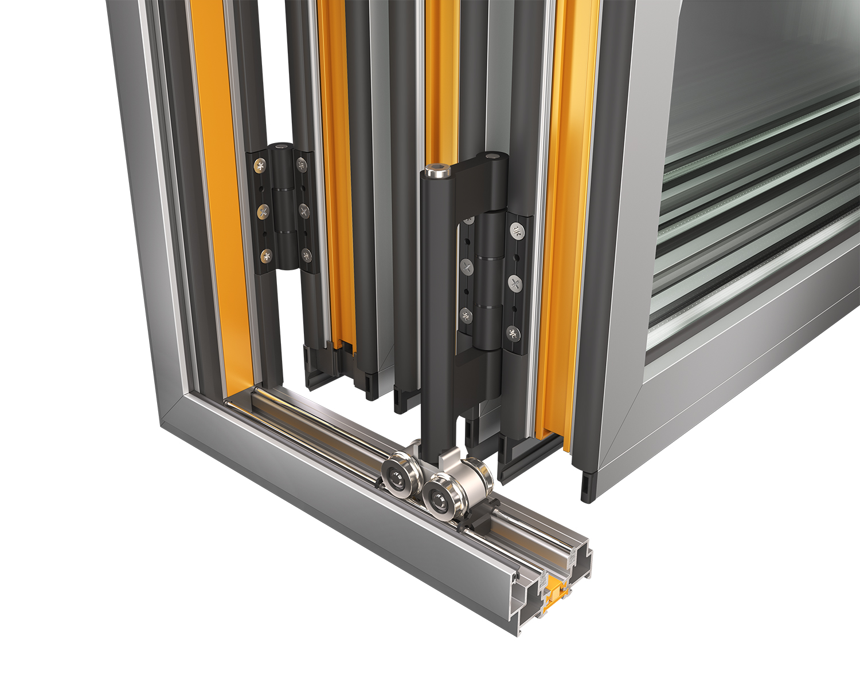
Accessories
2
Robust hinges
4
Foam insulating materials
Special roller-hinges (odd)
4 rollers
up to 140 Kg per vent
(95 per bearing/roller)
adjustable at installation
rust-free / anti-lift
1
3
Solid inox rails

Slide 8
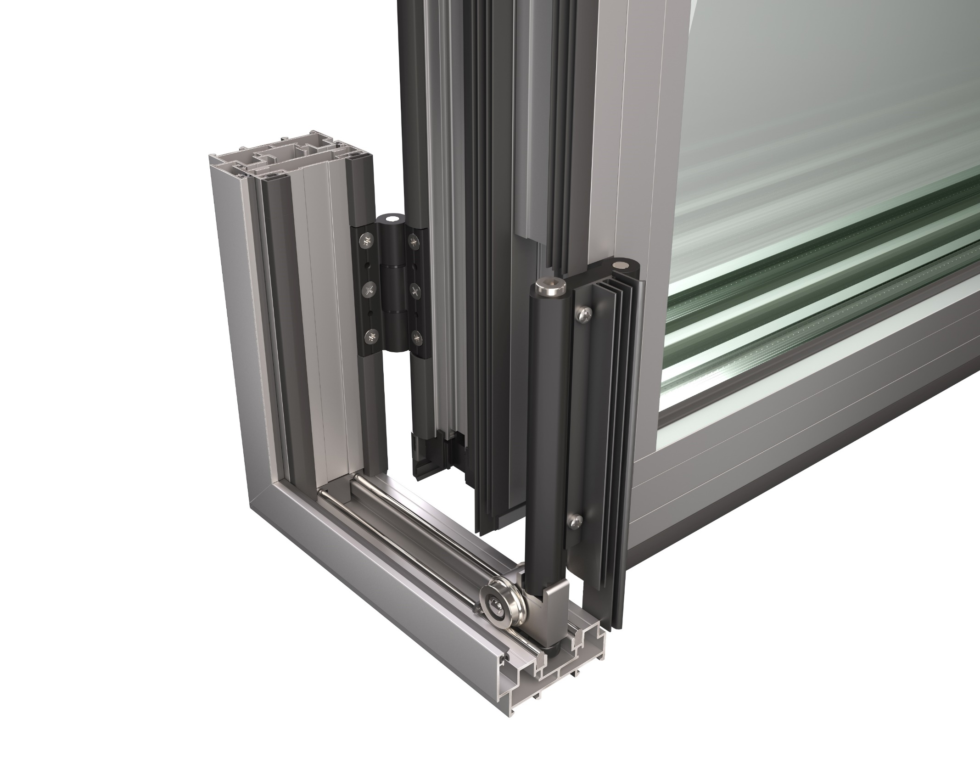
Accessories
3
EPDM gaskets
Special gasket fitting integrated with roller-hinge
4
Various caps
2
Special roller-hinges (even)
2 rollers
up to 140 Kg per vent
1

Slide 9
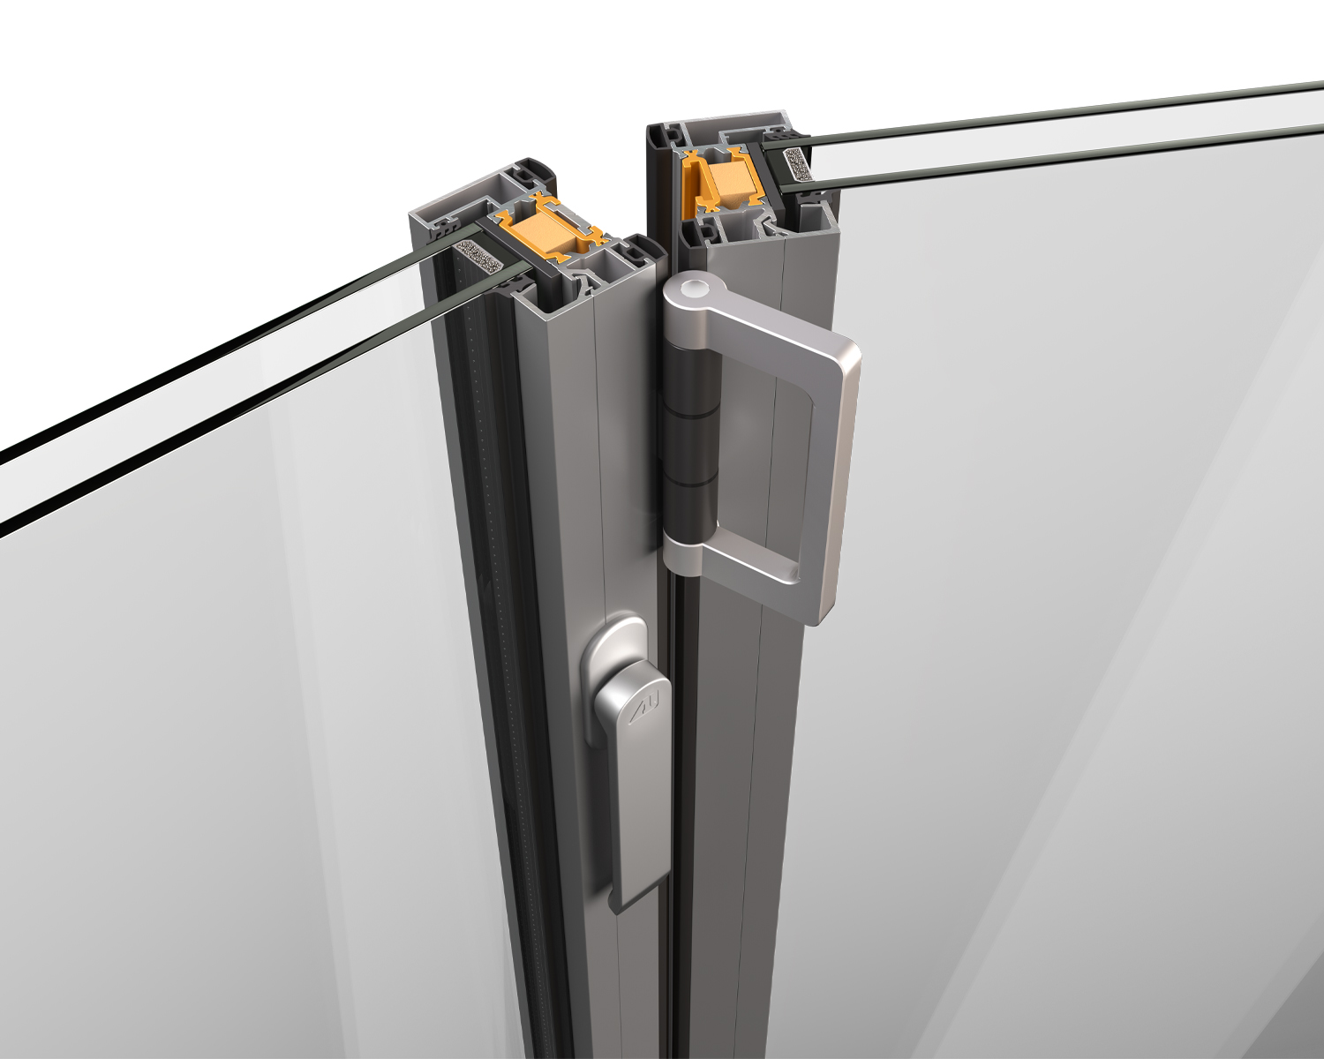
Accessories
3
NRG bars, foam fittings, up to 32mm polyamides
Pull handle
1
2
Aluminium design flat handle

Slide 10
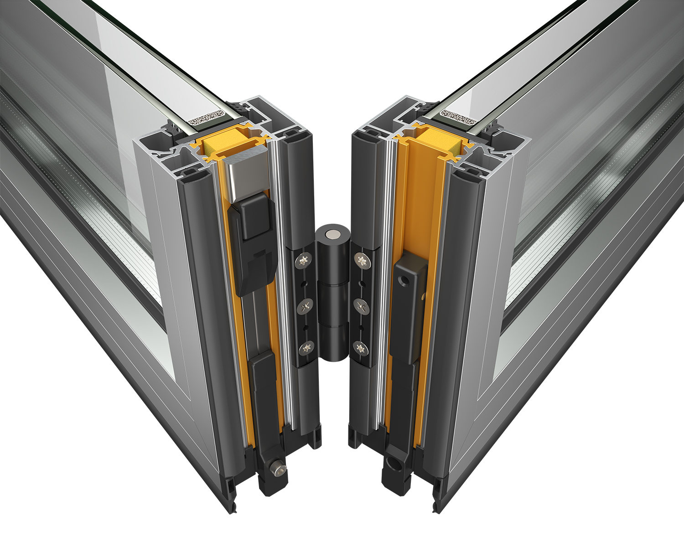
Accessories
2
Adjuster for quadruple bolts
1
Quadruple (or double) shoot bolts (polyamide or alum.)
3
Crimp or mechanical cleat corners (sash & frame)

Slide 11
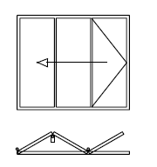
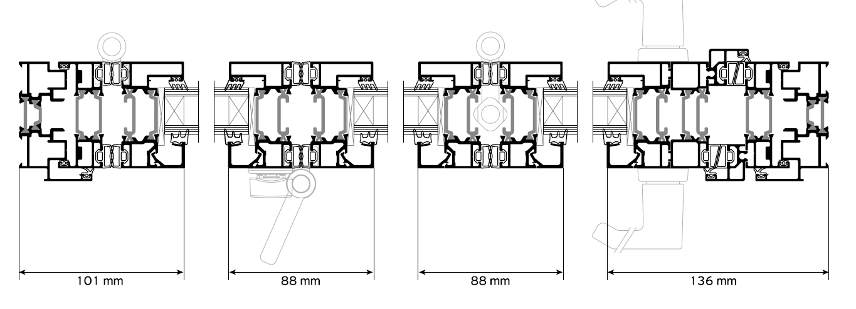
Basic Sections
Frame profile
Same frame/rail profile perimetrically !!!
45° cutting (sash, frame)
Horizontal adjustment (-2 +5 mm), only with screws

Slide 12
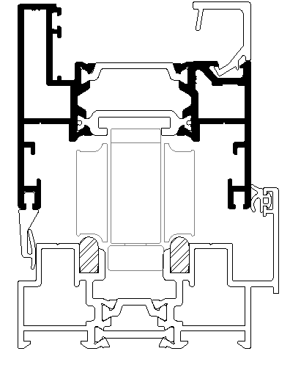
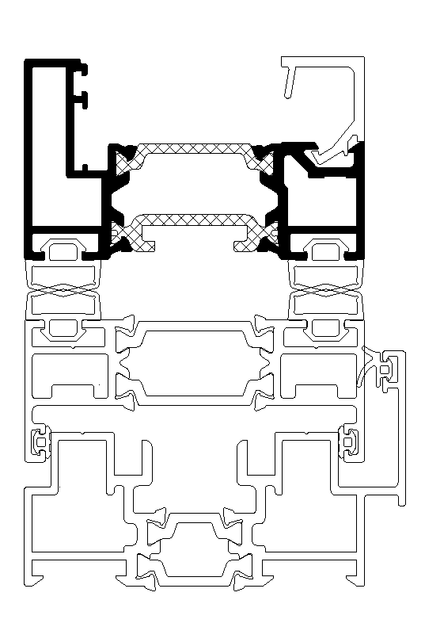
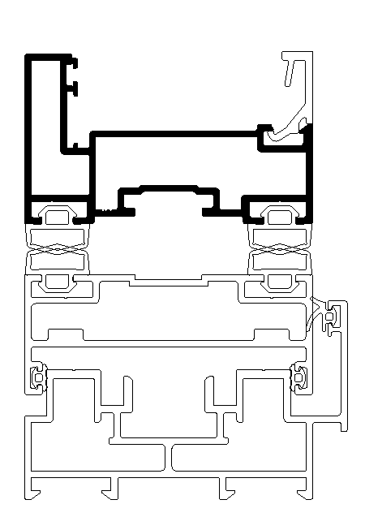
Basic Sections
Sash profiles
Basic insulated sash
Basic non-insulated sash
Bottom ΜF65 sash (alternative)

Slide 13
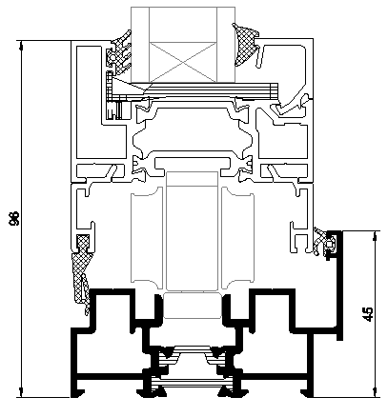
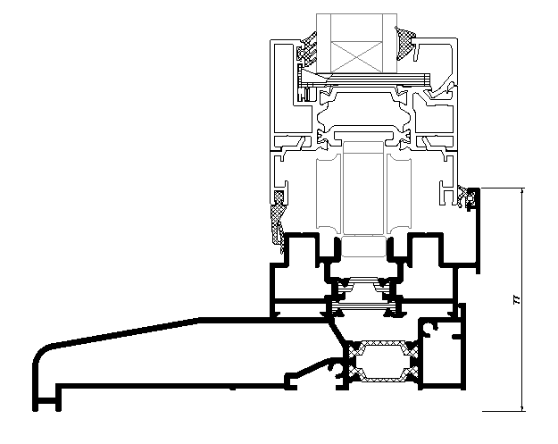
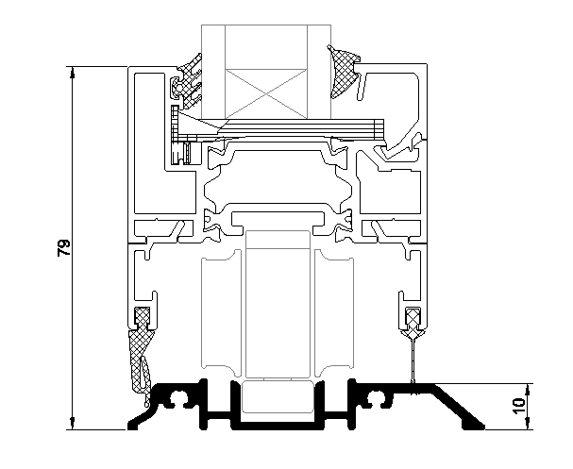
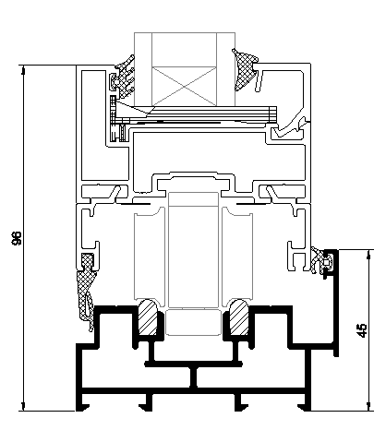
Basic Sections
Standard insulated threshold
Low threshold
With subsill
Standard non-insulated threshold

Slide 14
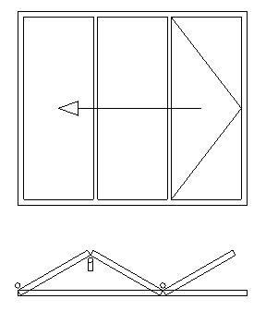
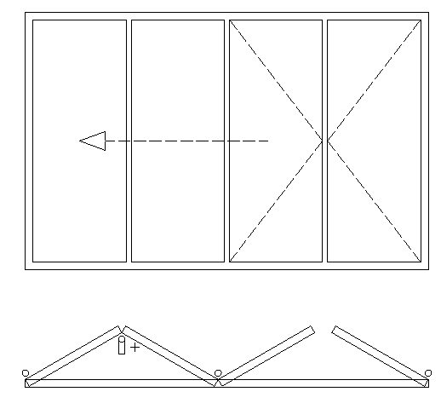
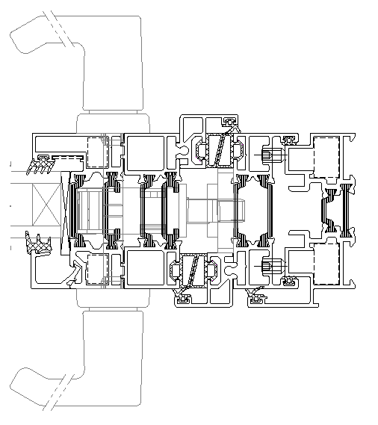
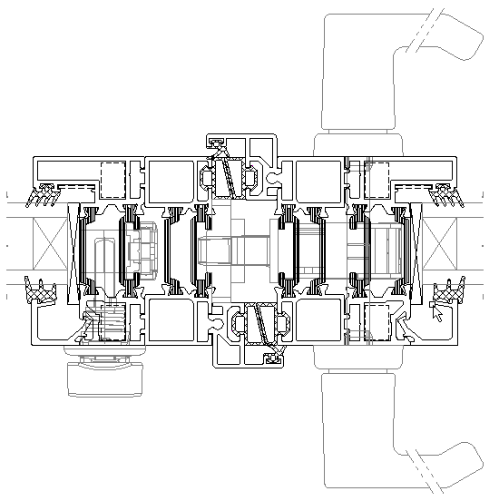
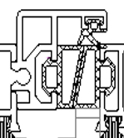
Basic Sections
3+0
3+1 Door 3+3 meeting style
additional wing profile for adjoining, which needs a simple cutting

Slide 15
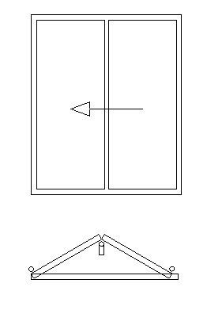
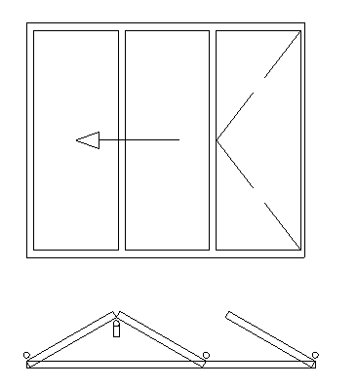
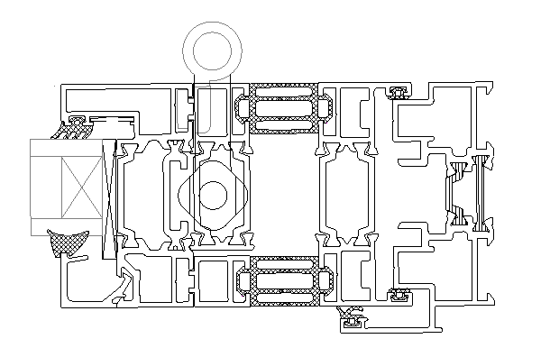
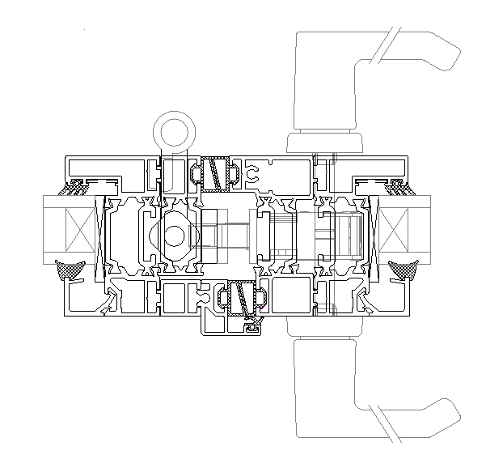
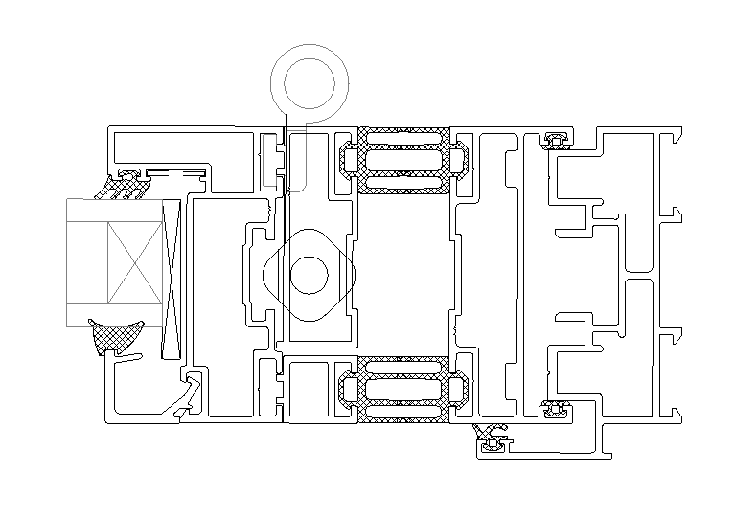
Basic Sections
2+0
2+1 Door 2+3 meeting stile

Slide 16
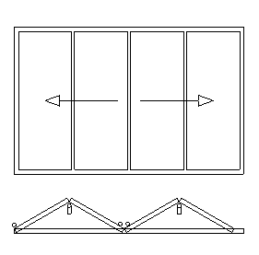
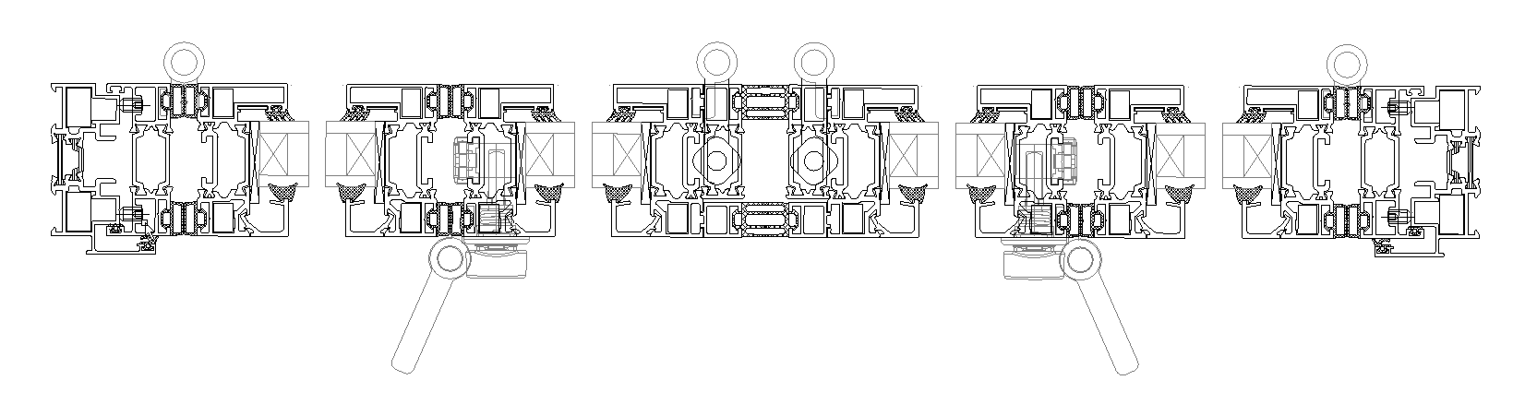
Basic Sections
Even Typologies
Special gaskets for air-tight sealing in the middle
Additional profiles hinting the roller-hinges
2 rollers-hinges (half)

Slide 17
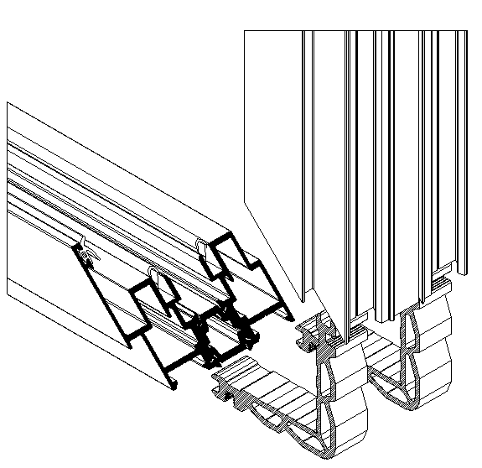
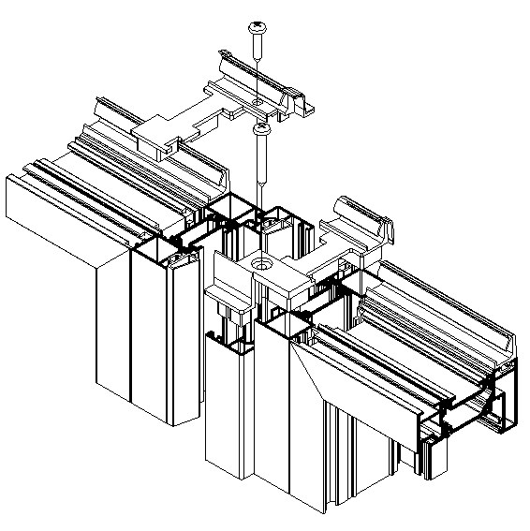
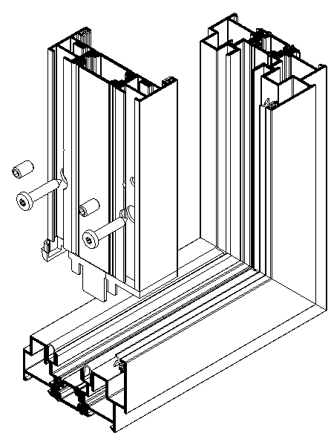
Fabrication & Installation
45 degrees frame cutting
Sophisticated caps, various gaskets, adjoining profile
Frame adjusting -2 / +5mm only with screws

Slide 18
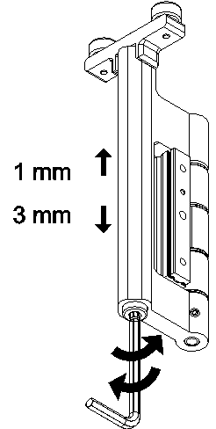
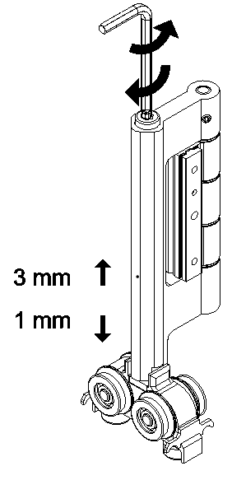
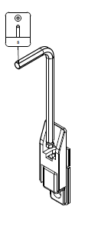
Fabrication & Installation
Shoot bolt adjusting (4,5mm)
Roller hinges adjusting (4mm)

Slide 19
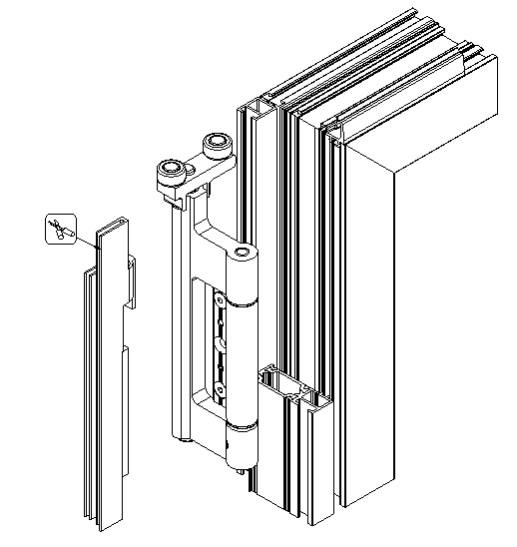
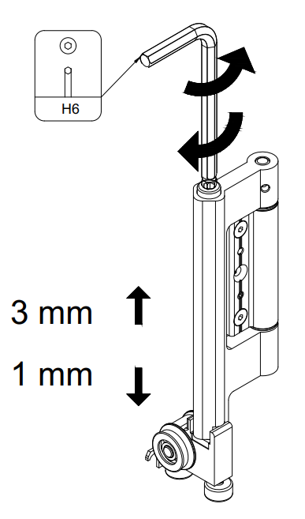
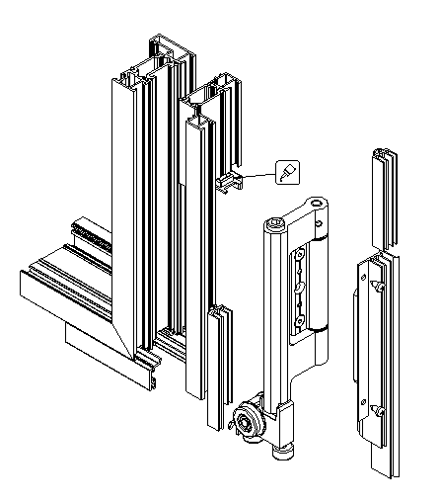
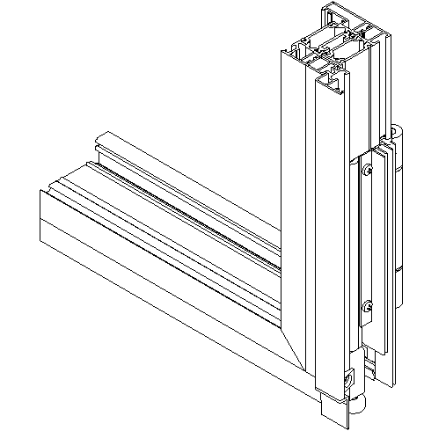
Fabrication & Installation
In case of even typologies
Roller hinges adjusting (4mm)
Additional profiles for integrating roller hinges
Special gaskets, caps

Slide 20
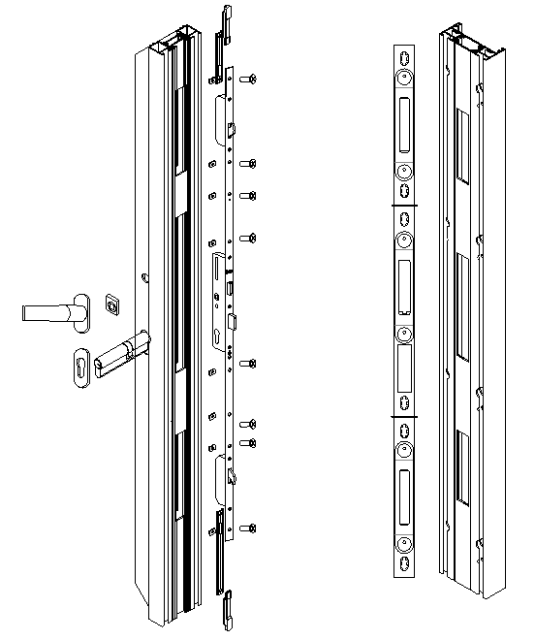
Locking points
Special 5-point lock
3-point lock with hooks
plus additional shooting bolts (top/bottom)
better sealing and easy locking only through the handle

Slide 21
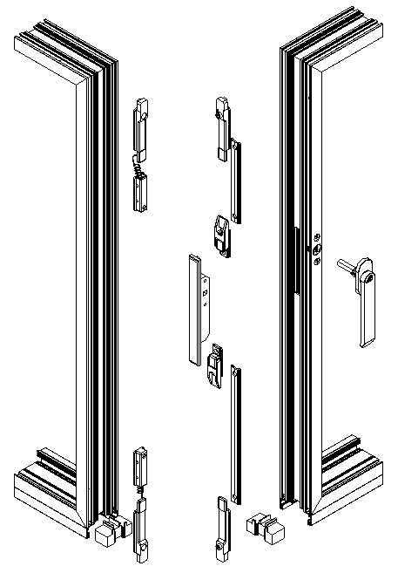
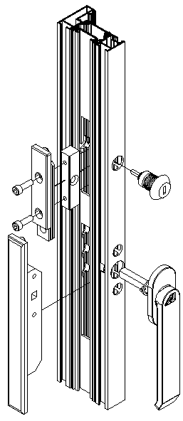
Intermediate vents Locking points
ALUMIL design handle & handle locking
Quadruple (or double) shooting bolts

Slide 22
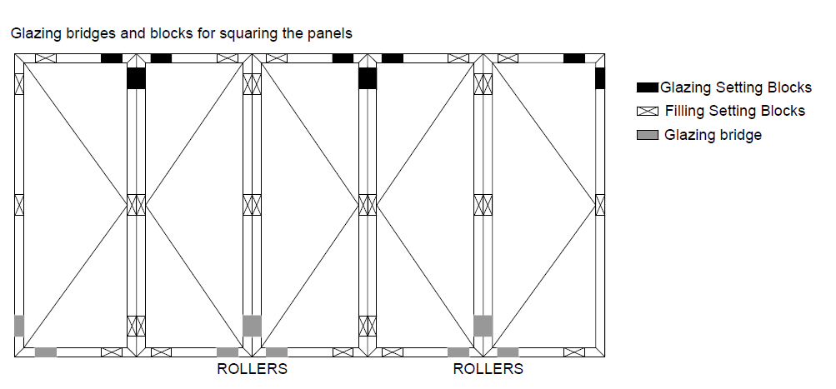
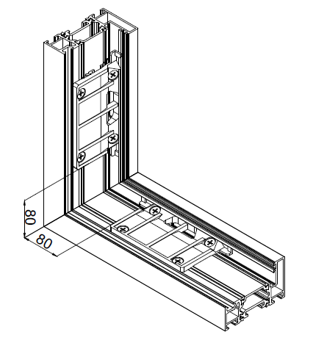
Basic Sections
“start from the correct glazing setting & bonding”
24-44mm glazing thickness
It is recommended to bond all sash corners after vent squaring

Slide 23
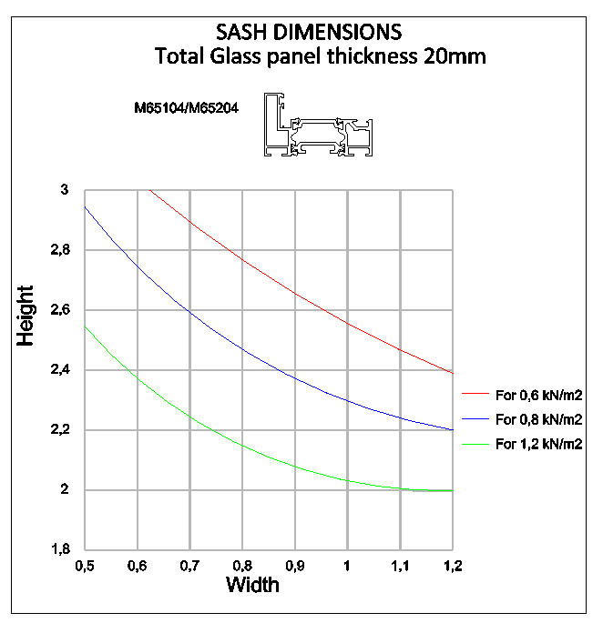
Max Dimensions – Wind load
without alum. reinforcement
Up to 1.2m vent width
With 20mm (worst case), it does not exceed weight limitations
Example
For vent width 1.0m, maximum height is
600Pa H = 2.5 m
800Pa H = 2.3 m
1200Pa H = 2.0 m

Slide 24
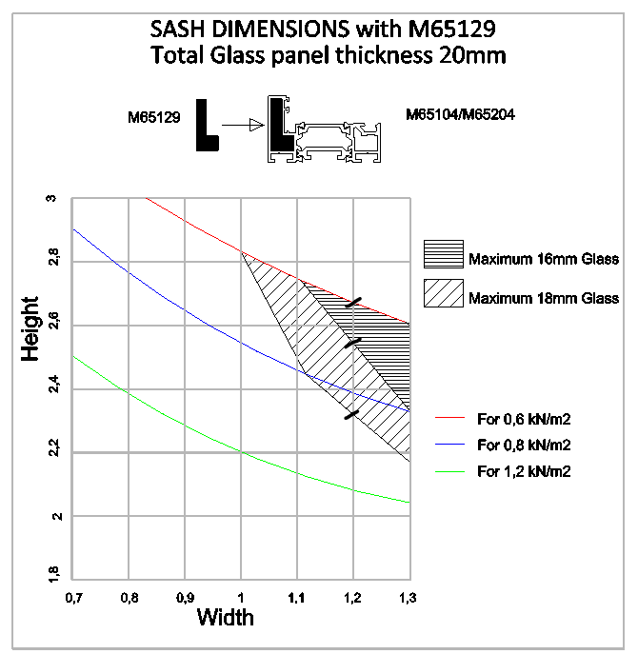
Max Dimensions – Wind load
with alum. reinforcement
Up to 1.3m vent width
Weight constraints is incorporated in the table
Example
For vent width 1.2m
with 20mm glass, up to 2.3m
with 18mm glass, up to 2.5m
with 16mm glass, up to 2.7m

Slide 25
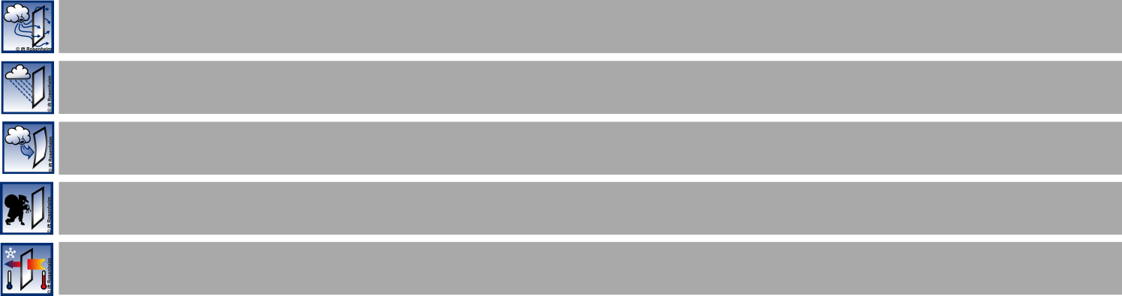
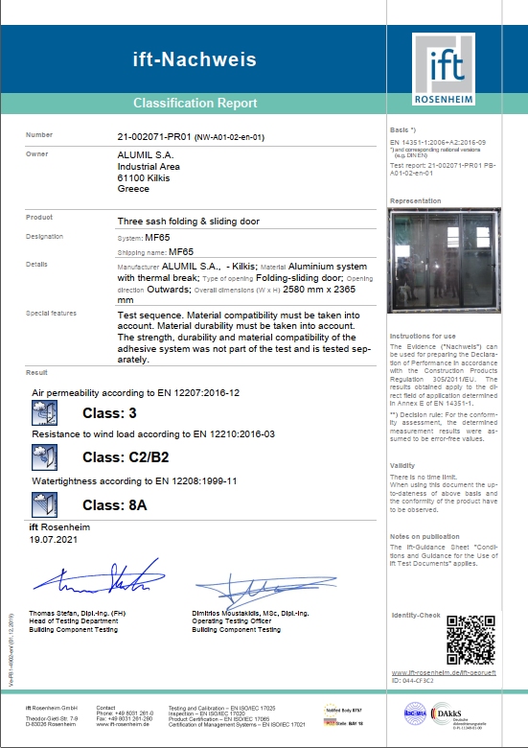

Certifications (MF65)
Air permeability EN12207:2016-12
CLASS 3
Watertightness EN 12208:1999-11
CLASS 8A
Resistance to windload EN 12210:2016-03
CLASS C2/B2
Thermal insulation EN 10077-2
Uf from 2.2 W/m²K

Slide 26

Certifications (MF65)
Thermal Insulation
 | Ug = 1,1 | Ug = 0,8 | Ug = 0,6
U_{w} | 1,54 | 1,29 | 1,13
For a 3+0 typology 2,6m x 2,8m (W x H)

Slide 27

Commercial Section

Slide 28

Benefits
1. Minimal design & top aesthetics
88 mm sash/sash face width
100 mm frame/sash face width

Slide 29

Benefits
2. Robustness and max dimensions
Vents up to 1.3m width or 3.0m height
Max dimension, e.g. 1.2 x 2.6m (with reinforcement)
140 Kg per vent

Slide 30

Benefits
3. Range of solutions
insulated and non-insulted system
odd & even numbered typologies (n+0, n+1, n+m) & corner
standard or “balcony” door, opening inwards & outwards
double and triple glazing, standard & low threshold

Slide 31
Benefits
4. Easy fabrication & installation
thanks to
one single rail profile perimetrically (45° cutting)
no special machining (SMARTIA punching)
pre-drilled profiles & very simple vertical frame adjusting (with screws)
adjustable top/bottom roller-hinges
adjustable quadruple shoot bolts

Slide 32


Benefits
5. Excellent performance & energy efficiency
Water sealing 8A / 450 Pa (without sub sill)
Thermal insulation Uw up to 1.11 W/m²K
Air permeability CLASS 3

Slide 33

Benefits
140 Kg/vent
6. Long-lasting smooth operation
High-quality, heavy-duty roller hinges set
No problem even at the open position

Slide 34

Benefits
7. Enhanced burglar protection
Quadruple shoot bolts
5-point door locking
Anti-lift mechanism
Profile robustness

Slide 35

Benefits
Homeowners
Let natural light flood the space, and maximize outwards visibility (88mm sightline, 1.3m vent width)
Increase energy efficiency and cost savings thanks to the high thermal insulation
Enhanced burglar protection thanks to the quadruple bolts, the 3-point door locking, the anti-lift mechanism, etc.
Smooth operation and long-lasting flawless functionality

Slide 36

Benefits
Architects
Minimal aesthetics and the lowest sightline (88mm).
Allow the design of high-performance buildings with energy efficient & money saving system.
Enhanced levels of burglar protection.
Very large & robust constructions, up to 1.3m width or 3m height.
Wide variety of solutions & typologies.
Smooth operation flawless in time.

Slide 37

Benefits
Fabricators
Easy fabrication with one single rail profile placed perimetrically, 45° cutting and no need for special machining.
Easy installation thanks to adjustable roller-hinges & shooting bolts, pre-drilled profiles, very simple frame adjusting.
Bottom slide operation, thus no particular steel construction is needed which might be the case in top-hung.
Easy cost and offer estimation (profile pricing €/m).
Opportunity to increase clientele and personal prestige with this “value for money” product, ideal for commercial & residential use.

Slide 38


Thank you for your attention

